Slide 1
U.S Department of Health & Human Services Indian Health Service Office of Environmental Health & Engineering
Environmental Health Services Overview
“Through shared decision making and sound public health measures, enhance the health and quality of life of all American Indians and Alaska Natives to the highest level by eliminating environmentally related disease and injury.”
Notes:
Welcome
Introduce self and Program
Discuss objectives of presentation:
IHS Role
DEHS Role and Mission
DEHS Program and Focus Areas

Slide 2
Indian Health Service (IHS)
Principle Health Care Provider for Indian People
Goal- raise health status to the highest level possible
Provide a comprehensive health service delivery system for:
2+ million American Indians/Alaska Natives
574 federally recognized tribes in 37 states
Notes:
Please review current fact sheets on IHS Website to ensure slide accuracy before presenting. Fact sheets are located under the About Us tab on the IHS Home Page.)
(The Presenter may share with the audience that: Due to the opportunity provided by the legislation, and the mission of IHS to build Tribal capacity the numbers of tribes served directly by IHS fluctuates from year to year.)
The Indian Health Service (IHS):
An agency within the Department of Health and Human Services
Responsible for providing federal health services to American Indians (AI) and Alaska Natives (AN).
The foundation of the IHS is to uphold the Federal Government’s obligation to promote healthy Indian people,
communities, and cultures and to honor and protect the inherent sovereign rights of Tribes.
The provision of health services to members of federally-recognized tribes:
Federally recognized American Indian Tribes and Alaska Native corporations have a government-to-government
relationship with the United States.
This unique relationship is based on Article I, Section 8 of the U.S Constitution and has been given substance
through numerous treaties, Supreme Court decisions, legislation, and Executive Orders.
Congress passed the Indian Self-Determination and Education Assistance Act (Public Law 93-638, as amended)
to provide Tribes the option of assuming from the IHS the administration and operation of health services &
programs in their communities, or to remain within the IHS administered direct health system.
Congress subsequently passed the Indian Health Care Improvement Act (P.L. 94-437), which is a health-specific
law that supports the options of P.L. 93-638.

Slide 3
Division of Environmental Health Services
Critical part of IHS’s preventive care programs
Goal - Reduce high morbidity and mortality rates in communities
Notes:
Introduction
The Division of Environmental Health Services (DEHS) Program of the Indian Health Service (IHS), within the Office of Environmental Health & Engineering (OEHE):
Provides comprehensive environmental health services to American Indian and Alaska Native (AI/AN)
communities.
Since the early 1960’s, DEHS has been delivering services to Tribal entities.
Program Purpose:
To address a wide range of environmental conditions that contribute to high morbidity and mortality in
communities.
The environment; which includes the home, community, workplace, and natural surroundings is
recognized as a vital factor in overall health and well being.

Slide 4
Division of Environmental Health Services
Works with tribal communities to prevent disease and injury by:
Monitoring and investigating
Identifying health hazards in the environment
Providing training and technical assistance
Providing project funding
Notes:
DEHS works with tribal communities to prevent disease and injury by:
monitoring and investigating
identifying health hazards in the environment
providing training and technical assistance
providing project funding
EHS staff provide technical assistance and public health services in a multitude of ways. Some additional examples of EH activities :
Food Safety
Head Starts
Water Quality & Safety
Hazard Investigation
Emergency Response

Slide 5
The Ten Essential Environmental Health Services
A nationally-accepted framework needed to achieve the program goal of healthy environments contributing to healthy people
Notes:
DEHS Program Management Philosophy
The three core functions of governmental public health were defined as assessment, policy development, and assurance as defined by the Institute of Medicine in a 1988 report, “The Future of Public Health.” The Public Health Functions Steering Committee developed the “Ten Essential Public Health Services,” as a companion to the three core functions. The DEHS operates within the framework of the “Ten Essential Public Health Services.”
The Ten Essential Public Health Services provide a nationally-accepted framework to describe public health activities needed to achieve the goal of healthy people in healthy communities. The IHS-DEHS has adopted the Ten Essential Public Health Services and modified them to be the Ten Essential Environmental Health Services to define our program, clarify our role in public health, and plan our activities to achieve maximum public health benefits.
The 10 Essential Environmental Public Health Services:
The Ten Essential Public Health Services
Monitor health status to identify community problems. This service is accomplished by the collection of health-related data that measures the health status of a specified population. The collected data is organized to identify health status, risk factors and resource needs associated with the population.
Diagnose and investigate health problems and health hazards in the community. A system is in place to identify and respond to public health threats. This could include infectious disease outbreaks, chronic disease prevalence, injury incidence, environmental contamination, and the occurrence of man-made or natural disasters.
Inform, educate, and empower people about health issues. Affected populations are given a voice in public health decisions through health communications, partnerships, health education, and health promotion initiatives that are based on evidence of effectiveness.
Mobilize community partnerships and action to identify and solve health problems. Practices include community engagement, constituency development, and partnership mobilization.
Develop policies and plans that support individual and community health efforts. Health improvement planning and policy development are based on health status information, public input, analysis of policy options, and recommended actions based on proven or promising interventions.
Support laws and regulations that protect health and ensure safety. Assures that laws and regulations are based on current public health science and best practice. Collaboration is emphasized between regulators, enforcers, and those obligated to obey the laws and regulations.
Link people to needed personal health services and assure the provision of health care when otherwise unavailable. Assess the availability and utilization of personal and environmental health care services and work collaboratively to assure comprehensive access to health systems.
Assure a competent public health and personal health care workforce. Supports training, continuing education and professional development of the public health workforce to assure the effective delivery of services.
Evaluate effectiveness, accessibility, and quality of personal and population- based health services. An evaluation process is planned and implemented that identifies the strengths, weaknesses and gaps with the goal of improving public health in the community.
Research for new insights and innovative solutions to health problems. Contribute to public health science by funding and participating in activities that address new insights in the practice of field-based public health.

Slide 6
Division of Environmental Health Services Five Focus Areas
Children’s Environment
Food Safety
Safe Drinking Water
Vectorborne and Communicable Disease
Healthy Homes
Notes:
In 2010, the DEHS moved forward with five new focus areas; while still performing established environmental health services.
Children’s Environment: Prevent illness and injury by reducing risk factors where children live learn and play.
Food Safety: Prevent foodborne illness and promote food safety and security.
Safe Drinking Water: Prevent waterborne illness and ensure safe drinking water supplies.
Vectorborne and Communicable Disease: Prevent disease transmitted by insects, animals, humans and the environment.
Healthy Homes: Prevent disease and injury in homes caused by unhealthy living conditions.
The focus areas provide for a nationwide definition of needs and help DEHS prioritize for resources and staffing requirements.
The strategy for the success of the incorporation of the new focus areas is for the environmental health programs to work both in
independently and collaboratively to address routine work and the focus areas.

Slide 7
Division of Environmental Health Services
The Environmental Health Program includes two specialty areas:
Injury Prevention
Institutional Environmental Health
Notes:
Read Slide and then state: “The following slides provide details on these two specialty areas”.

Slide 8
Injury Prevention
Specialists work with Tribes and other partners to prevent severe injuries and fatalities
Priorities:
unintentional falls
motor vehicle related injury/death
Notes:
(Please review the most current IHS Injury Fact Sheet for current information and statistics. Fact sheets are located under the About Us tab on the IHS Home Page.)
Injuries are the leading cause of death for American Indians and Alaska Natives from ages 1-44 years, and the third leading cause of death overall.
(Please visit the IHS Injury Prevention Website for more information on the program points below.
Please only select a few of the program points for your discussion on Injury Prevention.)
Injury Prevention Program
Epidemiology - Housing Hazards
Coalition & Project Development - Training & Evaluation
Suicide Prevention - Marketing & Advocacy
Tribal Capacity Building Grants - IP Specialist Fellowship Road Hazard Reduction
MV Occupant Protection - DUI Prevention
Assault & Violence - PFD & Drowning
Smoke & CO Detectors - Falls

Slide 9
Institutional Environmental Health
Specialists work with Tribes and IHS staff to ensure
safety of community members and staff
Priorities:
Hazard assessment and control based on best safety management practices
Ensure patient and staff radiation exposures are as low as reasonably achievable
Provide resources and support for IHS and Tribal safety programs
Notes:
(Do Not Read Notes Verbatim, instead Highlight information and use to answer questions)
The IEH program is a cadre of specialists who conduct radiation protection assessments, industrial hygiene surveys, occupational safety inspections, incident investigations and many other field-based surveys to identify, reduce or eliminate hazards.
In the photograph above, IEH Specialists are conducting an air contaminate survey.
The IHS Certified Radiation Protection Surveyor program which builds IEH staff competencies in x-ray radiation safety. IEH specialists evaluate and work to reduce patient and staff radiation exposure risk from more than 1,200 x-ray devices. The IEH Program also manages the radiation dosimeter program which provides personal dosimeters to more than 2,000 employees having potential exposure to x-ray radiation.
The IEH program supports local safety programs. Providing healthcare safety officer training, evaluating safety-based accreditation needs, and supporting safety committees and hazardous surveillance surveys are just a few of the ways IEH specialists support safety programs.
The IEH program also manages and supports worker safety aspects of WebCident, the IHS Web-based incident reporting system. WebCident is used by more than 225 safety officers in 450 IHS and Tribal locations as a tool for investigating, trending, and recording worker safety incidents.

Slide 10
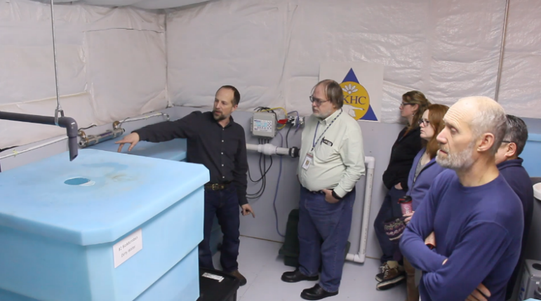
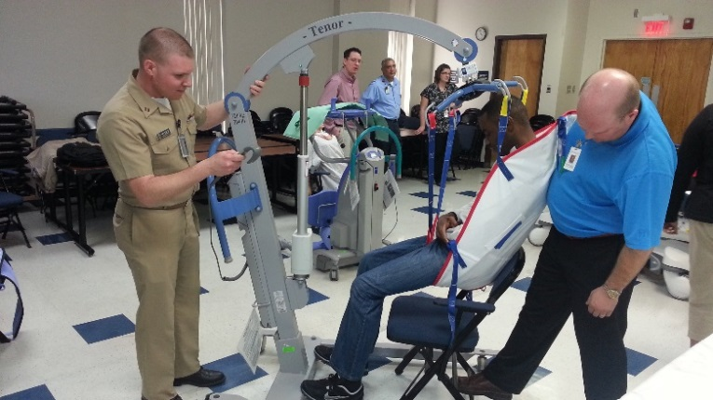
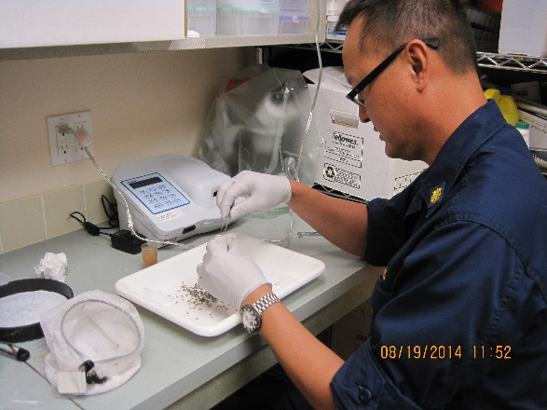
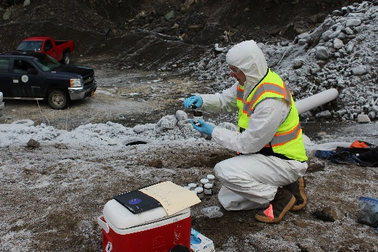
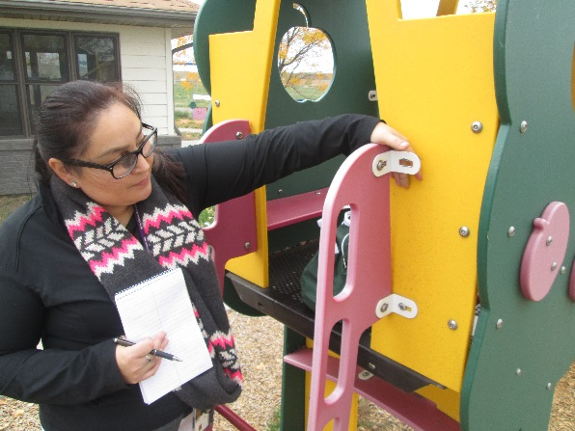
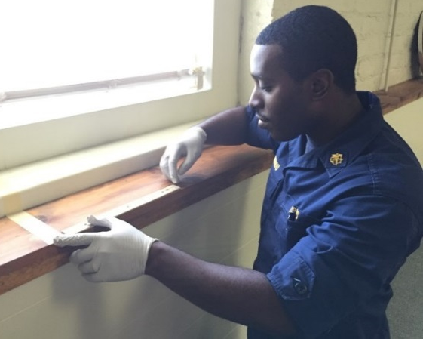
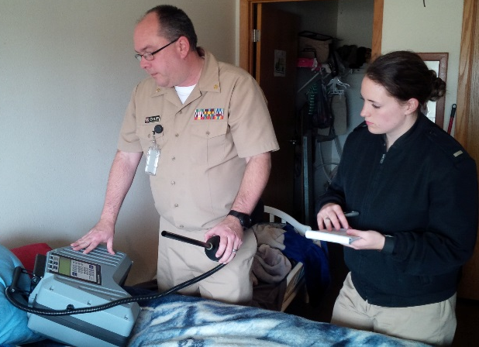
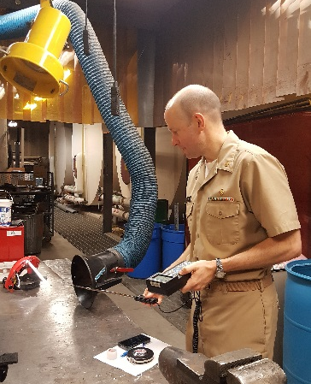
Questions?

Slide 11
IHS DEHS 5600 Fishers Ln, MS: 10N14C, Rockville, MD 20857 301-443-1054 http://www.dehs.ihs.gov
Alaska Area/OEHE 4141 Ambassador Dr Suite 300 Anchorage, AK 99508 Ph. (907) 729-3501 | California Area/DEHS 650 Capitol Mall Suite 7-100 Sacramento, CA 95814 Ph. (916) 930-3981, ext. 336 | Oklahoma City Area/DEHS 701 Market Dr Oklahoma City, OK 73114 Ph. (405) 951-6001
Albuquerque Area/DEHS 4101 Indian School Rd, NE Albuquerque, NM 87110 Ph. (505) 248-4947 | Great Plains Area/DEHS 115 4th Ave, SE Room 309 Aberdeen, SD 57401 Ph. (605) 226-7597 | Phoenix Area/DEHS 40 North Central Ave Suite 720 Phoenix, AZ 85004 Ph. (602) 364-5068
Bemidji Area/EHSS 2225 Cooperative Court Bemidji, MN 56601 Ph. (218) 444-0503 | Nashville Area/DEHS 711 Stewarts Ferry Pike Nashville, TN 37214 Ph. (615) 467-1622 | Portland Area/DEHS 1414 NW Northrup St Suite 800 Portland, OR 97209 Ph. (503) 414-7774
Billings Area/OEHE 2900 4th Ave North Billings, MT 59101 Ph. (406) 247-7090 | Navajo Area/DEHS P.O. Box 9020 Window Rock, AZ 86515 Ph. (928) 871-5807 | Tucson Area/EHSB 7900 South J Stock Rd Tucson, AZ 85746 Ph. (520) 295-5629
Notes:
Contact information for IHS Headquarters and Area Offices, for more information.

