Slide 1
Endoscopic Imaging
DICOM Capture Workstation for the capturing of endoscopic images and the creation of CPRS templates for reporting/progress notes.
J. Stephen Farris – St. Louis VAMC
VISTA Imaging and Diagnostic Imaging Coordinator

Slide 2
Introduction
Reason or Need for Solution
ENDOSOFT and Clinical Procedure Configuration
VistA Imaging Setup
Exam Room Configuration
CPRS Report Template
Procedural Results
Benefits
Development and Enhancements
Conclusions

Slide 3
Simplicity
“ Simplicity is the ultimate sophistication”
Leonardo da Vinci
“Everything should be made as simple as possible, but not simpler”
-Albert Einstein

Slide 4
Reasons
Upgrade of ENDOSOFT
ENDOSOFT’s Clinical Procedure Interface
Manual entering of patient demographics
Long acquisition setup time for procedure scoping
Reports into CPRS for progress note
DICOM interface into VISTA Imaging
ENDOSOFT & CPRS on the same workstation
Inefficient Clinical Workflow
Notes:
Upgrade of ENDOSOFT server and workstations
RPCs was utilized to query patient demographic
One-way communication VISTA
GI Client decided to utilize new ENDOSOFT’s CP Interface
Trouble in implementation ENDOSOFT’s CP Interface
ENDOSOFT CP interface was not completed – not fully implemented or tested in a consolidated environment
The CP format was not clinically desirable by the GI Clinic
Manual entering of patient demographics
Long acquisition setup time for procedure scoping
Reports where COPYED in ENDOSOFT and PASTED into CPRS for progress note
No straight forward DICOM interface into VISTA Imaging without CP
ENDOSOFT & CPRS on same workstation but did not play well together - WINDOWS switching could not minimize ENDOSOFT windows to switch to CPRS or VI

Slide 5
CP Puzzle
“It is a riddle, wrapped in a mystery, inside an enigma; but perhaps there is a key”
- Winston Churchill

Slide 6
ENDOSOFT and CP Configuration
ENDOSOFT – Server/Client
  Server for image storage and VISTA Interface
  Three workstations with Endoscopy clients and CPRS
New ENDOSOFT HL7 and DICOM configuration
  HL7 for outbound order and inbound report
  HL7 order trigger the DICOM MWL
  VISTA Image Gateway – No VI without CP
Time consuming template for generating reports
No video streaming of procedures available
Notes:
Upgrade of old ENDOSOFT server from BROKER interface to CP
RPCs was utilized to query patient demographic
One-way communication – information could be pull but not pushed to VISTA
Clinical Staff decide to utilize Clinical Procedure to push report to CPRS
Clinical Staff lack of understanding of CP
ENDOSOFT – Server/Client
Server for SQL database, image storage and VISTA Interface
Three workstation clients configured with ENDOSOFT client and CPRS
New ENDOSOFT HL7 and DICOM configuration
HL7 for out bound order and inbound report
HL7 order trigger the DICOM MWL query for patient demographics
No easy way to push select images to DICOM Image Gateway

Slide 7
VistA Imaging
“ Never wait for trouble.”
- Chuck Yeager

Slide 8
VistA Imaging Setup
Endoscopic DICOM Capture Workstation
  Scope Interface
  Workstation network interface
VISTA/CPRS
  Consult
  Requested service
DICOM Modality Work List (MWL) – Text Gateway
  Definition of modality AE
  Text gateway setup
DICOM Storage Class Provider – Image Gateway
  Definition of listener port
  Modality processing

Slide 9
Endoscopic DICOM Capture Workstation
Small footprint computer – low profile PC
1.8 GHz Centrino processor
1 GB system memory and 120 GB IDE drive
10/100/1000 Mbit and Wireless networking port
Dual monitor capable
Analog video to USB for DICOM conversion
MS WINDOWS XP Professional
TIMS acquisition software
Notes:
Standard WINDOW XP Professional workstation with ACQ software for ADC convertor

Slide 10
Endoscopy Setup
Biomed responsible for scope interface
  Analog interface – BNC, VGA …
  Verification of image review for procedure
Verification of image capture
  Video image
  Single frame image
Local storage of acquired procedural images

Slide 11
Endoscopic Hardware and Interface
Fujinon 2200 Video System
CCD 590 Lower GI Tract Colonoscopy
BNC video output
Analog interface supplied by vendor – BNC to USB
Foot pedal for capturing streaming video
TIMS DICOM workstation interfaced to multiple vendor scopes

Slide 12
Workstation Network Interface
Assign IP from a medical modality subnet
Network interface info
  IP Address
  Netmask
  Default gateway
  No DNS – hard coded IP resolution
VistA Imaging info
  Text Gateway – IP, AE Title and listener port #
  Image Gateway - IP, AE Title and listener port #

Slide 13
VISTA/CPRS
CAC creates a consult for procedure
CAC provides VI coordinator with IEN of REQUESTED SERVICE
Add entry to DICOM HEALTHCARE PROVIDER SERVICE file (#2006.5831)
  REQUESTED SERVICE – service name of consult
  SERVICE GROUP – GASTROENTEROLOGY
  SERVICE DIVISION – division doing acquisition
  CLINIC – clinic doing acquisition, i.e... GI LAB JC
File entry trigger HL7 message for Text Gateway

Slide 14
Modality MWL Configuration
Define site specific AE Title for the modality
  Four AE Titles needed for the four rooms
  Each AE Title unique for the site and room
    Vendor should be able to set the AE Title for the unit
    <3 letter site><clinic><room number> ..ie STLGIR1
    The name convention is a St. Louis standard not a national
Capture workstation DICOM MWL info
  Called AE Title is VISTA_HIS
  Called DICOM port is 60010
  Calling modality to GI

Slide 15
WORKLIST Dictionary
Create entries for modalities in WORKLIST.dic file
  AE Title of the modality
  Institution Name or number
  Imaging service
  Image type
  Type of accession number
  Description (optional)
Update WORKLIST.dic on Text Gateway

Slide 16
MWL Entry – WORKLIST.dic
STLGIR1|657|CON|GI|LONG|GI DICOM Capture Station Room 1
Unique AE Title for each entry
Site Code will default to Gateway’s site if left blank
Consult not radiology package
Image type or modality type
Long Accession <mmddyy>-<case #>
Utilize description for future reference
Test by utilizing a consult with a TEST patient

Slide 17
DICOM SCP – Image Gateway
Select a DICOM Gateway to receive and process images
  Consult DICOM gateway separate from radiology
  # of existing Listener ports
Define a port number for Listener (instrument.dic)
Define modality processing parameters (modality.dic)
Update the dictionary files on DIG
Create shortcut for Listener port

Slide 18
Instrument Dictionary
GI1|GI Lab|657|CON|60701|VHASTLDIG7
  Mnemonic
  Description
  Institution Name
  Imaging Service
  Port #
  DICOM Gateway Name
Entries needed for each capture modality

Slide 19
Listener Port
Shortcut on DIGs Desktop
  “C:\Program Files\Vista\Imaging\DICOM\MAG_Cstore.exe” localhost 60000 GI1
  MAG_Cstore is executable interface to Cache Mumps
  Localhost is IP address of the server hosting the Listener port
  60000 default port for VI interface
  Mnemonic of the entry in the instrument dictionary file
Shortcut will be needed for each mnemonic of capture workstation sending to the Digs
Single Listener could be used for all capture modality but separated ports are recommended to avoid bottle necks

Slide 20
Modality Dictionary
TIMS|WS3000|ES|<DICOM>|CORRECT^MAGDIR3||datamisc.dic|CON
  Manufacturer
  Model
  Modality
  Dcmtotga.exe Parameters
  Case # lookup code
  Data extraction code
  Data extraction file
  Imaging Service
Only one entry required for each manufacturer or model

Slide 21
DICOM Storage
Acquire images for TEST patient
Test acquisition software for creating SC images
Transmit image to VISTA Imaging
Verify processing of images on DIG
  Correct MODALITY.dic definition
  No entry in VISTA correct bucket
Review images in Vista Imaging Client for correctness

Slide 22
Exam Room Configuration
DICOM capture workstation
Endoscopic hardware and interface
Clinical Workstation – CPRS/VISTA Imaging
  CPRS
  VISTA Imaging Client for review and QA of images
Procedure Workflow
CPRS report template
Procedural results

Slide 23
Clinical Workstation
CPRS
  Entering consults
  IMED Consent
  Template for report to progress note
VISTA Imaging
  Review/QA of images
  Deletion of images
  Printing

Slide 24
Procedure Workflow
Consult is entered for the colonoscopy procedure in CPRS
Consents signed for procedure
Patient demographics are queried from the DICOM MWL (Text Gateway)
Acquire images and/or video streams
Label images and discard if needed
Output
  Send to VISTA Imaging
  Send to printer if hardcopy is needed for patient

Slide 25
CPRS Report Template
GI Procedure template selection
Colonoscopy procedure
Progress note reviewed and signed
Pathology order generated if needed
50 to 60 percent of the studies are normal
Planned Flexsig, EGD and other GI procedures
Live only with colonoscopy
Other procedure plan “Go-Live” before end of year
Continue modification and enhancement based on physician feedback
Notes:
After images are acquired physician utilize the template to generate a progress note

Slide 26
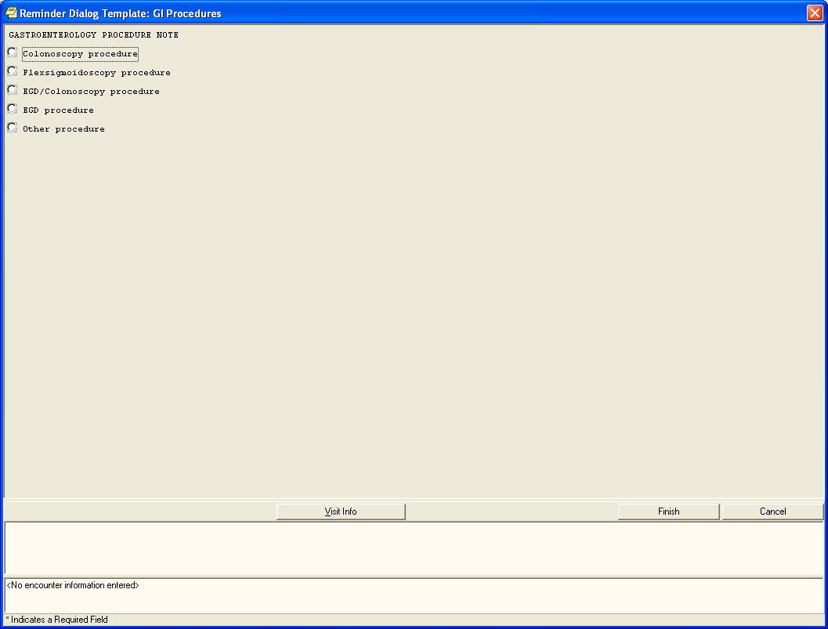
Initial Screen after selecting GI Procedures from the Shared Template list.

Slide 27
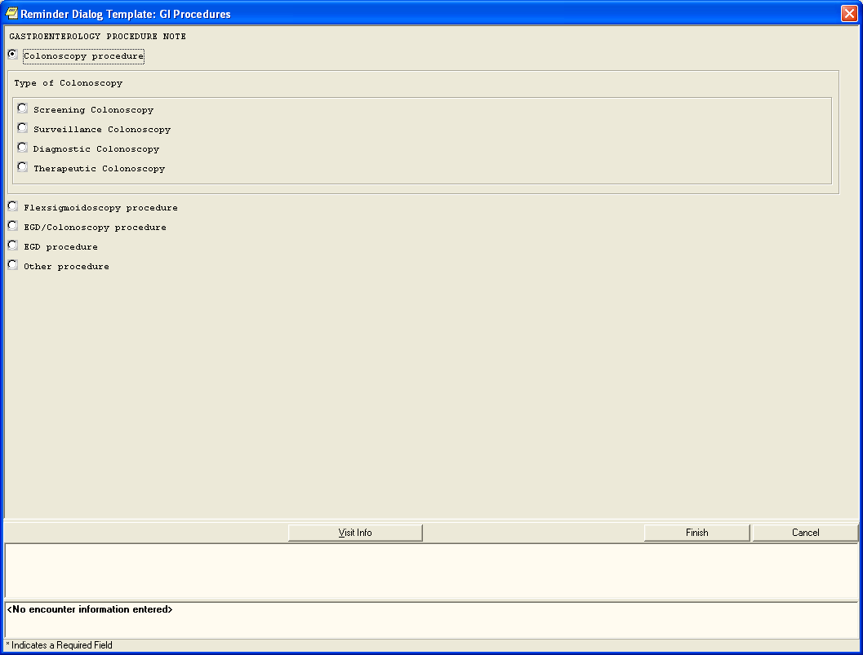
Display after selecting Colonoscopy procedure.

Slide 28
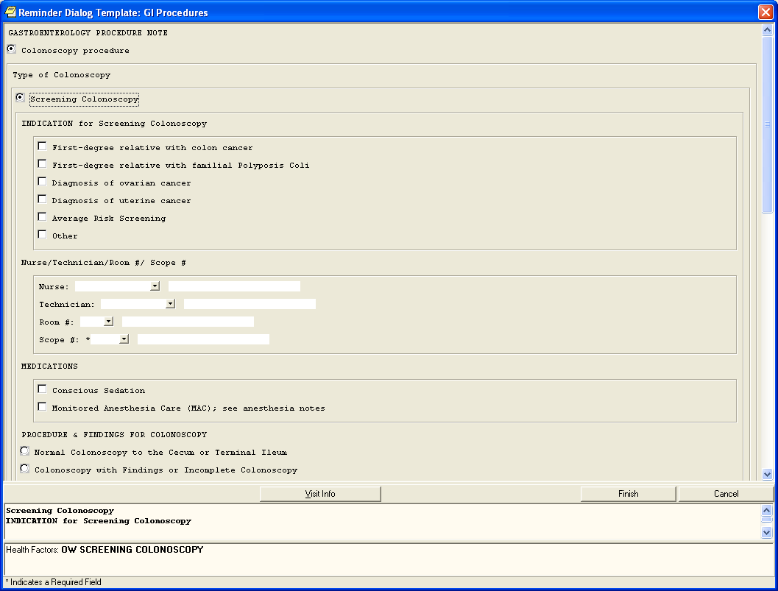
Further expansion after selecting Screening Colonoscopy. (The scroll bar lets the user know that there is more information on this page.)

Slide 29
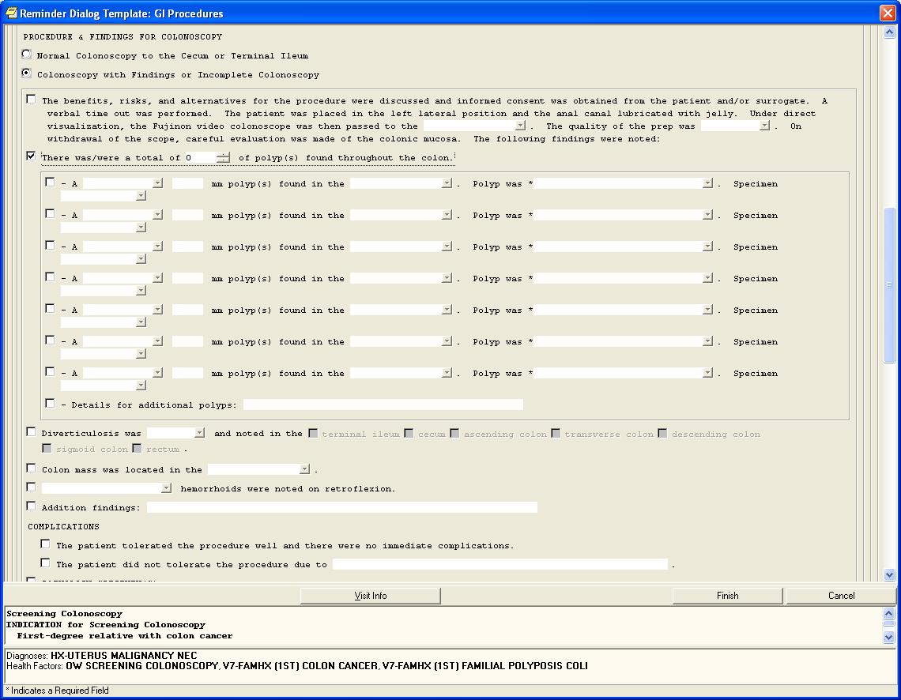
Additional selections driven by the original selection “Screening Colonoscopy”.

Slide 30
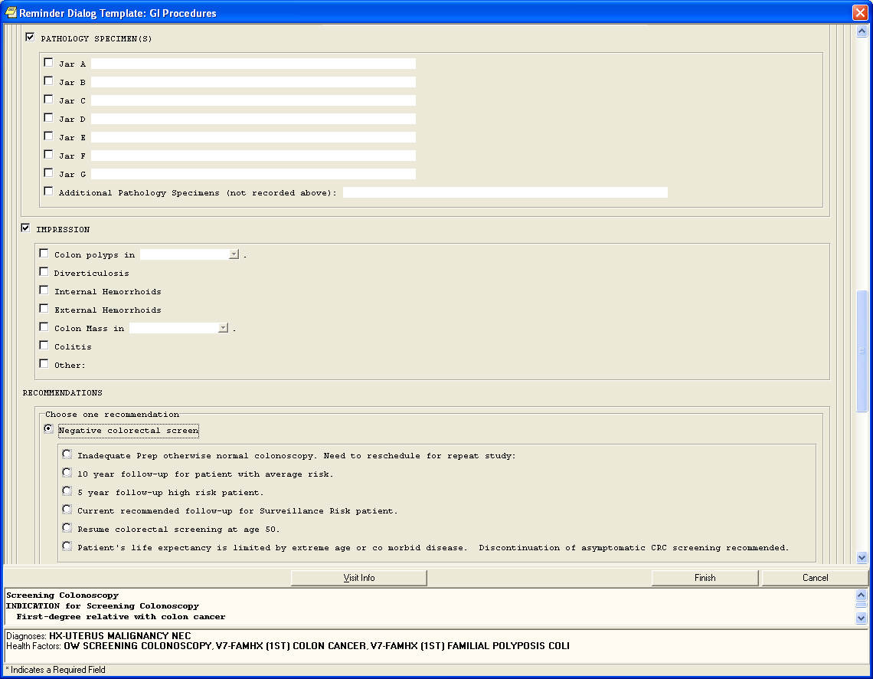
Additional selections driven by the original selection “Screening Colonoscopy”.

Slide 31
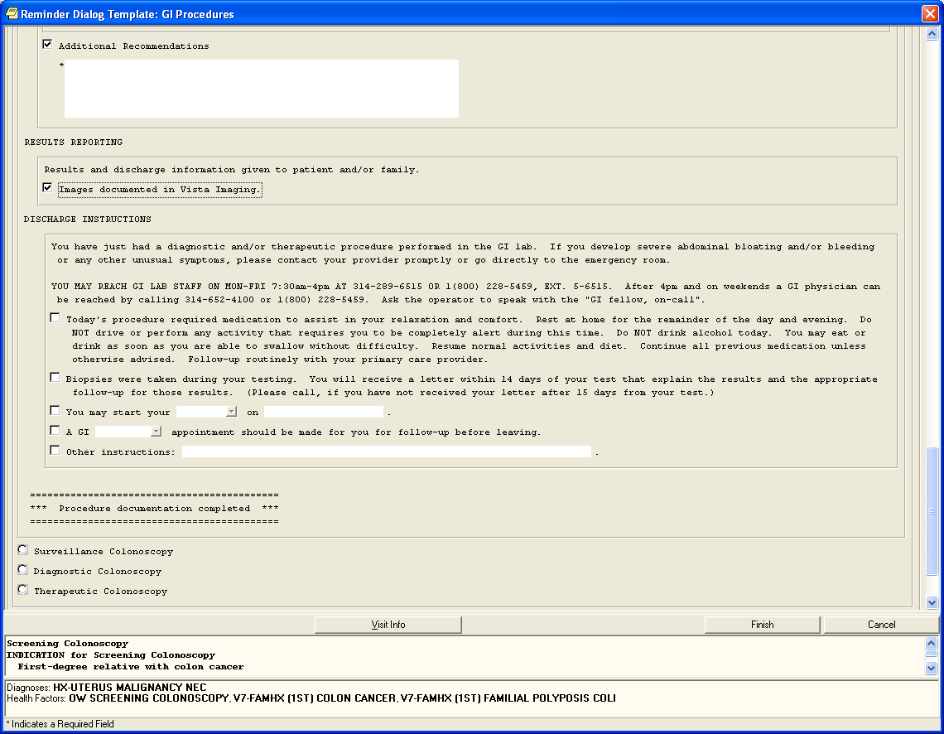
Additional selections driven by the original selection “Screening Colonoscopy”. Displays end of this section as well as displaying the other colonoscopy choices.

Slide 32
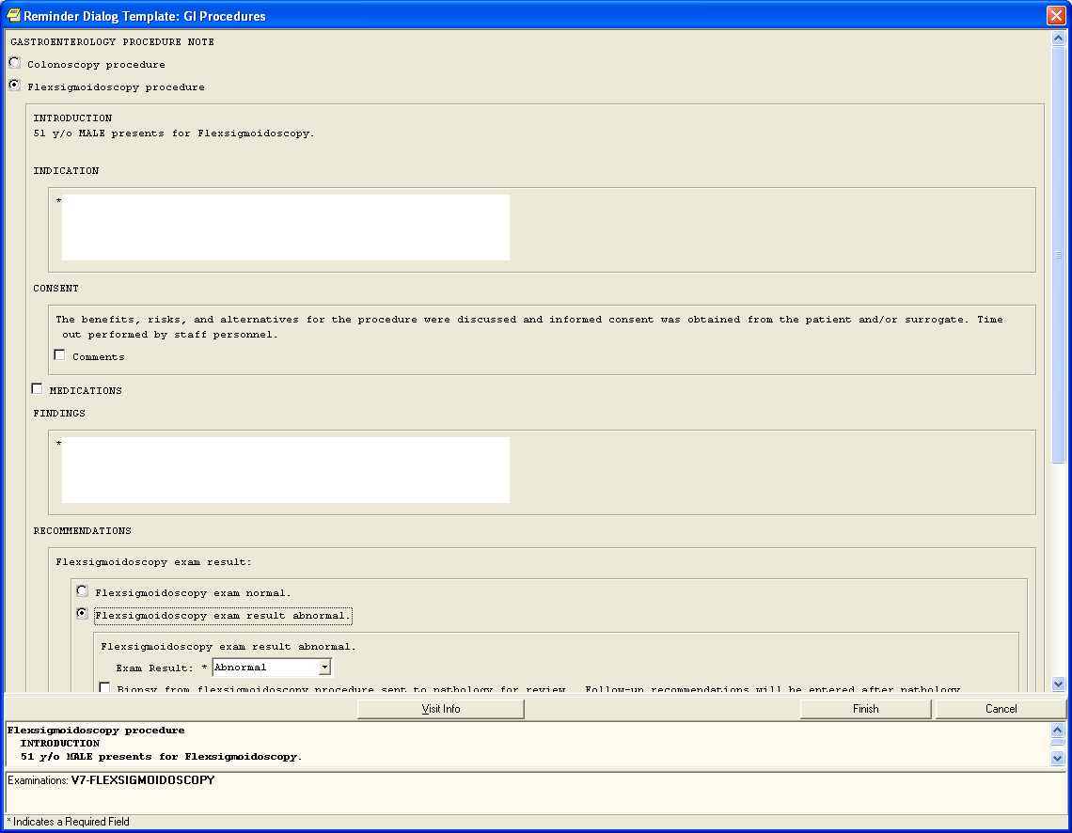
Display of selections for the Flexsigmoidoscopy procedure. (The scroll bar lets the user know that there is more information on this page.)

Slide 33
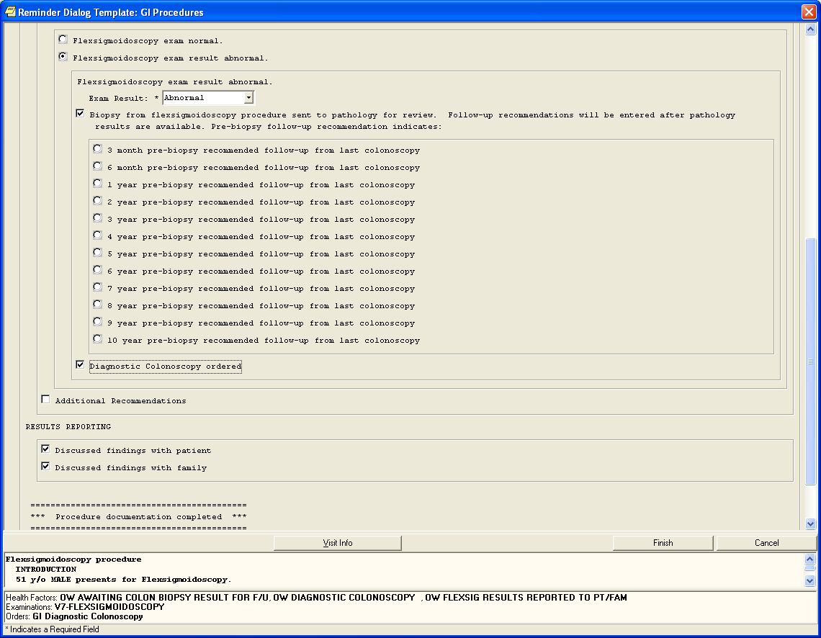
Additional selections driven by the original selection “Flexsigmoidoscopy procedure”.

Slide 34
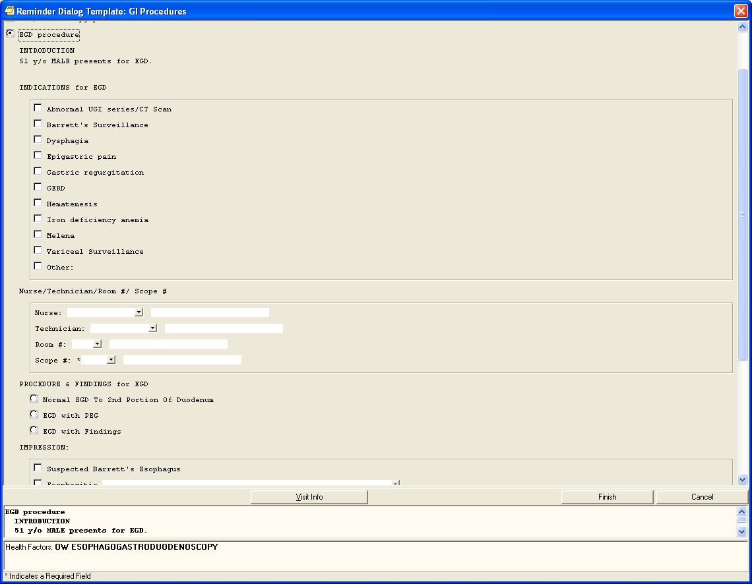
Display after selecting EGD procedure.

Slide 35
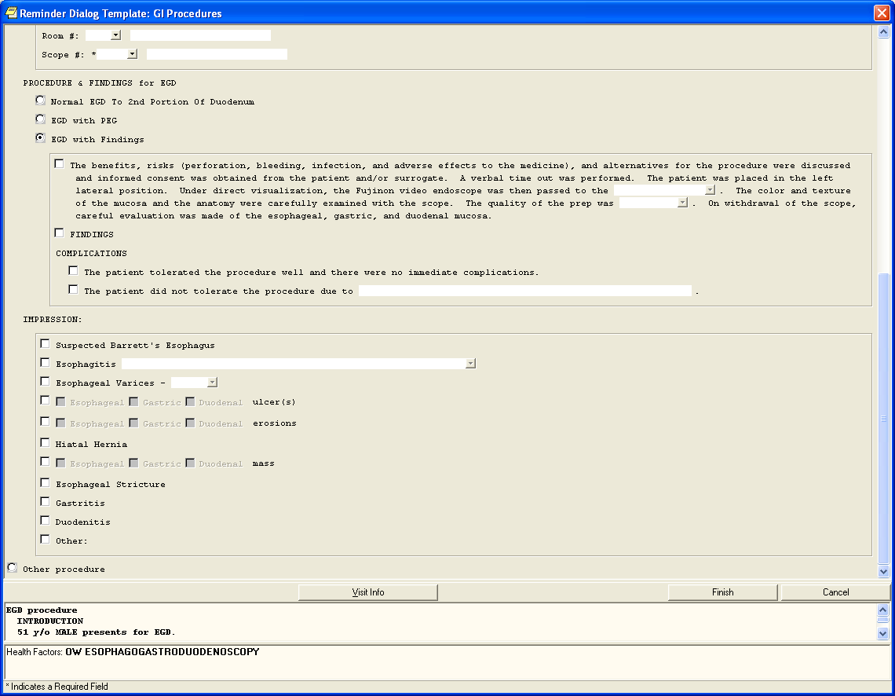
Additional selections driven by the original selection “EGD procedure”. Displays end of this section as well as displaying the “Other procedure” choice.

Slide 36
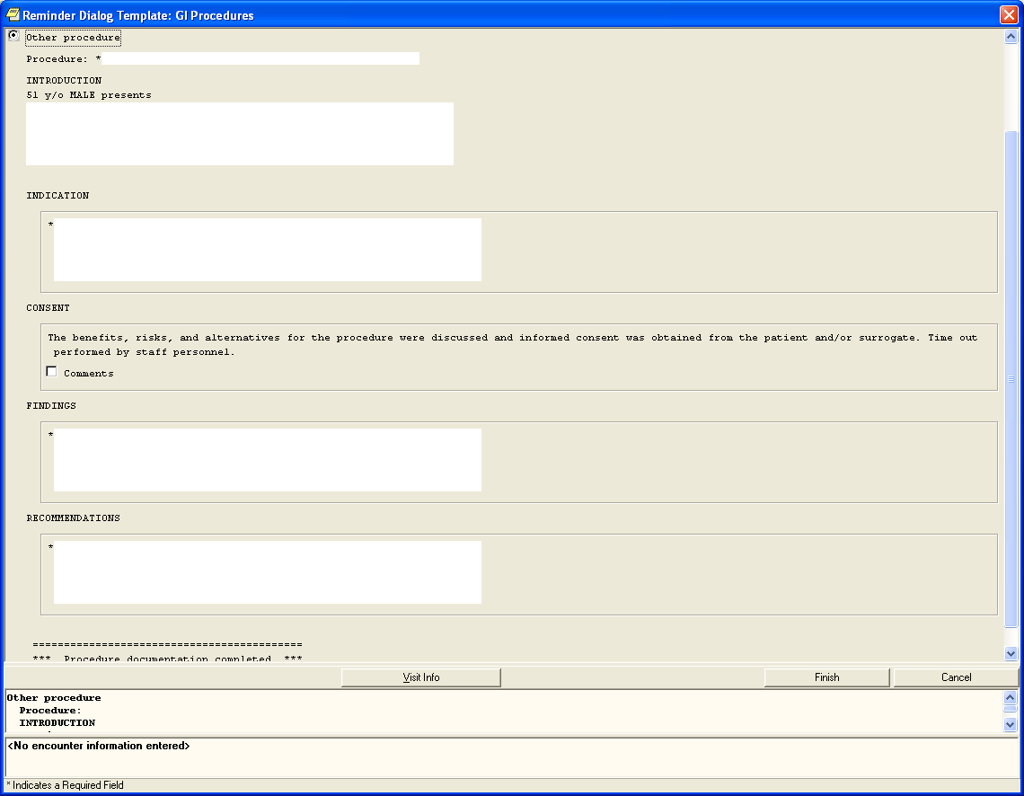
Display after selecting “Other procedure” as well as the end of the screen.

Slide 37
Procedural Results
The endoscopic colonoscopy images to VISTA Imaging
  Verification of images viewable in VI Client
  QA of images by Physicians, PA and Clinical Staff
Clinical utilization of CPRS report template
  Verification of completed progress notes
  Formatting issues noted for enhancement
  Template modification noted for enhancement
Decreased acquisition setup time for procedure
Capture of both static images and video streams

Slide 38
Benefits
“Write your injuries in dust, your benefits in marble.”
- Benjamin Franklin

Slide 39
Benefits
Improved patient care
  There average 16 cases a day
  On Endosoft it takes 10 minutes per case for a total of 160 minutes spent on report documentation
  CPRS template takes 5 minutes per case for a total of 80 minutes spent on report documentation
  Half the time is needed for CPRS template . Time is anticipated to decrease as report template is refined
Improved Patient Safety
  Patient demographics are queried from the DICOM MWL
  Progress note for reporting is entered directly into CPRS
User Friendly
  Image capturer straight forward and uncomplicated
  Template simple and easily modified

Slide 40
Benefits cont..
Minimal Maintenance
  More time spent on this presentation than DICOM workstation setup
  Auto deletion of local images files – FIFO
  Isolated Medical Device on Medical VLAN
  Utilization of standardized clinical workstation for CPRS
VISTA Imaging approved and DICOM compliant
  Tested and validated modality for VISTA Imaging
  DICOM Storage Class User and MWL
Money Saver
  One cost for DICOM capture workstation about 12K
  ENDOSOFT requires an annual fee of 12K for maintenance and support per year
  VA’s CPRS for report template and progress notes

Slide 41
Future
“Do your duty and a little more and the future will take care of itself”
- Andrew Carnegie

Slide 42
Development and Enhancements
Dual Monitor workstations on DICOM capture workstation
Citrix access on DICOM capture workstation for CPRS/VISTA Imaging
CPRS Template for other Endoscopic procedures
Formatting issues for improved clinical workflow
Template modification for improved clinical workflow

Slide 43
Conclusion
Simple design and implementation
Clearly distinguished between Medical and OI&T devices
Ease of creation of CPRS template and enhancements
Other analog image interface – ENT
Clinical workflow not dependent on DICOM capture architecture

Slide 44
Questions ?
“Why a four-year-old child could understand this report. Run out and find me a four-year-old child. I can't make head nor tail out of it.”
- Groucho Marx

