Slide 1

RPMS- EHR Immunization Data Exchange and M.U. Technical Training for Area Teams
National Data Exchange Training Team
Scott Hamstra
Joanne Hawkins
Cecile Town
Mary Brickell
John Parker
Nathan Bunker
Notes:
Presenters listed in order of presentations…

Slide 2
IHS Data Exchange Team
Mary Brickell - Portland Area IT Specialist
Nathan Bunker - Dandelion Software Inc. - IHS Transport Consultant
Scott Hamstra - Sells Hospital, IHS Tucson Area
  BI & BYIM developer, tester, trainer
JoAnne Hawkins – Meaningful Use Team Lead
Tom Love - Cimarron Informatics - BYIM software programmer
John Parker - Chinle Hospital, IHS Navajo Area
  BI & BYIM developer, tester, trainer
Cecile Town - IHS Data Exchange Coordinator

Slide 3
Agenda
Start | Topic
10:00 | Welcome and Introductions | 15 min
10:15 | Module 2: Overview & Data Exchange Background Scott Hamstra | 15 min
10:30 | Module 3: Data Exchange and Meaningful Use JoAnne Hawkins | 30 min
11:00 | Module 4: The Data Exchange Process and Participants Cecile Town | 30 min
11:30 | Module 5: Creating the HL7 Message John Parker | 30 min
12:00 | Lunch | 1 hour
1:00 | Module 6: The Immunization Interface Management (BYIM) Technical Module Mary Brickell & John Parker | 1.5 hours
2:30 | Module 7: Transporting the Message to the IIS Nathan Bunker & John Parker | 30 min
3:00 | Module 8: Transport Technical Module Nathan Bunker & John Parker | 45 min
3:45 | Break | 15 min
4:00 | Module 9: Support: Identifying and Addressing Data Exchange Issues Scott Hamstra | 30 min
4:30 | Q&A, Feedback for Facility level technical training | 30 min
5:00 | Adjourn

Slide 4
Needs & Expectations
Tell us what you . . .
  need
  think you need
  would like to hear
  expect to hear
  expect to learn
OUR GOAL is YOUR GOALS

Slide 5
Agenda
Start | Topic
10:00 | Welcome and Introductions | 15 min
10:15 | Module 2: Overview & Data Exchange Background Scott Hamstra | 15 min
10:30 | Module 3: Data Exchange and Meaningful Use JoAnne Hawkins | 30 min
11:00 | Module 4: The Data Exchange Process and Participants Cecile Town | 30 min
11:30 | Module 5: Creating the HL7 Message John Parker | 30 min
12:00 | Lunch | 1 hour
1:00 | Module 6: The Immunization Interface Management (BYIM) Technical Module Mary Brickell & John Parker | 1.5 hours
2:30 | Module 7: Transporting the Message to the IIS Nathan Bunker & John Parker | 30 min
3:00 | Module 8: Transport Technical Module Nathan Bunker & John Parker | 45 min
3:45 | Break | 15 min
4:00 | Module 9: Support: Identifying and Addressing Data Exchange Issues Scott Hamstra | 30 min
4:30 | Q&A, Feedback for Facility level technical training | 30 min
5:00 | Adjourn

Slide 6



Objectives for Module 2
Provider viewpoint on
data exchange
Data exchange &
  Healthy People 2020
  IHS Strategic Plan

Slide 7


Objectives for Module 3
Understand:
  Meaningful Use Guidelines
  Requirements/timelines
  Roles/responsibilities

Slide 8


Objectives for Module 4
Area Team
  Roles
  Actions

Slide 9





Objectives for Modules 5 – 8*
Software used for exchange
BYIM
  Install
  Configure
Transport between RPMS and IIS
Identify security requirements
HL7 Communications Bridge
  access
  install
  configure
  troubleshoot
** Techies this is for you

Slide 10
Objectives for Module 9 & 10
Identify and address data exchange issues
Identify topics for Tier 1 support trainings
Portland
Billings
Aberdeen
Bemidji
California
Phoenix
Nashville
Tucson
Navajo
Albuquerque
Oklahoma
Alaska

Slide 11
Data Exchange Background
Scott Hamstra, MD

Slide 12




Vaccine Registries
Great – Fabulous – Critical TOOL
- get high rates 90%! & maintain high rates 90%
75%
2008
Healthy People 2020 Goal
  95% children <6 years -- within . . .
  fully operational, population-based
  immunization registries
CDC provides
  $$$$$ for states
  technical assistance
IHS Strategic Plan
  data sharing relationships

Slide 13











IHS Data Exchange Background
Notes:
Also known as Immunization Registries, Immunization Information Systems (IIS) are confidential, population-based, computerized information systems
They collect vaccination data about all children within a geographic area (usually statewide)
Some registries also collect vaccine data for adults.

Slide 14

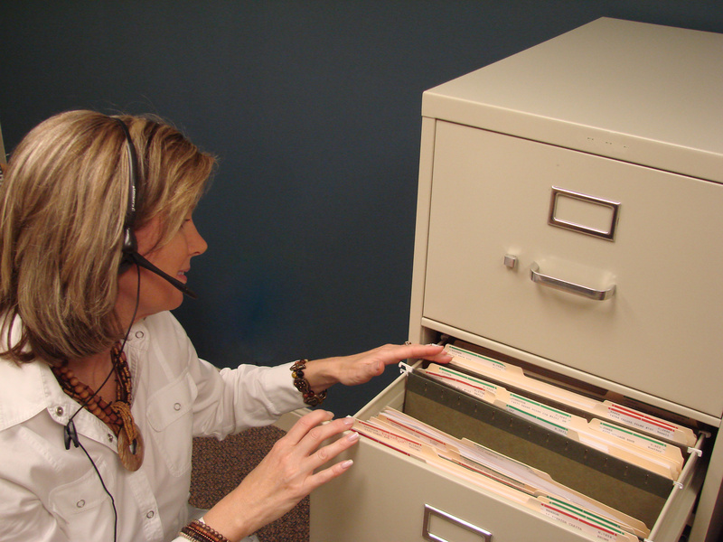
IHS Data Exchange Background
State IIS
Notes:
Also known as Immunization Registries, Immunization Information Systems (IIS) are confidential, population-based, computerized information systems
They collect vaccination data about all children within a geographic area (usually statewide)
Some registries also collect vaccine data for adults.

Slide 15

What’s an IIS (Immunization Information System) ?
Registry = Log of People & Vaccines
  confidential
  population-based
  computerized information systems
  just like RPMS - but only for Vaccines
Vaccines on all children
  in a region/geographic area
  usually a state, IIS becomes SIIS (for AZ = ASIIS)
Some -- vaccine data for adults.

Slide 16



IHS Data Exchange Initiative
TWO WAY Exchange between RPMS & SIIS
Uses 2 things
BYIM (RPMS IHS)
HL7 Communications Bridge software
Benefits:
  Keep doing what you do
  (RPMS has it all = 1 stop shopping)
  Eliminates double data entry (= No!! No!!)
  Data from the IIS directly into RPMS records
  CDC standards, interoperable with most States
Notes:
RPMS based
Software designed to export immunizations to the IIS and pull IIS imports back to RPMS
Software add immunizations directly into individual RPMS records
Process can be automated

Slide 17
Software Used
RPMS Immunization Module - BI
IHS Immunization Data Exchange
  RPMS Software – BYIM
    Often IIMM on RPMS Menu
HL7 Communications Bridge
  non IHS software, used in some states

Slide 18
Data Exchange Options
One-way
RPMS Exports to IIS only (nothing comes back)
Local ITU site – can “view” IIS patient vaccine record
  **** avoids duplicate data entry ******
Two-way
RPMS Export & Import
  Local ITU site RPMS (same as above)
  While “secure connection in place”
  IIS sends back the package with individual vaccines to import
  ** Both processes - piloted tested with 1 facility
  BEFORE going into the production phase with an IIS

Slide 19

Data Exchange -- so what?
Provider & IMM Coordinator View
#1 Better Data, Better Care
  Having accurate information at fingertips, means it’s easier to . . .
  Do the Right Thing
  and
  Do the Right Thing Well

Slide 20






Data Exchange -- so what?
Provider & IMM Coordinator View
#2 Saves CLINIC time
  fewer questions
  fewer searches for records
  fewer phones calls
  faster decisions
  faster care
  happier patients

Slide 21






Data Exchange -- so what?
Provider & IMM Coordinator View
#3 Saves Time & Money
  Fewer Due / Past Due Letters
    Paper
    Envelopes
    Postage
    Staff
  Fewer PHN Home Visits
    Time – a lot
    Gas
    Vehicle wear and tear

Slide 22





Data Exchange -- so what?
Provider & IMM Coordinator View
#4 Saves shots
  Saves vaccine costs
  Saves a limited, precious resource
  Saves “tears” – mom, dad & baby

Slide 23

Data Exchange -- so what?
Provider & IMM Coordinator View
#5 Better Data, Better Reports
  Closer to Reality – THE TRUTH!
    Truth is “always” higher than what can prove
    Absent data
  GPRA report
    higher %
    more accurate MOGE & denominator
  Multiple IMM reports
    higher %

Slide 24
Impact on GPRA Reporting
Tucson Area #1 for 4 Straight Years
  Is Tucson really higher than others?
  Maybe - Maybe Not
    KNOW from experience . . .
    Visible 2 year data lag on GPRA vaccine rates
Exchange has Double Value
  Increases RATE 2 ways
    #1 More kids Up To Date
    #2 Remove more MOGE (Moved or Going Elsewhere)

Slide 25

Impact on Immunization Rates
Not always intuitively obvious to the most casual observer, BUT . . .
The better your data (accurate & timely)
  the better your system works
    the better your frontline works
      the higher your data (better rate)
The “Positive” Cycle
It’s a Win-Win-Win
And why the rich get richer

Slide 26
Interface Success – Arizona
IT REALLY WORKS!
EXPORTS -- Huge Initial Numbers
  2007, 2.5 million records I/T/U to ASIIS
From 1st 6 IHS facilities to ASIIS
  ~1.1 million shots for ~88,000 people
  920,602 shots on 37,932 - were NEW to ASIIS
IMPORTS from ASIIS to IHS facilities
  New to IHS: 490,449 shots
  “opened” eyes to doctor/clinic “shopping”

