Slide 1
Meaningful Use and IHS

Slide 2
Setting
The IHS National Immunization and Information Technology Programs work closely with IIS personnel, software programmers and ITU facility staff to establish and maintain functional interfaces.
ITU clinics utilizing the IHS RPMS can use the IHS interface software to demonstrate meaningful use through submission of test immunization messages in states with an IIS that can accept HL7 uploads.

Slide 3
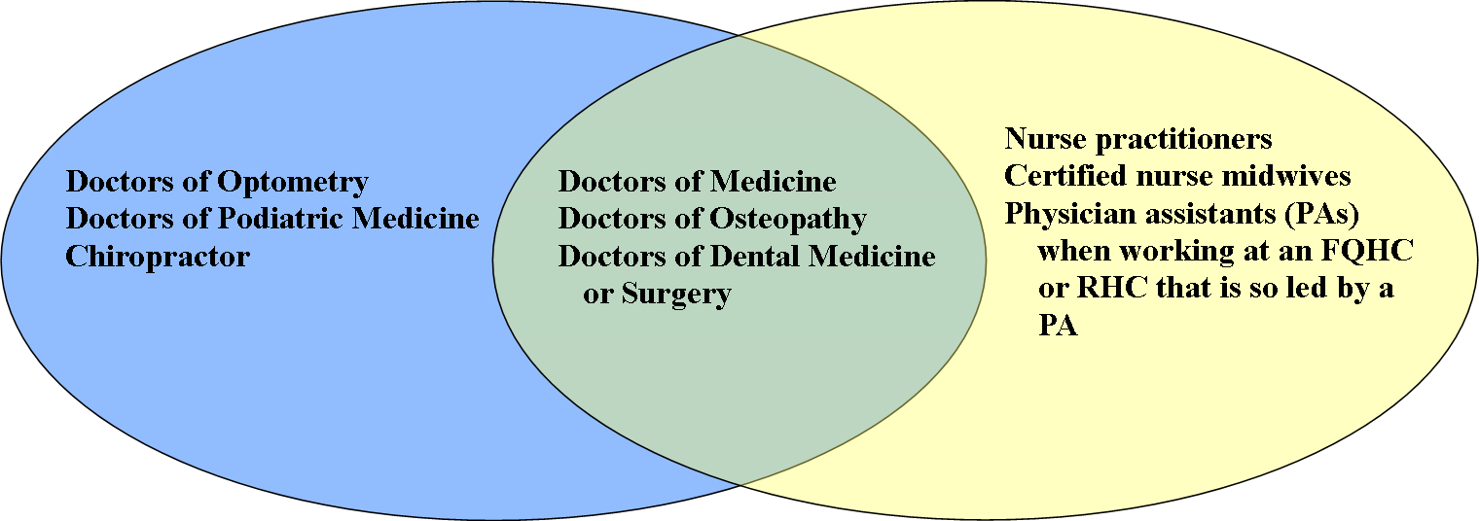
Eligible Professionals
Medicare-only Eligible Professionals
Medicaid-only Eligible Professionals
Could be eligible for both Medicare & Medicaid incentives

Slide 4
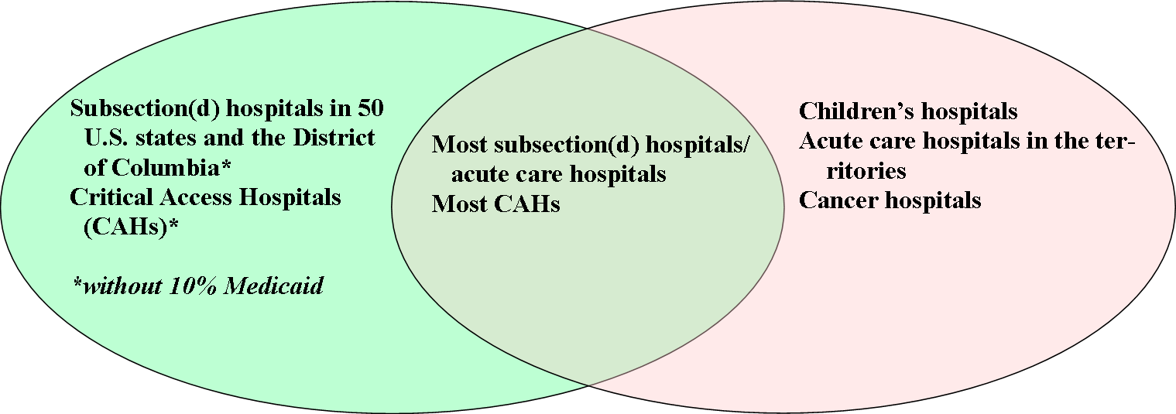
Eligible Hospitals
Hospitals only eligible for Medicare incentive
Hospitals only eligible for Medicaid incentive
Could be eligible for both Medicare & Medicaid (most hospitals)

Slide 5
Medicare-Medicaid EHR Incentive Programs
A “meaningful user” must:
Use a certified EHR product
Meet core objectives and at least 5 “menu” objectives
At least one “menu” objective must address public health
Report quality measures

Slide 6
What are the Requirements of Stage 1?
Eligible Professionals must complete:
    15 core objectives
      6 total Clinical Quality Measures (CQM)
      (3 core or alternate core, and 3/38 from menu set)
    5 objectives out of 10 from menu set
      1 must be public health
Hospitals must complete:
    14 core objectives
      15 CQM
    5 objectives out of 10 from menu set
      1 must be public health

Slide 7
Pick One
Submit electronic data to immunization registries (eligible professionals and hospitals)
Provide electronic syndromic surveillance data to public health agencies (eligible professionals and hospitals)
Provide electronic submission of reportable lab results to public health agencies (hospitals only)
Notes:
All EPs and hospitals must choose at least one of the population and public health measures to demonstrate as part of the menu set.

Slide 8
MU: Stage 1 Menu Set Objectives
Stage 1 Public Health Objectives | Stage 1 Public Health Measures
Capability to submit electronic data to immunization registries or Immunization Information Systems and actual submission in accordance with applicable lw and practice | Performed at least one test of the certified EHR technology’s capacity to submit electronic data to immunization registries and follow-up submission if the test is successful (unless none of the immunization registries to which the EP, eligible hospital or CAH submits such information have the capacity to receive such information electronically
HospitalsOnly: Capability to submit electronic data on reportable (as required by state or local law) lab results to public health agencies and actual submission in accordance with applicable law and practice | HospitalsOnly: Capability to submit electronic data on reportable (as required by state or local law) lab results to public health agencies and actual submission in accordance with applicable law and practice
Capability to submit electronic syndromic surveillance data to public health agencies and actual submission in accordance with applicable law and practiceactual submission in accordance with applicable law and practice | Performed at least one test of certifiedEHR technology’s capacity to provide electronic syndromic surveillance data to public health agencies and follow-up submission if the test is successful (unless none of the public health agencies to which the EP, eligible hospital or CAH submits such information have the capacity to receive such information electronically)

Slide 9
Menu Set MU Objective
“Capability to submit electronic data to immunization registries or Immunization Information Systems and actual submission in accordance with applicable law and practice.”
- 42 CFR Part 495.6,(e)(9)(i)
Notes:
Submit actual immunization data to at least one organization in accordance with applicable law and practice [up from performing just a test; test or “dummy” data not permissible]

Slide 10
Stage 2
Stage 2 Final Rule will be released June 2012
Submit actual immunization data to at least one organization in accordance with applicable law and practice [up from performing just a test; test or “dummy” data not permissible]
Notes:
The proposed rule for Stage 2 will be released in January 2012 for public comment. The final rule for Stage 2 will be released in June 2012.

Slide 11
Timeline - Medicare
Eligible Hospitals
Eligible Professionals
Eligible Hospitals demonstrating Meaningful Use for 2011, must successfully send one valid HL7 test message for a certified EHR system to a state immunization registry by 9/30/11.
Eligible Professionals demonstrating Meaningful Use for 2011, must successfully send one valid HL7 test message for a certified EHR system to a state immunization registry by 12/31/2011
Sites with multiple EPs need only test once.

Slide 12
Timeline - Medicaid
Eligible Hospitals
Eligible Professionals
Adopt/Implement/Upgrade to a Certified EHR by 09/30/11
Meet Patient Volume Threshold – 10%
Adopt/Implement/Upgrade to a Certified EHR by 12/31/11
Meet Patient Volume Threshold – 30%
Notes:
Medicare eligible professionals (EPs) need to use a certified EHR to successfully send one valid HL7 test message from their certified EHR system to a state immunization registry by 12/31/2011. Sites with multiple EPs need only test once.

Slide 13
Hospitals
  There are 42 IHS hospitals
    33 Subsection D/Acute
    9 Critical Access
  19 of 42 (45%) currently export immunization data to their state IIS
  15 of 42 (36%) hospitals will be exempt
  8 of 42 (19%) hospitals are in states with pending data exchange and can attest if test messages are submitted by the end of their EHR reporting period.
Notes:
There are 42 IHS hospitals -- 9 are Critical Access Hospitals, 33 are Acute Care/Subsection D. Subsection D/acute care and CA hospitals may qualify for both Medicare and Medicaid incentives. Exempt hospitals are in: NC, OK, ND, SD, MT Pending states with hospitals are: NE, NM

Slide 14
MU Measure
Type of Measure: Attestation
EHR MU Guide: Section 4.1.9
A single test per RPMS facility will be performed with a state immunization registry.
Results from this test should be entered as a “Yes” or “No” in the MU reports for the purposes of attestation.
Recommended:
Record receipt of test from IIS for audit purposes

Slide 15
RPMS Reporting Logic
Measure Inclusions:
  COUNT: eligible providers
  HAVING: performed at least one test of the certified EHR technology’s capacity to submit electronic data to immunization registries during the EHR reporting period
  AND HAVING: performed follow-up submission if the test was successful (unless none of the immunization registries to which the EP submits such information has the capacity to receive the information electronically) during the EHR reporting period
Notes:
Immunization Registries: Perform at least one test of certified EHR’s capacity to submit electronic data to immunization registries and follow-up submission if the test is successful. NOTE: EPs should not choose this measure if their respective state does not have an immunization registry and/or does not have the capacity to receive the information electronically. (Yes/No answer, provided by person running report)

Slide 16
RPMS Reporting Logic
Measure Exclusion:
EPs, eligible hospitals, and CAHs that do not administer one or more immunizations during the EHR reporting period are excluded from this measure.
NOTE:
EPs should not choose this measure if their respective state does not
have an immunization registry and/or does not have the capacity to
receive the information electronically.
Notes:
Immunization Registries: Perform at least one test of certified EHR’s capacity to submit electronic data to immunization registries and follow-up submission if the test is successful. NOTE: EPs should not choose this measure if their respective state does not have an immunization registry and/or does not have the capacity to receive the information electronically. (Yes/No answer, provided by person running report)

Slide 17
IHS Data Exchange
2011
AK
WA
ME
MT
ND
VT
MN
NY
NH
MA
OR
SD
WI
RI
ID
MI
CA
WY
CT
PA
NJ
IA
OH
DC
CO
NE
IL
IN
DE
NV
UT
WV
VA
MD
KS
MO
KY
NC
TN
AZ
OK
AR
SC
NM
States w/non-Federally Recognized Tribes or No Tribes (16)
MS
AL
GA
San Diego County IIS
TX
LA
FL
Two Way Exchange
(12)
Pending Exchange
(7)
One Way Exchange
(2)
ITU State, No Exchange
(14)
Current IHS Immunization Data Exchange Operations
Notes:
This depicts the current status of the IHS Immunization Data Exchange initiative. Any IHS, Tribal or Urban (I/T/U) facility that operates the RPMS Immunization Package is capable of performing bidirectional HL7 data exchange in batch mode. There is data exchange potential in 34 of 50 states.
-Most RPMS sites in the turquoise states currently operate bidirectional data exchange with the state immunization information system (IIS).
-Some RPMS sites in the green states currently send information (one-way) to the IIS.
-Although, there are ITU sites in the light blue states, these facilities don't participate in data exchange using the IHS data exchange software at this time.
Note that we say 34 out of 50 states with data exchange potential, but the numbers above add up to 35. The reason for this is because we count California twice, once as a two way HL7 state due to San Diego County, the next time as a “One Way Exchange” (non HL7) State. Illinois is included because there is an Urban site there that administers immunizations.

Slide 18
I/T/U facilities exchanging data
State | Exchanging | Total Sites | %
Alaska | 13 | 13 | 100 %
Arizona | 12 | 15 | 80 %
California (SD County) | 1 | 4 | 25 %
Idaho | 1 | 3 | 33 %
Louisiana | 1 | 4 | 25 %
Maine | 1 | 4 | 25 %
Minnesota | 4 | 9 | 44 %
Mississippi | 1 | 1 | 100 %
Montana | 8 | 12 | 67 %
Utah | 1 | 1 | 100 %
Washington | 10 | 24 | 42 %
Wisconsin | 5 | 8 | 63 %
Wyoming | 1 | 1 | 100 %
South Dakota | 4 | 13 | 31 %
Notes:
Alaska – ANMC, Nome, Maniilaq, Barrow, YKHC, TCC, BbaHC, KIC, SEARHC Juneau & Sitka, Kodiak, Metlakatla, EAT, Chugiachmiut, APIA
Arizona – Chinle, Fort Defiance, Gallup, Kayenta, Parker, PIMC, Whiteriver, Sells, Winslow – will be 15 – three coming online
California – Southern Indian Health Council submits to San Diego County Immunization Registry
Minnesota – Cass Lake, Prairie Island, Red Lake, White Earth
Oregon – Warm Springs
Montana – One way only - Blackfeet Community Hospital (Browning), Crow Service Unit , Harlem Hospital (Ft. Belknap), Fort Peck Service Unit (Poplar), Wind River Service Unit (Ft. Washakie), Northern Cheyenne Service Unit (Lame Deer), Flathead Tribal Health, Rocky Boy Tribal Health
Utah – Uintah & Ouray/Fort Duchesne
Washington - 9 are exchanging data (two-way), 1 (Puyallup) exchanging one-way, 2 (Lummi & Lower Elwha) need updates to confirm, 1 regionalized site (Upper Skagit) set up and ready, but not going to WA production server yet, 7 Regionalized sites not set up yet, 2 stand-alone sites still not set up (Nisqually and Inchelium)
Wisconsin – Ho Chunk 10/2007, Oneida 12/2006, Peter Christensen 4/2008, Potawatomi 4/2/2010, St. Croix 3/22/2010 - The rest have never.
Wyoming – Wind River
Maine – Aroostook Band of Micmacs, Houlton Band of Maliseet Indians, Passamaquoddy Tribe- Indian Township, Passamaquoddy Indian Tribe- Pleasant Point
South Dakota – Wagner, Rosebud, Pine Ridge, Sioux San

Slide 19
IHS MU Attestation
Current Exchange, Can Attest (12)
AK
Exempt (10)
WA
ME
MT
ND
VT
MN
NY
NH
MA
OR
SD
WI
RI
ID
MI
WY
CT
PA
NJ
IA
OH
DC
NV
NE
IL
IN
WV
DE
UT
MD
CA
CO
KS
MO
KY
VA
TN
NC
AZ
OK
AR
SC
NM
States w/non-Federally Recognized Tribes or No Tribes (17)
MS
AL
GA
San Diego County IIS
TX
LA
FL
Pending Exchange, Can Attest (13)
Current IHS Immunization Data Exchange Operations
Notes:
As of March 2011, 12 states are able to attest, if needed for Medicare Meaningful Use. An additional 11 states, shown in light blue, will be able to, but IHS will need to be able to assist facilities in those states with software installations and test messaging in order to do so. The states shown in gray are exempt for this year. Although some of them can, or will be able to accept HL7 messages this year, this may not be able to occur until after July 1st, when our Medicare eligible providers and hospital will need to begin their 90 day testing period.

Slide 20
Status
Currently, there are 232 ITU facilities in 34 states, with 63 (27%) facilities exchanging immunization data with 14 IIS.
2011 - RPMS will interface with 19 of 35 (54%) possible IIS.
IHS facilities can now attest for Meaningful Use in 12 states
Medicare eligible IHS providers and hospitals will be able to attest in 11 additional states in 2011
Interface discussions are underway in half of the ‘Exempt’ states.

Slide 21
Non-RPMS Sites and MU
Each EHR vendor is responsible for ensuring that
its products are certified and capable of supporting
Meaningful Use; IHS accepts this responsibility for
the RPMS EHR
  Non-RPMS sites will be dependent upon certification of their commercial-off-the-shelf (COTS) products

Slide 22
Who attests?
2011 IHS Meaningful Use

Slide 23
Can Attest – Already Exchanging
Alaska Area – Alaska
Albuquerque Area – Colorado, New Mexico
Bemidji Area – Minnesota*, Wisconsin*
Billings Area – Wyoming
California Area – San Diego County only*
Nashville Area – Maine*, Mississippi, Louisiana*
Navajo Area – Arizona, New Mexico*
Phoenix Area – Arizona*, Utah
Portland Area – Idaho*, Washington

Slide 24
Must Attest – Not Yet Exchanging
Aberdeen Area – Nebraska, South Dakota
Bemidji Area – Minnesota*, Wisconsin*, Michigan, Illinois
California Area – San Diego County only*
Nashville Area – Maine*, Louisiana*, New York, South Carolina, Florida
Navajo Area – Arizona*, New Mexico*
OKC Area - Kansas
Phoenix Area – Arizona*, Nevada
Portland Area – Idaho*, Oregon
Notes:
These states don’t have live data exchange yet. If your facilities in these states are not choosing the lab or surveillance menu options or if there are hospitals in these states going for Medicare incentives, then its important to help the facilities stand up these exchanges per the training material.

Slide 25
States Not Yet Participating?
2011 IHS Meaningful Use

Slide 26
Not Participating for 2011
Aberdeen Area
North Dakota
Iowa
Billings Area
Montana
California Area
California – except San Diego County
Nashville Area
Massachusetts
Connecticut
North Carolina
Alabama
OKC Area
Oklahoma
Texas
Notes:
The states do not accept HL7 format messages at this time.

Slide 27
For more detailed information
An IHS MU Guide for the Immunization Submissions has been posted to the IHS Division of Epidemiology web page:
http://www.ihs.gov/epi/index.cfm?module=epi_vaccine_mu

Slide 28
Area MU Coordinators
Area MU Coordinators
Area | MU Coordinator | Email | Phone Number
Aberdeen | CAPT Scott Anderson | Scott.Anderson@ihs.gov | (605) 335-2504
Alaska | Richard Hall Kimi Gosney Erika Wolter | rhall@anthc.org kgosney@anthc.org ewolter@anthc.org | (907) 729-2622 (907) 729-2642 (907) 729-3907
Albuquerque | Jacque Candelaria (Acting) | Jacque.Candelaria@ihs.gov | (505)988-9821
Bemidji | Jason Douglas Alan Fogarty | Jason.Douglas@ihs.gov Alan.Fogarty@ihs.gov | (218) 444-0550 (218) 444-0538
Billings | CAPT James Sabatinos | James.Sabatinos@ihs.gov | (406) 247-7125
California | Marilyn Freeman | Marilyn.Freeman@ihs.gov | (916) 930-3981, ext. 362
Nashville | Robin Bartlett | Robin.Bartlett@ihs.gov | (615) 467-1577
Navajo | LCDR Andrea Scott | Andrea.Scott@ihs.gov; | (928) 292-0201
Oklahoma | Amy Rubin | Amy.Rubin@ihs.gov | (405) 951-3732
Phoenix | CAPT Lee Stern | Lee.Stern@ihs.gov | (602) 364-5287
Portland | CAPT Leslie Dye Donnie Lee, MD | Leslie.Dye@ihs.gov Donnie.Lee@ihs.gov | (503) 326-3288 (503) 326-2017
Tucson | Scott Hamstra, MD | Scott.Hamstra@ihs.gov | (520) 295-2532

Slide 29
Area MU Consultants(contractors)
Area | MU Consultants | Email | Phone Number
Team Lead (ABQ) | JoAnne Hawkins | Joanne.Hawkins@ihs.gov | (505) 382-4228
Regional Consultant #1 | Troy Whaley | Troy.Whaley@ihs.gov
Regional Consultant #2 | Melissa Alford | Melissa.Alford@dncx.com
Aberdeen | Carol Smith | Carol.Smith3@ihs.gov | (605) 484-7090
Alaska | Karen Sidell Audra Hill | Karen.Sidell@ihs.gov Audrey.hill@dncx.com | (907) 729-2624
Albuquerque | Malissa Lyons | Malissa.Lyons@ihs.gov | (505)933-1294
Bemidji | Susanna Frenkel | Susanna.Frenkel@ihs.gov
Billings | Jeremy Lougee | Jeremy.Lougee@ihs.gov | (406) 247-7128
California | Tim Campbell | Tim.Campbell@ihs.gov | (707) 889-3009
Nashville | Robin Kitzmiller | Robin.Kitzmiller@ihs.gov | (615)467-1532
Navajo | Donna Nicholls | Donna.Nicholls@ihs.gov | (505) 205-9177
Oklahoma | Ursula Hill | Ursula.Hill@ihs.gov | (405) 951-6036
Phoenix | Rick Bowman | Richard.Bowman@ihs.gov | (520) 603-6817
Portland | Angela Boechler | Angela.Boechler@ihs.gov | (971) 221-8057
Tucson | Rick Bowman | Richard.Bowman@ihs.gov | (520) 603-6817
Notes:
29

