Slide 1
Module 5 – Creating the HL7 Message
OBJECTIVES
Describe the purpose and function of the BYIM software
Describe what information RPMS sends to IIS
Locate the BYIM software within the RPMS
Identify a resource for immunization testing for NextGen

Slide 2
Immunization Interface Management
BYIM
  IHS Software developed via contract with Cimarron Informatics for use by IHS, Tribal and Urban RPMS facilities
  The software extracts immunization information from the RPMS Immunization Package and exchanges HL7 messages with IIS in batch mode.
    The software exports to the SIIS and imports back to RPMS
    It can add immunization data directly into individual RPMS records
    Process can be automated
  Developed according to CDC standards, BYIM sends all of the National Vaccine Advisory Committee (NVAC) required core data items in HL7 2.4.
  Future versions will allow real-time transmission in HL7 2.5 format.

Slide 3
How IHS/IIS Data Exchange Works
RPMS IZ
Package
IHS software extracts data from RPMS, exports to the IIS and imports back to RPMS
IIS
Export
Data
Exchange
Software
Import
  -Many providers enter immunization data into the IIS
  -IIS centralizes immunization data for all providers
After exchange, I/T/U providers can view complete immunization histories for their patients
IHS Data Exchange software is built to CDC standards so it can work with any IIS that meets those standards

Slide 4
Immunization Interchange Management Menu – BYIM
  BYIM can be referred to as IIMM
  Look for IIMM on RPMS Menu:
  IHS CORE
       IIMM

Slide 5
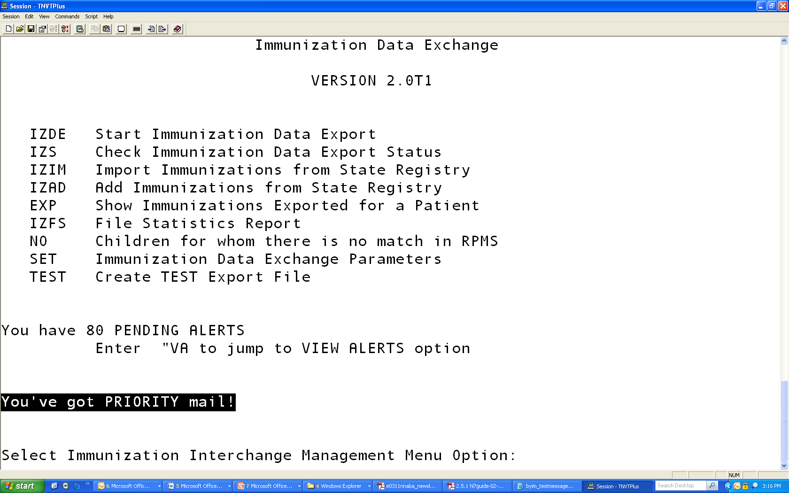
RPMS BYIM Menu

Slide 6
What data does RPMS send?
Demographic data, i.e.,:
  Patient ID Patient Name (last, middle, first)
  Date of birth
  Sex (M or F or Unknown)
  Race = AI/AN or Unknown
Vaccine Administration data, i.e,:
  Date of Vaccine
  Date of data transfer
  Vaccine CVX code
  01 = Historical 00 = Administered
  Facility
  Lot #, Manufacturer
Notes:
Generally, the RPMS sends a combination of demographic and vaccine administration information to the IIS. This information is extracted directly from the Immunization Module and contains specific patient identifying information as well as information about the patient visit and specific vaccine information. This level of detail enables the IIS to determine which facility sent the information, if the patient identified is the same patient seen by other providers in the state, and allows the IIS to create a consolidated immunization record. In the event of a vaccine recall, information such as Vaccine CVX code, Lot number, date of administration, and administering facility would allow appropriate action.

Slide 7
Health Level Seven (HL7)
A nationally recognized standard for electronic data exchange between systems housing health care data
HL7 defines a syntax or grammar for formulating the messages that carry this information
HL7 describes a standard messaging vocabulary
HL7 is platform independent --- it does not depend on specific software
Notes:
Immunization Information Systems (IIS) are centralized population based repositories of
immunization related information. They receive and share data on individual
clients/patients with a number of other systems, including Electronic Health Record
systems (EHR‐S

Slide 8
HL7 Format
MSH|^~\&|IMMUNIZATION REGISTER|CHINLE HOSP|||20100208043011-0700||VXU^V04|IHS-6923602|P|2.4|||AL|AL|
PID|1|111111|808101111111^^^^MR||PATIENT^DEMO^JANE^^^|PATIENT^MOTHER^^^^|20090924|F||1002-5|BOX XYZ^^SUNCITY^AZ^86503||||||||999999999
NK1|1|PATIENT^MOTHER^^^^|MTH^MOTHER^HL70063|BOX XYZ^^SUNCITY^AZ^86503|928 999 9999 C||NOK^NEXT OF KIN^99IHS
PV1|1||CHINLE HOSP^EMERGENCY MEDICINE||||^BURDICK,YVETTE RR||^BINGGELI,ROBERT A||||||||||5520898||V04^20090924^I^IHS|||||||||||||||||||||||
RXA|0|1|20090926120000|20100207193200|08^HEP B, ADOLESCENTOR PEDIATRIC^CVX|.5|||00^NEW IMMUNIZATION RECORD^NIP001|ROLFING,BARBARA A|CHINLE HOSP^^^CHINLE HOSP||||||^^MVX
RXA|0|1|20091125082700|20100207193200|110^DTaP-Hep B-IPV^CVX|.5|||00^NEW IMMUNIZATION RECORD^NIP001|TSOSIE,DONOVAN D|CHINLE HOSP^^^CHINLE HOSP||||AC21B188AA||SKB^GLAXOSMITHKLINE^MVX
RXA|0|1|20091125082700|20100207193200|116^ROTAVIRUS, PENTAVALENT^CVX|2|||00^NEW IMMUNIZATION RECORD^NIP001|TSOSIE,DONOVAN D|CHINLE HOSP^^^CHINLE HOSP||||0534Y||MSD^MERCK & CO.^MVX
RXA|0|1|20091125082700|20100207193200|100^Pneumococcal, PCV-7^CVX|.5|||00^NEW IMMUNIZATION RECORD^NIP001|TSOSIE,DONOVAN D|CHINLE HOSP^^^CHINLE HOSP||||D74804||WA^WYETH-AYERST^MVX
RXA|0|1|20091125082700|20100207193200|49^HIB (PRP-OMP)^CVX|.5|||00^NEW IMMUNIZATION RECORD^NIP001|TSOSIE,DONOVAN D|CHINLE HOSP^^^CHINLE HOSP||||1438U||MSD^MERCK & CO.^MVX
Notes:
Message Segment Header contains information about the sending facility, date and time of transmission, type of message, HL7 version
PID Segment is the Patient Identifier Segment which contains demographic information about patient, not likely to change, such as race, name, social security number, DOB
NK1 is the Next of Kin Segment – information NOK, usually mother, includes address
PV1 Segment is the Patient Visit Segment, contains specific visit information, including providers, financial class information about the patient such as VFC eligibility
RXA – Pharmacy/Treatment Administration Segment: Date of Vaccine*, Date of data transfer, Vaccine CVX code, Vaccine Name,
01 = Historical 00 = Administered, Facility, Lot #, Manufacturer --- see MVX

