Slide 1
Installation and Set Up
Guide to installing the HL7 Bridge for Windows Server

Slide 2
UNIX
John Parker

Slide 3
Overview of Process
Each site conducts IIMM Data Exchange using vaccine data
put into the local RPMS data system (using IMM or EHR)
You are required to download both the BYIM and the HL7
Communication Bridge software.
-use the BYIM software only to manually exchange data.
-use BYIM & the Bridge software together to automate exchange
Either way, this is the process that occurs:
  Export Process
    Create an export file = IZDE Step 1
    Send the file to the state registry Step 2
  Import Process
    Get a file back from the state registry Step 3
    Review vaccines from state Step 4
    Add vaccines to the RPMS data system Step 5
    = IZAD
These steps are usually performed by the site clinical IZ contact.

Slide 4
First steps, IT site manager must set up BYIM…
How to set up the import and export directories/folders
2. How to set up mailman messages

Slide 5
Set-up in UNIX: Establish import and export directories to work with the Bridge
To set-up the import and export directory, the site manager first
creates three directories on the RPMS server.
1. The hl7bridge directory:
/usr/local/hl7bridge/
Within the hl7bridge directory,
2. The requests directory:
/usr/local/hl7bridge/requests/
3. The responses directory:
/usr/local/hl7bridge/responses/
Notes:
NOTE: of the four sites on today’s training, 3 are UNIX --- Rosebud, Rapid City (Sioux San) and Pine Ridge. BYIM and Bridge have already been installed, but the Area IT probably did this so it would be good to QUICKLY run through these slides.

Slide 6
SET - UNIX
On the RPMS using the SET Immunization Data Exchange
Parameters, point to these directories as follows:
PATH FOR OUTBOUND MESSAGES:
/usr/local/hl7bridge/requests/Replace
PATH FOR INBOUND MESSAGES:
/usr/local/hl7bridge/responses/ Replace
AUTO IMPORT IMMUNIZATIONS: YES//
AUTO ADD IMMUNIZATIONS: NO//
(Note: Begin data exchange with AUTO ADD off. This will allow providers to check imported data and manually add it until confident that imports are valid.)

Slide 7
Then, Set Up, Bridge 2.0.1.1:
Follow the directions in the Installation Guide and Release Notes, Section 2.3, to obtain the HL7 Bridge software.
Use the Bridge documentation to install the software.
Set up the Bridge to automate data exchange. To complete this, you must contact State Registry personnel to connect the Bridge to the registry.
Notes:
Installed already for each site by Shawn Tennyson at the Area

Slide 8
Set up Automation Pieces - 1
To set-up taskman to run these processes automatically, the site
manager does the following using Schedule/Unschedule Options option
in Taskman Management:
Select OPTION to schedule or reschedule: BYIM IZ AUTO EXPORT
Edit Option Schedule
Option Name: BYIM IZ AUTO EXPORT
Menu Text: Entry Point for Auto Export TASK ID: 267914
__________________________________________________________________________
QUEUED TO RUN AT WHAT TIME: JUL 3,2007@04:30
DEVICE FOR QUEUED JOB OUTPUT:
QUEUED TO RUN ON VOLUME SET: CCHC
RESCHEDULING FREQUENCY: 1D
TASK PARAMETERS:
SPECIAL QUEUEING: Persistent
____________________________________________________________________________
Notes:
Site managers should check and confirm that these steps have been completed. Ideally, should be set to communicate with SDIIS between 4am and 6am daily.

Slide 9
Set up Automation Pieces - 2
And -
Select OPTION to schedule or reschedule: BYIM IZ AUTO IMPORT
Edit Option Schedule
Option Name: BYIM IZ AUTO IMPORT
Menu Text: Entry Point for Auto Import TASK ID: 267943
__________________________________________________________________________
QUEUED TO RUN AT WHAT TIME: JUL 3,2007@06:00
DEVICE FOR QUEUED JOB OUTPUT:
QUEUED TO RUN ON VOLUME SET: CCHC
RESCHEDULING FREQUENCY: 1D
TASK PARAMETERS:
SPECIAL QUEUEING: Persistent
_______________________________________________________________________________
These can literally be set-up to run more frequently or less frequently without any
problem. Please be aware of time zone issues if conducting exchange in Arizona.
Notes:
Site managers should check and confirm that these steps have been completed. Ideally, should be set to communicate with SDIIS between 4am and 6am daily.

Slide 10
Automated Exchange Using the HL7 Communications Bridge & BYIM

Slide 11
Prior to Exchange,
Test Functionality
During testing, check two aspects of software:
proper installation (BYIM & HL7 Bridge)
function
  Automation (BYIM & HL7 Bridge)
    Site manager converts each step to automation and clinical contact confirms each step works properly
NOTE: sites can only automate when the state registry is
capable of supporting this function.

Slide 12
D.I.Y. HL7 Bridge Screening
IMPORTANT
The HL7 Bridge only sends HL7 data files
once and does not monitor for problems
On a regular schedule, check the response directory for error messages on reciprocal files
Check hl7bridge error and log files to help resolve bridge-related problems

Slide 13
UNIX Configuration
Directory: /usr/local/hl7bridge
total 24
drwxrwx--- 8 root cacheusr 4096 Nov 19 2008 ./
drwxrwxrwx 7 root system 256 Feb 05 2009 ../
drwxrwx--- 2 bin cacheusr 256 Nov 19 2008 bridge/
-rwxrwx--- 1 root cacheusr 0 Nov 19 2008 hl7bridge-process.log*
-rwxrwx--- 1 bin cacheusr 122 Mar 26 2008 hl7bridge.sh*
drwxrwx--- 2 bin cacheusr 256 Nov 18 2008 lib/
drwxrwx--- 2 bin cacheusr 256 Nov 19 2008 logs/
drwxrwx--- 2 bin cacheusr 256 Nov 18 2008 props/
drwxrwx--- 2 bin cacheusr 256 Nov 18 2008 requests/
drwxrwx--- 2 bin cacheusr 256 Nov 19 2008 responses/

Slide 14
UNIX error.text
zihtest in /usr/local/hl7bridge$cd logs
zihtest in /usr/local/hl7bridge/logs$ls
error.txt ihs-err.txt ihs-log.txt log.txt
zihtest in /usr/local/hl7bridge/logs$ll
Directory: /usr/local/hl7bridge/logs
total 40
drwxrwx--- 2 bin cacheusr 256 Nov 19 2008 ./
drwxrwx--- 8 root cacheusr 4096 Nov 19 2008 ../
-r--r--r-- 1 bin bin 111 Mar 20 2009 error.txt
-rw-r----- 1 root system 111 Mar 20 2009 ihs-err.txt
-rw-r----- 1 root system 109 Mar 20 2009 ihs-log.txt
-r--r--r-- 1 bin bin 254 Mar 20 2009 log.txt
zihtest in /usr/local/hl7bridge/logs$cat error.txt
03/19/2009 10:22:32 AM - - Error file opened
03/20/2009 12:44:18 PM - - Closing file
zihtest in /usr/local/hl7bridge/logs$

Slide 15
UNIX log.txt
zihtest in /usr/local/hl7bridge/logs$cat log.txt
03/19/2009 10:22:32 AM - - Log file opened
03/19/2009 10:22:32 AM - - Initializing HL7 Bridge Manager Version0
03/19/2009 10:22:32 AM - - Java Version 1.4.2
03/20/2009 12:44:18 PM - - Closing file
zihtest in /usr/local/hl7bridge/logs$

Slide 16
Error messages in response file
MSH|^~\&|5.0^QSInsight^L|^^|DBO^QSInsight^L|QS4444^^|20060327105957||ACK^|1143478797500.100010558|P|2.3.1|MSA|AE|QS444437861000000042|Not logged in: USERID and PASSWORD were not recognized|||207^^HL70357|ERR|^^^207^^HL70357|
MSH|^~\&|||||20060327100747||ACK^||P|2.3.1|MSA|AE||Unable to connect to address 'http://nbunker:8081/iweb_test/HL7Server' Cause: Connection refused: connect|||207^^HL70357|ERR|^^^207^^HL70357|
Notes:
Refer back to slide two where a file is listed as a response file
The first example is an error of the state registry not able to recognize the user id and password next step would be to verify in the ihs.properties sender information userid and password given by the state registry
2nd example is an error of the http connection being refused next step would be to verify in the ihs.properties sender information on the correct link to the state registry

Slide 17
Windows
Mary Brickell

Slide 18
What you need to get started:
Access to RPMS Server
  Ability to add folders and start processes
Java installed
BYIM Installed
HL7Bridge zip file
Contact at State Immunization Registry
URL to State Immunization Registry
Username and Password
Access to RPMS BYIM

Slide 19
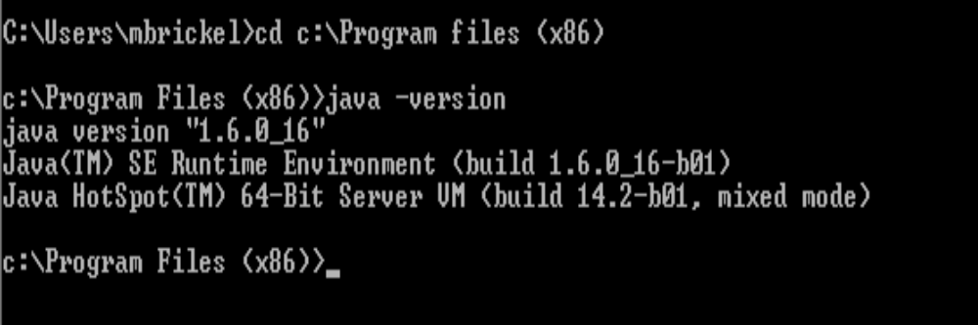
Java
Make sure you have the correct version of Java installed
Anything later than version 1.6_16 will not work
Anything later than version 1.6_16 will not work
Notes:
This is an older version. Once you install this, you will want to change the setting for Java to “Never Check” for updates. That way the site manager won’t automatically update it and break the bridge

Slide 20
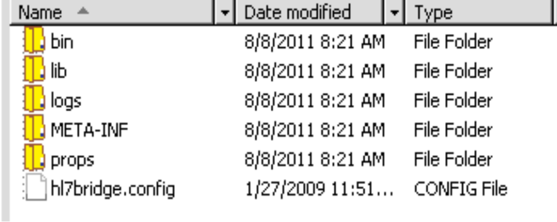
Bridge Installation - Folders
Create a folder called hl7bridge in a secured directory on your RPMS server.
Unzip the hl7bridge.zip file

Slide 21
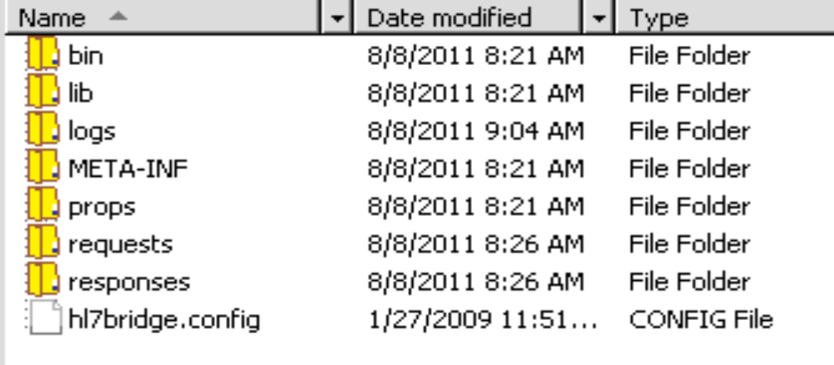
Bridge Installation - Folders
Create 2 new folders requests and responses

Slide 22
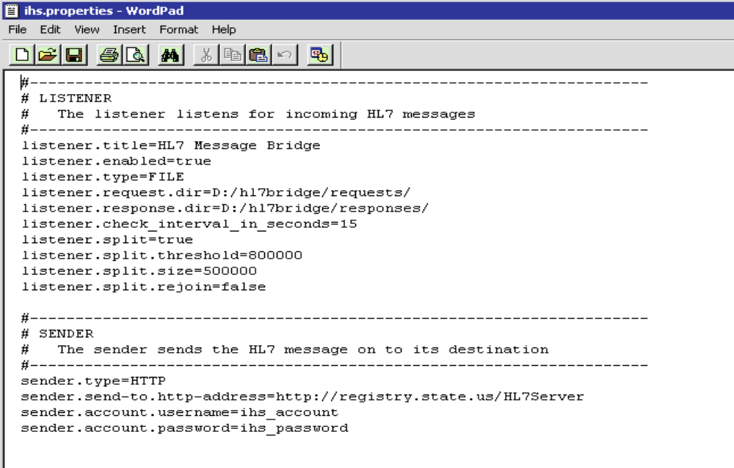
Bridge Installation - Properties
Edit the ihs.properties file found in the props folder
Edit path to Requests and Responses folder make sure to use forward slash (/ )
Change to true
Enter URL for State Registry
Enter username and password

Slide 23
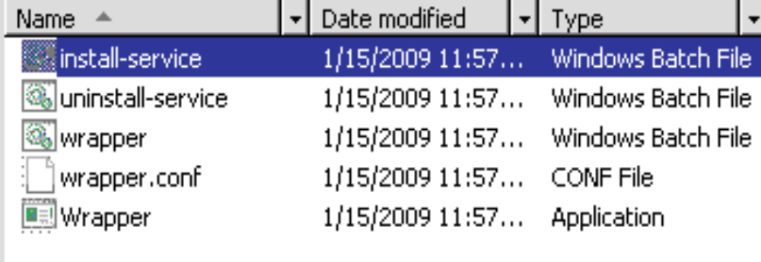
Bridge Installation – Install service
Open the bin folder and click and run the install-service
A DOS window will flash up on the screen

Slide 24
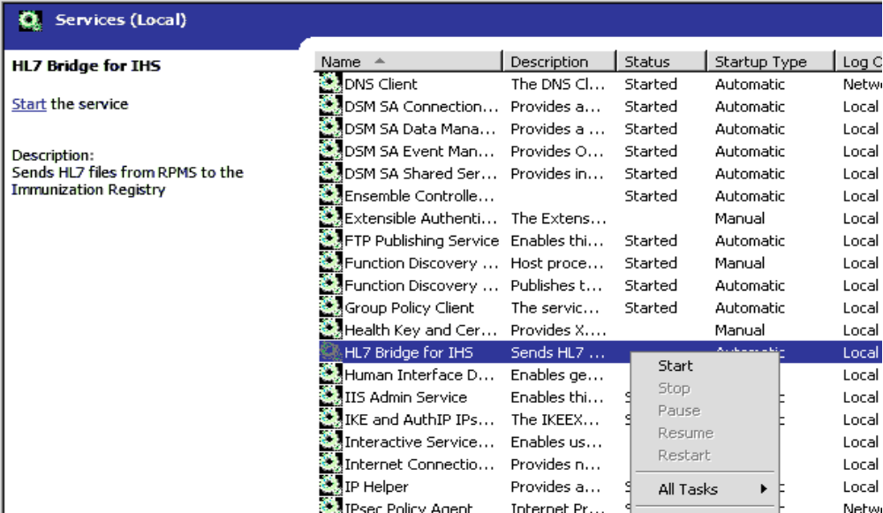
Bridge Installation – Starting the Service
Go to Start – Administrative Tools – Services and start the HL7 Bridge for IHS service

Slide 25

GIS
The GIS processes needs to be running so the izdata files get created
  Make sure the OUTPUT CONTROLLER (1) AND FORMAT CONTROLLER (2) are running
    GIS-BPM-IBP
    Select BACKGROUND PROCESS CONTROL NAME: 1
Do the same with #2.
If you get a message “Appears to NOT be Running
Start the processors by going back to the GIS menu and select option S1

Slide 26
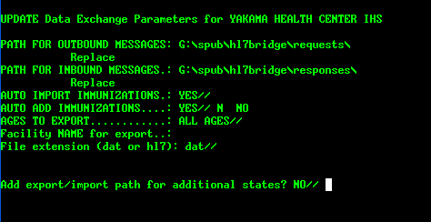
BYIM Parameters
Go to BYIM – SET
Make sure the paths match what you have in your properties file

Slide 27
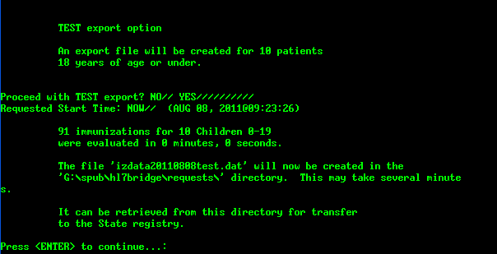
TEST
Create a TEST Export File
BYIM – TEST
Note the file name that was created

Slide 28
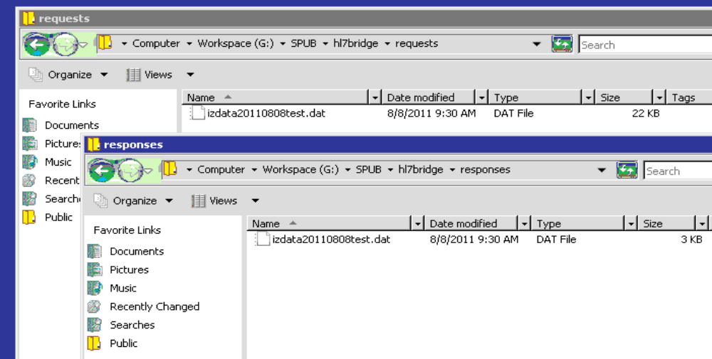
Test – Check Requests
Check the requests folder and make sure your test file has been created
Check the responses folder

Slide 29

Automating the process
In TaskMan, Schedule the Export and Import Tasks.
  BYIM AUTO EXPORT
  BYIM AUTO IMPORT

Slide 30
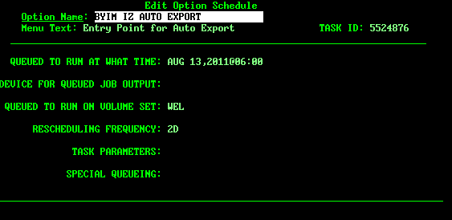
Automating the Process
Auto Export

Slide 31
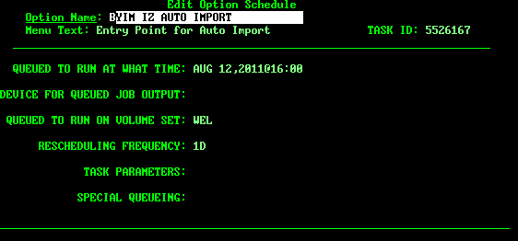
Automating the Process
Auto Import

Slide 32
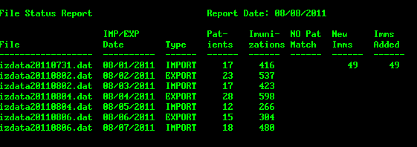
Troubleshooting Guide
Data Exchange not working!!
  What does that mean?
    First run the IZFS File Statistics report
The exports and imports at this site are set to run every other day, they should be running consistently

Slide 33
Troubleshooting Guide
Before you call….
  No files in requests folder
    Check GIS, are processes running?
    Check TaskMan, is it running?
  No files in responses folder
    Check HL7 Bridge service is it started?
      Can’t start service
    Check Java version
      May have to uninstall new version and install old version
  No new Immunizations to add
    Check izdata file in responses what is the error?
      Check error log file
    Run BYIM NO report, correct kids’ name in RPMS or Registry

Slide 34
Tier 1
Site Manager
  Restart GIS Processors
  Restart TaskMan
  Start the HL7 Bridge Service
  Check the izdata files for errors
    File permission
    Password change
    State Registry down
  Edit properties file to update passwords
Immunization Coordinator
  Troubleshoot with State Registry to determine if the issue is local (Immunization Data Entry)
    Lot and manufactures aren’t being entered
    Wrong vaccine being entered
    Wrong Facility being entered

Slide 35
Set up BYIM Export/Import Group in MailMan – Tier 1
The site manager or other authorized person needs to set up the BYIM
EXPORT/IMPORT GROUP in MailMan by adding the email addresses of
those individuals who should be notified whenever the following
occurs:
An HL7 immunization data export file is ready to be sent to the state registry.
Immunization data from the state registry is ready to be added to the RPMS database.
Members of this mail group should include to following:
  IT person tasked with monitoring/transmitting the immunization data files between the site and the state registry
  Clinical IZ staff member, who performs the activities related to the IZDE, IZIM, and IZAD IIMM options.

Slide 36
BYIM Set-up: Mailman Message
Start in the MailMan Master Menu and choose the following option: Manage Mailman
From Manage Mailman, choose: Group/Distribution Management
From Group/Distibution Management, choose: Mail Group Edit
EXAMPLE:
MailMan Master Menu -->
Manage Mailman -->
Group/Distribution Management -->
Mail Group Edit
Notes:
We need to explain WHY we put the Mailman message in

Slide 37
Set up Mailman Message (continued)
Select MAIL GROUP NAME: BYIM EXPORT/IMPORT GROUP
MAIL GROUP NAME: BYIM EXPORT/IMPORT GROUP Replace
Select MEMBER: PARKER,JOHN M// (add new members to the group here, (LASTNAME,FIRSTNAME))
MEMBER: PARKER,JOHN M//
TYPE: INFO//
Select MEMBER:
DESCRIPTION:
Mail group for individuals to be notified of an Immunization Data Exchange export and import action.

Slide 38
Set up Mailman Message (continued)
Edit? NO//
TYPE: public//
ALLOW SELF ENROLLMENT?:
ORGANIZER: LOVE,TOM//
COORDINATOR: PARKER,JOHN M//
Select AUTHORIZED SENDER:
Select MEMBER GROUP NAME:
Select REMOTE MEMBER:
Select DISTRIBUTION LIST:

Slide 39
Tier 2
Install patches and fixes
Kill processes if hung up
Re-install HL7 Bridge if needed
Troubleshoot issues that cannot be resolved by Site Manager
Determine if issue needs to be elevated to Tier 3

Slide 40
Tier 3
Resolve problems with the file segments
Resolve problems with the BYIM package
Resolve problems with GIS

Slide 41
RPMS BYIM Menu
Add BYIMMENU to AKMOCORE menu
Immunization Data Exchange
VERSION 2.0
IZDE Start Immunization Data Export
IZS Check Immunization Data Export Status
IZIM Import Immunizations from State Registry
IZAD Add Immunizations from State Registry
EXP Show Immunizations Exported for a Patient
IZFS File Statistics Report
NO Children for whom there is no match in RPMS
SET Immunization Data Exchange Parameters
TEST Create TEST Export File
Select Immunization Interchange Management Menu Option:

Slide 42

IZDE Start Immunization Data Export
The last Immunization export ran on: AUG 11,2011
This export will include:
All patients
who have had a visit since the last export.
You can enter another date for the export.
Export Immunizations given since AUG 11,2011: AUG 11,2011//

Slide 43
IZS Check Immunization Data Export Status
The Immunization data export file is ready for transmission

Slide 44
IZIM Import Immunizations from State Registry
The file from the State Registry must be in the drive/directory:
** G:\spub\HL7Bridge\responses **
Enter the name of the file from the State Registry:

Slide 45
IZAD Add Immunizations from State Registry
State Registry Immunizations Aug 11, 2011 07:43:39 Page: 0 of 27
(446) Immunizations from the State Registry
NUM DOB NAME IMMUNIZATION DATE RECEIVED
----- -------- --------------------------- ------------------ -------------
1 20110414 PATIENT,ONE HEP B PED (8) 04/14/2011
2 20110402 PATIENT,TWO HEP B PED (8) 04/02/2011
3 20110402 PATIENT,TWO HEP B PED (8) 06/23/2011
4 20110402 PATIENT,TWO ROTA-5 (116) 06/23/2011
5 20110402 PATIENT,TWO PENTACEL (120) 06/23/2011
6 20110402 PATIENT,TWO PCV-13 (133) 06/23/2011
7 20090824 PATIENT,THREE PEDIARIX (110) 01/13/2010
8 20090824 PATIENT,THREE PENTACEL (120) 12/02/2009
9 20090824 PATIENT,THREE PENTACEL (120) 02/24/2010
+ Enter ?? for more actions
ADD Add immunizations from State Reg.
DEL Remove Immunizations from State Reg. List
Select Action: Next Screen//

Slide 46
EXP Show Immunizations Exported for a Patient
Immunization Export summary for:
DEMO, PATIENT DOB: 11/25/2007 HRN: 99999
Export Date Immunization Admin Date
----------- -------------------- ----------
04/29/2011 VARICELLA 02/06/2009
04/29/2011 MMR 02/06/2009
04/29/2011 HIB (PRP-T) 02/06/2009
04/29/2011 Pneumococcal, PCV-7 02/06/2009
04/29/2011 INFLUENZA, SPLIT [TI 02/06/2009
04/29/2011 DTAP 09/21/2009
04/29/2011 INFLUENZA, SPLIT [TI 09/21/2009
04/29/2011 HEP A, PED/ADOL, 2 D 04/19/2011
04/29/2011 Pneumococcal, PCV-13 04/19/2011

Slide 47
IZFS File Statistics Report
1 File Name
2 By Date range
File Status Report Report Date: 08/11/2011
IMP/EXP Pat- Imuni- NO Pat New Imms
File Date Type ients zations Match Imms Added
------------------ ---------- ------ ------ ------ ------ ------
izdata20110731.dat 08/01/2011 IMPORT 17 416 49 49
izdata20110802.dat 08/02/2011 EXPORT 23 537
izdata20110802.dat 08/03/2011 IMPORT 17 423
izdata20110804.dat 08/04/2011 EXPORT 28 598
izdata20110804.dat 08/05/2011 IMPORT 12 266
izdata20110806.dat 08/06/2011 EXPORT 15 304
izdata20110806.dat 08/07/2011 IMPORT 18 480
izdata20110808.dat 08/08/2011 EXPORT 5 126
izdata20110808.dat 08/09/2011 IMPORT 23 555 32 32
izdata20110810.dat 08/10/2011 EXPORT 29 557
izdata20110810.dat 08/11/2011 IMPORT 16 344 15 15

Slide 48
NO Children for whom there is no match in RPMS
1 Patient Name
2 Date of Birth
3 Import File Date
# PATIENT NAME DOB IMP DATE SEX
--- ------------------------- -------- -------- ---
1 DEMO,ONE 20030725 20101216 F (DOB MISMATCH)
2 DEMO,TWO 19920922 20100513 F (NAME MISMATCH)
3 DEMO,THREE 19920922 20110322 F (NAME MISMATCH)
4 DEMO,FOUR 19990303 20100624 F (NAME MISMATCH)
5 DEMO,FIVE 20061110 20100527 M
6 DEMO,SIX 20100920 20110206 F (SEX MISMATCH)
Select Names to Remove from the No Match List: (1-6):

Slide 49
SET Immunization Data Exchange Parameters
UPDATE Data Exchange Parameters for DEMO SITE
PATH FOR OUTBOUND MESSAGES: G:\spub\HL7Bridge\requests
Replace
PATH FOR INBOUND MESSAGES.: G:\spub\HL7Bridge\responses
Replace
AUTO IMPORT IMMUNIZATIONS.: YES//
AUTO ADD IMMUNIZATIONS....: NO//
AGES TO EXPORT............: ALL AGES//
Facility NAME for export..: DEMO SITE
File extension (dat or hl7): dat//
Add export/import path for additional states? NO//

Slide 50
TEST Create TEST Export File
TEST export option
An export file will be created for patients
18 years of age or under.
Enter the number of patients
to include in the test export: (10-999): 10//

