Slide 1
Immunization Data Exchange (BYIM v 2.0*1)
Transporting the Message
to the IIS
Nathan Bunker & John Parker
Updated 08/05/2011

Slide 2
Faculty Disclosure Statement
As a provider accredited by ACCME, ANCC, and ACPE, the IHS Clinical Support Center must ensure balance, independence, objectivity, and scientific rigor in its educational activities. Course directors/coordinators, planning committee members, faculty, and all others who are in a position to control the content of this educational activity are required to disclose all relevant financial relationships with any commercial interest related to the subject matter of the educational activity. Safeguards against commercial bias have been put in place. Faculty will also disclose any off-label and/or investigational use of pharmaceuticals or instruments discussed in their presentation. Disclosure of this information will be included in course materials so those participating in the activity may formulate their own judgments regarding the presentations. The course directors/coordinators, planning committee members, and faculty for this activity have completed the disclosure process and have indicated that they do not have any significant financial relationships or affiliations with any manufacturers or commercial products to disclose. Mr. Bunker is a Software Developer and HL7 Consultant and has an financial relationships with Cimarron, Comforce, and Crystal Lightning. He has been contracted through IHS to provide EHR consultation and training. Mr. Bunker will not be promoting any of the other products or companies with which he has a financial relationship during this presentation

Slide 3
Big Picture
RPMS
Local
File Folder
HL7
Internet
BYIM
File
.
.
.
HL7
State
File
IIS

Slide 4
How To Connect
Same | Stephen Hawking | State IIS
Language | English | HL7
Vocabulary | Physics | Vaccinations
Location | Cambridge | State Defined
HL7 defines a message standards for communication health information
CDC IISB defines vocabulary and concepts that can be used to talk about vaccinations
The State IIS defines how data is to be sent

Slide 5
Is Transport Standardized?
HL7 does allows senders and receivers to negotiate how messages are sent
CDC does not mandate method for sending health data
State IIS are free to set their own requirements
Sending data to the State IIS is currently a big hurdle

Slide 6
Transport in the Future
This year CDC has convened a meeting of State IIS stakeholders and asked them to determine a single transport method they could all support
The recommendations from the group are not mandatory for State IIS but are expected to be widely adopted
IHS participated and gave feedback.
We are working to remove this hurdle.

Slide 7
Sending HL7 Files
Transporting Messages to the IIS

Slide 8
Ways to Send HL7 Files
Manual upload on IIS Web Site
  Always a manual process
  Can’t be automated
Secure FTP
  Normally a manual process
  Possible to automate
HTTPS Post
  Automated process

Slide 9
Manual Upload on IIS Website
Pros
  Supported by most State IIS
  Quick & easy transport
Cons
  Not automated
Contact State IIS for
  Login account
  Instructions

Slide 10
Secure FTP
Original non-secure standard
  File Transport Protocol
Secure standards
Pros
  Once setup very easy to transfer
Cons
  By default not automatic
  State IIS picks the standard & software

Slide 11
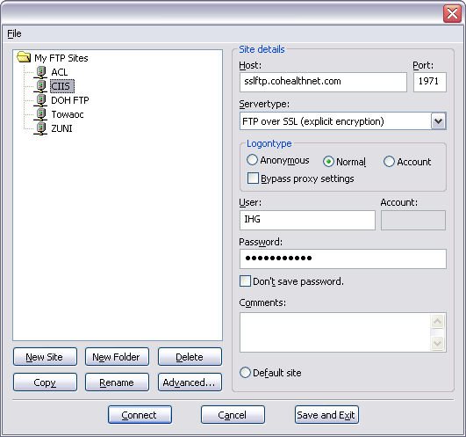
Typical Setup
Notes:
Thanks Marcella Begaye!

Slide 12
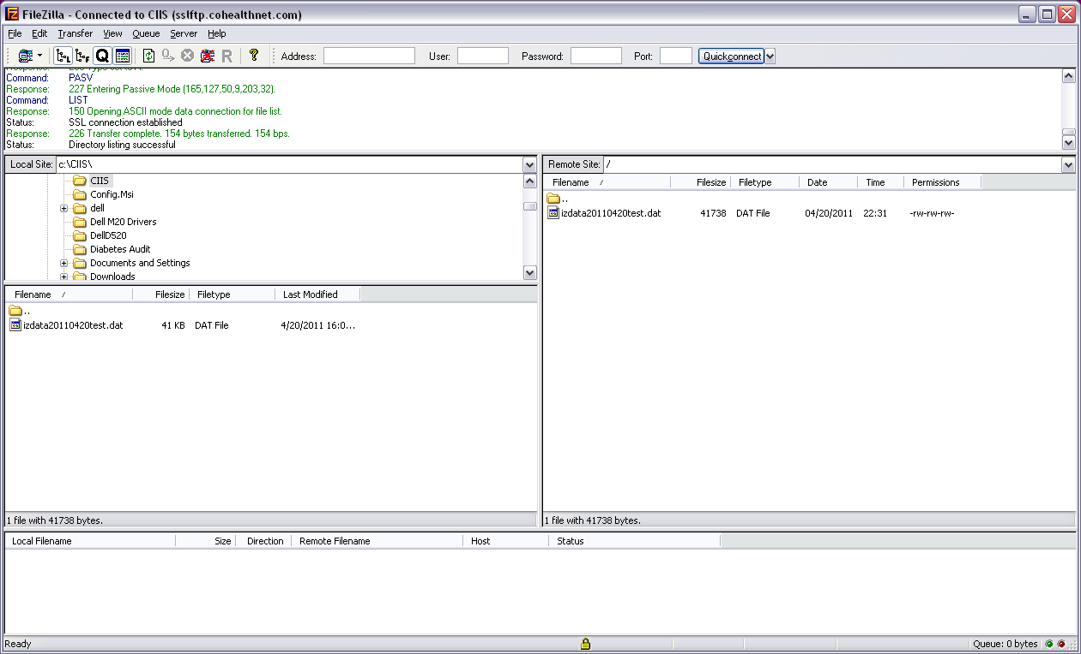
Transferring the File

Slide 13
HTTPS POST
Pros
  Secure standard
  Can be automated with HL7 Bridge
  Data can be transferred very quickly
  Supported by many State IIS
Cons
  Old standard, will not be adopted by all states

Slide 14
Other Ways of Sending HL7
SOAP / Web Services
  Many states are adopting
  Different implementations
  Selected by Transport Layer committee
  To be adopted nationwide
PHIN-MS
  Supported by some states
  Requires installation of CDC software
NHIN Direct

Slide 15
Getting Data Back
Transporting Messages to the IIS

Slide 16
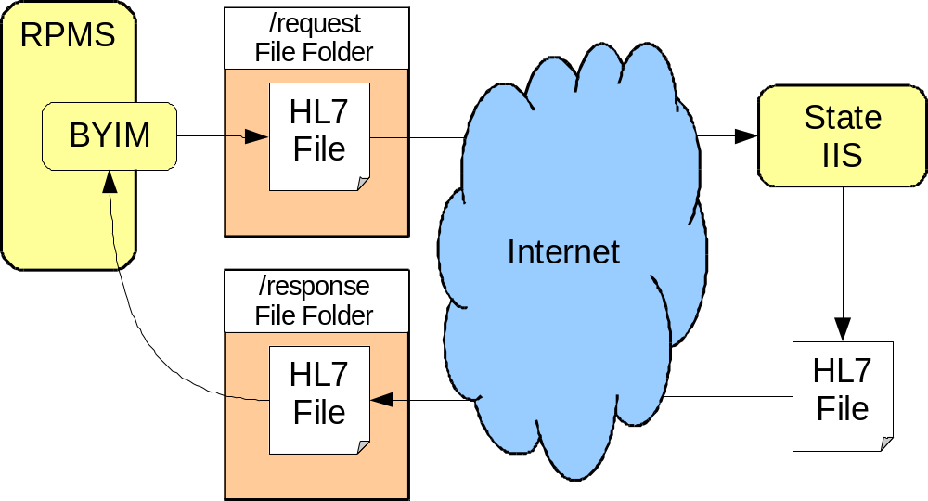
Big Picture

Slide 17
Sending Data Back
Not offered by all State IIS
Return file may created
  When requested by user
  When data is submitted by clinic
  On a regular schedule
Return file may be sent to IHS clinic
  When user downloads it
  In submission return file

Slide 18
Pros & Cons
Pros
  Data is received from IIS
  May be able to keep current patients synchronized with State IIS
  May be able to get notice of vaccination at other locations within days
Cons
  State IIS chooses criteria for what is sent
  Updates for new patients may take days

Slide 19
User Download
Login to State IIS website
Download update file to local IHS system
Load data using BYIM

Slide 20
Return File
Response is determined by State IIS
  No return, no acknowledgement no return file
  Only HL7 acknowledgements for errors
  Only HL7 acknowledgements
  Acknowledgements + return file
  Return file only
Return file might contain:
  Updates on registered patients
  Updates on patients just reported

Slide 21
Future Improvements
State IIS
  Adding support for return files
  Improving process for generating return files
New Query Interface
  May add State IIS query support to BYIM
  Pros
    Get vaccination history for on any patient
  Cons
    Only get updates for patients queried

Slide 22
Security
Transporting Messages to the IIS

Slide 23
Security
When Testing
  Sample test messages from BYIM are real data
  Consider cleaning HL7 test messages
    Remove patient identified information
    Continue to treat message as real data

Slide 24
Security
When Troubleshooting
  Send minimal identifying information
  Use secure email where available
  Use telephone to transmit key information
  Only share as much information as is necessary to resolve the issue
    State IIS normally only needs to see one record that demonstrates a particular issue
Security
  When Transmitting
    Always send data to HTTPS or SFTP address
    Never send data to an HTTP or plain FTP address
    Never send data in unencrypted email
      Data sits in mail servers and can be easily searched for and retrieved
    Ask for strong passwords from State IIS
    If possible, reset password received

