Slide 1
OIT Office Hours
PXRM v2.0 p1003
(Clinical Reminders)
Updates and New Reminders
IHS Office of Information Technology
EHR Program

Slide 2
Office Hour Presenters
CDR Susan Pierce-Richards, ARNP
OIT EHR Project Lead
Barbara Hess, DHA
OIT EHR Project Analyst

Slide 3
Agenda
Introduction
Presenters:
  Office Hour Presenters have different specialties within the EHR system who will be responding to your questions.
Questions/Answers:
  Please do not put your phone “On Hold” during the conference call.
  “Raise your hand” through the Adobe Connect features provided.
  Please state your name/site.
  Please state your question clearly.
  Please keep background noise to a minimum to better hear the questions and answers.

Slide 4
Contents of Patch
PXRM 2.0p1003

Slide 5
Fixes in Patch
Fixes duplicate storage of CPTs from reminder dialogs.
Fixes taxonomy look up of CPTs to include codes marked as primary procedure “yes,” “no,” and “null.”
If you have local taxonomies, edit one of the codes in the taxonomy so it indexes and looks up properly.

Slide 6
SNOMED look ups
Taxonomies are used in Reminder logic for:
  ICD-9 diagnosis codes
  ICD-9 and CPT procedure codes
New Computed Finding “IHS-SNOMED” introduced for using SNOMED terms in reminder logic.

Slide 7
IHS-SNOMED Computed Finding
Although PXRM v2.0p1004 will introduce VA code that supports SNOMED terms in the Reminder Taxonomies, IHS will not be populating taxonomies with SNOMED.
SNOMED Subsets are much easier to maintain in DTS.

Slide 8
IHS-SNOMED Computed Finding (cont.)
Computed finding “IHS-SNOMED”
  The field “Computed Finding Parameter” will contain the name of the Apelon Subset that will be used to determine if the problem is part of this cohort.
  IHS is developing and will maintain a series of these subsets for this use, all with the prefix PXRM.
  Strongly recommend you only use PXRM subsets for reminders.
  These will be updated in BSTSv2.0p2.

Slide 9
Current PXRM Subsets
PXRM ASTHMA
PXRM COLORECTAL CANCER
PXRM DIABETES
PXRM DIABETIC NEPHROPATHY
PXRM ESSENTIAL HYPERTENSION *** (BSTSv1.0 p2)
PXRM DIALYSIS
PXRM HEPATITIS C *** (BSTSv1.0 p2)
PXRM HIV
PXRM HYPERTENSION
PXRM ISCHEMIC HEART DISEASE
PXRM OSTEOPOROSIS-OSTEOPENIA

Slide 10
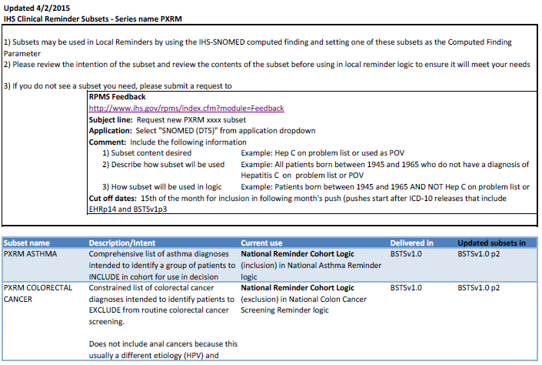
Clinical Reminder Subsets

Slide 11
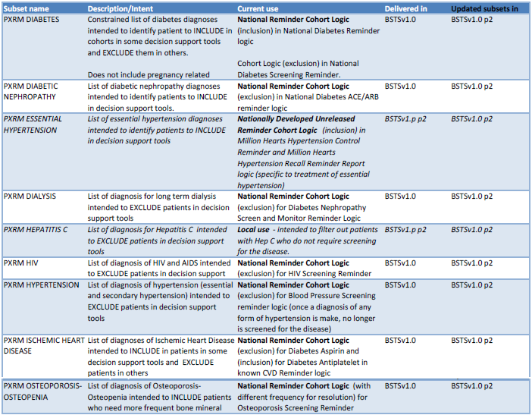
Clinical Reminder Subsets (cont.)

Slide 12
New Reminder Terms
Reminder Logic needs to look for both ICD and SNOMED terms.
Created new Reminder Terms to replace Taxonomies in National Reminders.
New Reminder Terms contain:
  Reminder Taxonomy
  IHS-SNOMED computed finding (if taxonomy contains ICD diagnosis codes)
Notes:
Encounters may have additional ICD codes entered in PCC data entry.
If you experience RPMS down time, you may have some transcribed PCC entered problems and/or POVs

Slide 13
New Reminder Term
Previous Diabetes Cohort:
Reminder Taxonomy: IHS-DIABETES DX 2007
New Diabetes Cohort:
Reminder Term: IHS-DIABETES DX 2014
  Contains findings:
  Reminder Taxonomy: IHS-DIABETES DX 2007
  Computed finding: IHS-SNOMED
  CF Parameter: PXRM DIABETES

Slide 14
Reminder Term Example
Reminder Term: IHS-DIABETES DX 2014
Findings:
  Finding Item: IHS-DIABETES DX 2007 (FI(1)=TX(71))
  Finding Type: REMINDER TAXONOMY
  Beginning Date/Time: T-3Y
  Finding Item: IHS-SNOMED (FI(2)=CF(681))
  Finding Type: REMINDER COMPUTED FINDING
  Beginning Date/Time: T-3Y
  Computed Finding Parameter: PXRM DIABETES <<< SNOMED Subset in DTS – Only PXRM series is vetted for use in decision support at this time

Slide 15
Logic Example
Baseline Frequency:
Do In Advance Time Frame: Wait until actually DUE
Sex Specific:
Ignore on N/A:
Frequency for Age Range: 1 year for all ages
Match Text:
No Match Text:
Findings:
---- Begin: IHS-ASTHMA 2014 (FI(1)=RT(29) ------------------------
Finding Type: REMINDER TERM
Use in Patient Cohort Logic: AND
Beginning Date/Time: T-2Y
Include Visit Data: YES
Mapped Findings:
Mapped Finding Item: TX.IHS-ASTHMA 2013
Beginning Date/Time: T-2Y
Mapped Finding Item: CF.IHS-SNOMED
Beginning Date/Time: T-2Y
Computed Finding Parameter: PXRM ASTHMA
---- End: IHS-ASTHMA 2014 ------------------------------------------
---- Begin: IHS-ASTHMA PLAN 2012 (FI(2)=CF(160)) ------------------
Finding Type: REMINDER COMPUTED FINDING
Use in Resolution Logic: OR

Slide 16
Clinical Maintenance Example
Cohort:
Reminder Term: IHS-ASTHMA 2014
Computed Finding: Snomed findings
08/28/2014 value – Asthma causes daytime symptoms 1 to
2 times per month; Asthma causes daytime symptoms 1 to
2 times per month

Slide 17
Updated reminders

Slide 18
Reminder Taxonomies replaced by Reminder Terms
Those that have diagnoses in the taxonomy, also contain the IHS-SNOMED Computed Finding and the Reminder Taxonomy.
IHS-ASTHMA ACTION PLAN 2014
IHS-ASTHMA CONTROL 2014
IHS-ASTHMA PRIM PROV 2014
IHS-ASTHMA RISK EXACERBATION 2014
IHS-ASTHMA SEVERITY 2014
IHS-ASTHMA STEROID 2014
IHS-BLOOD PRESSURE 2014
IHS-COLON CANCER 2014
IHS-DIAB ACE/ARB 2014
IHS-DIAB ANTPLT KNOWN CVD 2014
IHS-DIAB ASPIRIN FEMALE 2014
IHS-DIAB ASPIRIN MALE 2014
IHS-DIAB BP CONTROL 2014
IHS-DIAB EYE EXAM 2014
IHS-DIAB FOOT EXAM 2014
IHS-DIAB HGBA1C 2014
IHS-DIAB HGBA1 C CONTROL 2014
IHS-DIAB NEPHRO SCR/MON 2014
IHS-DIABETES SCREENING 2014
IHS-HIV SCREEN 2014
IHS-LIPID FEMALE 2014
IHS-LIPID MALE 2014
IHS-MAMMOGRAM 40-49 2014
IHS-MAMMOGRAM 50-74 2014
IHS-MAMMOGRAM 75-100 2014
IHS-OSTEOPOROSIS SCREEN 2014
IHS-PAP SMEAR 21-29Y 2014
IHS-PAP SMEAR 30-64Y 2014

Slide 19
Immunization Reminders with Updates to the National Reminder Terms
IHS-HEP A ADULT IMMUN 2014
IHS-HEP B ADULT IMMUN 2014
IHS-HPV IMMUN 2014
IHS-PED HEPA IMMUN 2014
IHS-PED HEPB IMMUN 2014
IHS-PED POLIO IMMUN 2014

Slide 20
Deployment

Slide 21
Reminders Deployment
If using Hepatitis, Polio, or HPV immunization reminders, install these new reminders right after loading the patch.
If using Asthma, Diabetes, HIV, Osteoporosis, Blood Pressure, Lipid, Mammogram, or Pap reminders install and swap those out as soon as possible:
  This assures you are picking up problems that do not automatically map to ICD-9, and have not been coded for POVs.

Slide 22
Subset Requests – for Local Reminders
SNOMED CT®

Slide 23
Local Reminders
If building a reminder that requires inclusion, exclusion, or resolution with a POV or Problem, create a Reminder Term.
The Reminder term must include:
  Reminder Taxonomy with ICD codes
  Computed Finding “IHS-SNOMED” with the computed finding parameter set to the PXRM Subset name

Slide 24
Local Reminders (cont.)
A CAC can create a Reminder Taxonomy.
A CAC cannot create a SNOMED subset in the Distributed Terminology Server (DTS) but can request one be created if there is not one already listed in PXRM subsets.

Slide 25
Use RPMS Feedback to Request a PXRM Subset
Go to: http://www.ihs.gov/rpms/index.cfm?module=Feedback
At the Subject line, type Request new PXRM xxxx subset.
At the Application field, select SNOMED (DTS).
At the Comment field, include the following information:
  Subset content desired (e.g., Hep C on problem list or used as POV)
  Description of how it will be used (e.g., all patients born between 1945 and 1965 who do not have a diagnosis of Hepatitis C should be screened for Hep C)
  How the subset will be used in logic (e.g., patients born between 1945 and 1965 AND NOT Hep C on problem list or POV
Cutoff is 15th of the month for delivery the first of the next month
(i.e., Submit request on June 14th, new subset will be in the July 1st updates to DTS content).

Slide 26
Build a Local Reminder Term (1)
Once the new Subset is available, use it in reminder logic.
Example: Hep C:
  Add a Reminder Taxonomy “WSP-HEP C” with the ICD-9 codes for Hepatitis C infection.
  Add a new Reminder Term “WSP-HEP C.”

Slide 27
Build a Local Reminder Term (2)
Reminder Term Management:
  TL List Reminder Terms
  TI Inquire about Reminder Term
  TE Add/Edit Reminder Term
  TC Copy Reminder Term

Slide 28
Build a Local Reminder Term (3)
Select Reminder Term: WSP-HEP C
Are you adding 'WSP-HEP C' as a new REMINDER TERM (the 84TH)? No// y (Yes)
REMINDER TERM CLASS: L LOCAL
NAME: WSP-HEP C//
CLASS: LOCAL//
SPONSOR:
REVIEW DATE:
DESCRIPTION:
No existing text
Edit? NO//
Reminder Term has no findings
Select Finding: TX.WSP-HEP C
Searching for a REMINDER TAXONOMY, (pointed-to by FINDING ITEM)

Slide 29
Build a Local Reminder Term (4)
Searching for a REMINDER TAXONOMY WSP-HEP C LOCAL ...OK? Yes// y (Yes)
Are you adding 'WSP-HEP C' as a new FINDINGS (the 1ST for this REMINDER TERM)?
No// y (Yes)
Editing Finding Number: 1
FINDING ITEM: WSP-HEP C//
BEGINNING DATE/TIME:
ENDING DATE/TIME:
OCCURRENCE COUNT:
USE INACTIVE PROBLEMS:
INCLUDE VISIT DATA:
CONDITION:
CONDITION CASE SENSITIVE:
USE STATUS/COND IN SEARCH:

Slide 30
Build a Local Reminder Term (5)
Choose from:
TX WSP-HEP C
Finding #: 1
Select Finding: CF.IHS-SNOMED
Searching for a REMINDER COMPUTED FINDING, (pointed-to by FINDING ITEM)
Searching for a REMINDER COMPUTED FINDING
IHS-SNOMED VISN
...OK? Yes// y (Yes)
Are you adding 'IHS-SNOMED' as a new FINDINGS (the 2ND for this REMINDER TERM)
? No// y (Yes)
Computed Finding Description:
Returns a yes or no if a problem is in a SNOMED subset
The subset name is entered in the COMPUTED FINDING
PARAMETER file

Slide 31
Build a Local Reminder Term (6)
Editing Finding Number: 2
FINDING ITEM: IHS-SNOMED//
BEGINNING DATE/TIME:
ENDING DATE/TIME:
OCCURRENCE COUNT:
COMPUTED FINDING PARAMETER: PXRM HEPATITIS C <<< name of new PXRM subset.
CONDITION:
CONDITION CASE SENSITIVE:
USE STATUS/COND IN SEARCH:
Choose from:
CF IHS-SNOMED
Finding #: 2
TX WSP-HEP C
Finding #: 1

Slide 32
Use a Local Reminder Term
Use the Reminder Term in Reminder Definition logic in the same way as the Reminder Taxonomy.
Cohort:
  AND – to include in cohort
  AND NOT – to exclude from cohort
Resolution:
  OR – one of one or more findings that will resolve a reminder if any are true
  AND – one of one or more findings that will resolve a reminder if all findings are true

Slide 33
Computed Findings

Slide 34
New Computed Findings
Reminder look ups now use Clinical Indices:
  Most files were indexed.
  Two files were not due to size of the files and usefulness – V Lab and V Med.
  Vast majority of V Lab and V Med are redundant (exist in Lab and Prescription files):
    V Lab
    V Med
  Computed findings can be used to extend logic where needed (will be infrequent need).

Slide 35
Additional Computed Findings
IHS-VLAB:
  Looks in V Lab file for labs listed in the Reminder Term listed in the Computed Finding Parameter.
  If you have unidirectional lab interface (so no lab results in Lab file, only in V Lab).
  Enter significant number of historical lab results in V lab.

Slide 36
Additional Computed Findings (cont.)
IHS-VMED:
  Looks in V Med file for medications listed in the Reminder Term listed in the Computed Finding Parameter.
  IF you enter historical meds in PCC (not through Outside Meds component).

Slide 37
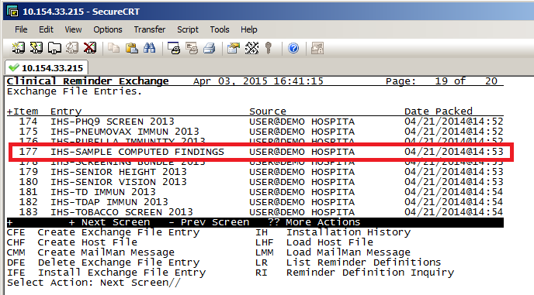
IHS-Sample Computed Findings
Install selected computed findings from the IHS-SAMPLE COMPUTED FINDINGS reminder.
You need @ access to install computed findings.

Slide 38
IHS-Sample Computed Findings (cont.)
Exchange File components Apr 03, 2015 16:43:36 Page: 1 of 2
Component Category Exists
Reminder: IHS-SAMPLE COMPUTED FINDINGS
Source: USER,DEMO at DEMO HOSPITAL
Date Packed: 04-21-2014@14:53:08
Package Version: 2.0
Description:
Keywords:
NO keywords given
Components:
ROUTINE
1 BPXRMDRG X
2 BPXRMLAB X
3 BPXRMSNO X
REMINDER COMPUTED FINDINGS
4 IHS-SNOMED X
5 IHS-VMED
6 IHS-VLAB
REMINDER DEFINITION
7 IHS-SAMPLE COMPUTED FINDINGS

Slide 39
Install Selected Computed Findings
Select Action: Quit// IS Install Selected Component
Select Component(s): (1-7): IFE// 6
REMINDER COMPUTED FINDINGS entry IHS-VLAB is NEW,
what do you want to do?
Select one of the following:
C Create a new entry by copying to a new name
I Install
Q Quit the install
S Skip, do not install this entry
Enter response: I// <enter>

Slide 40
Use a Finding - Example
You are a site with unilateral lab interface OR you enter a significant number of historical labs in on your diabetic patients:
  Copy the National Reminder and rename.
  ADD the computed finding IHS-VLAB.

Slide 41
Use a Finding (1)
The original reminder IHS-DIAB HGBA1C 2014 has been copied into TEST-DIAB HGBA1C 2014.
Do you want to edit it now? y YES
Select one of the following:
A All reminder details
G General
B Baseline Frequency
F Findings
FF Function Findings
L Logic
C Custom date due
D Reminder Dialog
W Web Addresses
Select section to edit: F Findings

Slide 42
Use a Finding (2)
Choose from:
RT IHS-DIABETES DX 2014 Finding #: 1
RT IHS-HGBA1C Finding #: 2
<<< use the name of this reminder term as the computed finding parameter
Select FINDING: CF.IHS-VLAB
Searching for a REMINDER COMPUTED FINDING, (pointed-to by FINDING ITEM)
Searching for a REMINDER COMPUTED FINDING IHS-VLAB VISN
...OK? Yes// y (Yes)
Are you adding 'IHS-VLAB' as a new FINDINGS (the 3RD for this REMINDER DEFINITION)? No// Y (Yes)
Computed Finding Description:
This computed finding uses the reminder term entered in
the COMPUTED FINDING FILE to search for lab results in
the V LAB file.
Editing Finding Number: 3
FINDING ITEM: IHS-VLAB//

Slide 43
Use a Finding (3)
REMINDER FREQUENCY:
MINIMUM AGE:
MAXIMUM AGE:
RANK FREQUENCY:
USE IN RESOLUTION LOGIC: OR
1 OR
2 OR NOT
Choose 1-2: 1 OR
USE IN PATIENT COHORT LOGIC:
BEGINNING DATE/TIME:
ENDING DATE/TIME:
OCCURRENCE COUNT:
CONDITION:
CONDITION CASE SENSITIVE:
USE STATUS/COND IN SEARCH:
COMPUTED FINDING PARAMETER: IHS-HGBA1C <<< reminder term that lists the labs to find

Slide 44
Use a Finding (4)
FOUND TEXT:
No existing text
Edit? NO//
NOT FOUND TEXT:
No existing text
Edit? NO//
Reminder Definition Findings
Choose from:
CF IHS-VLAB Finding #: 3
RT IHS-DIABETES DX 2014 Finding #: 1
RT IHS-HGBA1C Finding #: 2
Select FINDING:

Slide 45
Use a Finding (5)
---- Begin: IHS-VLAB (FI(3)=CF(90)) -------------------------
Finding Type: REMINDER COMPUTED FINDING
Use in Resolution Logic: OR
Computed Finding Parameter: IHS-HGBA1C
---- End: IHS-VLAB ------------------------------------------

Slide 46
Resources
Clinical Applications Documentation Repository:
  http://www.ihs.gov/RPMS/index.cfm?module=Applications&option=View&AC_ID=0
EHR Updates Page:
  http://www.ihs.gov/ehr/index.cfm?module=dsp_ehr_patches_enhancements

Slide 47
Questions?

