Slide 1
2015
Indian Health Surveillance Report
SEXUALLY TRANSMITTED DISEASES
U.S. Department of Health and Human Services (HHS) Indian Health Service (IHS) Centers for Disease Control and Prevention (CDC)

Slide 2
Chlamydia
NATIONAL STD PROFILE

Slide 3
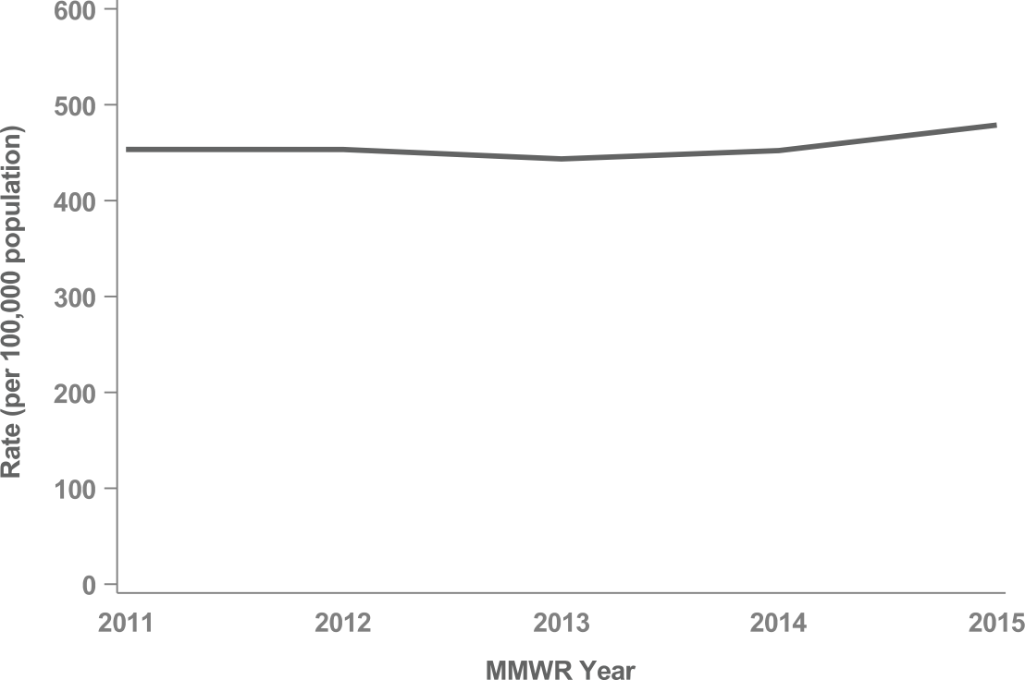
Figure 1. Chlamydia Rates, U.S.

Slide 4
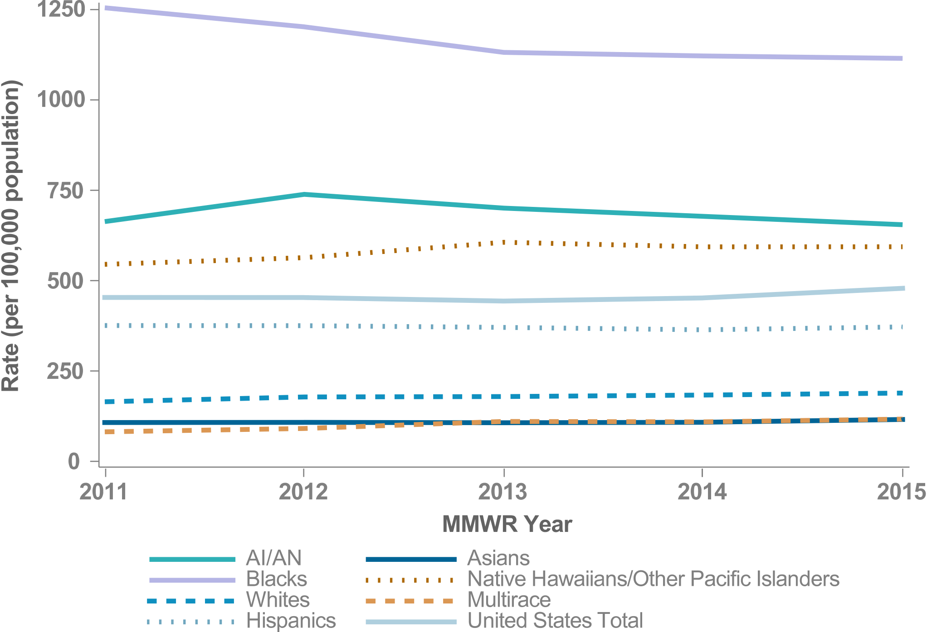
Figure 2. Chlamydia Rates by Race & Ethnicity, U.S.

Slide 5
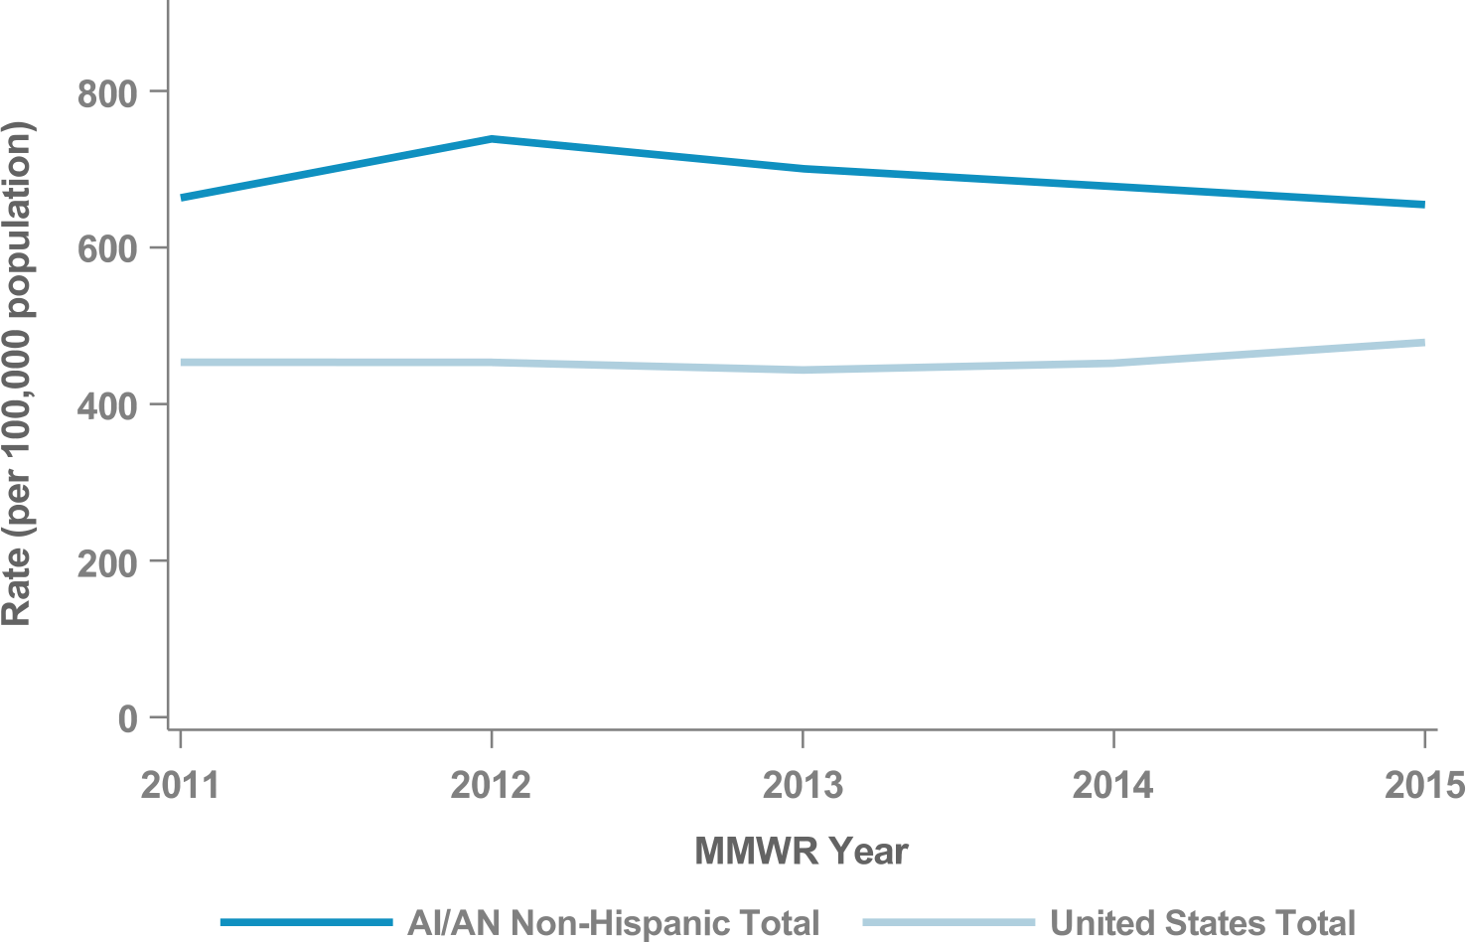
Figure 3. Chlamydia Rates, AI/AN Non-Hispanic, U.S.

Slide 6
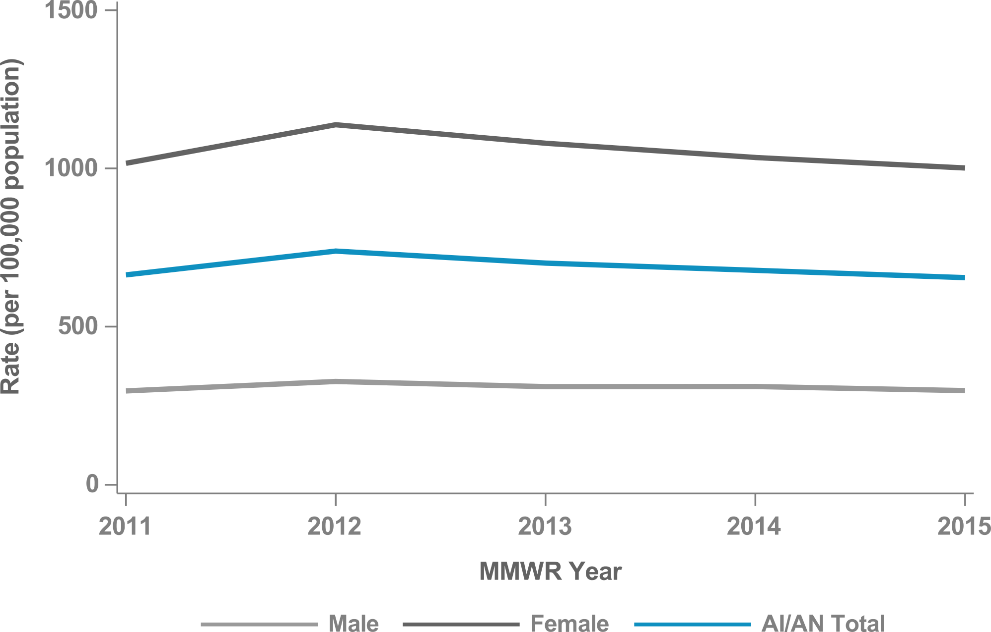
Figure 4. Chlamydia Rates by Sex, AI/AN Non-Hispanic, U.S.

Slide 7
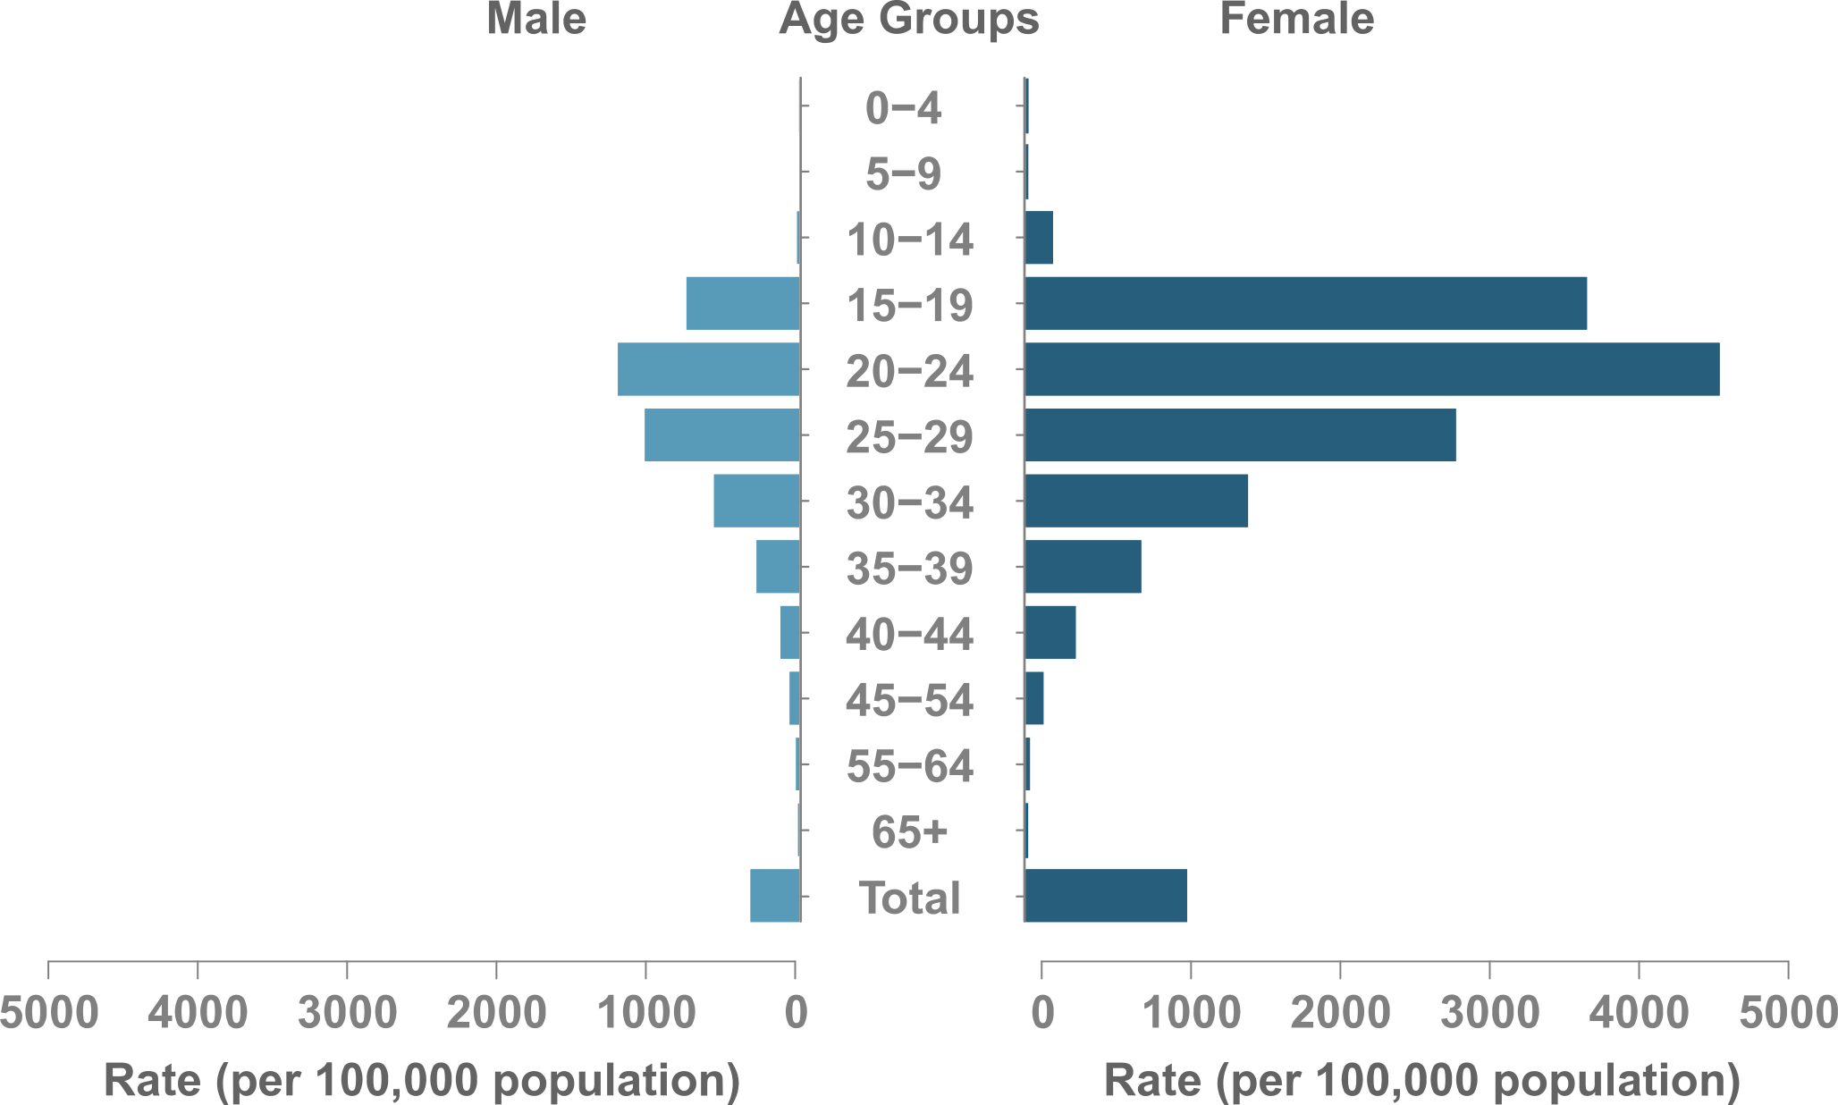
Figure 5. Chlamydia Rates by Sex & Age, AI/AN Non-Hispanic, U.S.

Slide 8
GONORRHEA
NATIONAL STD PROFILE

Slide 9
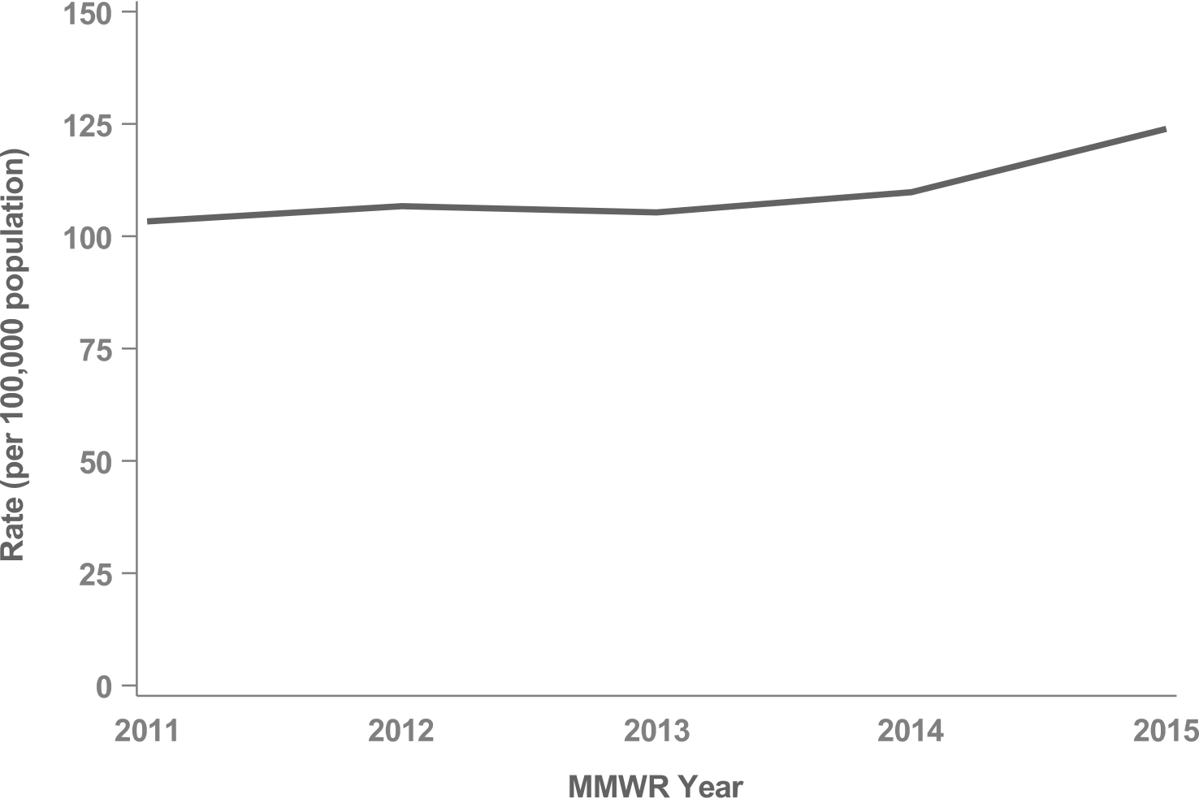
Figure 6. Gonorrhea Rates, U.S.

Slide 10
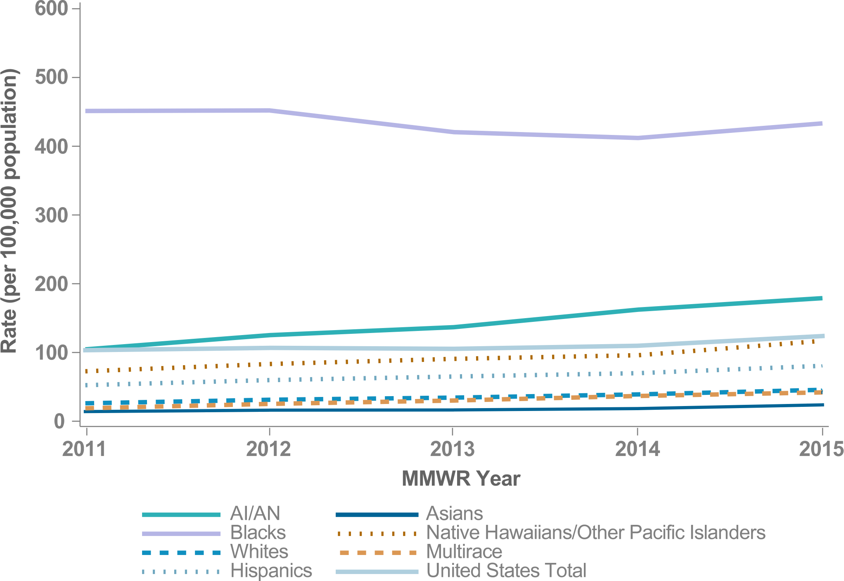
Figure 7. Gonorrhea Rates by Race & Ethnicity, U.S.

Slide 11
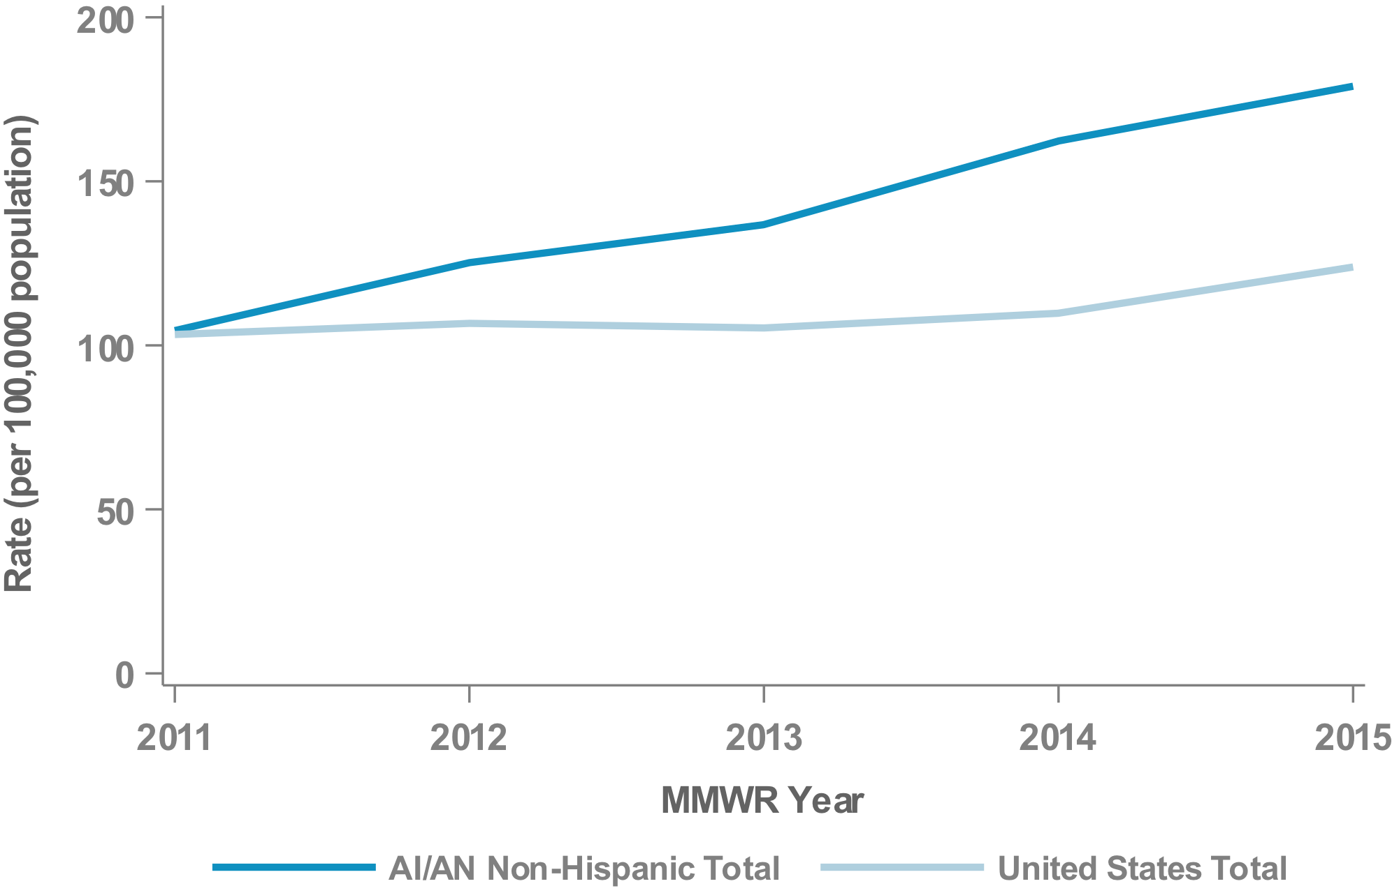
Figure 8. Gonorrhea Rates, AI/AN Non-Hispanic, U.S.

Slide 12
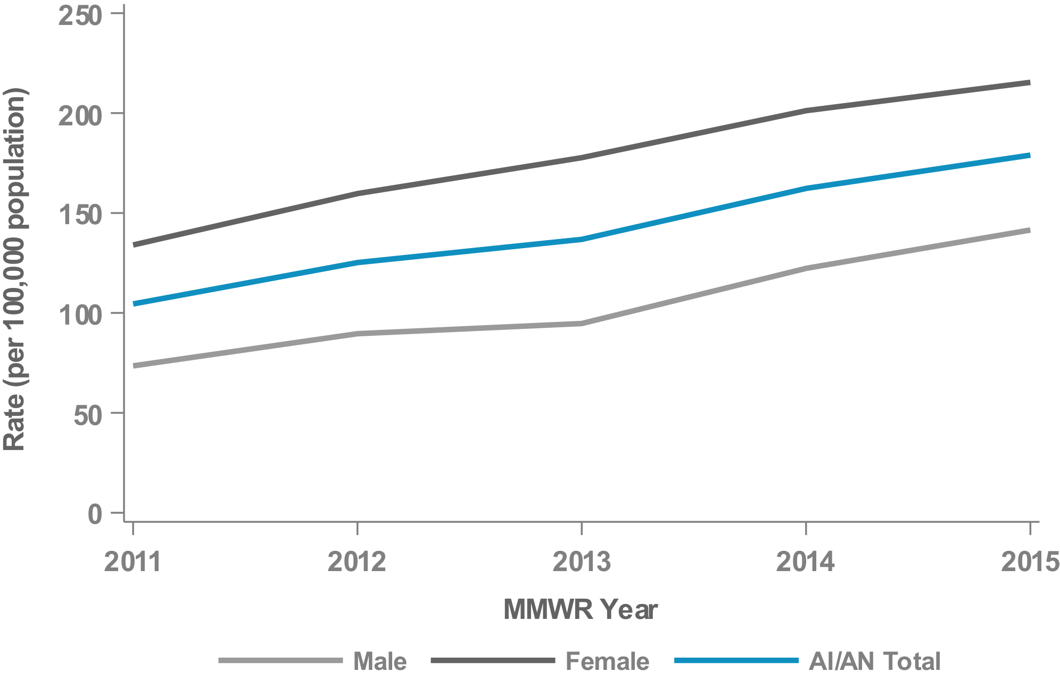
Figure 9. Gonorrhea Rates by Sex, AI/AN Non-Hispanic, U.S.

Slide 13
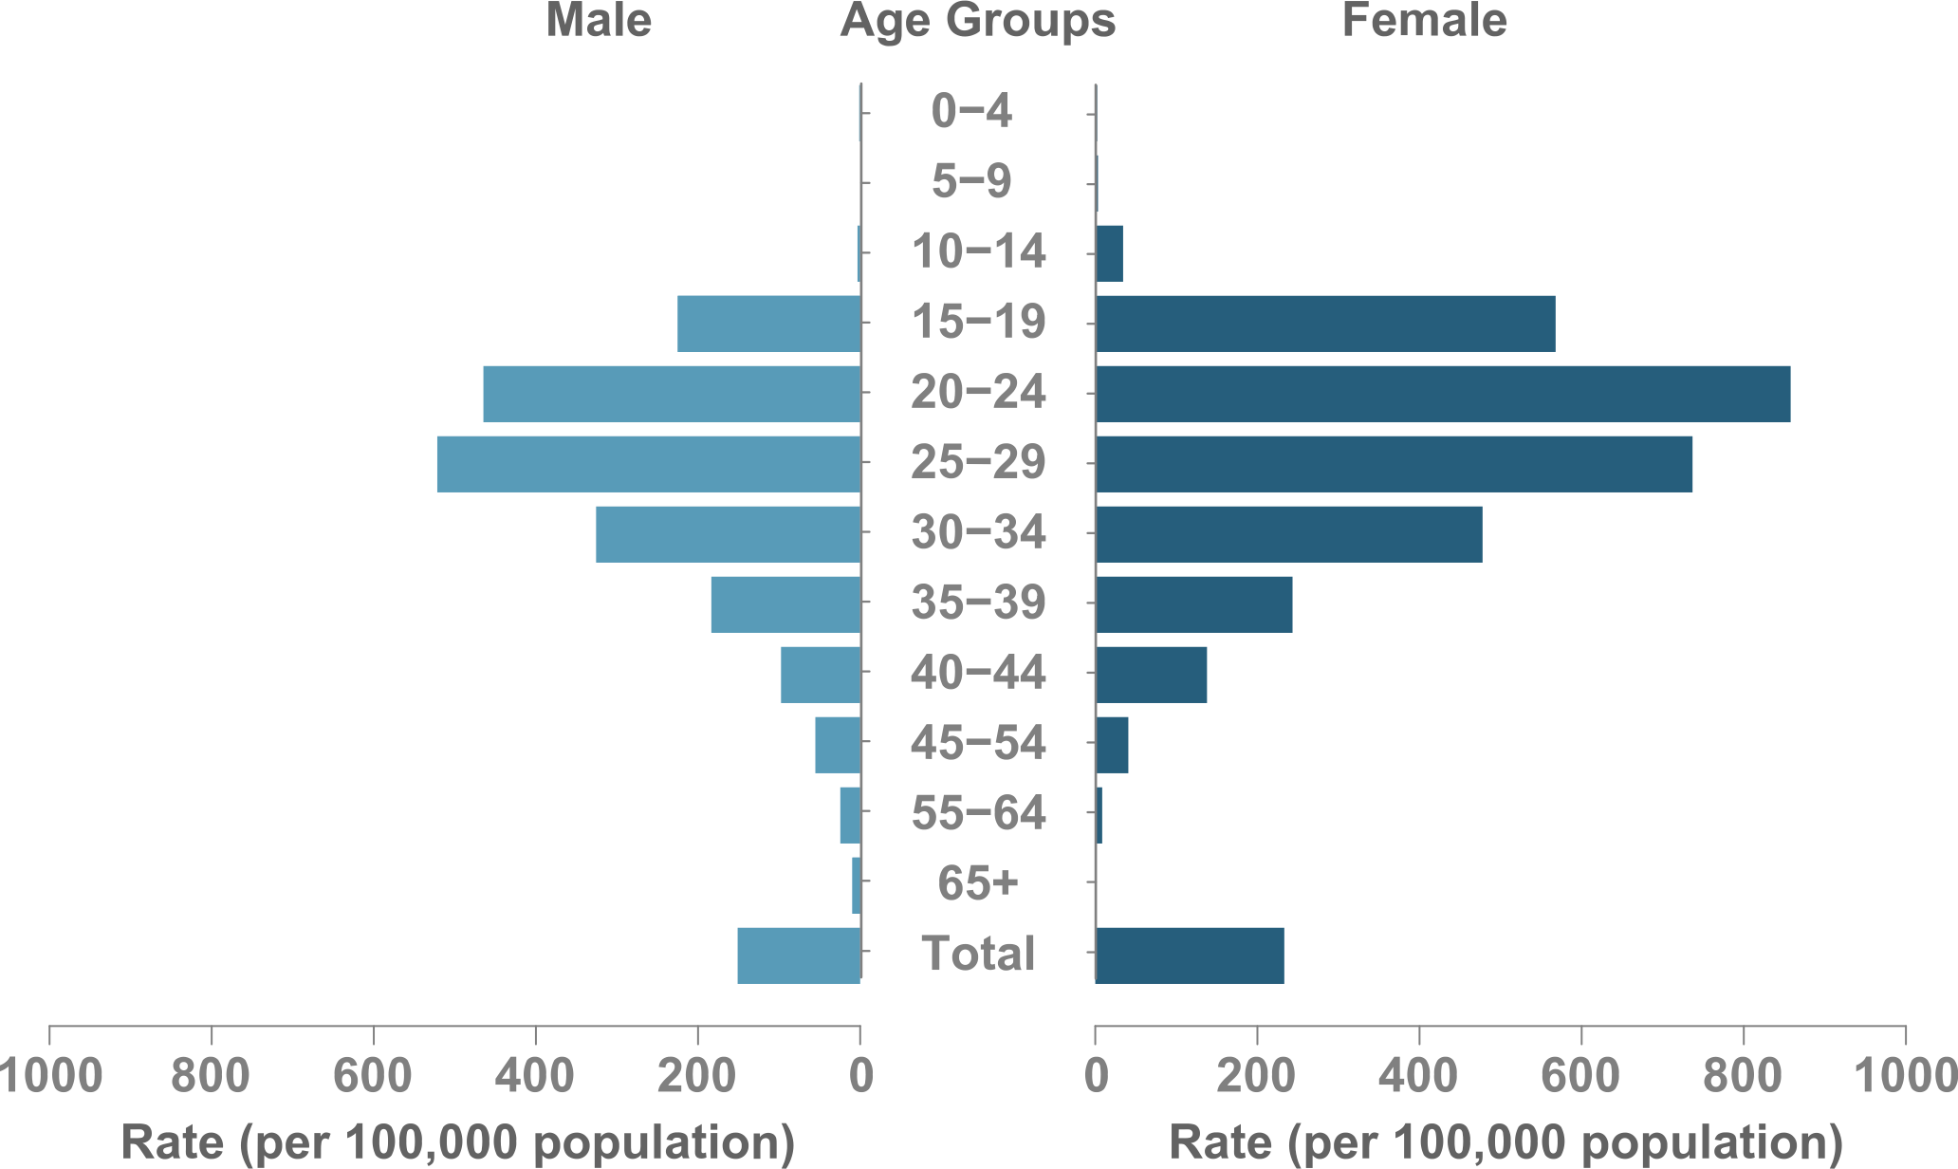
Figure 10. Gonorrhea Rates by Sex & Age, AI/AN Non-Hispanic, U.S.

Slide 14
PRIMARY & SECONDARY (P&S) SYPHILIS
NATIONAL STD PROFILE

Slide 15
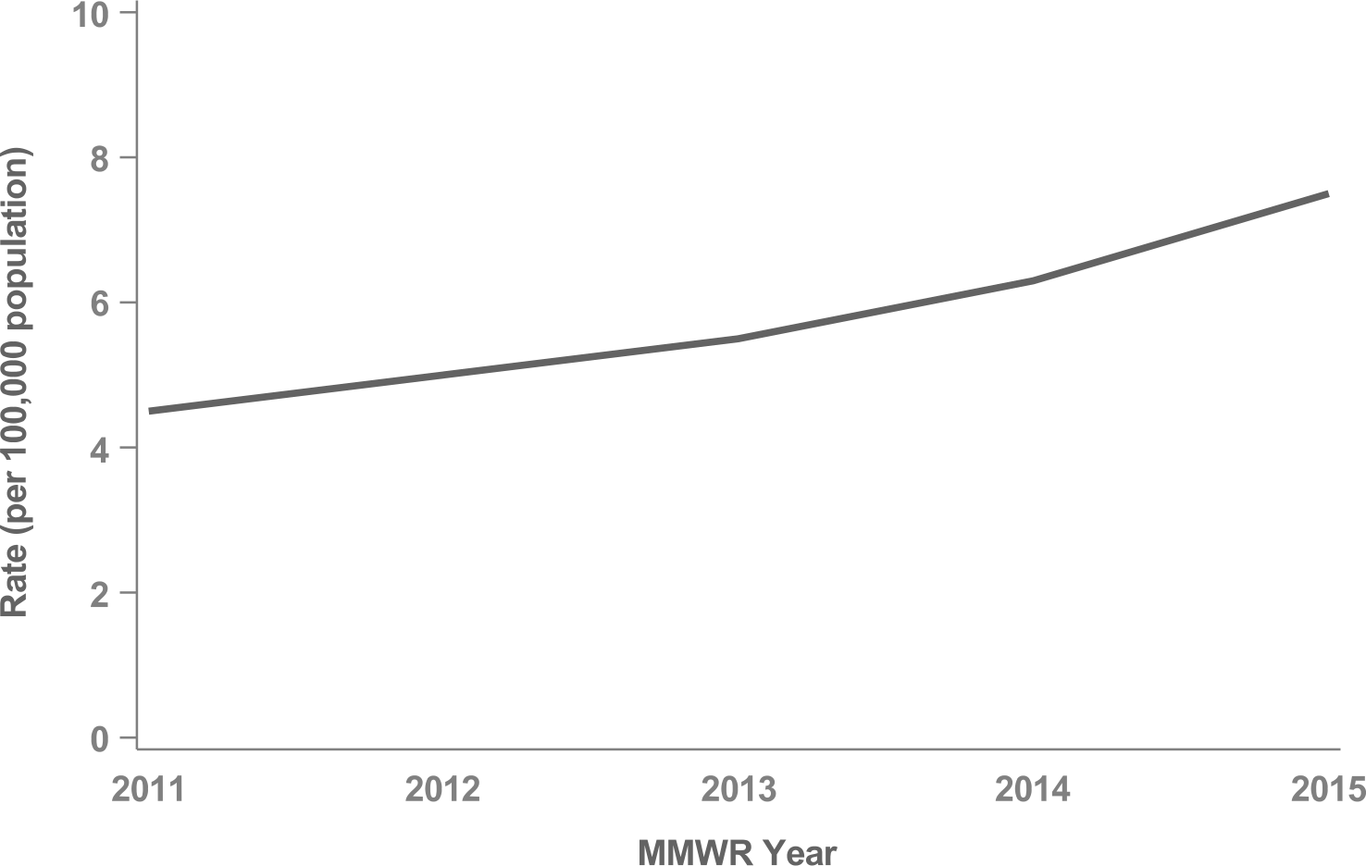
Figure 11. P&S Syphilis Rates, U.S.

Slide 16
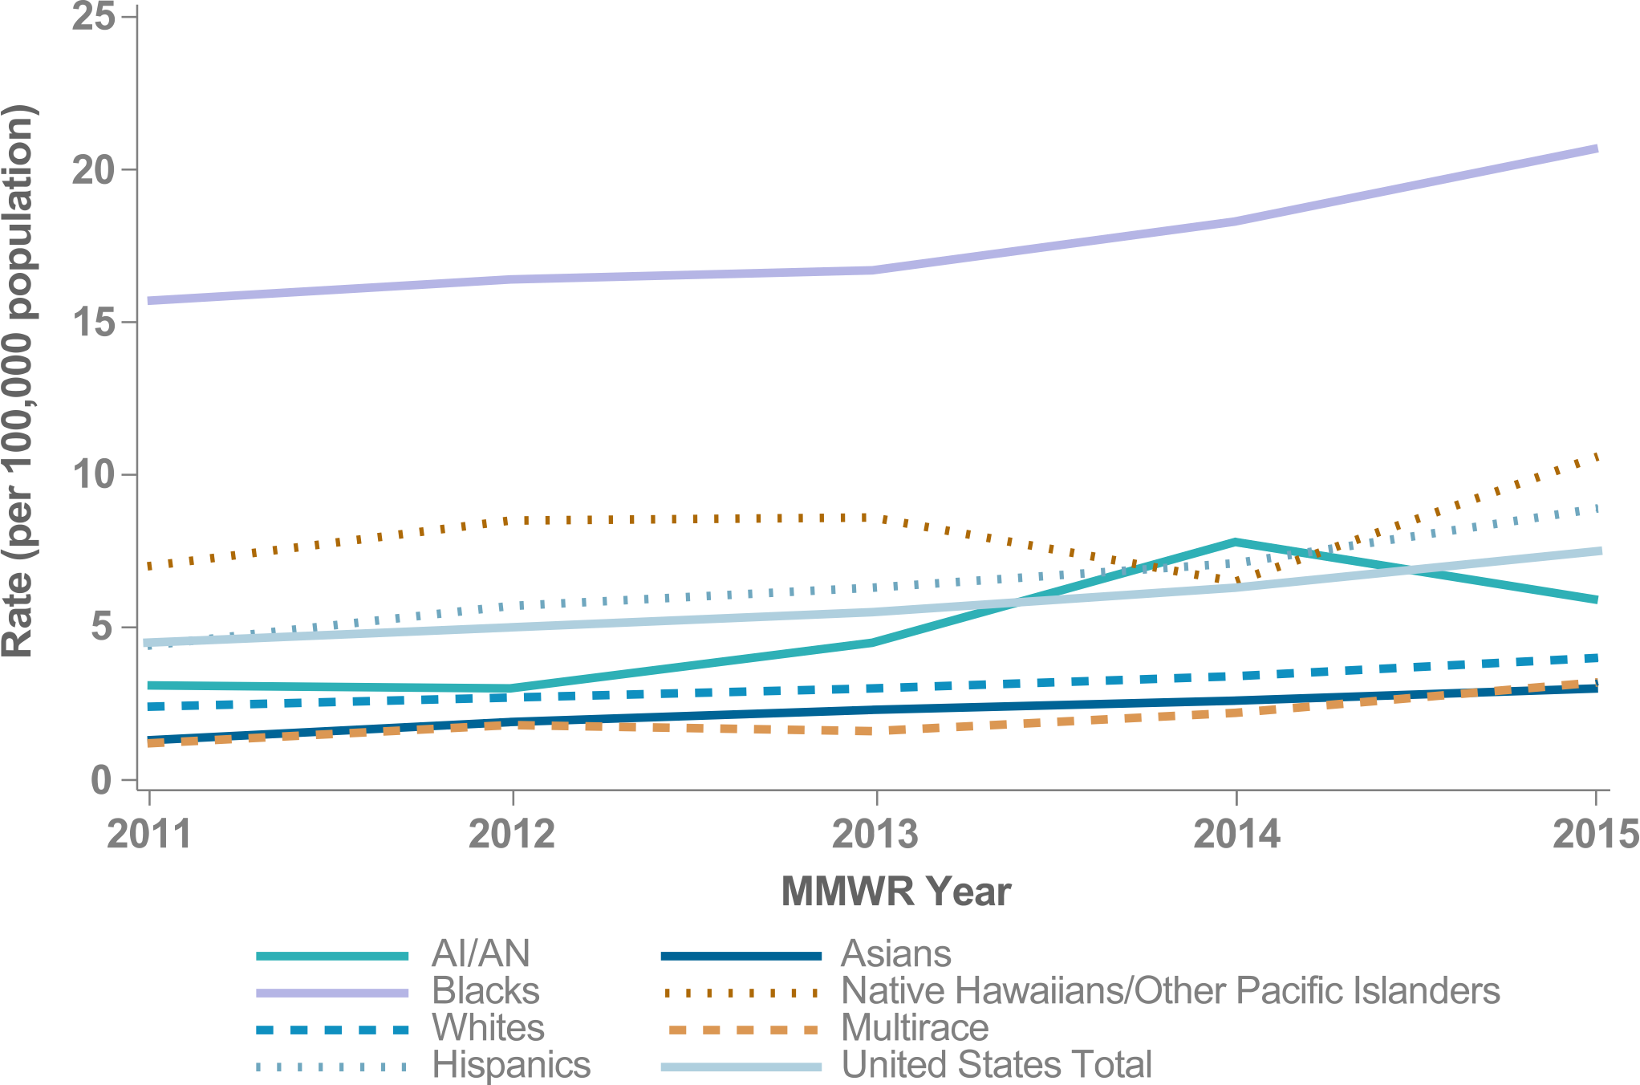
Figure 12. P&S Syphilis Rates by Race & Ethnicity, U.S.

Slide 17
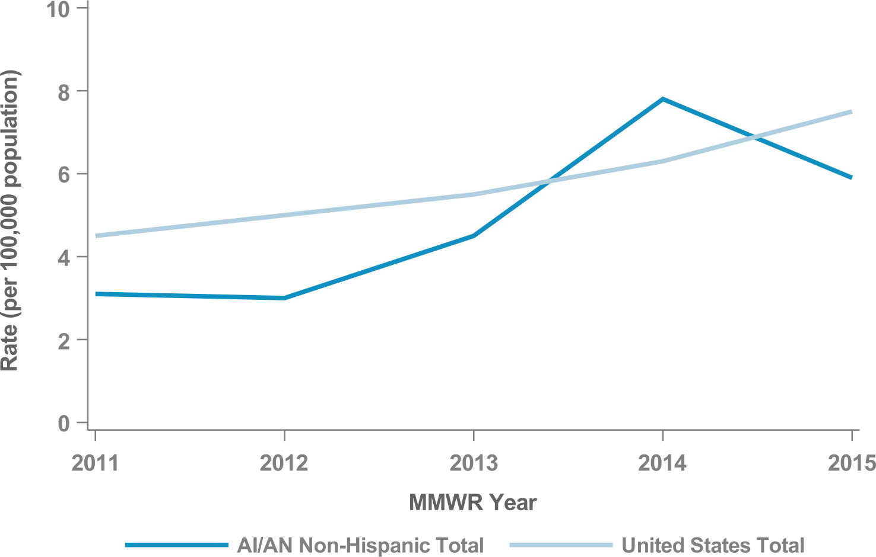
Figure 13. P&S Syphilis Rates, AI/AN Non-Hispanic, U.S.

Slide 18
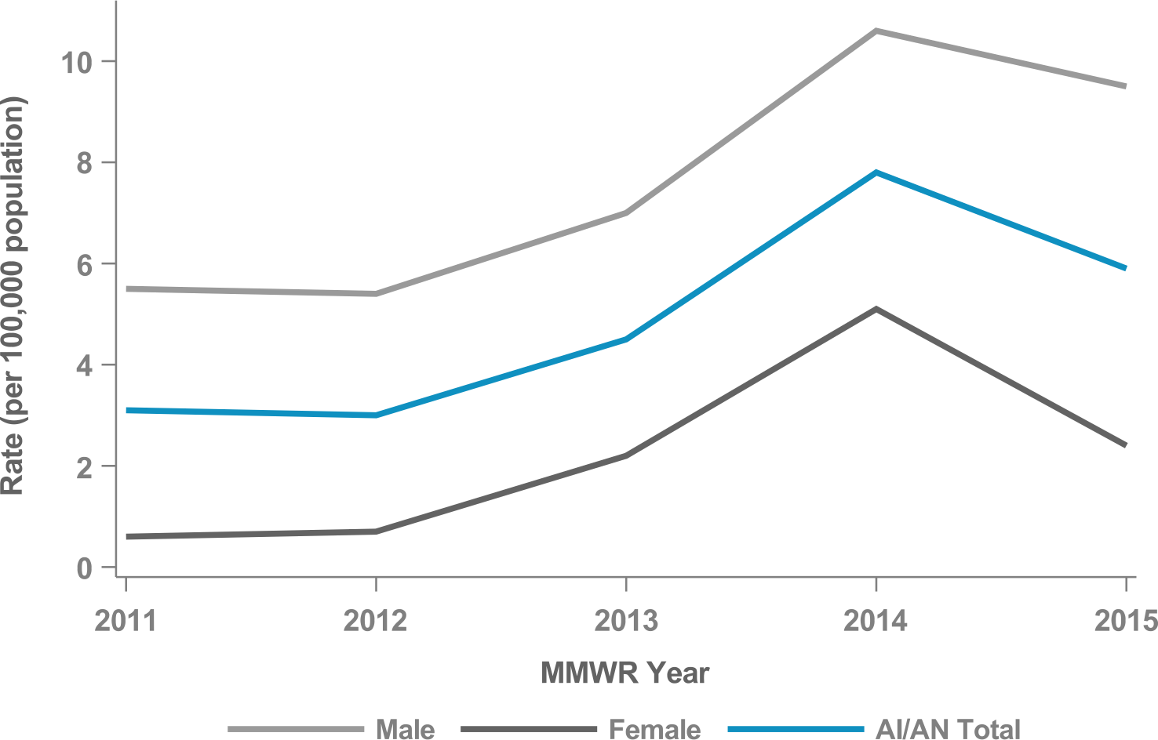
Figure 14. P&S Syphilis Rates by Sex, AI/AN Non-Hispanic, U.S.

Slide 19
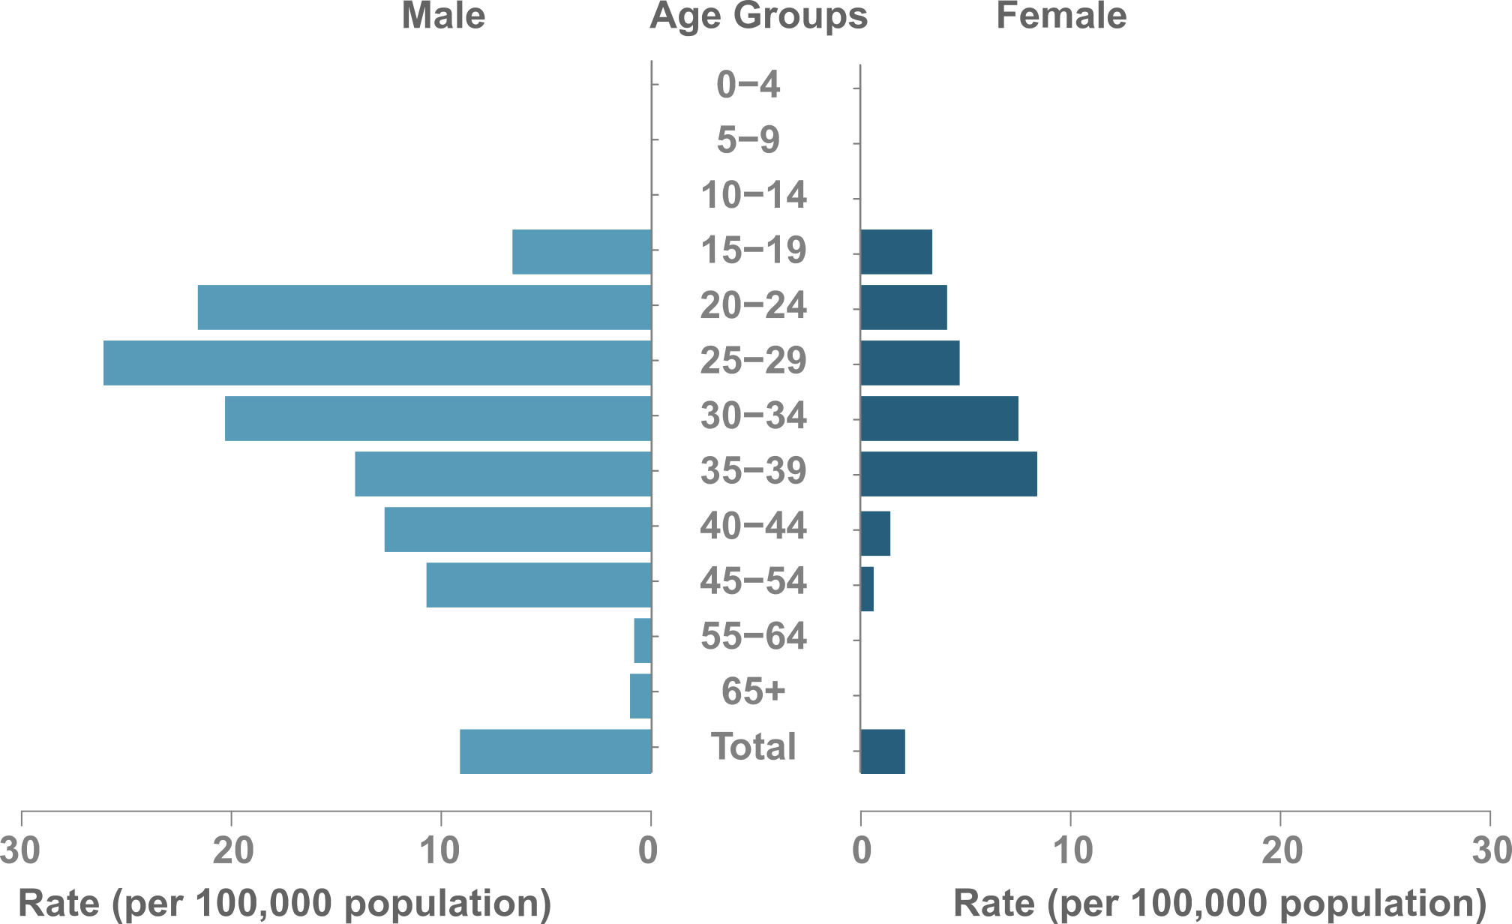
Figure 15. P&S Syphilis Rates by Sex & Age, AI/AN Non-Hispanic, U.S.

Slide 20
IHS OVERVIEW
IHS NATIONAL AND AREA STD PROFILES

Slide 21
IHS Overview
IHS Geography & Population (Data collection ending 2015)
States: 35 (AK, AL, AZ, CA, CO, CT, FL, ID, IN, IA, KS, LA, ME, MA, MI, MN, MS, MT, NE, NV, NM, NY, NC, ND, OK, OR, PA, RI, SC, SD, TX, UT, WA, WI, WY)
Counties: 641
IHS Areas: 12
IHS Service Population (est.): 2,161,310
Counties highlighted represent IHS Purchased and Referred Care Service Delivery Areas (PRCSDAs or service counties).

Slide 22
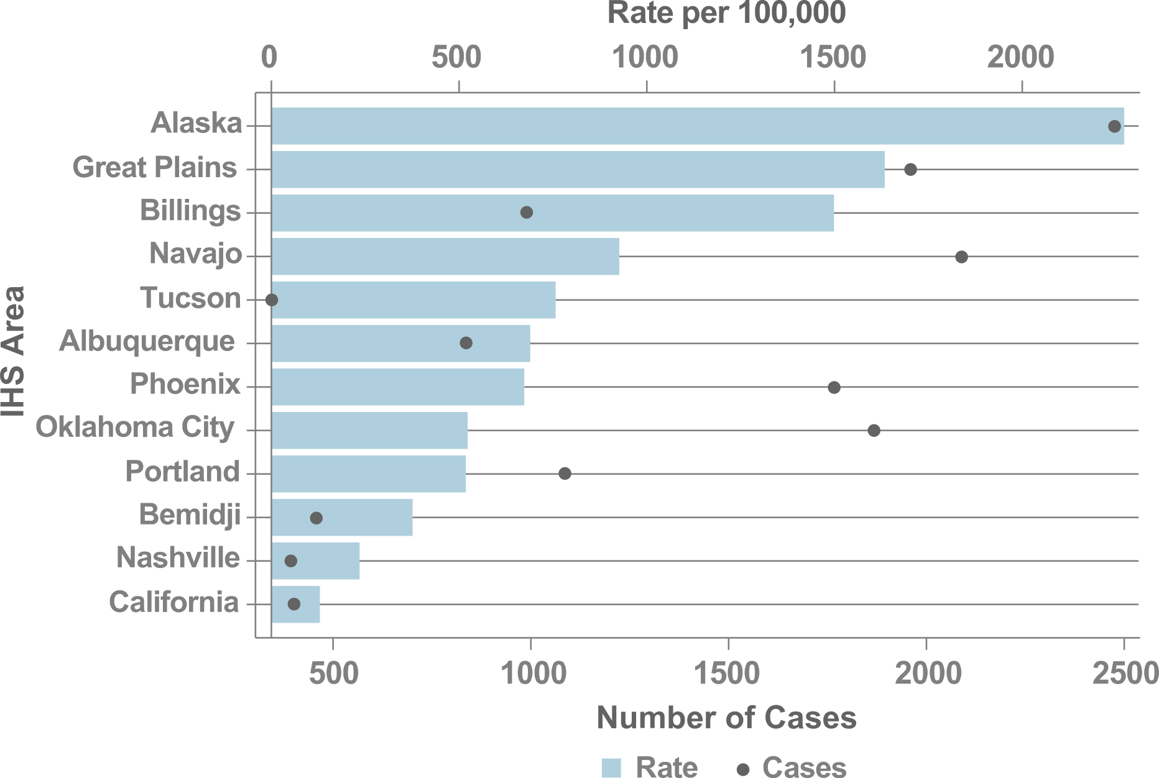
Figure 16. Chlamydia Rates by IHS Area, 2015

Slide 23
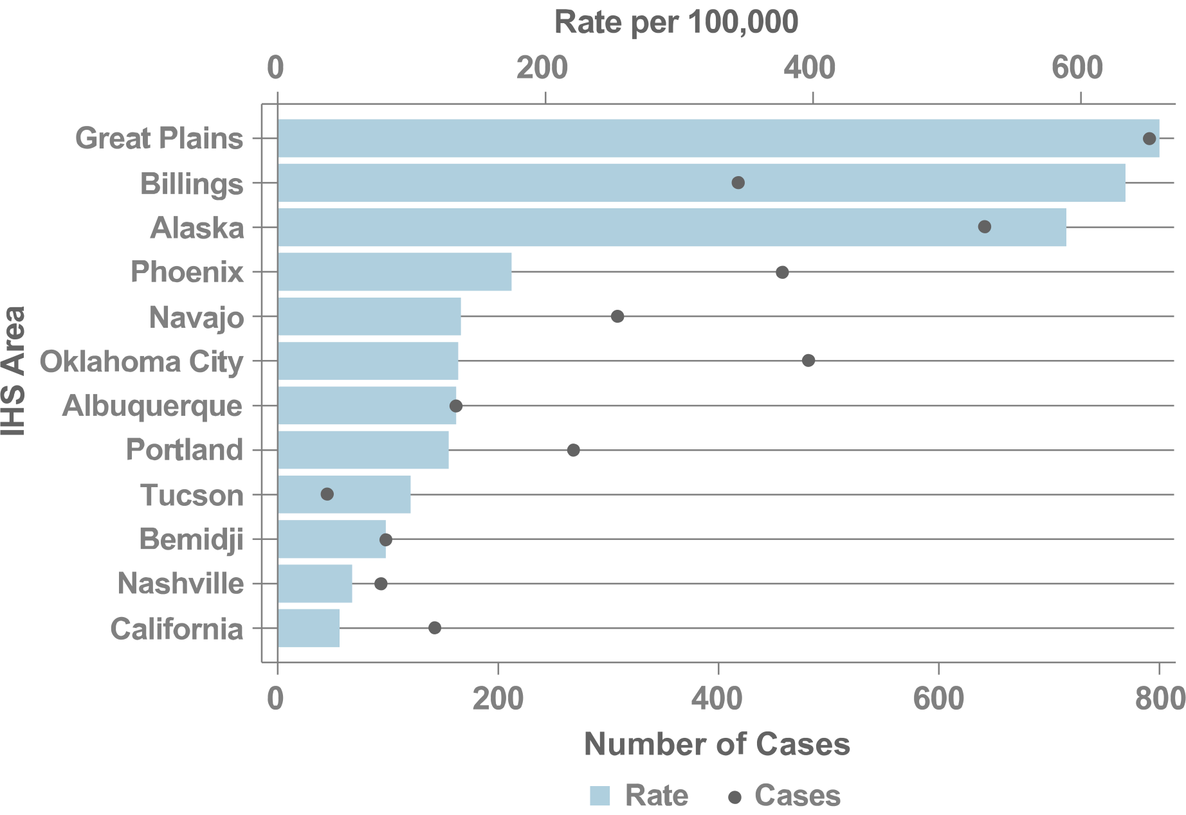
Figure 17. Gonorrhea Rates by IHS Area, 2015

Slide 24
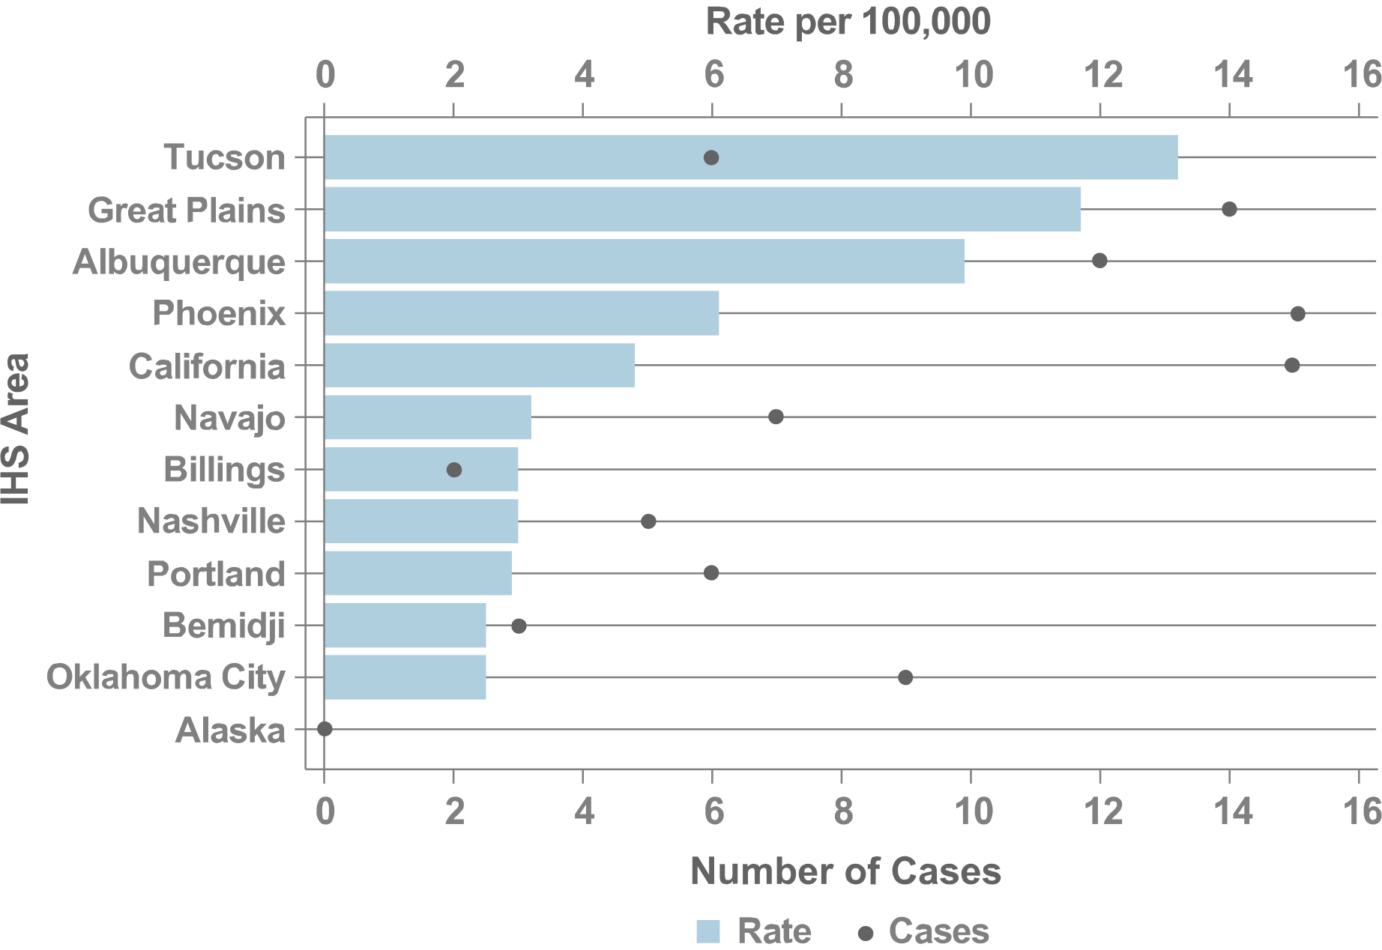
Figure 18. P&S Syphilis Rates by IHS Area, 2015

Slide 25
ALASKA
IHS NATIONAL AND AREA STD PROFILES

Slide 26
Alaska
IHS Geography & Population (Data collection ending 2015)
States: 1 (AK)
County Equivalents: AK (29/29)
IHS Service Population (est.): 142,897
Population Size Rank: 6 of 12 Areas
The state of Alaska began submitting race and ethnicity data that complied with OMB standards in 2015; therefore, trend data for the Alaska Area cannot be presented in this report. In future reports, additional years’ data beyond 2015 are planned to be incorporated for Alaska.
Counties highlighted represent IHS Purchased and Referred Care Service Delivery Areas (PRCSDAs or service counties).

Slide 27
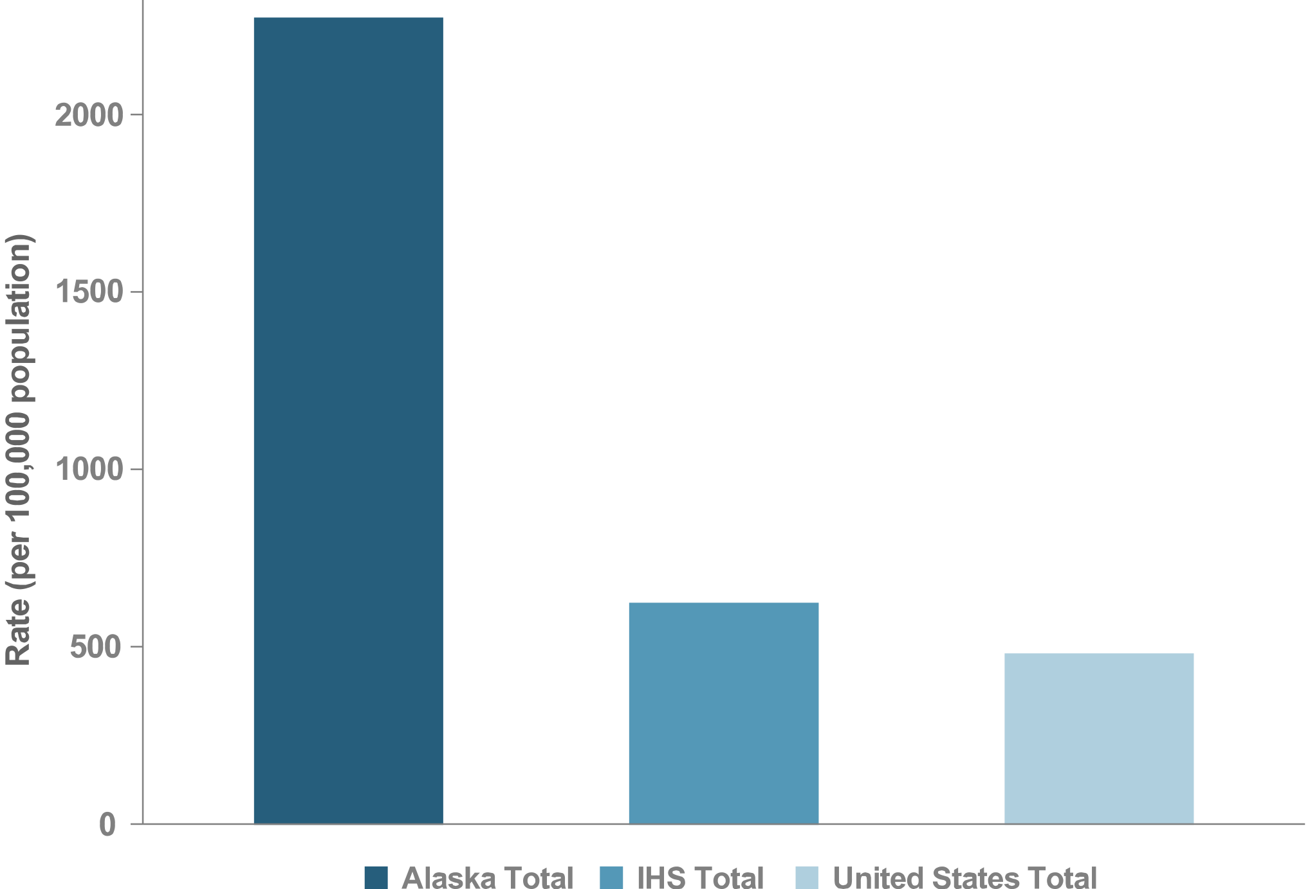
Figure 19. Chlamydia Rates, Alaska, 2015

Slide 28
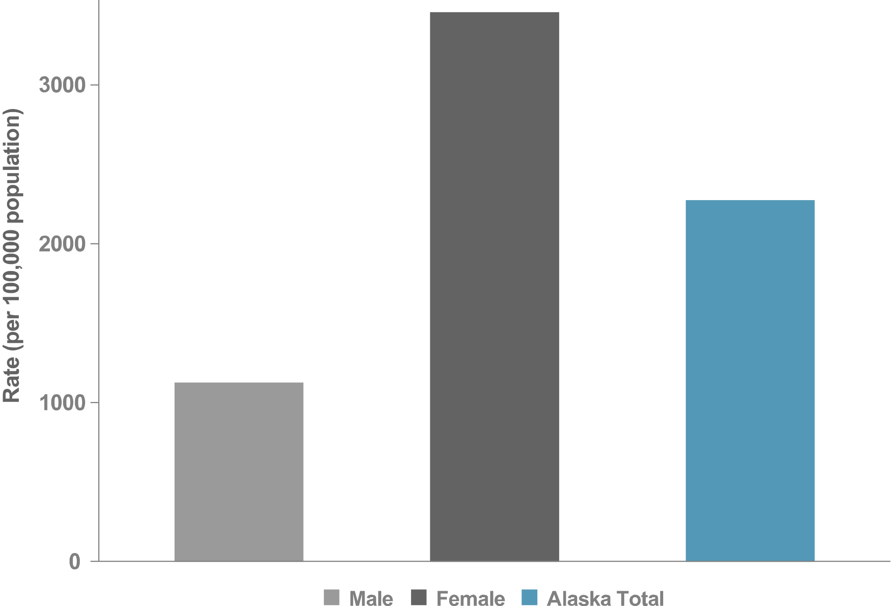
Figure 20. Chlamydia Rates by Sex, Alaska, 2015

Slide 29
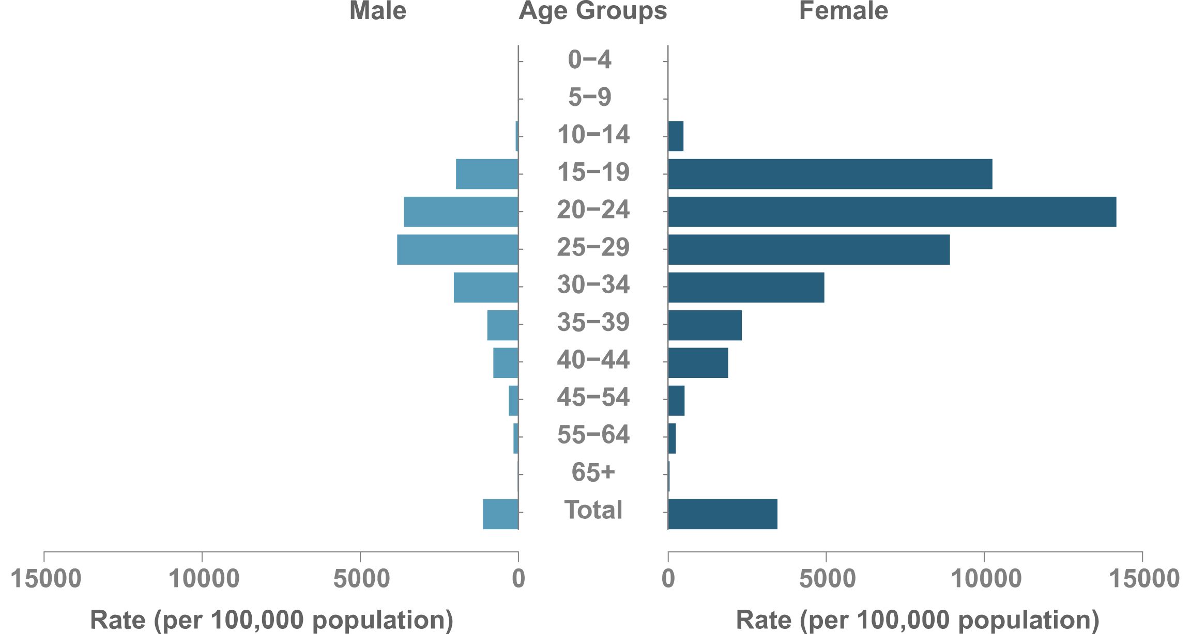
Figure 21. Chlamydia Rates by Sex & Age, Alaska, 2015

Slide 30
Figure 22. Gonorrhea Rates, Alaska, 2015

Slide 31
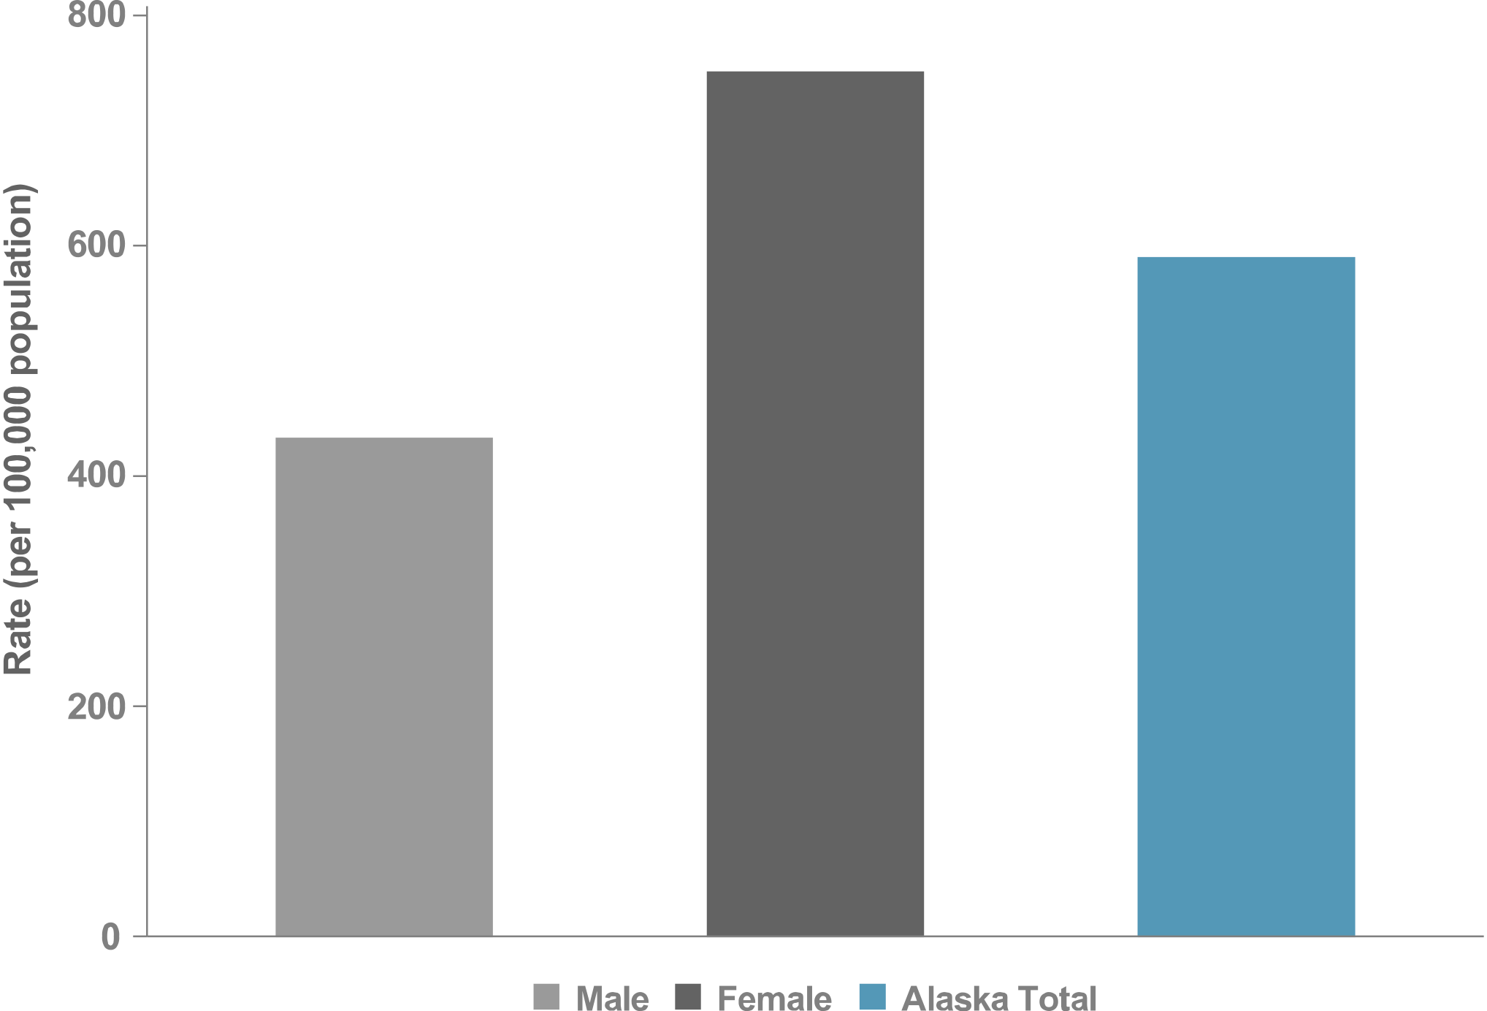
Figure 23. Gonorrhea Rates by Sex, Alaska, 2015

Slide 32
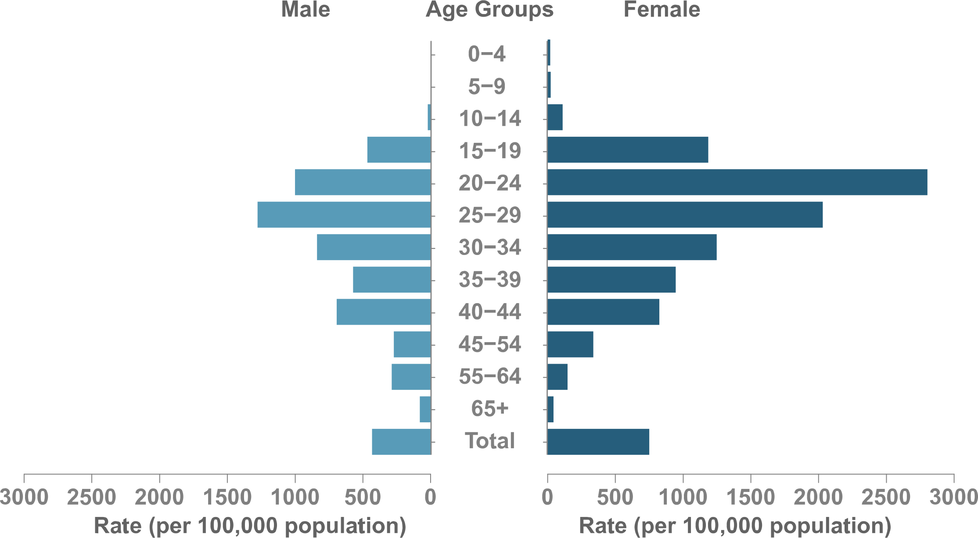
Figure 24. Gonorrhea Rates by Sex & Age, Alaska, 2015

Slide 33
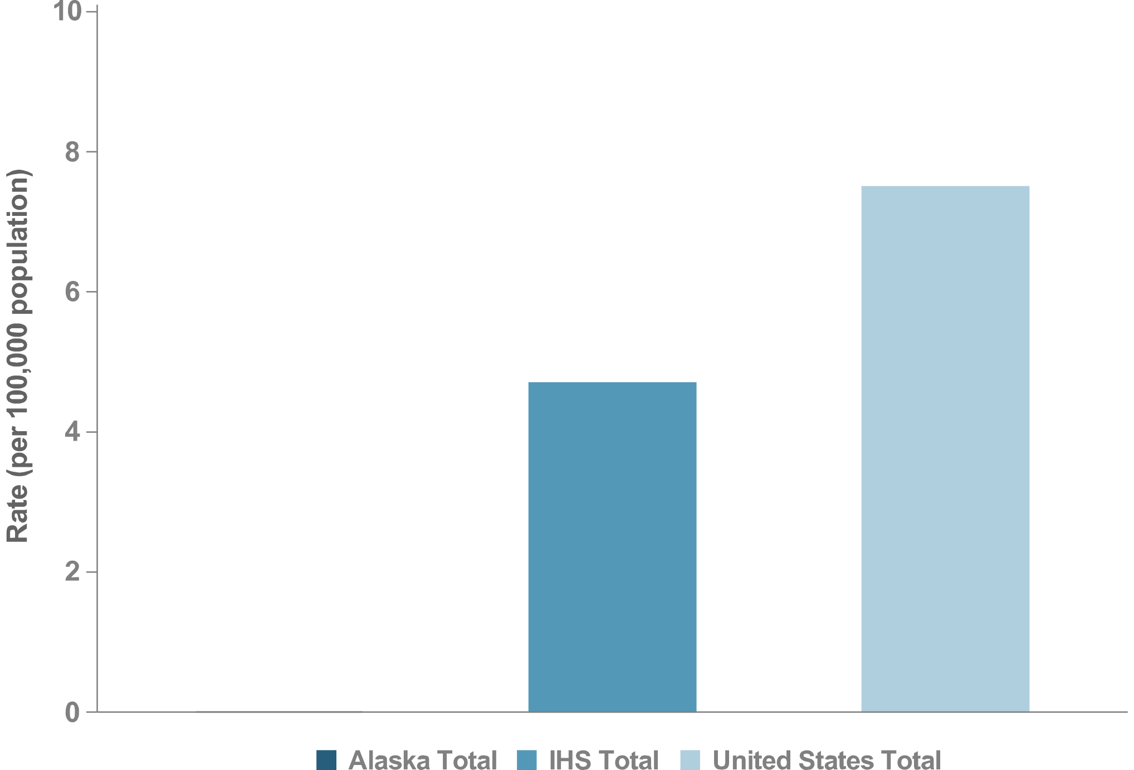
Figure 25. P&S Syphilis Rates, Alaska, 2015

Slide 34
Figure 26. P&S Syphilis Rates by Sex, Alaska, 2015
No P&S syphilis cases reported in 2015

Slide 35
Figure 27. P&S Syphilis Rates by Sex & Age, Alaska, 2015
No P&S syphilis cases reported in 2015

Slide 36
ALBUQUERQUE
IHS NATIONAL AND AREA STD PROFILES

Slide 37
Albuquerque
IHS Geography & Population (Data collection ending 2015)
States: 4 (CO, NM, TX, UT)
Counties: CO (4/64) NM (16/33) TX (1/254) UT (1/29)
IHS Service Population (est.): 120,723
Population Size Rank: 10 of 12 Areas
Counties highlighted represent IHS Purchased and Referred Care Service Delivery Areas (PRCSDAs or service counties).
Counties in light blue represent PRCSDAs that are shared between IHS Areas.

Slide 38
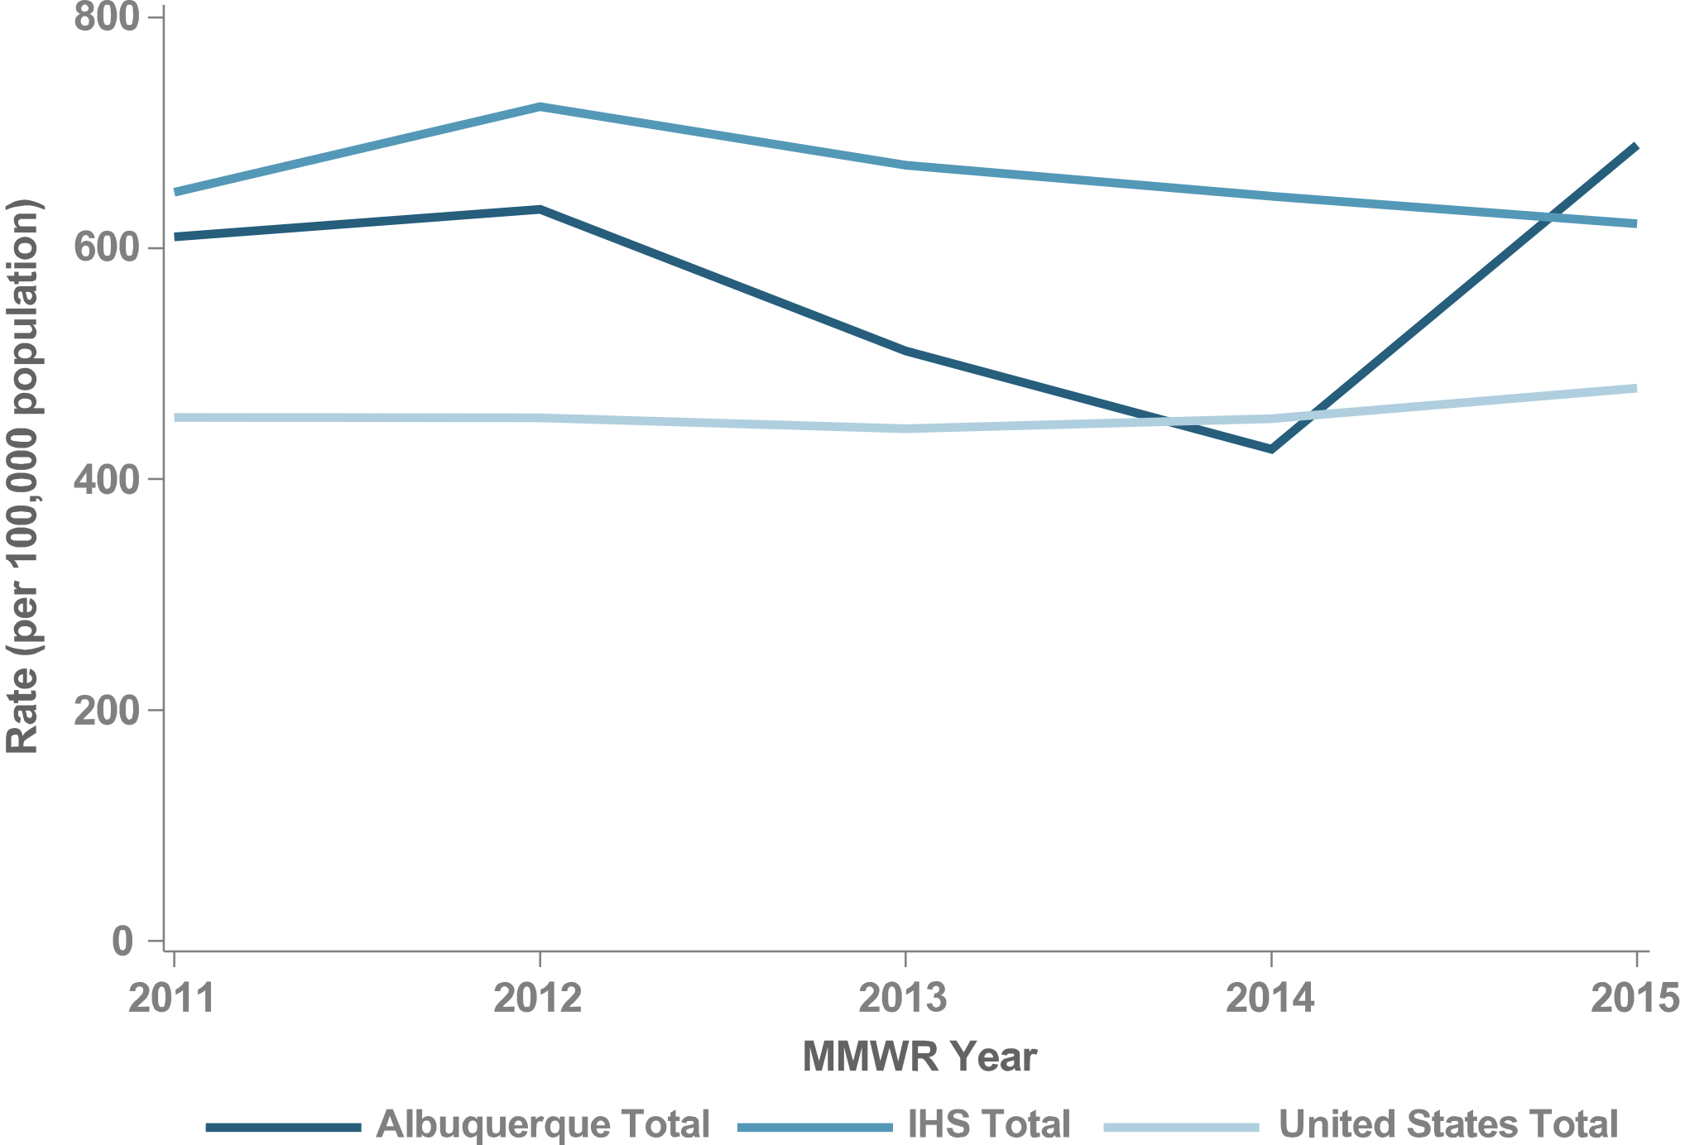
Figure 28. Chlamydia Rates, Albuquerque, 2011–2015

Slide 39
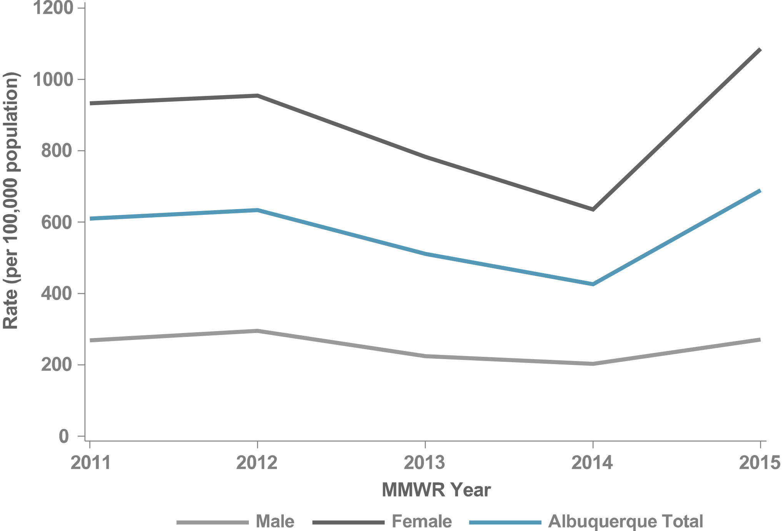
Figure 29. Chlamydia Rates by Sex, Albuquerque, 2011–2015

Slide 40
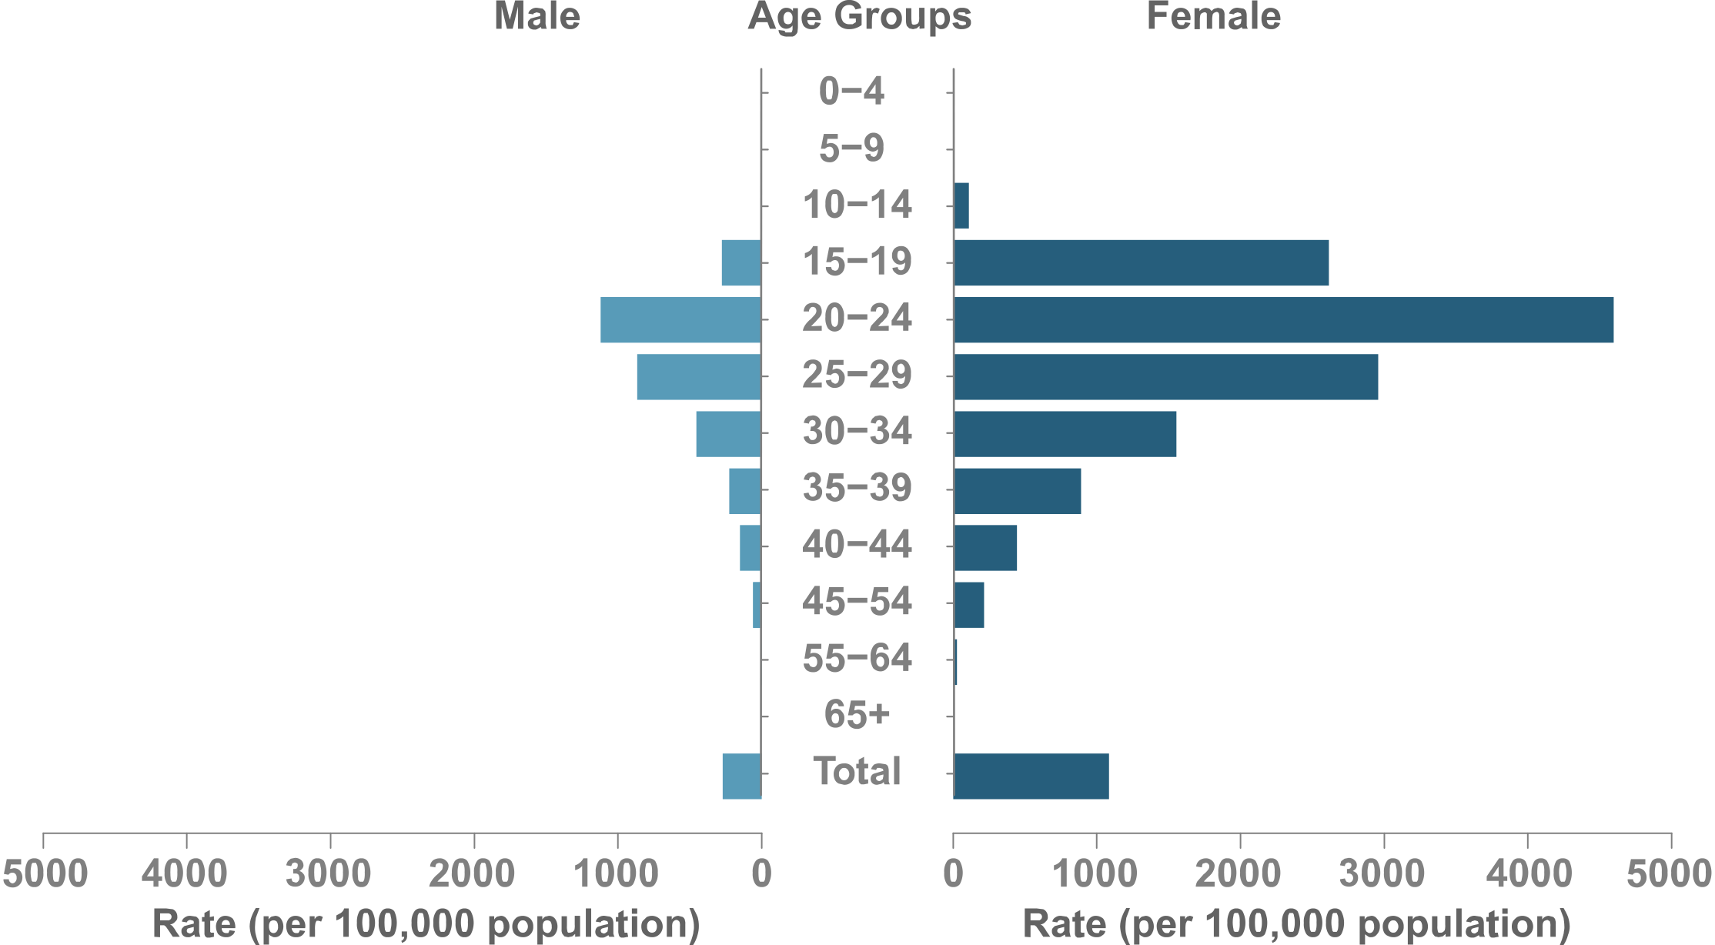
Figure 30. Chlamydia Rates by Sex & Age, Albuquerque, 2015

Slide 41
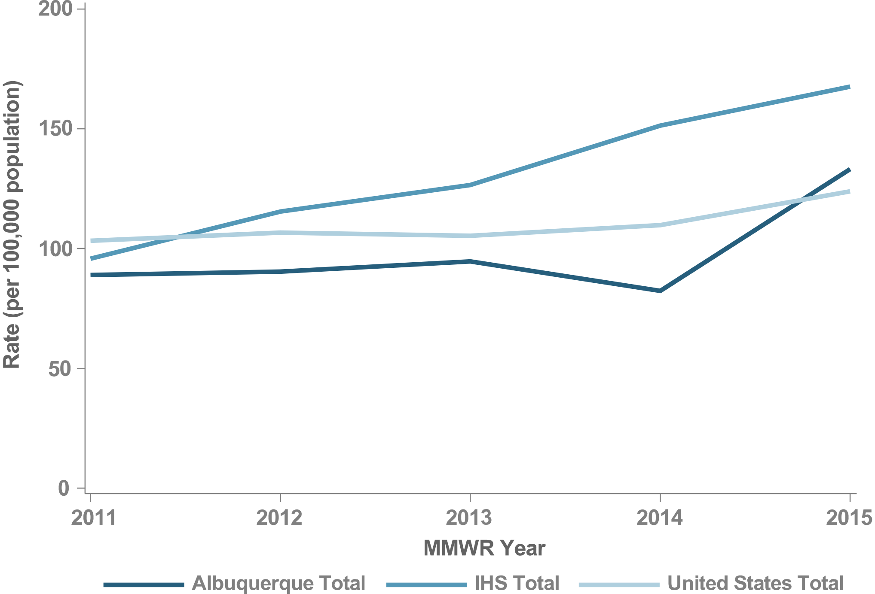
Figure 31. Gonorrhea Rates, Albuquerque, 2011–2015

Slide 42
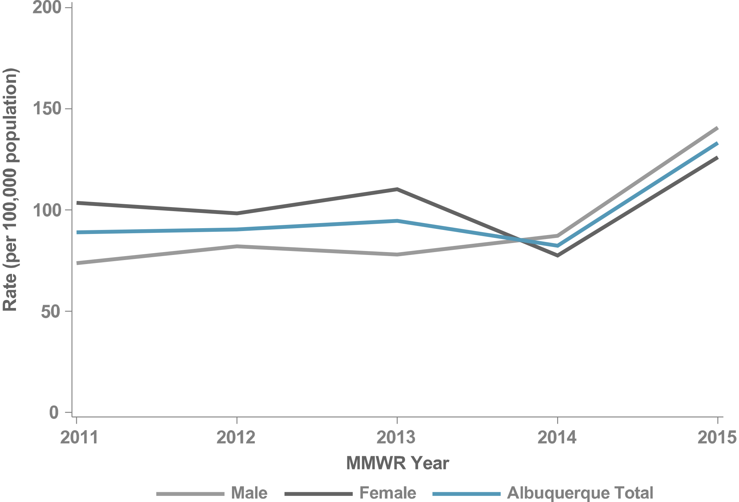
Figure 32. Gonorrhea Rates by Sex, Albuquerque, 2011–2015

Slide 43
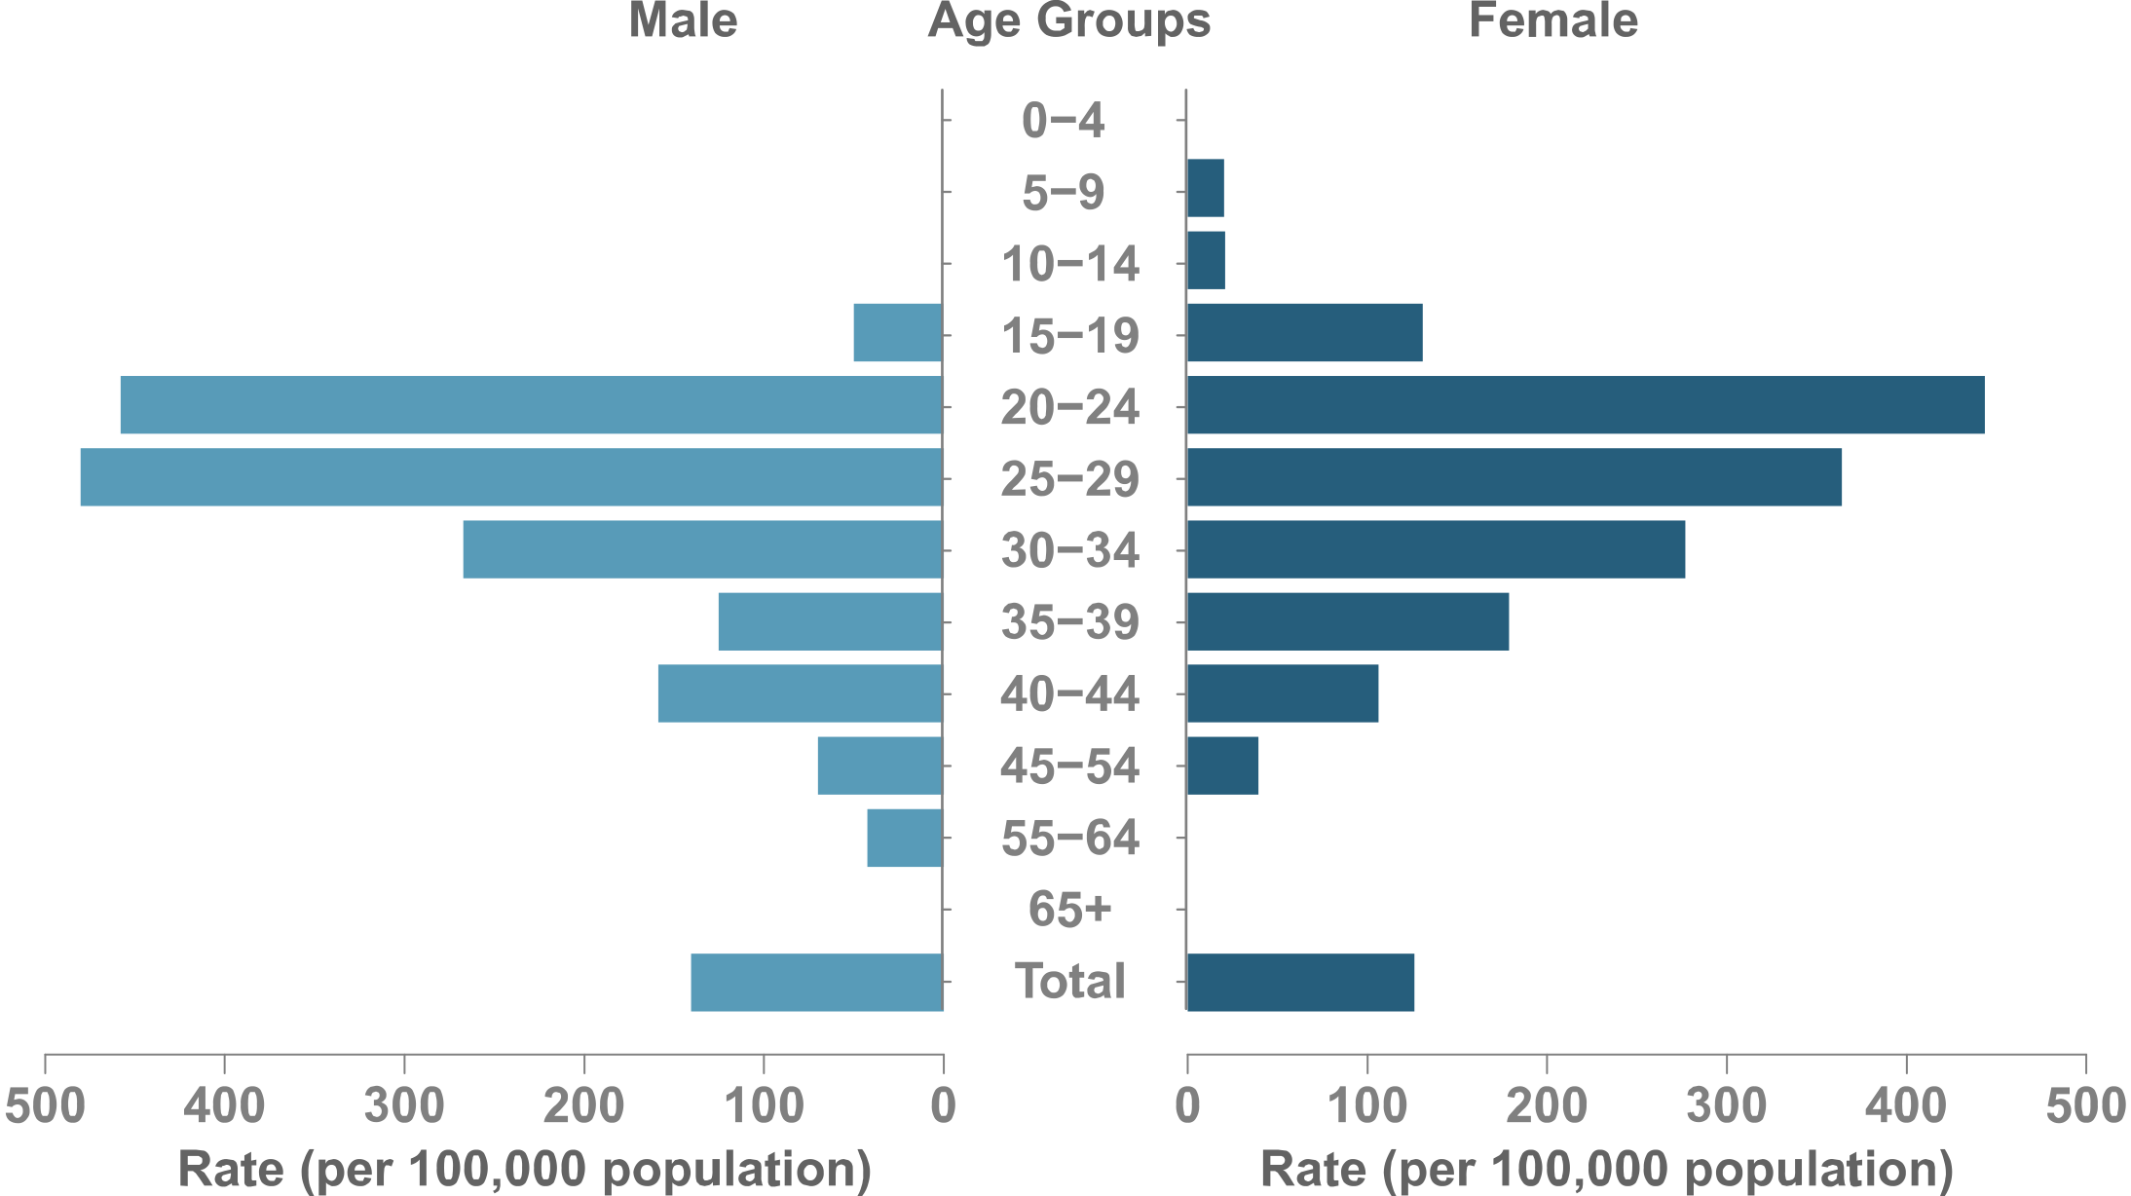
Figure 33. Gonorrhea Rates by Sex & Age, Albuquerque, 2015

Slide 44
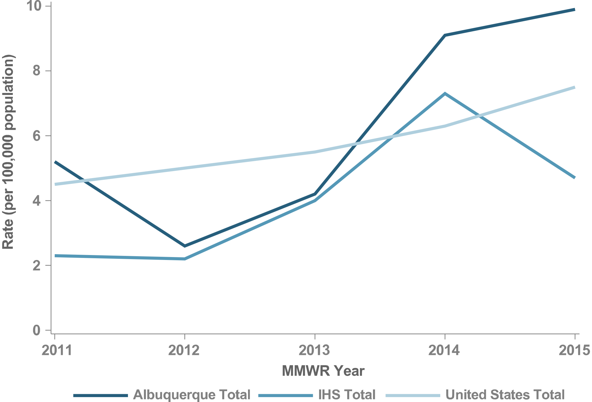
Figure 34. P&S Syphilis Rates, Albuquerque, 2011–2015

Slide 45
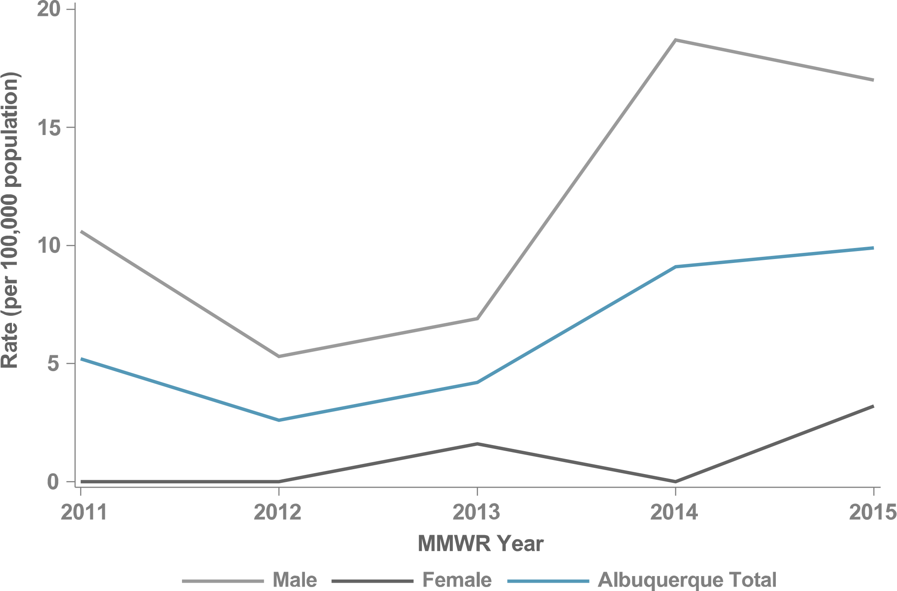
Figure 35. P&S Syphilis Rates by Sex, Albuquerque, 2011–2015

Slide 46
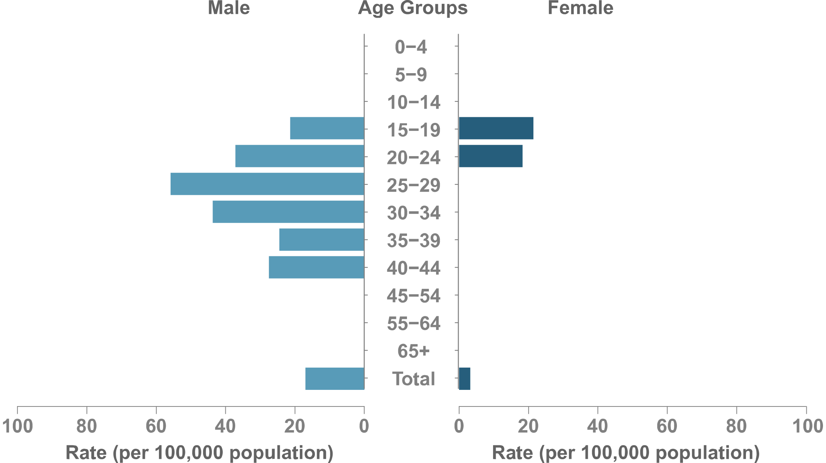
Figure 36. P&S Syphilis Rates by Sex & Age, Albuquerque, 2015

Slide 47
BEMIDJI
IHS NATIONAL AND AREA STD PROFILES

Slide 48
Bemidji
IHS Geography & Population (Data collection ending 2015)
States: 4 (IN, MI, MN, WI)
Counties: IN (6/92) MI (52/83) MN (29/87) WI (32/72)
IHS Service Population (est.): 138,376
Population Size Rank: 9 of 12 Areas
Counties highlighted represent IHS Purchased and Referred Care Service Delivery Areas (PRCSDAs or service counties).

Slide 49
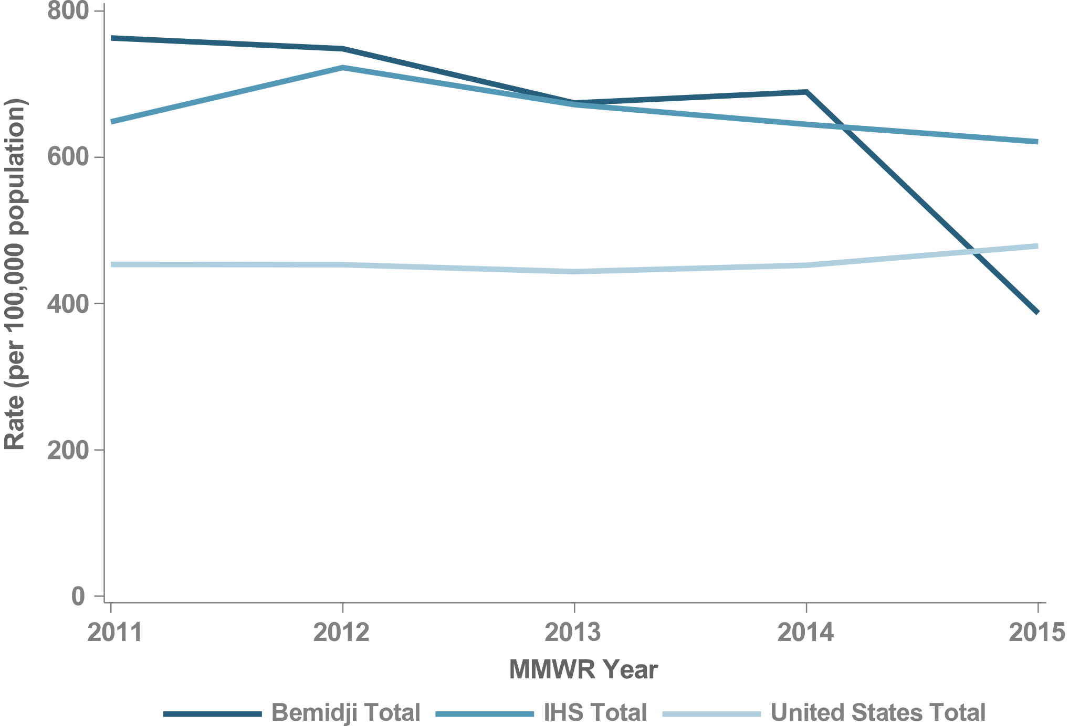
Figure 37. Chlamydia Rates, Bemidji, 2011–2015

Slide 50
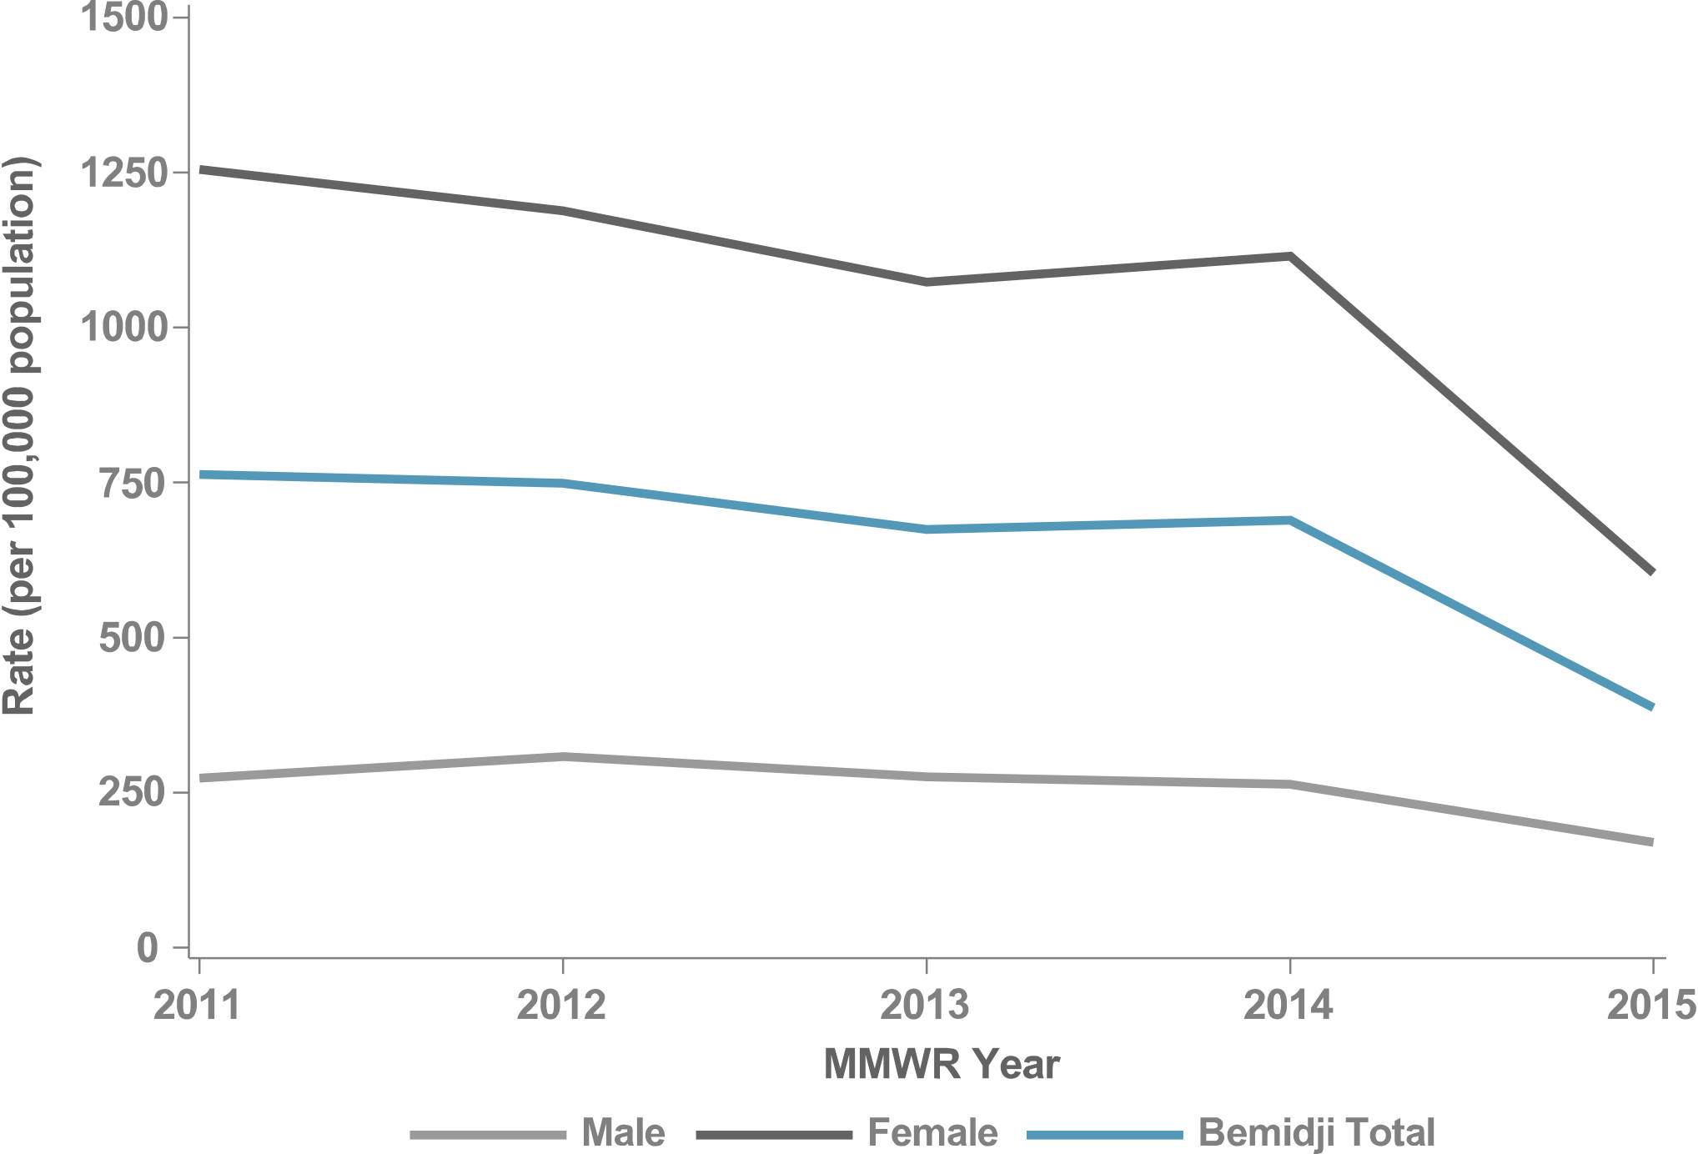
Figure 38. Chlamydia Rates by Sex, Bemidji, 2011–2015

Slide 51
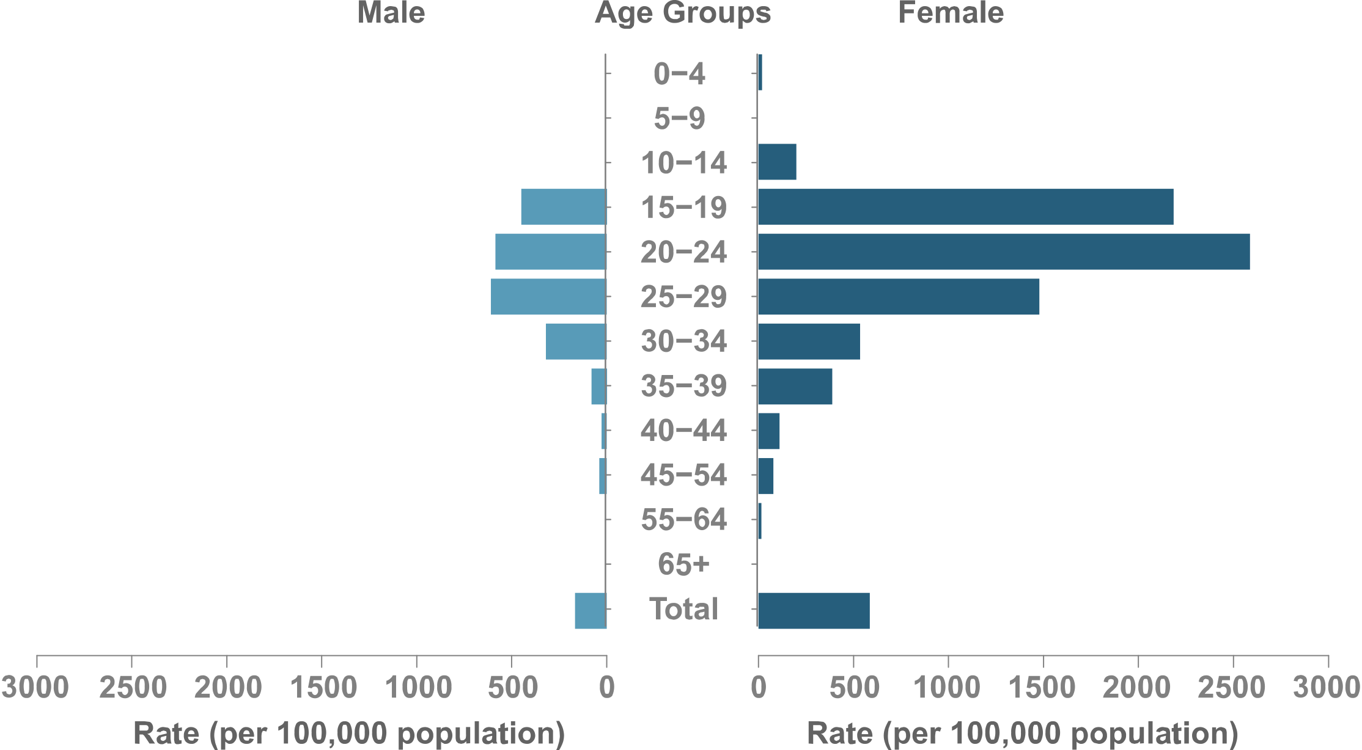
Figure 39. Chlamydia Rates by Sex & Age, Bemidji, 2015

Slide 52
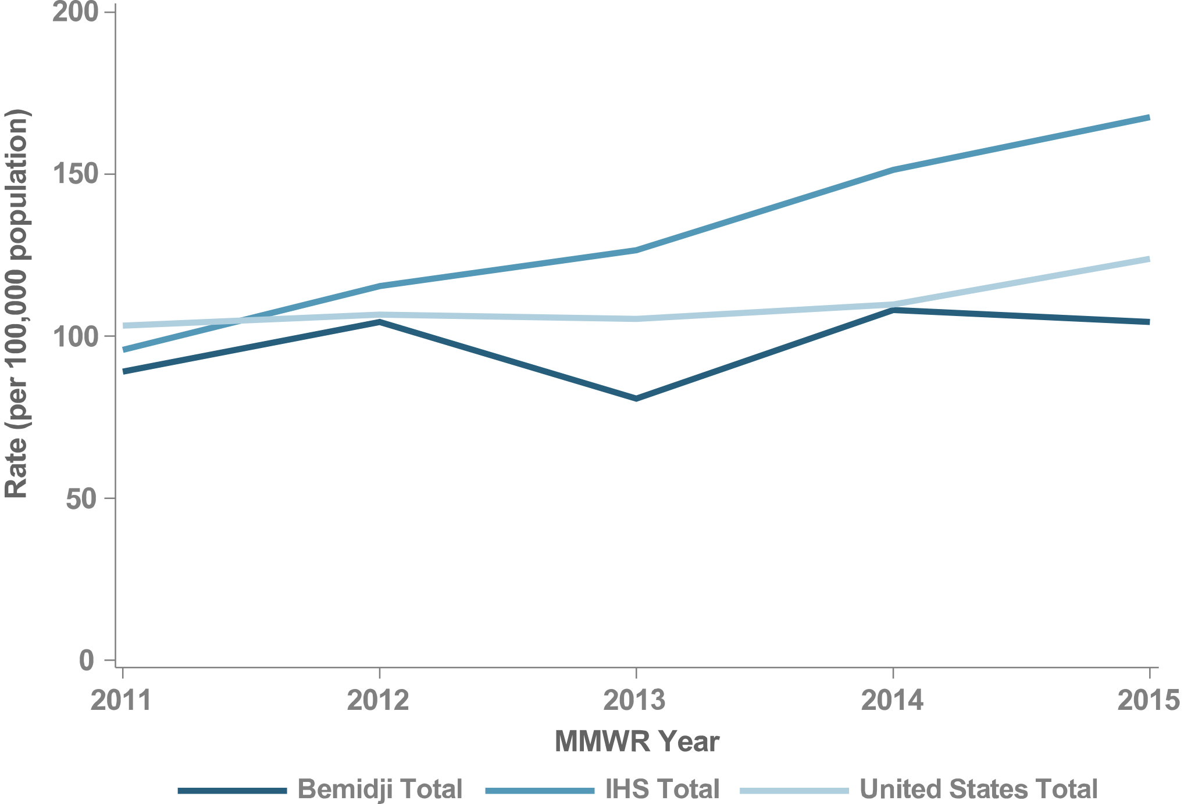
Figure 40. Gonorrhea Rates, Bemidji, 2011–2015

Slide 53
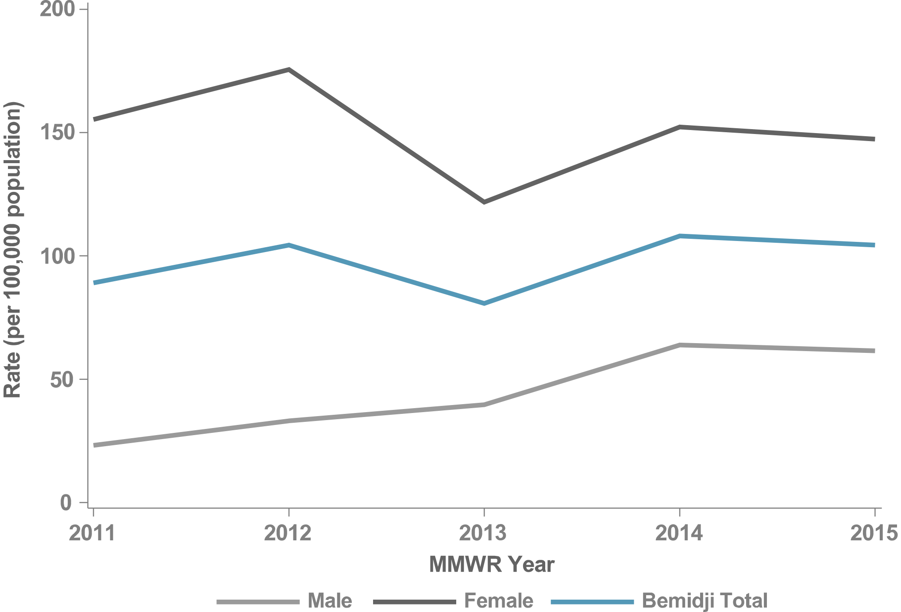
Figure 41. Gonorrhea Rates by Sex, Bemidji, 2011–2015

Slide 54
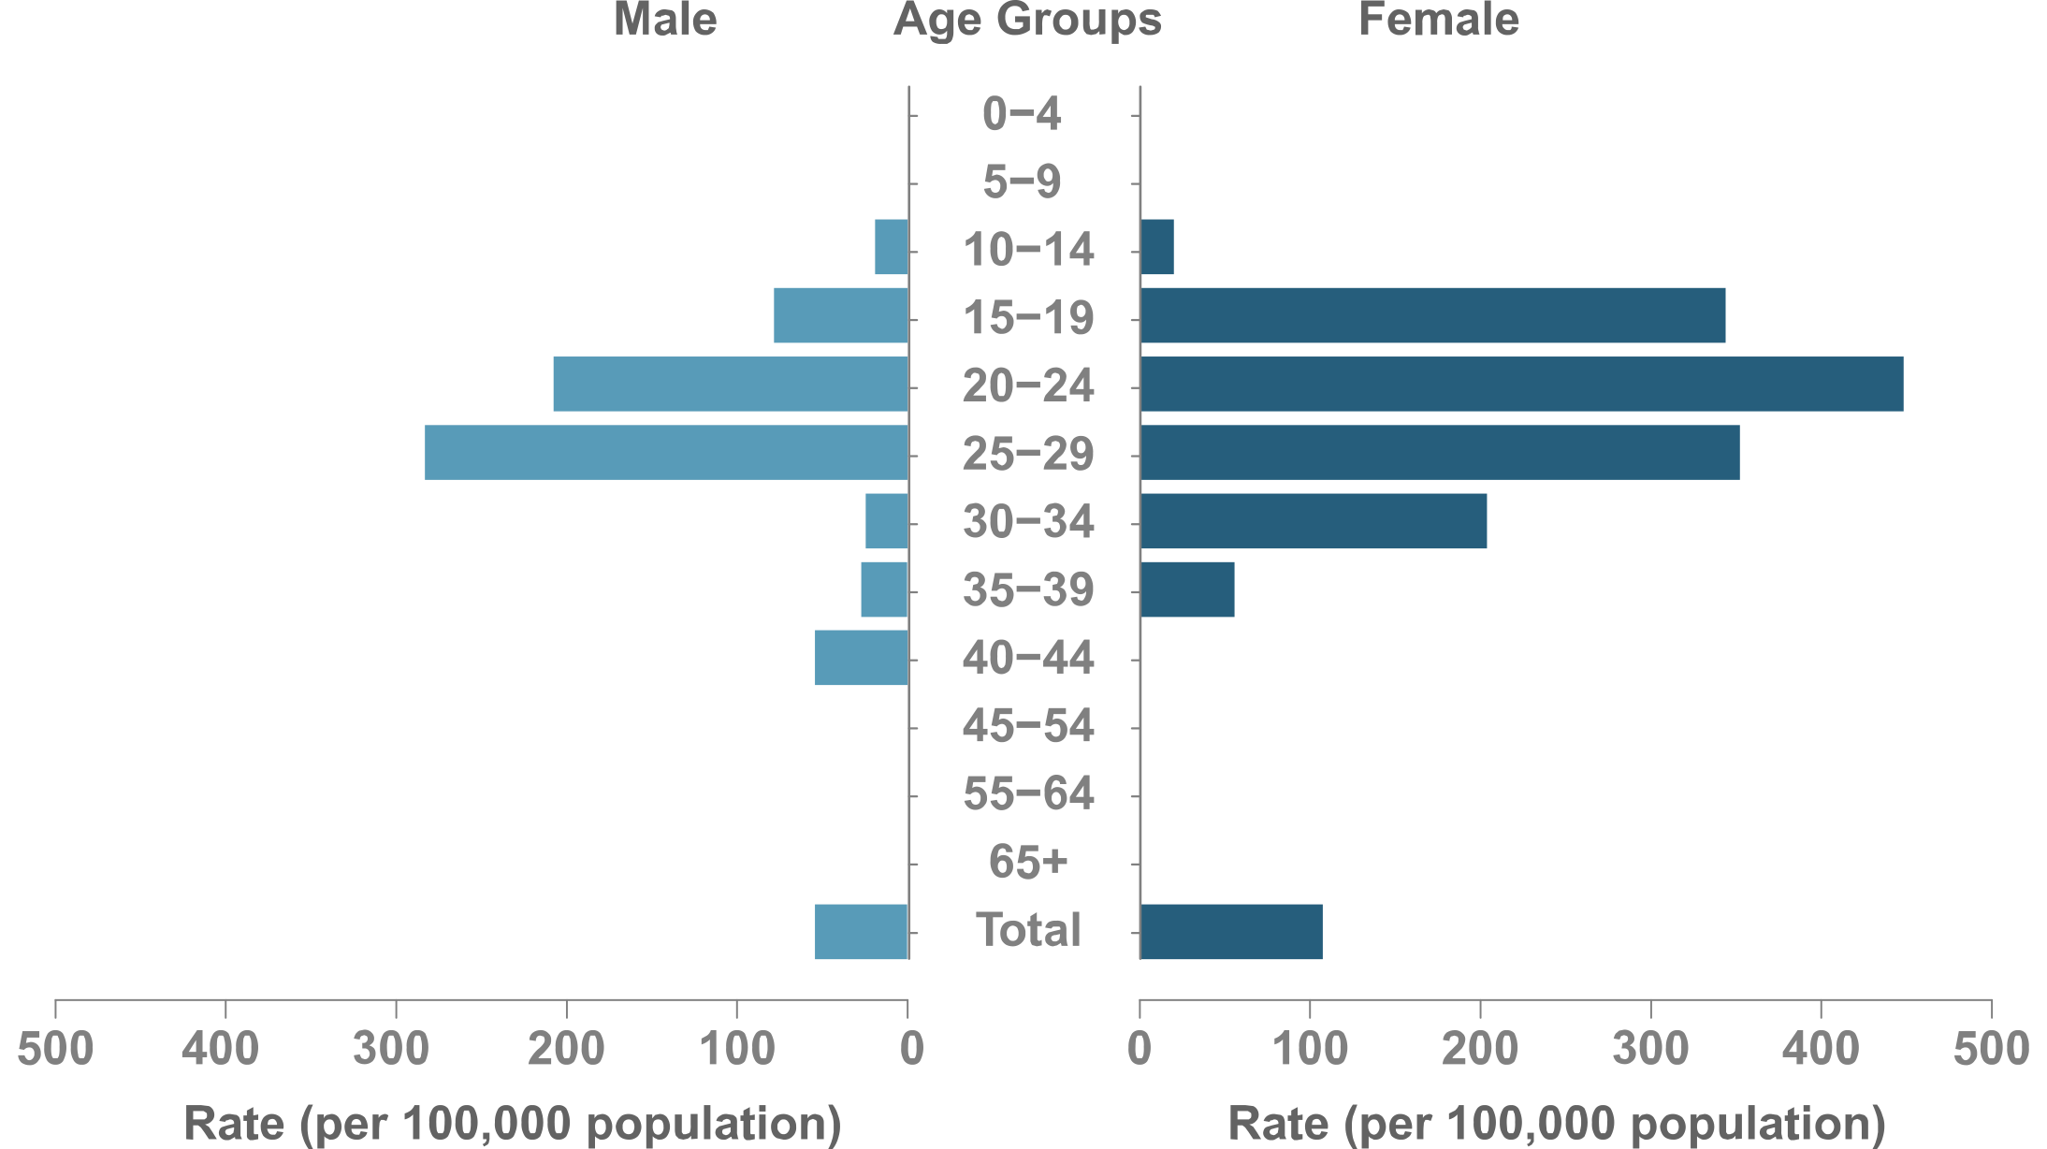
Figure 42. Gonorrhea Rates by Sex & Age, Bemidji, 2015

Slide 55
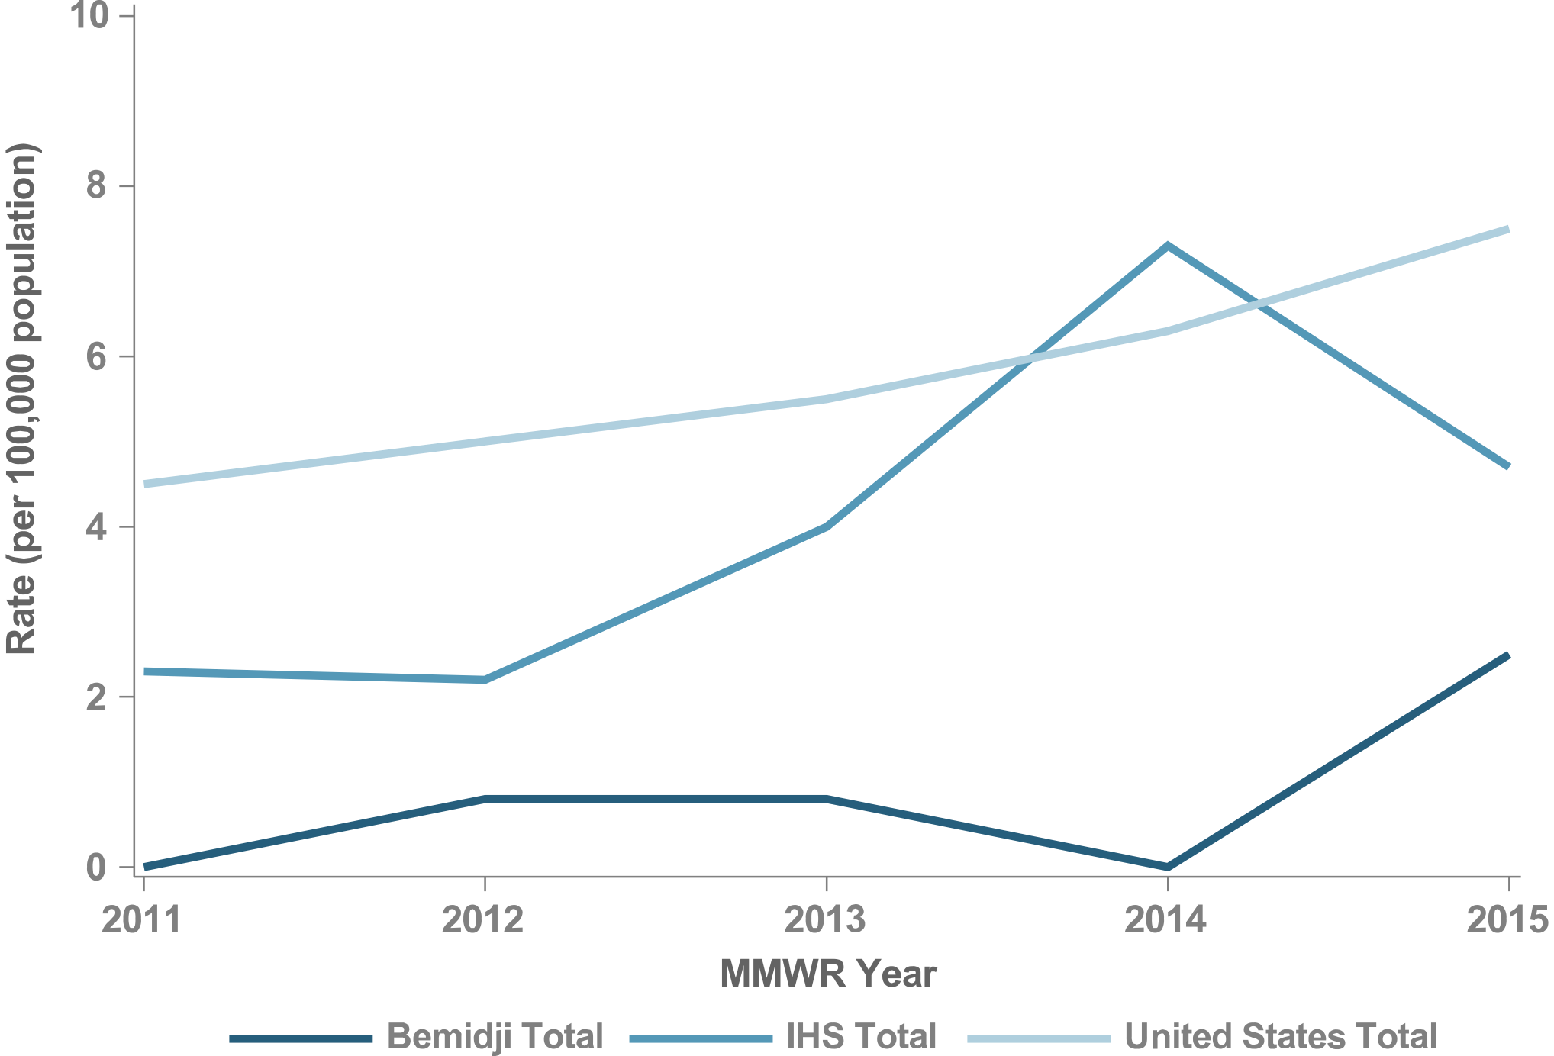
Figure 43. P&S Syphilis Rates, Bemidji, 2011–2015

Slide 56
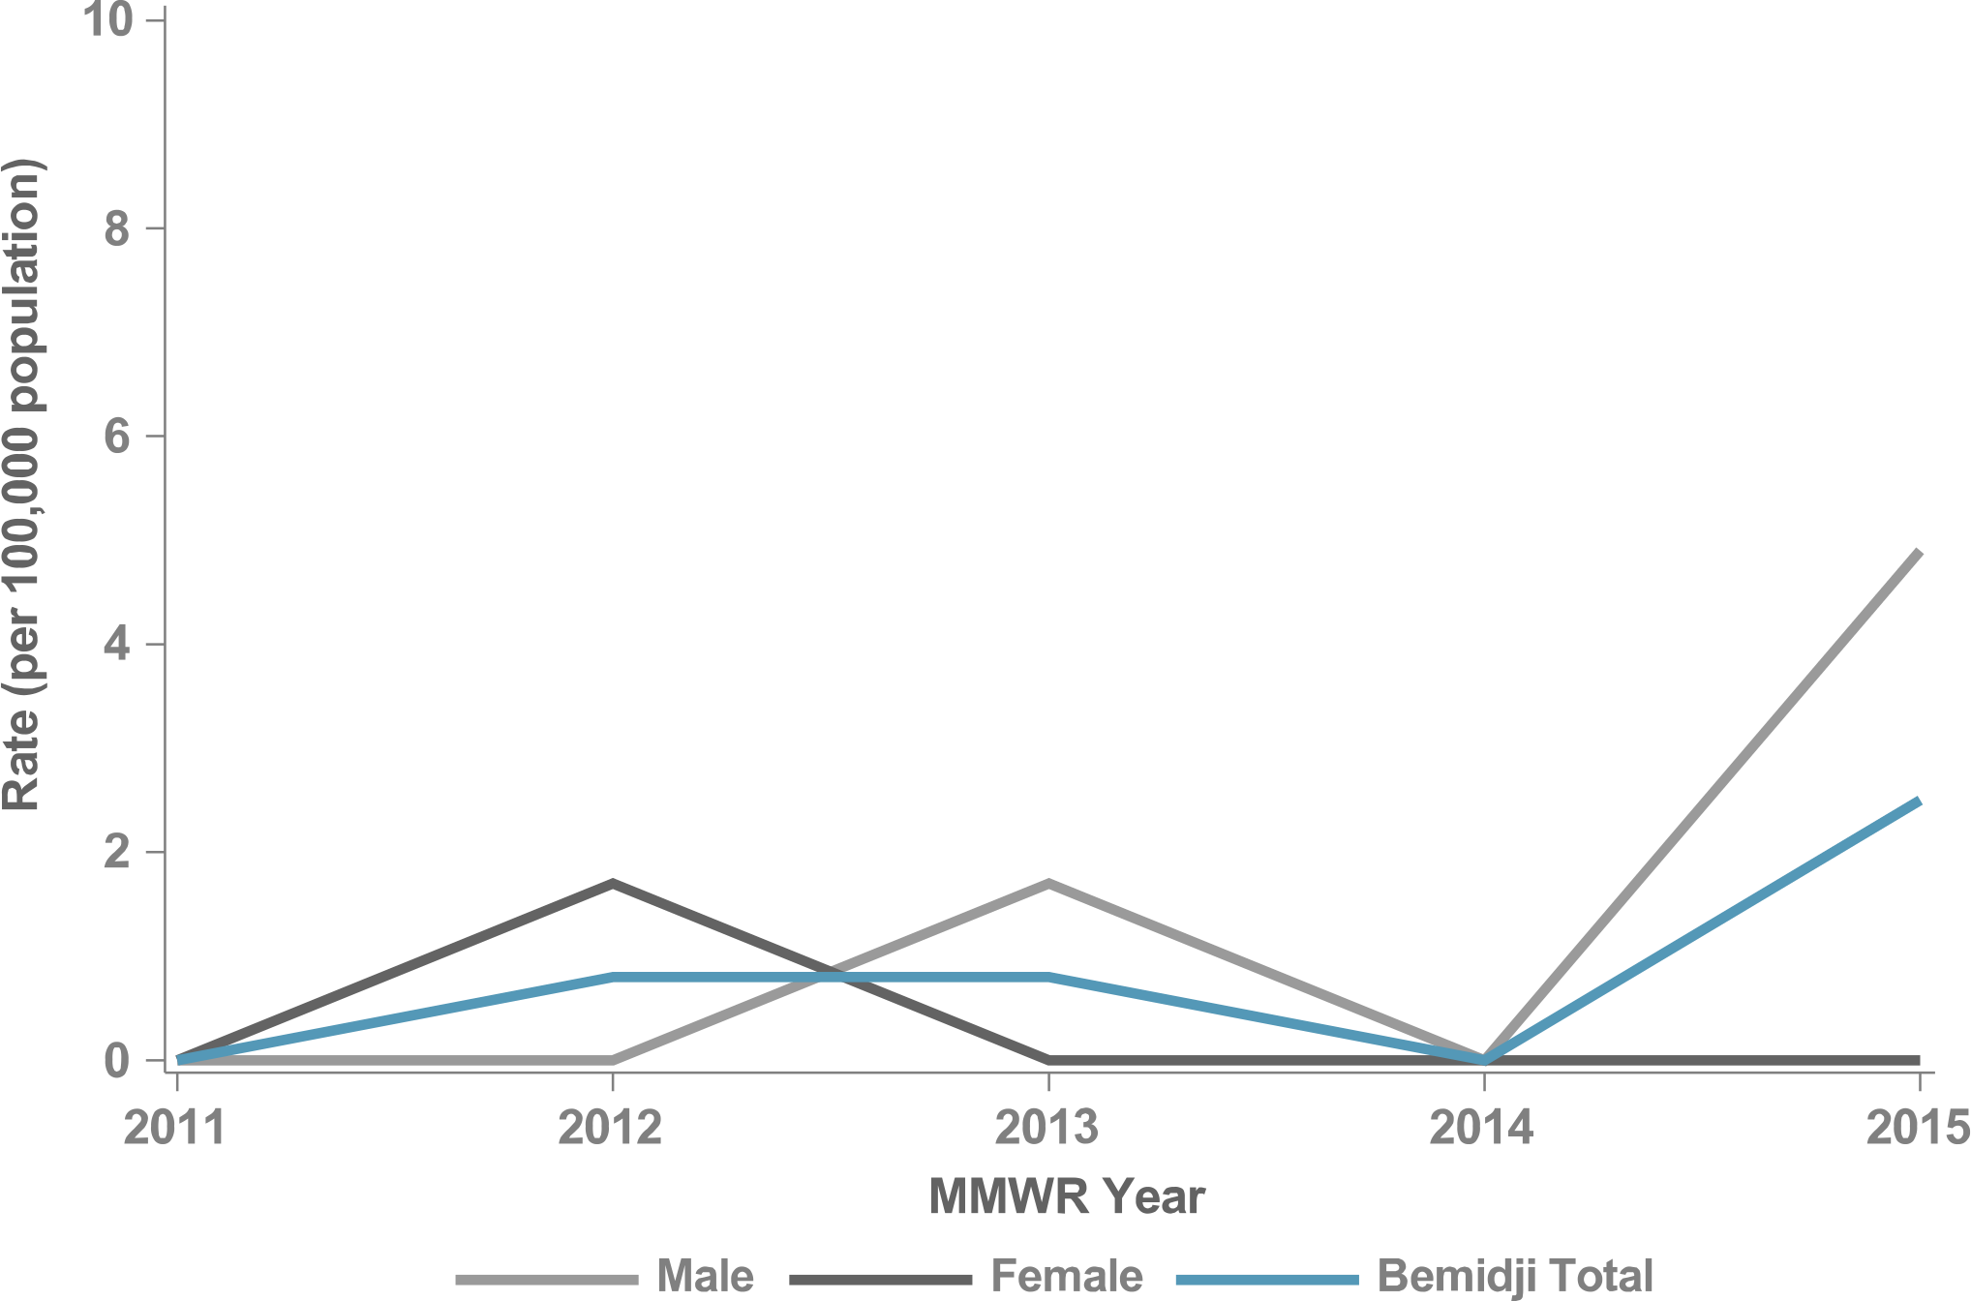
Figure 44. P&S Syphilis Rates by Sex, Bemidji, 2011–2015

Slide 57
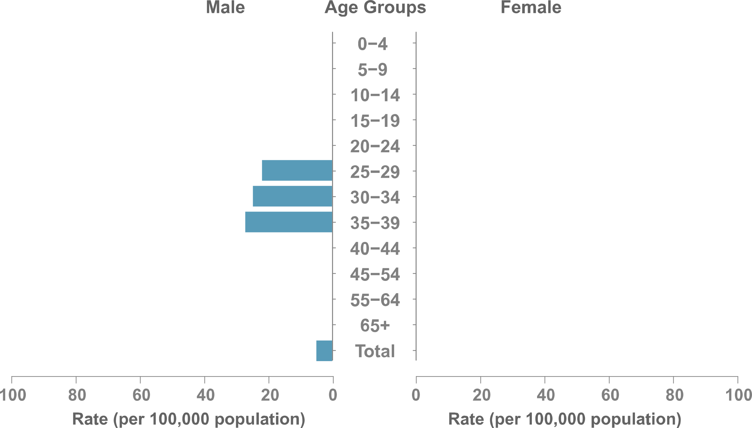
Figure 45. P&S Syphilis Rates by Sex & Age, Bemidji, 2015

Slide 58
BILLINGS
IHS NATIONAL AND AREA STD PROFILES

Slide 59
Billings
IHS Geography & Population (Data collection ending 2015)
States: 2 (MT, WY)
Counties: MT (23/56) WY (5/23)
IHS Service Population (est.): 78,545
Population Size Rank: 11 of 12 Areas
Counties highlighted represent IHS Purchased and Referred Care Service Delivery Areas (PRCSDAs or service counties).

Slide 60
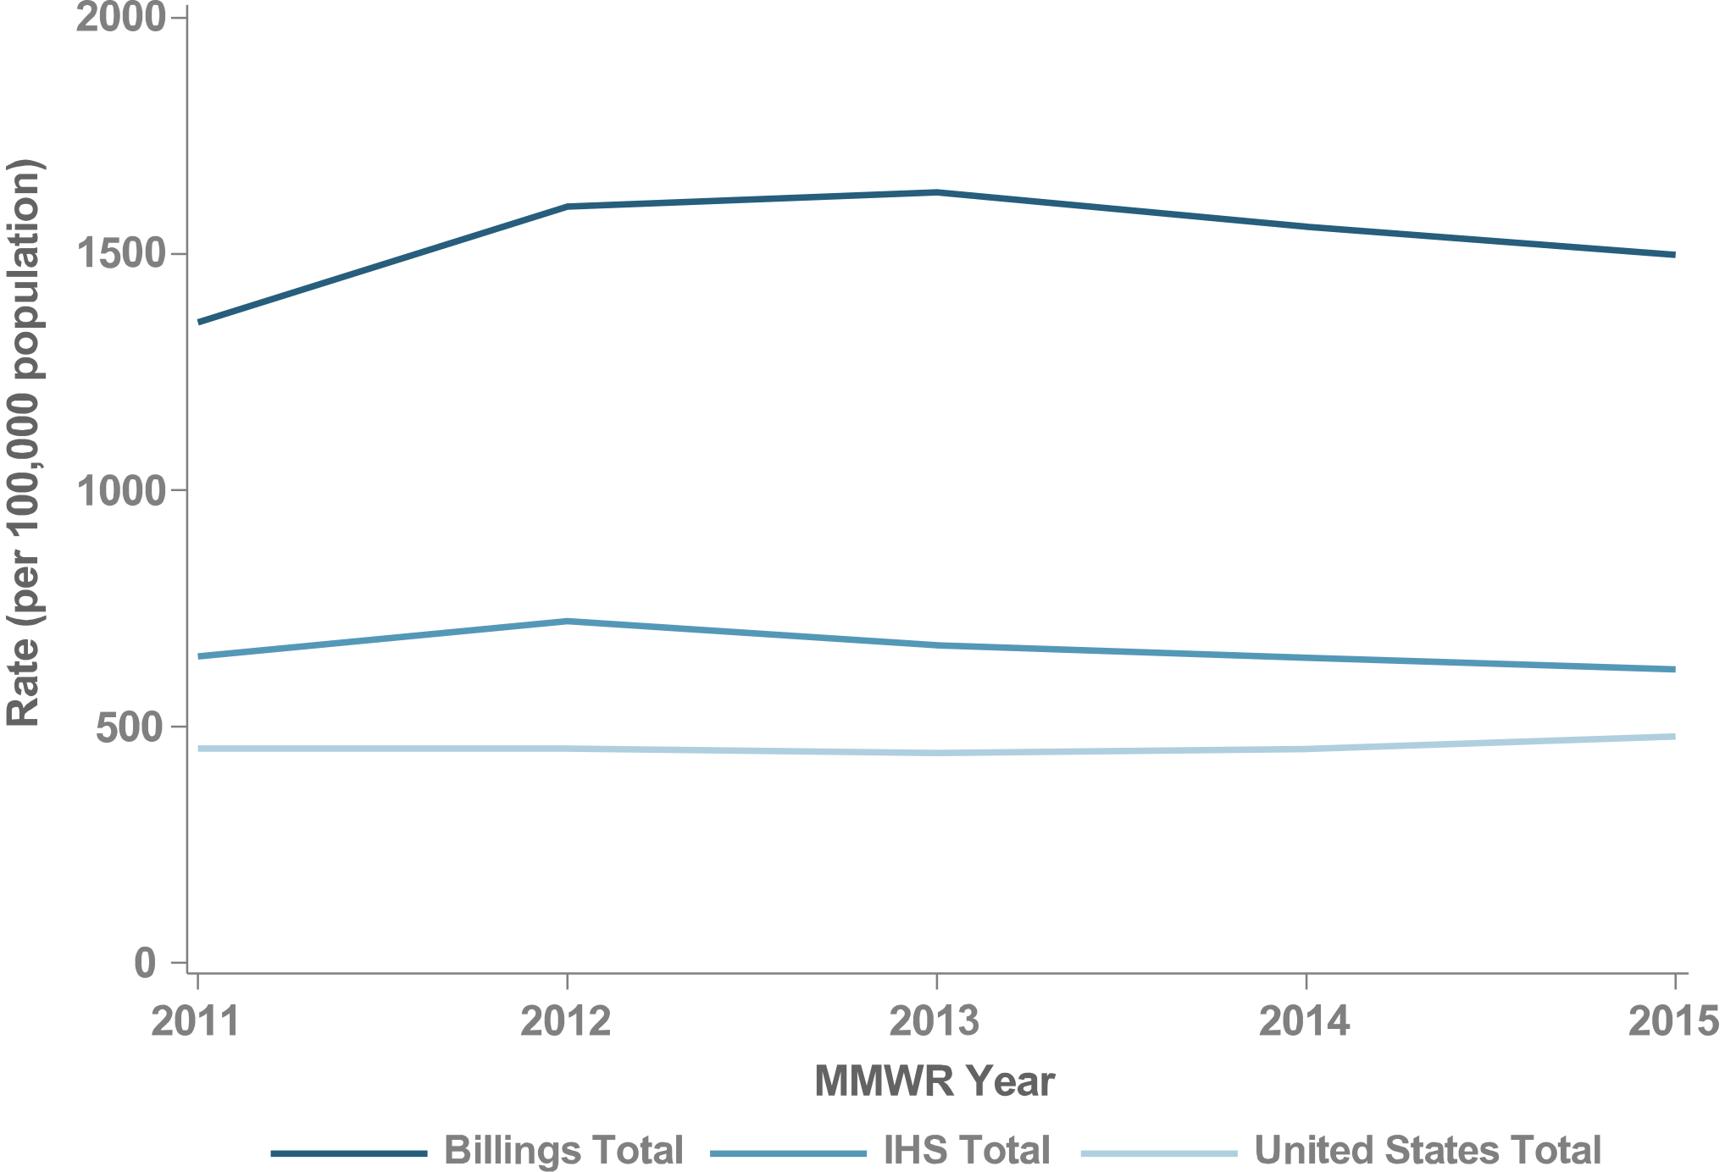
Figure 46. Chlamydia Rates, Billings, 2011–2015

Slide 61
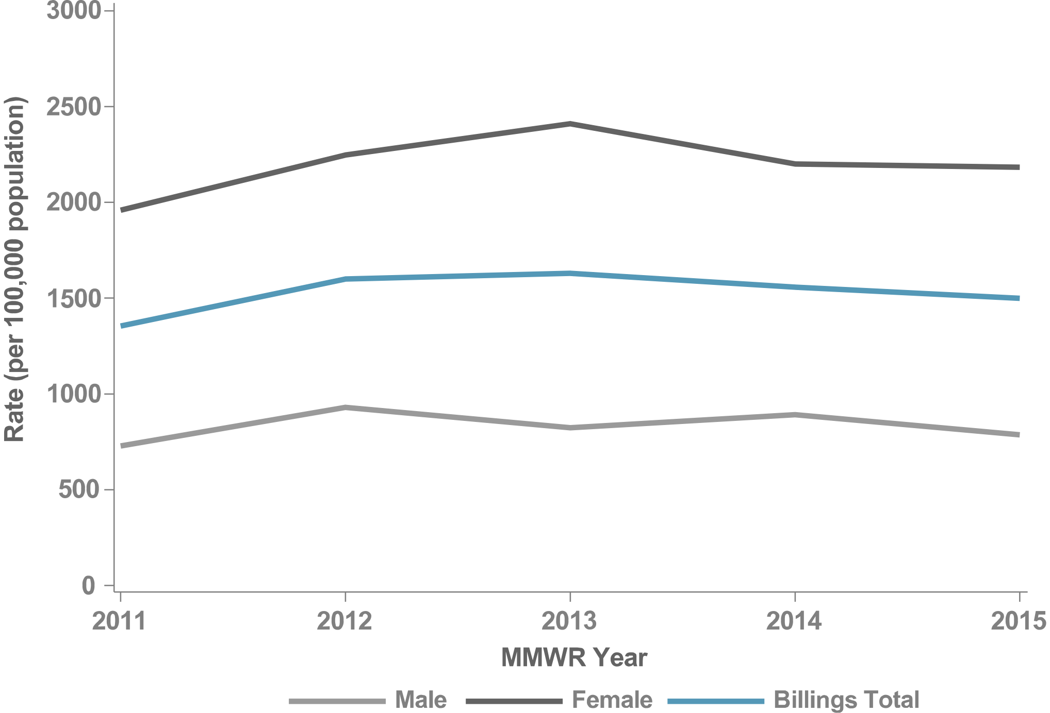
Figure 47. Chlamydia Rates by Sex, Billings, 2011–2015

Slide 62
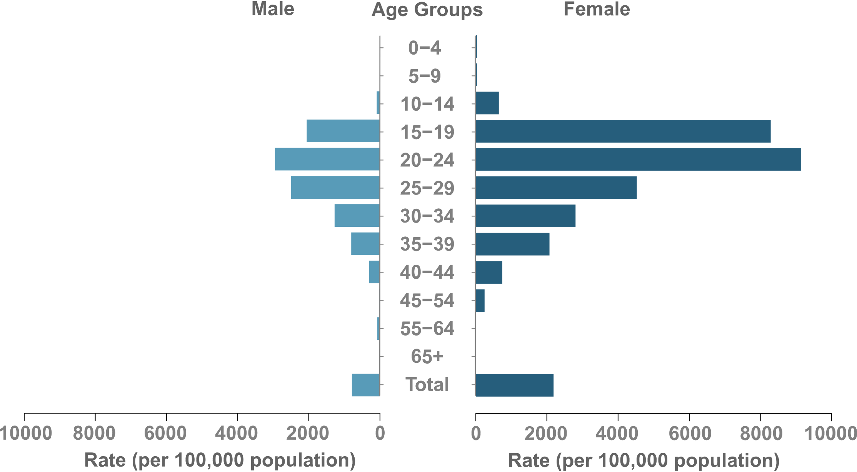
Figure 48. Chlamydia Rates by Sex & Age, Billings, 2015

Slide 63
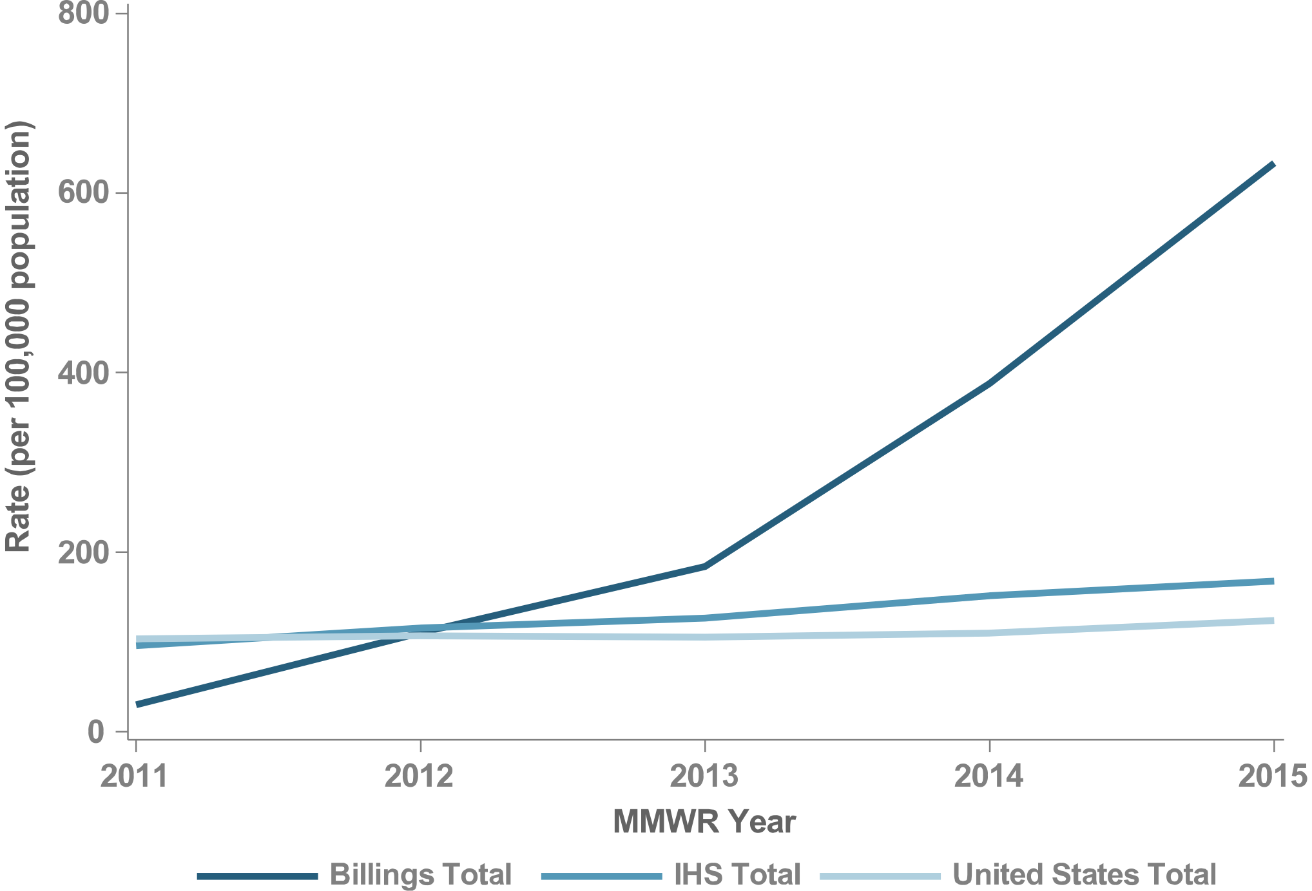
Figure 49. Gonorrhea Rates, Billings, 2011–2015

Slide 64
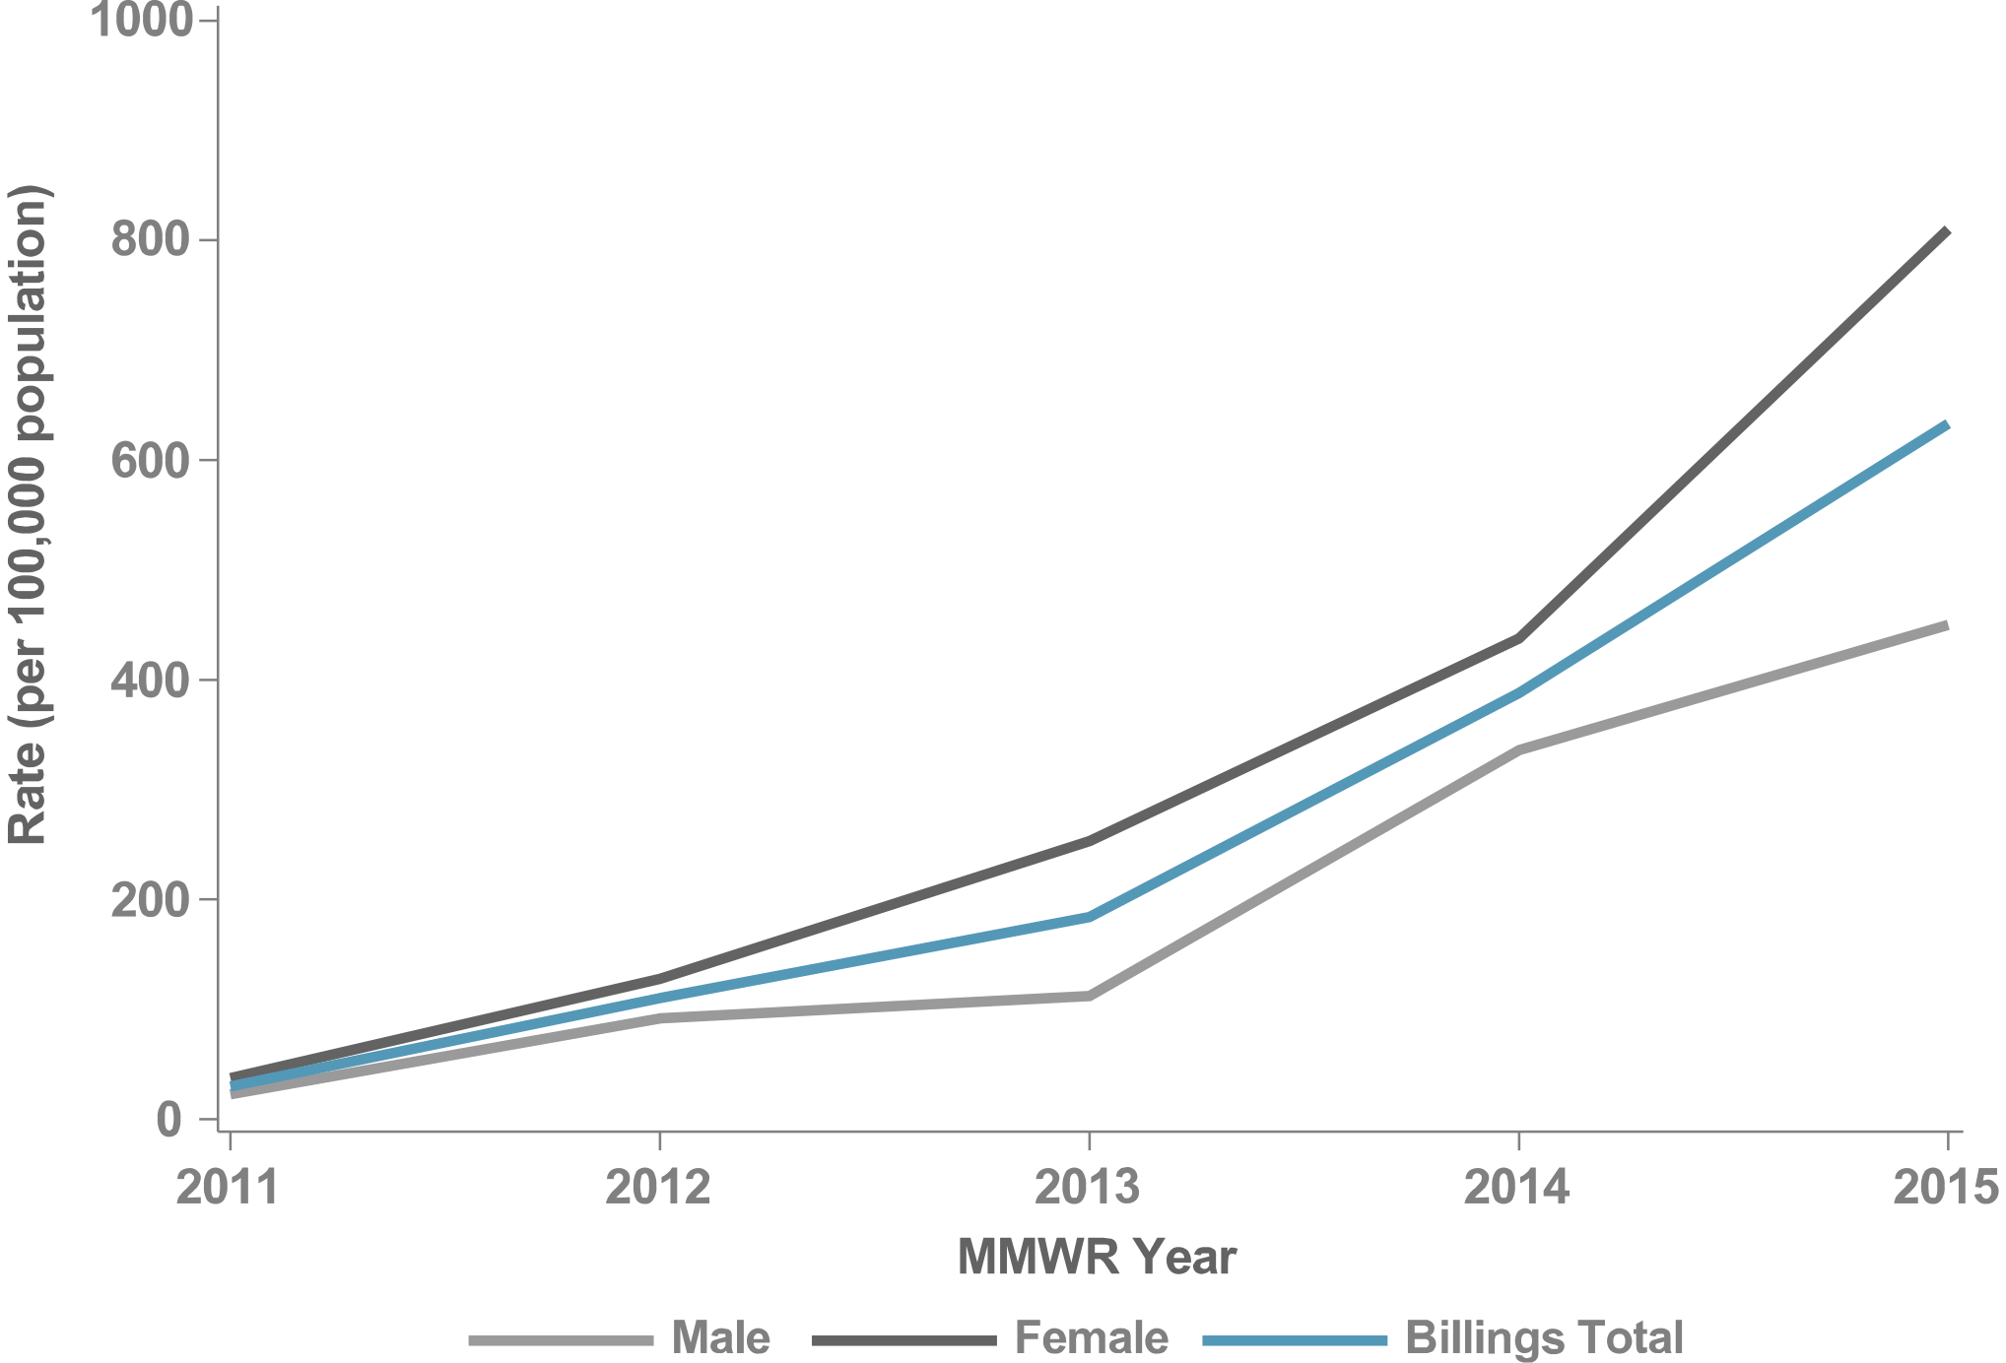
Figure 50. Gonorrhea Rates by Sex, Billings, 2011–2015

Slide 65
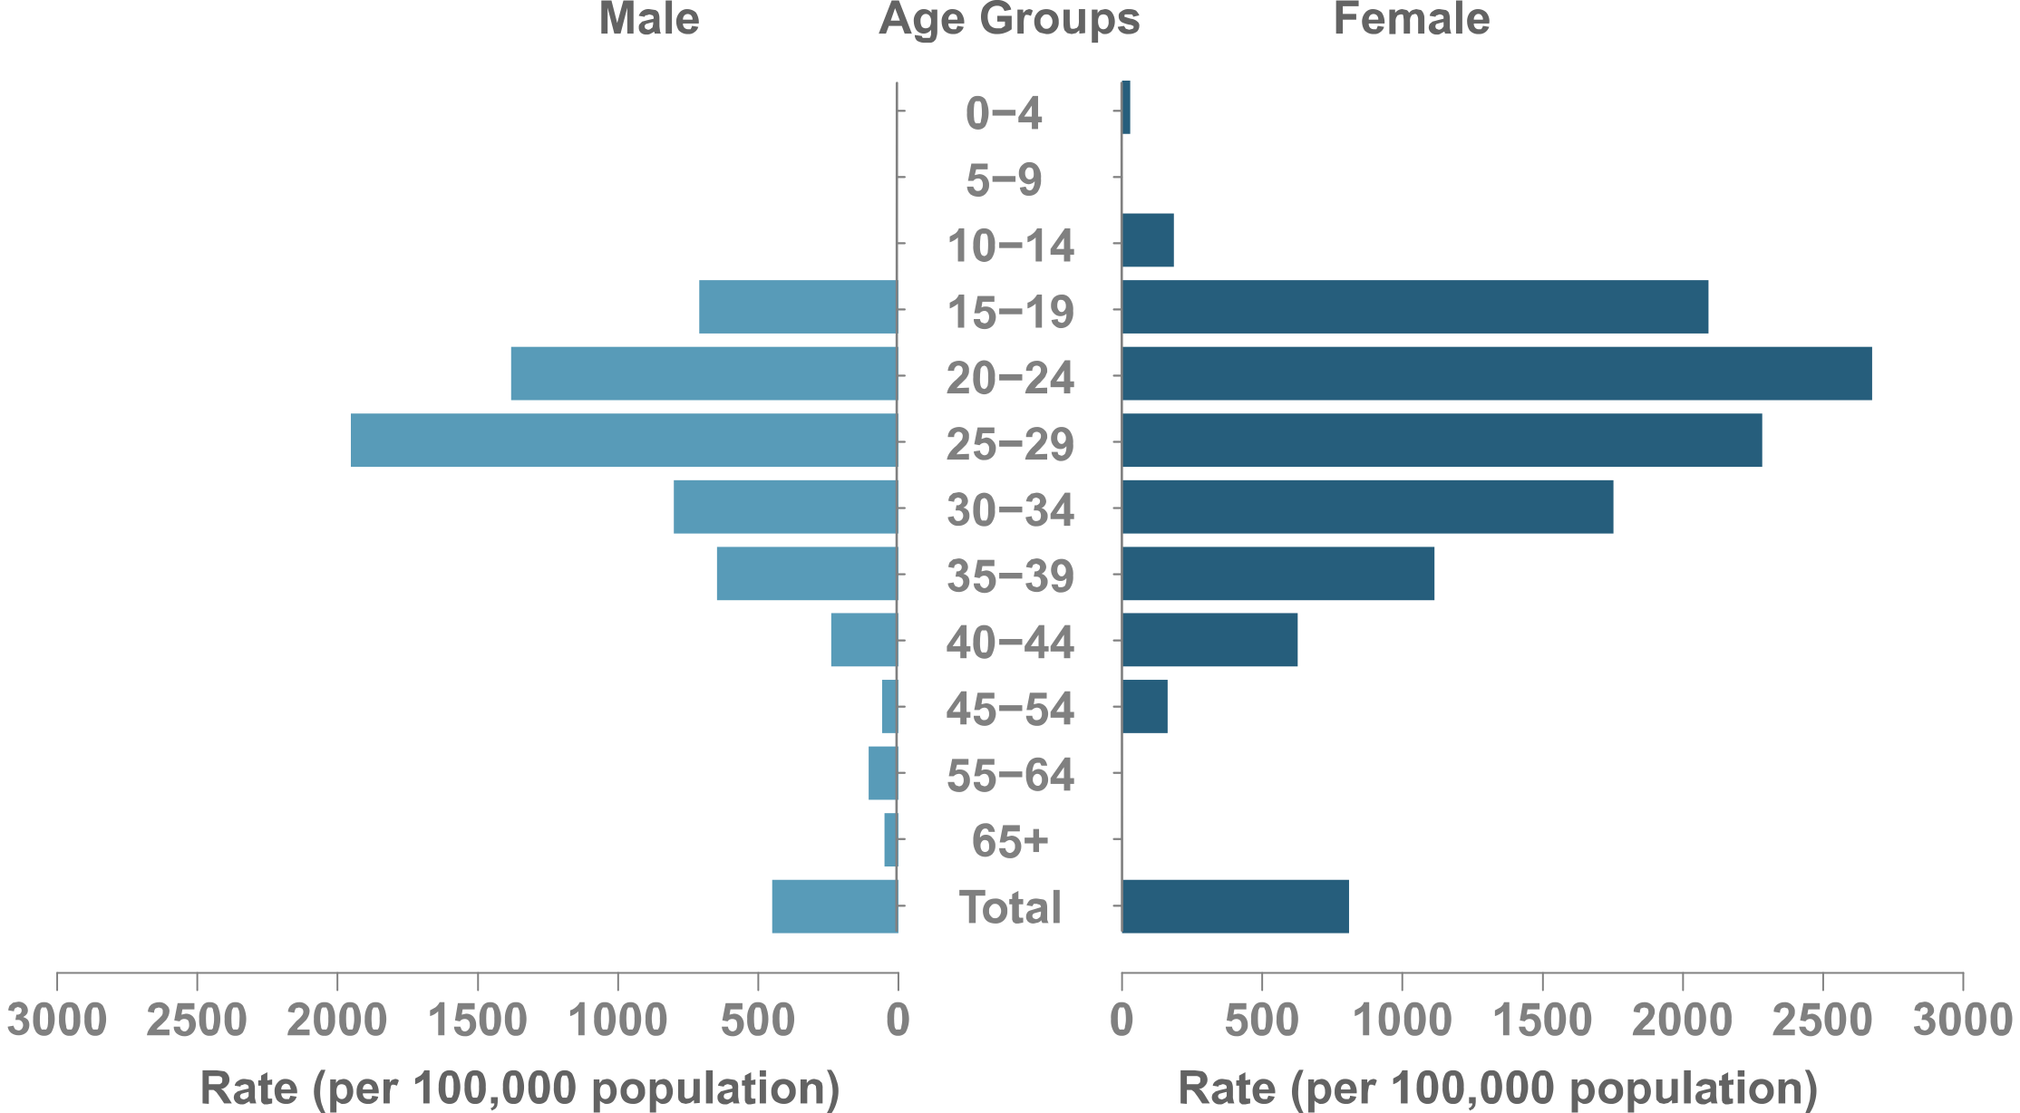
Figure 51. Gonorrhea Rates by Sex & Age, Billings, 2015

Slide 66
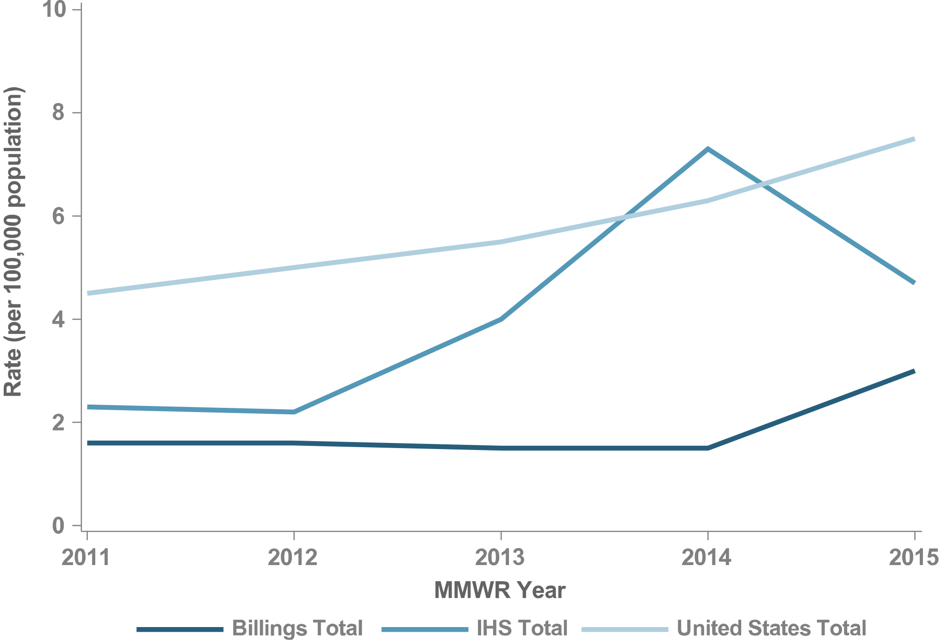
Figure 52. P&S Syphilis Rates, Billings, 2011–2015

Slide 67
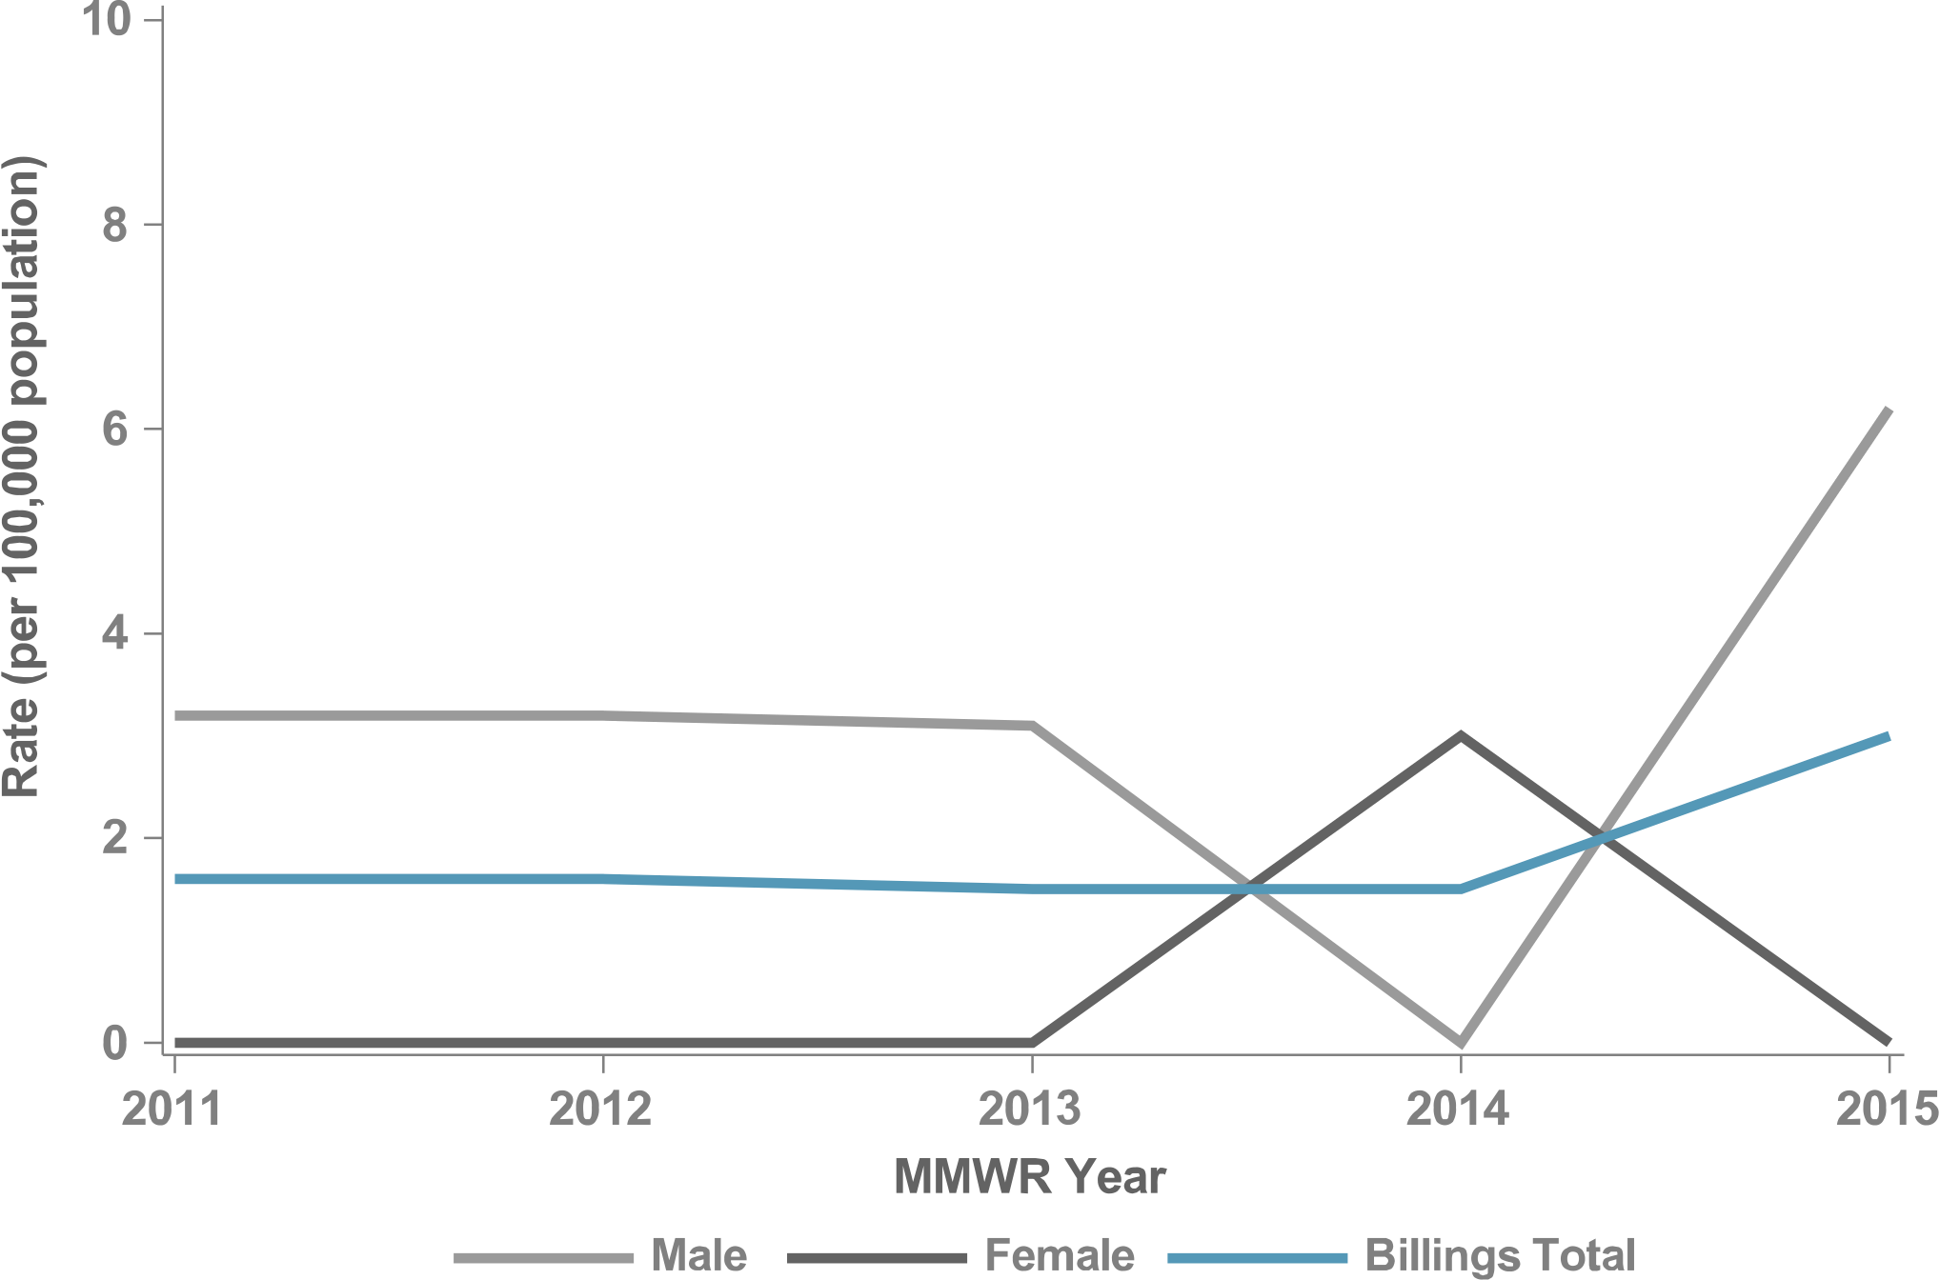
Figure 53. P&S Syphilis Rates by Sex, Billings, 2011–2015

Slide 68
Figure 54. P&S Syphilis Rates by Sex & Age, Billings, 2015

Slide 69
CALIFORNIA
IHS NATIONAL AND AREA STD PROFILES

Slide 70
California
IHS Geography & Population (Data collection ending 2015)
States: 1 (CA)
Counties: CA (40/58)
IHS Service Population (est.): 200,727
Population Size Rank: 5 of 12 Areas
Counties highlighted represent IHS Purchased and Referred Care Service Delivery Areas (PRCSDAs or service counties).
Counties in light blue represent PRCSDAs that are shared between IHS Areas.

Slide 71
Figure 55. Chlamydia Rates, California, 2011–2015

Slide 72
Figure 56. Chlamydia Rates by Sex, California, 2011–2015

Slide 73
Figure 57. Chlamydia Rates by Sex & Age, California, 2015

Slide 74
Figure 58. Gonorrhea Rates, California, 2011–2015

Slide 75
Figure 59. Gonorrhea Rates by Sex, California, 2011–2015

Slide 76
Figure 60. Gonorrhea Rates by Sex & Age, California, 2015

Slide 77
Figure 61. P&S Syphilis Rates, California, 2011–2015

Slide 78
Figure 62. P&S Syphilis Rates by Sex, California, 2011–2015

Slide 79
Figure 63. P&S Syphilis Rates by Sex & Age, California, 2015

Slide 80
GREAT PLAINS
IHS NATIONAL AND AREA STD PROFILES

Slide 81
Great Plains
IHS Geography & Population (Data collection ending 2015)
States: 4 (IA, ND, NE, SD)
Counties: IA (4/99), ND (20/53) NE (20/93) SD (37/66)
IHS Service Population (est.): 141,210
Population Size Rank: 8 of 12 Areas
Counties highlighted represent IHS Purchased and Referred Care Service Delivery Areas (PRCSDAs or service counties).

Slide 82
Figure 64. Chlamydia Rates, Great Plains, 2011–2015

Slide 83
Figure 65. Chlamydia Rates by Sex, Great Plains, 2011–2015

Slide 84
Figure 66. Chlamydia Rates by Sex & Age, Great Plains, 2015

Slide 85
Figure 67. Gonorrhea Rates, Great Plains, 2011–2015

Slide 86
Figure 68. Gonorrhea Rates by Sex, Great Plains, 2011–2015

Slide 87
Figure 69. Gonorrhea Rates by Sex & Age, Great Plains, 2015

Slide 88
Figure 70. P&S Syphilis Rates, Great Plains, 2011–2015

Slide 89
Figure 71. P&S Syphilis Rates by Sex, Great Plains, 2011–2015

Slide 90
Figure 72. P&S Syphilis Rates by Sex & Age, Great Plains, 2015

Slide 91
NASHVILLE
IHS NATIONAL AND AREA STD PROFILES

Slide 92
Nashville
IHS Geography & Population (Data collection ending 2015)
States: 13 (AL, CT, FL, LA, MA, ME, MS, NC, NY, PA, RI, SC, TX)
Counties: AL (5/67) CT (8/8) FL (6/67) LA (6/64) ME (3/16) MA (6/14) MS (10/82) NC (11/100), NY (16/62) PA (1/67) RI (1/5) SC (46/46) TX (1/254)
IHS Service Population (est.): 141,969
Population Size Rank: 7 of 12 Areas
Counties highlighted represent IHS Purchased and Referred Care Service Delivery Areas (PRCSDAs or service counties).

Slide 93
Figure 73. Chlamydia Rates, Nashville, 2011–2015

Slide 94
Figure 74. Chlamydia Rates by Sex, Nashville, 2011–2015

Slide 95
Figure 75. Chlamydia Rates by Sex & Age, Nashville, 2015

Slide 96
Figure 76. Gonorrhea Rates, Nashville, 2011–2015

Slide 97
Figure 77. Gonorrhea Rates by Sex, Nashville, 2011–2015

Slide 98
Figure 78. Gonorrhea Rates by Sex & Age, Nashville, 2015

Slide 99
Figure 79. P&S Syphilis Rates, Nashville, 2011–2015

Slide 100
Figure 80. P&S Syphilis Rates by Sex, Nashville, 2011–2015

Slide 101
Figure 81. P&S Syphilis Rates by Sex & Age, Nashville, 2015

Slide 102
NAVAJO
IHS NATIONAL AND AREA STD PROFILES

Slide 103
Navajo
IHS Geography & Population (Data collection ending 2015)
States: 3 (AZ, NM, UT)
Counties: AZ (3/15) NM (5/33) UT (2/29)
IHS Service Population (est.): 270,045
Population Size Rank: 2 of 12 Areas
Counties highlighted represent IHS Purchased and Referred Care Service Delivery Areas (PRCSDAs or service counties).
Counties in light blue represent PRCSDAs that are shared between IHS Areas.

Slide 104
Figure 82. Chlamydia Rates, Navajo, 2011–2015

Slide 105
Figure 83. Chlamydia Rates by Sex, Navajo, 2011–2015

Slide 106
Figure 84. Chlamydia Rates by Sex & Age, Navajo, 2015

Slide 107
Figure 85. Gonorrhea Rates, Navajo, 2011–2015

Slide 108
Figure 86. Gonorrhea Rates by Sex, Navajo, 2011–2015

Slide 109
Figure 87. Gonorrhea Rates by Sex & Age, Navajo, 2015

Slide 110
Figure 88. P&S Syphilis Rates, Navajo, 2011–2015

Slide 111
Figure 89. P&S Syphilis Rates by Sex, Navajo, 2011–2015

Slide 112
Figure 90. P&S Syphilis Rates by Sex & Age, Navajo, 2015

Slide 113
OKLAHOMA CITY
IHS NATIONAL AND AREA STD PROFILES

Slide 114
Oklahoma City
IHS Geography & Population (Data collection ending 2015)
States: 3 (KS, OK, TX)
Counties: KS (4/105) OK (77/77) TX (1/254)
IHS Service Population (est.): 419,083
Population Size Rank: 1 of 12 Areas
Counties highlighted represent IHS Purchased and Referred Care Service Delivery Areas (PRCSDAs or service counties).

Slide 115
Figure 91. Chlamydia Rates, Oklahoma City, 2011–2015

Slide 116
Figure 92. Chlamydia Rates by Sex, Oklahoma City, 2011–2015

Slide 117
Figure 93. Chlamydia Rates by Sex & Age, Oklahoma City, 2015

Slide 118
Figure 94. Gonorrhea Rates, Oklahoma City, 2011–2015

Slide 119
Figure 95. Gonorrhea Rates by Sex, Oklahoma City, 2011–2015

Slide 120
Figure 96. Gonorrhea Rates by Sex & Age, Oklahoma City, 2015

Slide 121
Figure 97. P&S Syphilis Rates, Oklahoma City, 2011–2015

Slide 122
Figure 98. P&S Syphilis Rates by Sex, Oklahoma City, 2011–2015

Slide 123
Figure 99. P&S Syphilis Rates by Sex & Age, Oklahoma City, 2015

Slide 124
PHOENIX
IHS NATIONAL AND AREA STD PROFILES

Slide 125
Phoenix
IHS Geography & Population (Data collection ending 2015)
States: 4 (AZ, CA, NV, UT)
Counties: AZ (13/15) CA (3/58) NV (17/17) UT (17/29)
IHS Service Population (est.): 234,076
Population Size Rank: 3 of 12 Areas
Counties highlighted represent IHS Purchased and Referred Care Service Delivery Areas (PRCSDAs or service counties).
Counties in light blue represent PRCSDAs that are shared between IHS Areas.

Slide 126
Figure 100. Chlamydia Rates, Phoenix, 2011–2015

Slide 127
Figure 101. Chlamydia Rates by Sex, Phoenix, 2011–2015

Slide 128
Figure 102. Chlamydia Rates by Sex & Age, Phoenix, 2015

Slide 129
Figure 103. Gonorrhea Rates, Phoenix, 2011–2015

Slide 130
Figure 104. Gonorrhea Rates by Sex, Phoenix, 2011–2015

Slide 131
Figure 105. Gonorrhea Rates by Sex & Age, Phoenix, 2015

Slide 132
Figure 106. P&S Syphilis Rates, Phoenix, 2011–2015

Slide 133
Figure 107. P&S Syphilis Rates by Sex, Phoenix, 2011–2015

Slide 134
Figure 108. P&S Syphilis Rates by Sex & Age, Phoenix, 2015

Slide 135
PORTLAND
IHS NATIONAL AND AREA STD PROFILES

Slide 136
Portland
IHS Geography & Population (Data collection ending 2015)
States: 3 (ID, OR, WA)
Counties: ID (14/44) OR (25/36) WA (32/39)
IHS Service Population (est.): 232,726
Rank: 4 of 12 Areas
Counties highlighted represent IHS Purchased and Referred Care Service Delivery Areas (PRCSDAs or service counties).

Slide 137
Figure 109. Chlamydia Rates, Portland, 2011–2015

Slide 138
Figure 110. Chlamydia Rates by Sex, Portland, 2011–2015

Slide 139
Figure 111. Chlamydia Rates by Sex & Age, Portland, 2015

Slide 140
Figure 112. Gonorrhea Rates, Portland, 2011–2015

Slide 141
Figure 113. Gonorrhea Rates by Sex, Portland, 2011–2015

Slide 142
Figure 114. Gonorrhea Rates by Sex & Age, Portland, 2015

Slide 143
Figure 115. P&S Syphilis Rates, Portland, 2011–2015

Slide 144
Figure 116. P&S Syphilis Rates by Sex, Portland, 2011–2015

Slide 145
Figure 117. P&S Syphilis Rates by Sex & Age, Portland, 2015

Slide 146
TUCSON
IHS NATIONAL AND AREA STD PROFILES

Slide 147
Tucson
IHS Geography & Population (Data collection ending 2015)
States: 1 (AZ)
Counties: AZ (4/15)
IHS Service Population (est.): 40,933
Rank: 12 of 12 Areas
Counties highlighted represent IHS Purchased and Referred Care Service Delivery Areas (PRCSDAs or service counties).
Counties in light blue represent PRCSDAs that are shared between IHS Areas.

Slide 148
Figure 118. Chlamydia Rates, Tucson, 2011–2015

Slide 149
Figure 119. Chlamydia Rates by Sex, Tucson, 2011–2015

Slide 150
Figure 120. Chlamydia Rates by Sex & Age, Tucson, 2015

Slide 151
Figure 121. Gonorrhea Rates, Tucson, 2011–2015

Slide 152
Figure 122. Gonorrhea Rates by Sex, Tucson, 2011–2015

Slide 153
Figure 123. Gonorrhea Rates by Sex & Age, Tucson, 2015

Slide 154
Figure 124. P&S Syphilis Rates, Tucson, 2011–2015

Slide 155
Figure 125. P&S Syphilis Rates by Sex, Tucson, 2011–2015

Slide 156
Figure 126. P&S Syphilis Rates by Sex & Age, Tucson, 2015

Slide 157
Sexually Transmitted Diseases
Indian Health Surveillance Report

