Slide 1
RPMS Immunization Package Training - Reports
Version 8.5*4
Amy Groom, MPH
IHS Immunization Program Manager

Slide 2
Some basic tips
To go back to a previous screen, enter “^” (shift 6)
To save changes and exit, hit the F1 key and “E” in quick succession
To quit and go back to the previous screen WITHOUT saving changes, hit the F1 key and “Q” in quick succession
“??” in any field will give you a list of what your data entry options are

Slide 3
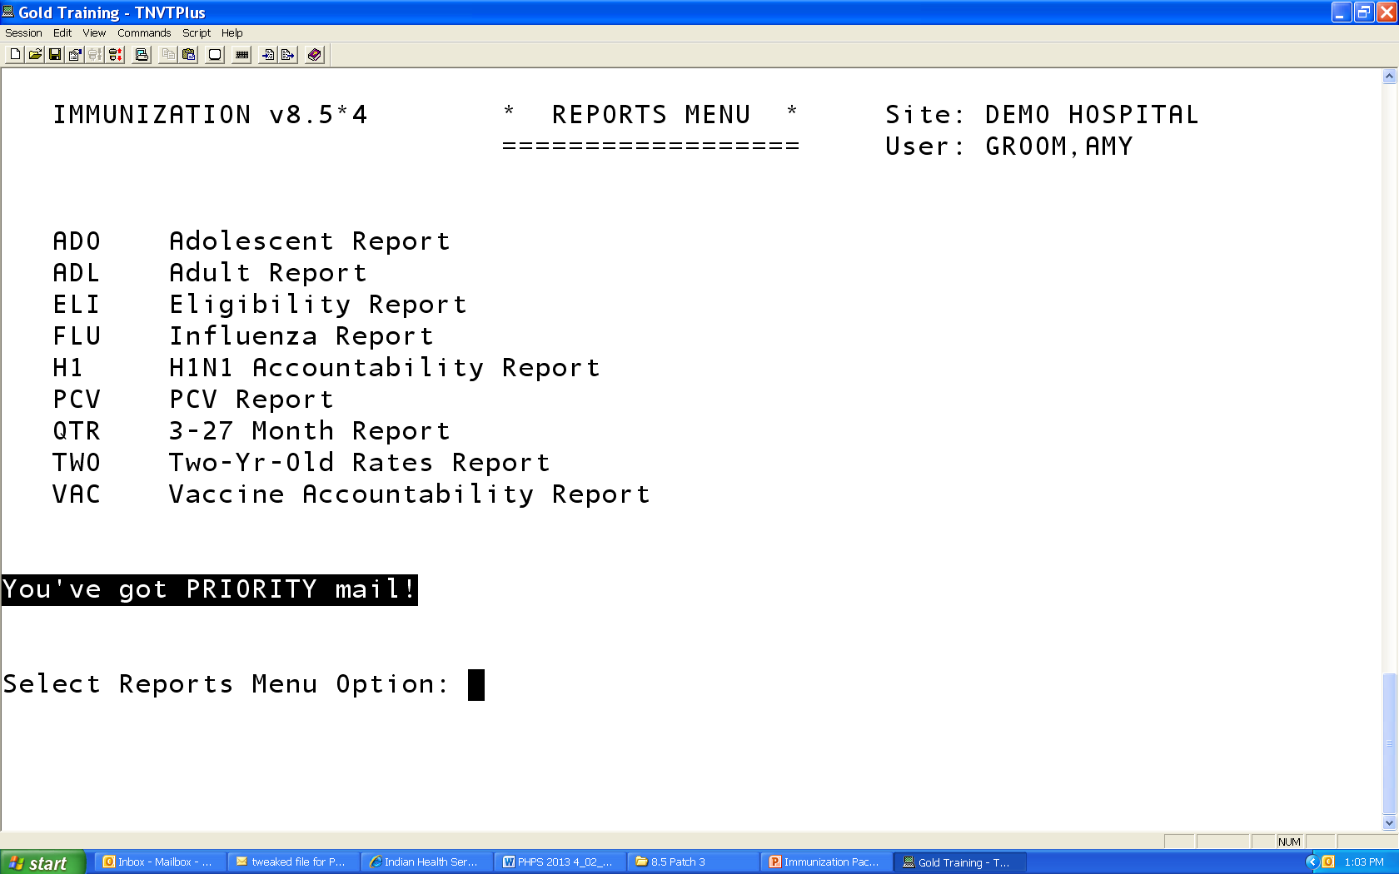
IMMUNIZATION v8.5*4 REPORTS MENU

Slide 4
Immunization Coverage Reports
Immunization Coverage Reports
  Adolescent
  Adult
  Flu
  3 – 27 month (QTR)
  Two year old
  PCV (used on Navajo for a specific vaccine study)
Accountability
  Eligibility
  Vaccine Accountability
  H1N1 Accountability

Slide 5
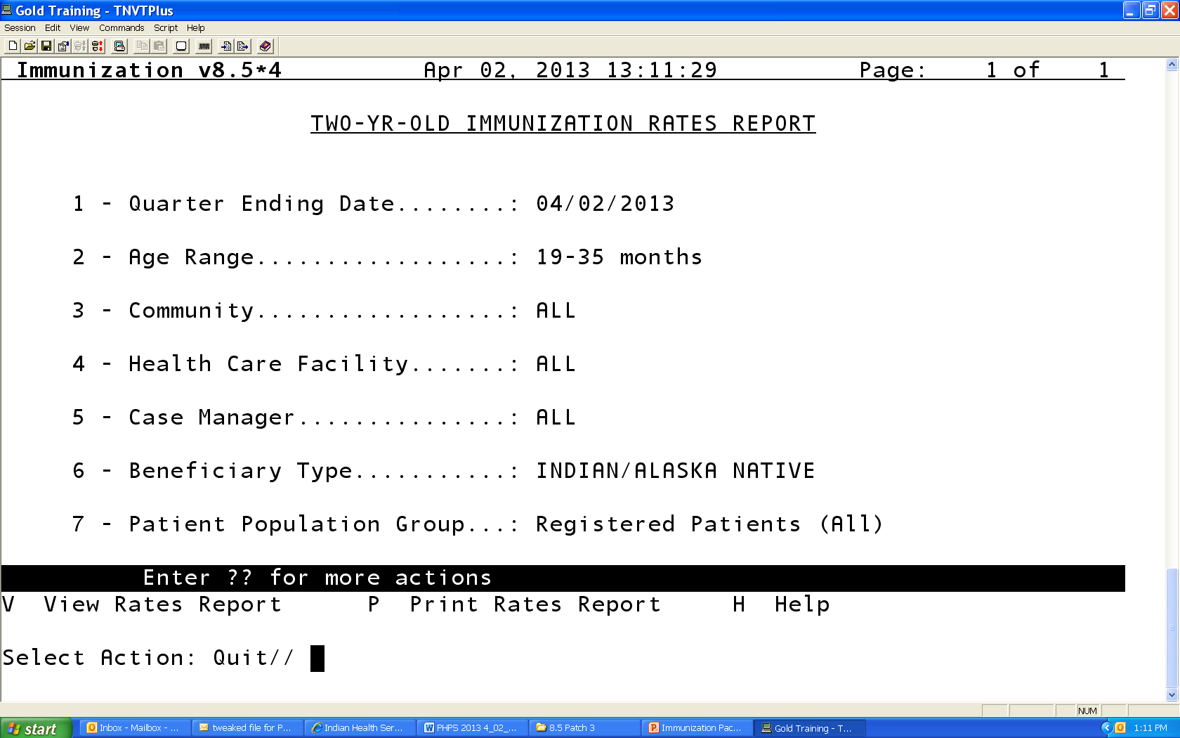
Report Parameters

Slide 6
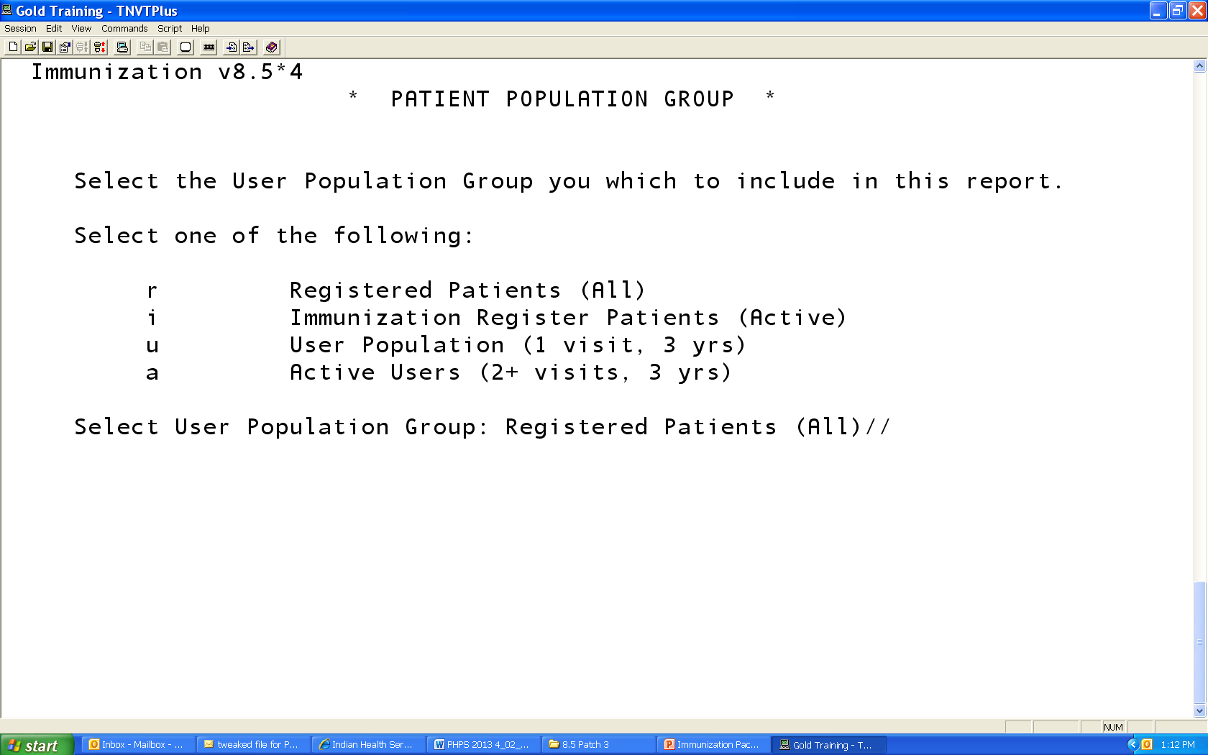
Choosing your Denominator
Default for 3-27 and 2 year olds is Active in the Immunization Register
Default for Flu, Adolescent and Adult is Active Users

Slide 7
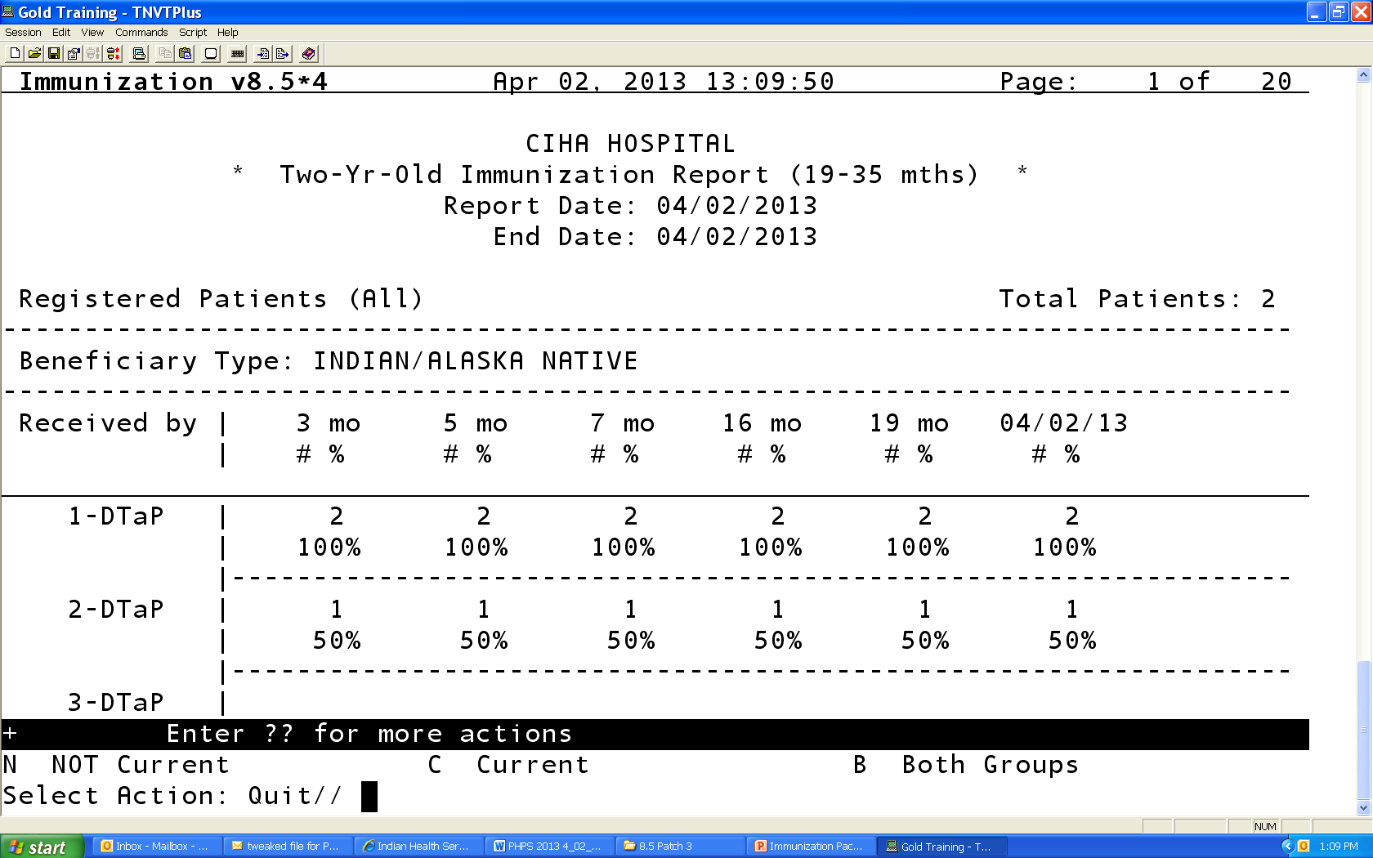
Current vs. Not Current
All coverage reports allow you to generate a list of the patients who are Not Current, Current, or Both groups
To View, type in “N” for Not Current, “C” for current, or “B” for both groups

Slide 8
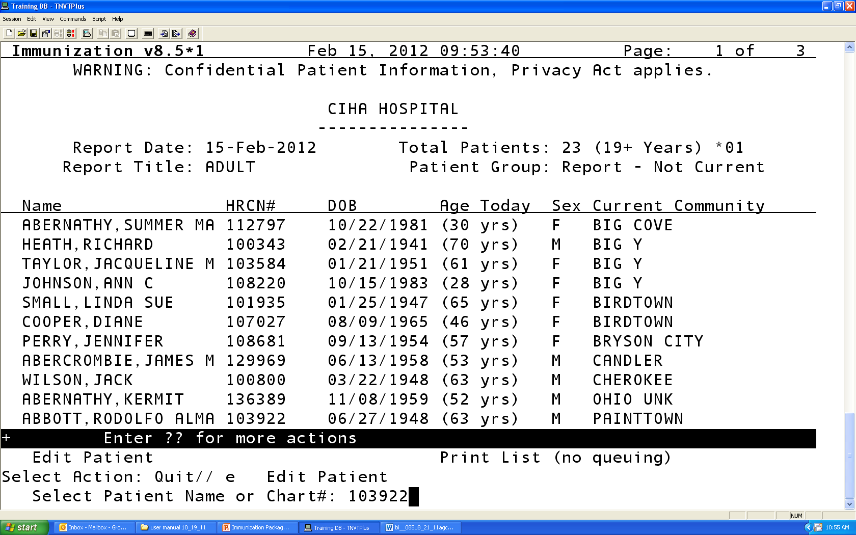
Patient Lists of “Not Current”
To view and individual patient record, select “E” for edit patient
Enter patient chart number
Enter forecast date (or accept default)
Patients Imm Record and complete history will be pulled up

Slide 9
3 – 27 Month Report (QTR)

Slide 10
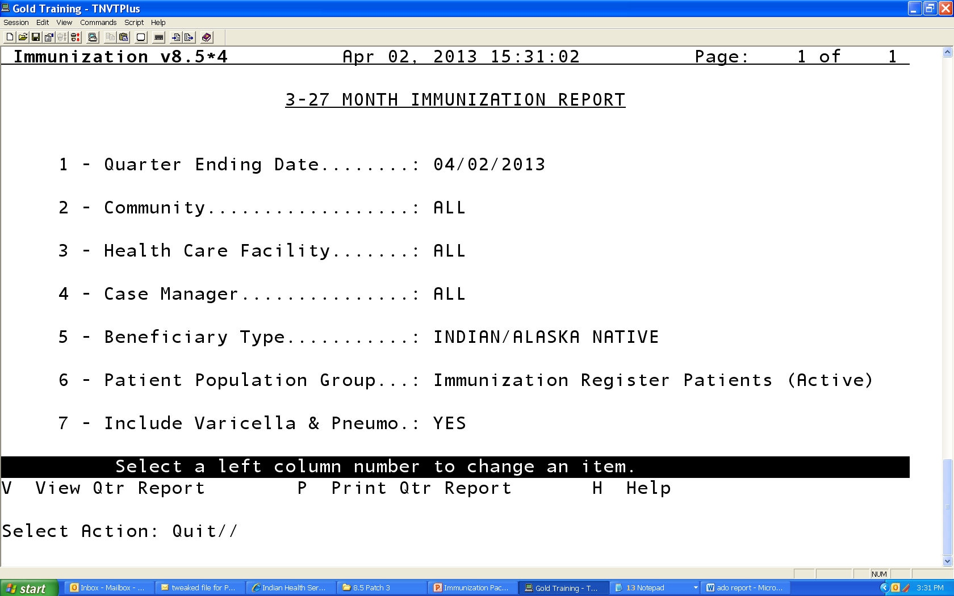
3-27 Month Immunization Report

Slide 11
Include Varicella & Pneumo
Default is YES
Means Varicella and Pneumococcal are included in the Minimum Needs
  E.g. child must have appropriate # of varicella and PCV to be current

Slide 12
Include Varicella & Pneumo : Yes
CIHA HOSPITAL
* 3-27 Month Immunization Report *
Report Date: 04/02/2013
End Date: 04/02/2013
Immunization Register Patients (Active)
-------------------------------------------------------------------------------
Beneficiary Type: INDIAN/ALASKA NATIVE
-------------------------------------------------------------------------------
Age in Months
|---------------------------------------------------------- ---------------------------
| 3-4 5-6 7-15 16-18 19-23 24-27 |
+
Minimum| 1-DTaP 2-DTaP 3-DTaP 3-DTaP 4-DTaP 4-DTaP|
Needs | 1-POLIO 2-POLIO 2-POLIO 2-POLIO 3-POLIO 3-POLI|
| 1-HIB 2-HIB 2-HIB 3-HIB 3-HIB 3-HIB |
| 1-HEPB 2-HEPB 2-HEPB 2-HEPB 3-HEPB 3-HEPB|
| 1-PCV 2-PCV 3-PCV 4-PCV 4-PCV 4-PCV |
| 1-MMR 1-MMR 1-MMR |
1-VAR 1-VAR 1-VAR

Slide 13
Include Varicella & Pneumo: No
CIHA HOSPITAL
* 3-27 Month Immunization Report *
Report Date: 04/02/2013
End Date: 04/02/2013
Immunization Register Patients (Active)
-------------------------------------------------------------------------------
Beneficiary Type: INDIAN/ALASKA NATIVE
-------------------------------------------------------------------------------
Age in Months
|---------------------------------------------------------- ---------------------------
| 3-4 5-6 7-15 16-18 19-23 24-27 |
+
Minimum| 1-DTaP 2-DTaP 3-DTaP 3-DTaP 4-DTaP 4-DTaP|
Needs | 1-POLIO 2-POLIO 2-POLIO 2-POLIO 3-POLIO 3-POLI|
| 1-HIB 2-HIB 2-HIB 3-HIB 3-HIB 3-HIB |
| 1-HEPB 2-HEPB 2-HEPB 2-HEPB 3-HEPB 3-HEPB|
| | 1-MMR 1-MMR 1-MMR |

Slide 14
3-27 month old report
3-27 month old report
*
Notes:
14
3-27 month old report

Slide 15
3-27 Month Old Report
  Logic accounts for different Hib formulations and different dose numbers needed when calculating CURRENT status
  For Hib and PCV – children up to date per catch up schedule counted as CURRENT

Slide 16
3-27 Month Old Report
Catch up schedule, vaccine brand included
Vaccine | 3-4mo | 5-6mo | 7-15mo | 16-18mo | 19-23mo
Hib
Pedvax (all doses <12mo) | 1 | 2 | 2 | 3 or 2 > 12 mo. 1 > 15 mo. | 3 or 2 > 12 mo. 1 > 15 mo.
ActHIB | 1 | 2 | 3 or 2 > 7 mo. | 4 or 3 > 7 mo. 2 > 12 mo. 1 > 15 mo. | 4 or 3 > 7 mo. 2 > 12 mo. 1 > 15 mo.
PCV (PCV7 and/or PCV13) | 1 | 2 | 3 or 2 > 7 mo. | 4 or 3 > 7 mo. 2 > 12 mo. 1 > 24 mo. | 4 or 3 > 7 mo. 2 > 12 mo. 1 > 24 mo.

Slide 17
Two Year Old

Slide 18
Two-Yr-Old Immunization Report
Notes:
18
Two-Yr-Old Immunization Report

Slide 19
Two-Yr-Old Immunization Report –cont…
Notes:
19
Two-Yr-Old Immunization Report CONT

Slide 20
Two Year Old Report
  Report takes into account Hib brand to determine if 3 or 4 doses of vaccine are needed to be considered up to date with vaccine series combinations (e.g. 4313314)
    If all PedvaxHib – 3 doses
    If all ActHib or mix of Pedvaxhib and Acthib products 4 doses
  Report also takes into account Rotavirus vaccine brand to determine if 2 or 3 doses of rotavirus are needed in the 431331423 and 4313314232 series measures
  Children who do not have recommended number of vaccine doses will be NOT CURRENT, EVEN IF they are current per the catch up schedule
    This is DIFFERENT than the 3-27 month report

Slide 21
3-27 month old vs. 2 year old report
3-27 month old report is your “worksheet”, your to do list. You can run this every week and focus efforts to catch children up as soon as they are falling behind
If you have good coverage in your 3-27 month report, you WILL have good coverage in your 2 year old report
Meant to provide lists of children the provider can follow up on now, when child is most vulnerable
  E.g if child is current per catch up schedule, then nothing the provider can do for that child, so child will be CURRENT in this report even if they didn’t receive the recommended number of doses.

Slide 22
3-27 month old vs. 2 year old report, cont.
Two year old report is more of a population level report that tells you how well you DID at MEETING THE RECOMMENDATIONS
  E.g the recommendation is that a child receive 4 doses of pneumococcal conjugate vaccine. If a child only received 3, then we DID NOT meet the recommendation (and probably left the child unprotected during the most vulnerable time of life).
The two year old report is a way to look back at how we did, but is not as useful as the 3-27 month report in identifying children who are behind today and for whom you can actually do something
  Once they are 2 yrs, if they didn’t get the vaccines, there isn’t much you can do.
Main Difference from 3-27 month old report:
  In the 2 year old report, even if a child is current per the catch up schedule, they will show up as NOT CURRENT in the 2 year old report.
  e.g. if a child received 3 doses of PCV, and does not need a 4th dose because they started at 7 months, this child will show up as NOT CURRENT because they did not get the recommended # of vaccines

Slide 23
Adolescent Report
Adolescent 11-17 years
  “Current” based on 1 Tdap/Td, 1 Mening, and 3 HPV

Slide 24
Adolescent Report

Slide 25
Adolescent Report, cont.

Slide 26
Adult Report
  All Ages report – 19yrs +
    Td/Tdap in last 10 yrs for 19 + yrs
    HPV 1,2 and 3 in Females 19-26 years, Males 19-21 years
    Zoster for 60+
    PPSV23 for 65+
      Ever
      After 65+ yrs

Slide 27
Adult Immunization Report
Immunization v8.5*4 Apr 02, 2013 13:52:58
CIHA HOSPITAL
* Adult Immunization Report *
Report Date: 04/02/2013
Active Users (2+ visits, 3 yrs)
Beneficiary Type: INDIAN/ALASKA NATIVE
-------------------------------------------------------------------------------
Number Percent
Total Number of Patients over 19 years old............: 155
TETANUS: # patients w/Td in past 10 years...........: 51 32.9
TETANUS: # patients w/Tdap in past 10 years.........: 6 3.9
HPV: Total # Female patients age 19-26..............: 6 3.9
HPV: # Female patients age 19-26 w/HPV1.............: 0 0.0
HPV: # Female patients age 19-26 w/HPV2.............: 0 0.0
HPV: # Female patients age 19-26 w/HPV3.............: 0 0.0
HPV: Total # Male patients age 19-21................: 2 1.3
HPV: # Male patients age 19-21 w/HPV1...............: 0 0.0
HPV: # Male patients age 19-21 w/HPV2...............: 0 0.0
HPV: # Male patients age 19-21 w/HPV3...............: 0 0.0
Total Number of Patients over 60 years old............: 49 31.6
ZOSTER: # patients w/Zostavax ever..................: 0 0.0
Total Number of Patients over 65 years old............: 37 23.9
TETANUS: # patients w/Td in past 10 years...........: 8 21.6
PNEUMOVAX: # patients w/Pneumovax at or over 65 yrs.: 9 24.3
PNEUMOVAX: # patients w/Pneumovax ever..............: 3 4 91.9
Total Patients included who had Refusals on record....: 4
To view patient rosters, select a group below:
N NOT Current C Current B Both Groups

Slide 28
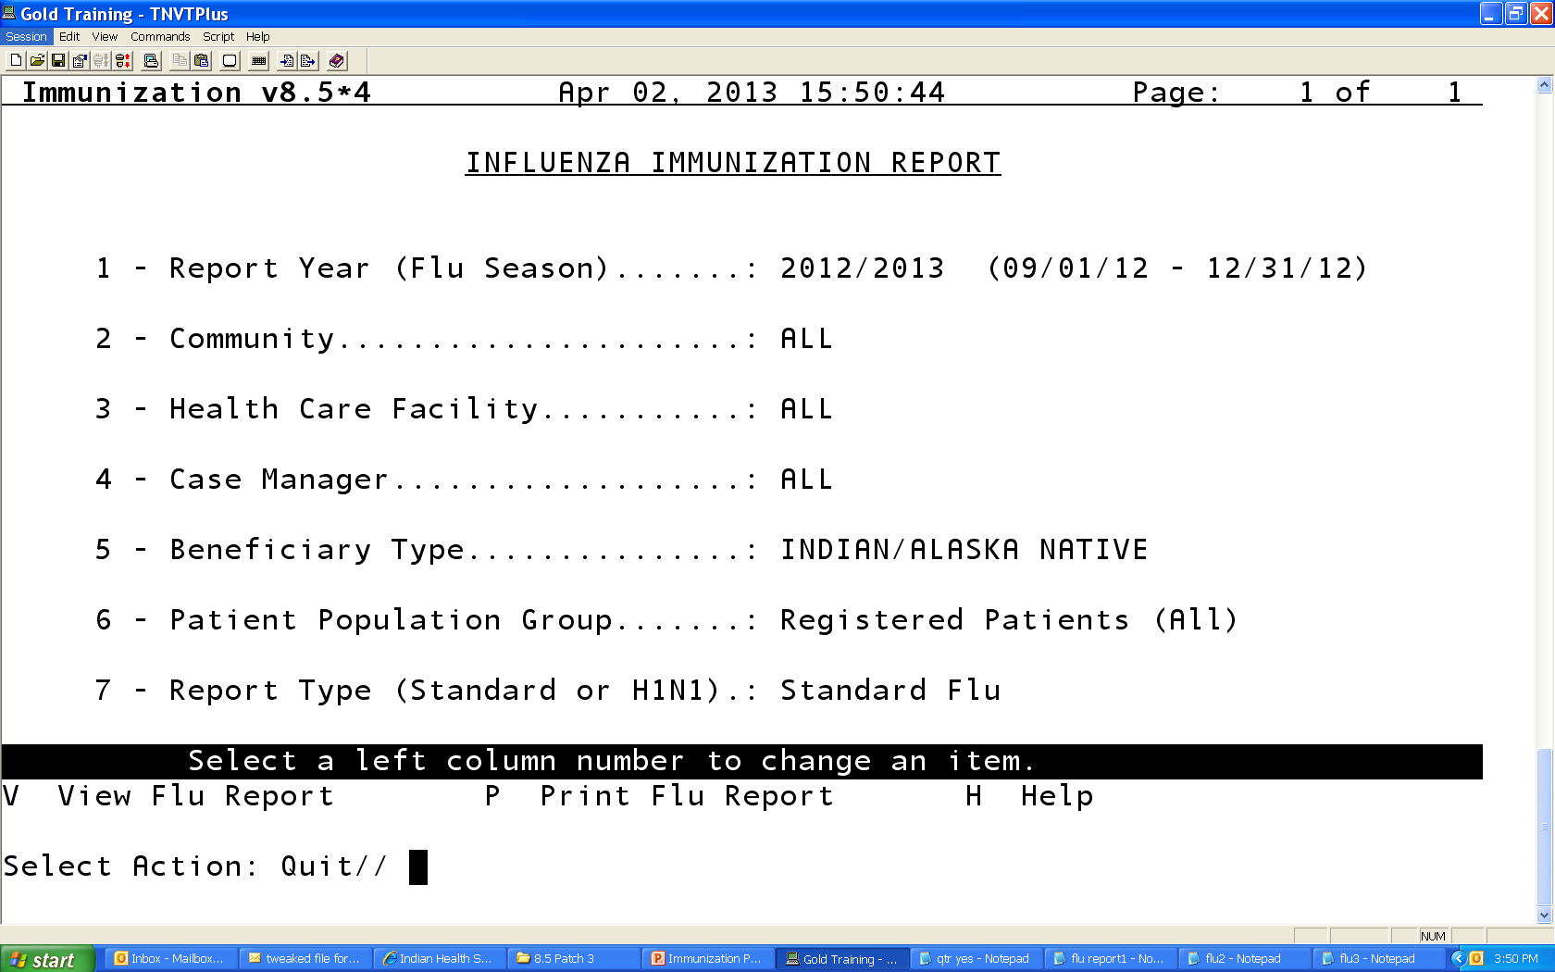
Flu Report

Slide 29
Standard Flu Immunization Report
Immunization v8.5*4 Apr 02, 2013 15:44:54 Page: 1 of 3
CIHA HOSPITAL
* Standard Flu Immunization Report *
Report Date: 04/02/2013
Date Range: 09/15/2012 - 12/31/2012
Registered Patients (All)
-------------------------------------------------------------------------------
Beneficiary Type: INDIAN/ALASKA NATIVE
-------------------------------------------------------------------------------
| Age in months/years on 12/31/2012 |
Dose# |------------------------------------------------------- | Totals
| 10-23m 2-4y 5-17y 18-49y *18-49hr 50-64y 65+yrs|
Denominator | 1 3 1732 3111 17 603 506 | 5973
-------------------------------------------------------------------------------
1-FLU | 0 0 1 1 1 0 0 | 3
2012 Season | 0% 0% 0% 0% 6% 0% 0%| 0%
-------------------------------------------------------------------------------
Fully | 0 0 1 1 1 0 0 | 3
Immunized | 0% 0% 0% 0% 6% 0% 0%| 0%
-------------------------------------------------------------------------------
Total Patients included who had Influenza Refusals on record 21
*NOTE: The 18-49hr column tallies patients who are High Risk in that
Age Group. They are not included in the normal 18-49y column.
-------------------------------------------------------------------------------

Slide 30
Vaccine Accountability Report
Used to track number of vaccines administered , by age group
  If you want to use to look at shots ADMINSTERED at your facility, do not include Historical vaccines (#7)
    Default is set to “Yes”
  Can be used for VFC inventory reporting
  Can be displayed by individual lot# (parameter #8)

Slide 31
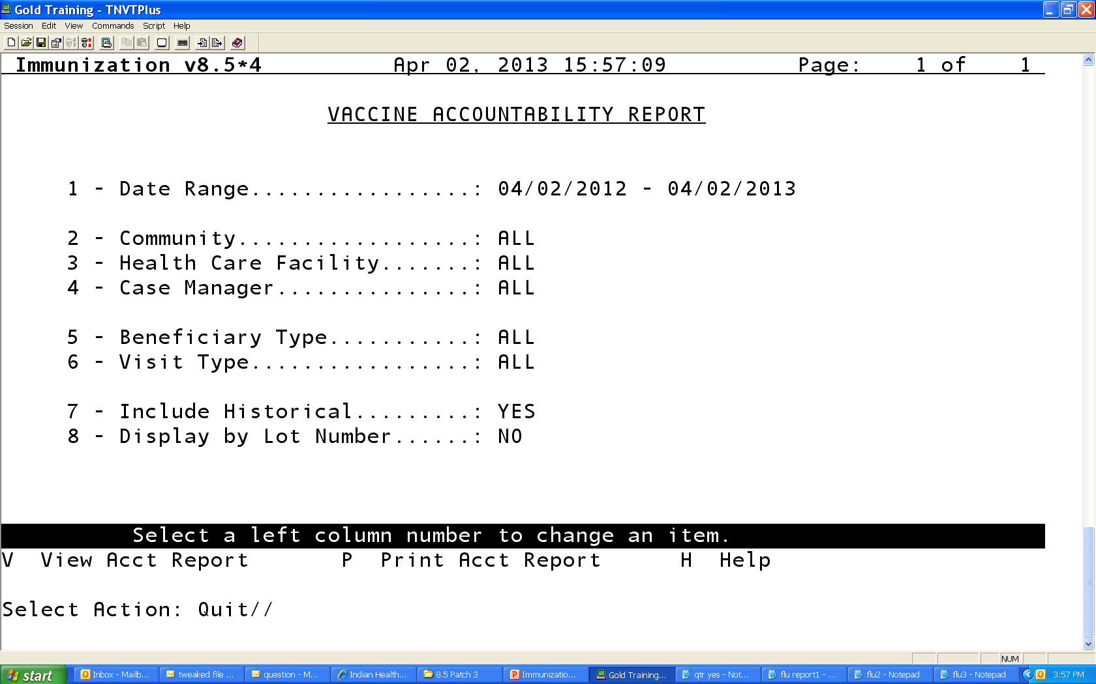
Vaccine Accountability Report

Slide 32
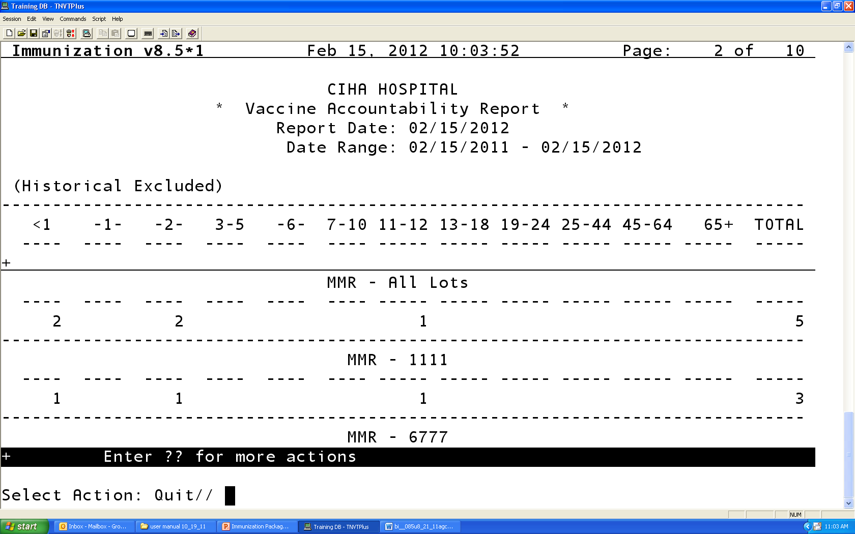
Vaccine Accountability – By Lot #

Slide 33
Vaccine Eligibility Report
A line listing of all vaccines administered in a certain time period. Includes Patient Name, Eligibility code and Lot Number.
In Reports Menu (REP)
Select “ELI” for Vaccine Eligibility Report
Set parameters for time period, etc. desired
Note: Default report is for CHILDREN. Does not include adults
To include adults, change parameter #8 to ‘Yes’.

Slide 34
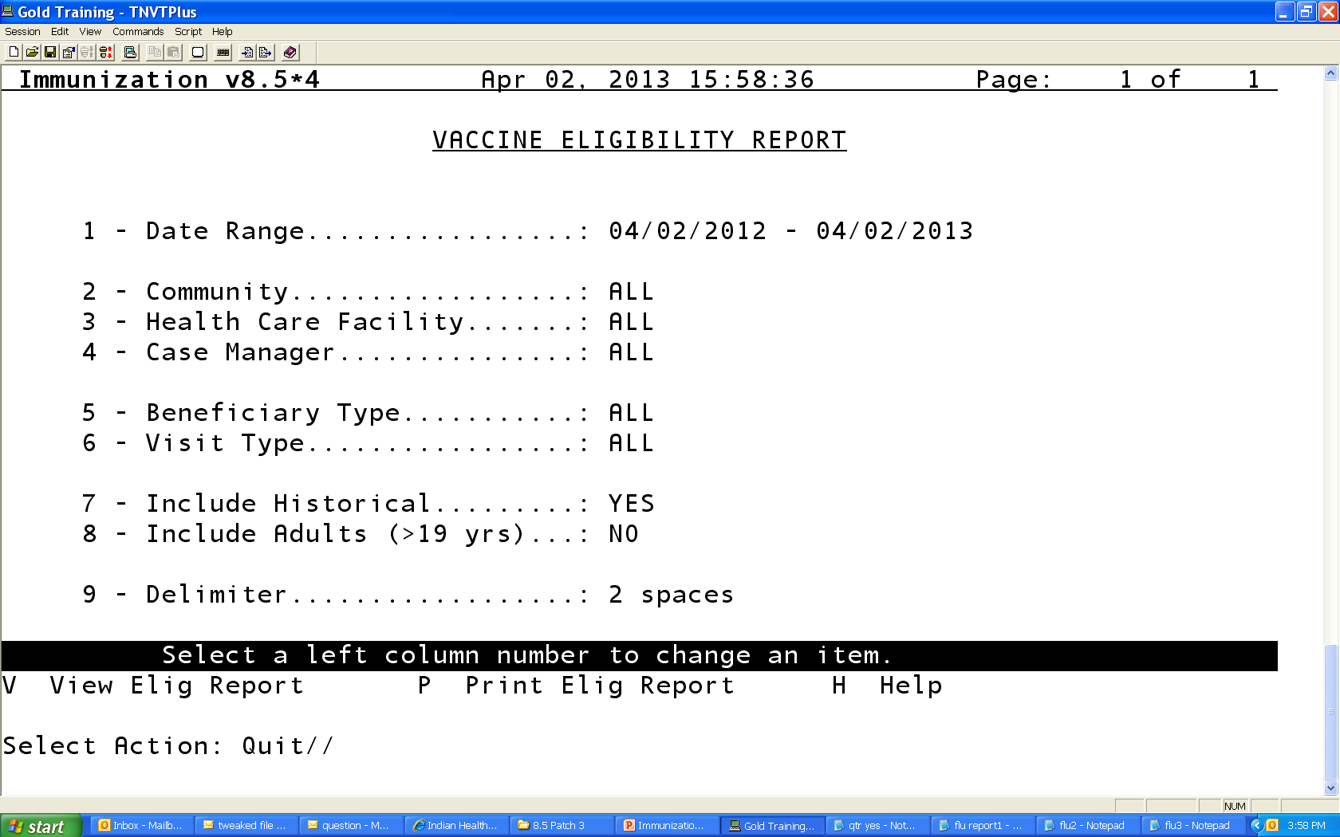
Vaccine Eligibility Report

Slide 35
Vaccine Eligibility Report
Immunization v8.5*4 Nov 14, 2012 11:46:52 Page: 6 of 14
CIHA HOSPITAL
* Vaccine Eligibility Report *
Report Date: 11/14/2012
Date Range: 11/14/2011 - 11/14/2012
(Historical Included, Adults Excluded) Total Immunizations: 140
-------------------------------------------------------------------------------
Date Last, First Name DOB Eligibility Vaccine Lot#
+
02/08/12 PATIENT, DEMO 11/03/97 DTaP Not Entered
02/08/12 PATIENT, 1 10/04/99 DTaP Not Entered
02/08/12 PATIENT, 2 02/19/04 DTaP Not Entered
02/08/12 PATIENT, 3 04/12/02 DTaP Not Entered
02/16/12 PATIENT,4 10/23/98 MMR Not Entered
03/07/12 PATIENT,ONE 02/18/11 AmIn/AKNa FLU-TIVpf Not Entered
04/07/12 PATIENT, ONE 08/18/11 AmIn/AKNa FLU-TIVpf Not Entered
04/16/12 PATIENT,TWO 05/08/94 AmIn/AKNa FLU-TIVpf Not Entered
04/25/12 PATIENT , THREE 03/22/03 DTaP Not Entered
04/25/12 PATIENT FOUR 07/28/05 DTaP Not Entered
+ Enter ?? for more actions
Select Action: Quit//

Slide 36
Immunization Resources
RPMS Immunization Package User Manual
  RPMS Application Documents
  http://www.ihs.gov/RPMS/index.cfm?module=home&option=documents
IHS vaccine preventable disease page
  www.ihs.gov/epi
CDC vaccine resources
  www.cdc.gov/vaccines
Immunization Action Coalition
  www.immunize.org

