Slide 1

Documenting
Physical Activity and
Exercise Education
IHS Health Education Program
2012

Slide 2
In an effort to improve our interaction with our patients, the IHS Health Education Program has developed the infrastructure for education; and, in partnership with OIT, several new enhancements have been developed in RPMS to better serve our patients.

Slide 3
Our IHS information systems, such as RPMS/EHR, can be used to document education for exercise and physical activity. Some of these tools are:
Patient Education Protocols and Codes (PEPC)
Patient Wellness Handout
Health Factors
iCare
Educational Assessments

Slide 4

Health Education is a partnership meant to provide many ways to interact with patients.
Internet Access/computer use
Understanding the impact of a patient’s health literacy level on obesity, exercise and physical activity
Improving the patient-provider communications – making sure the patient understands the information
Presenting written materials in Plain Language
Providing education
Documentation

Slide 5
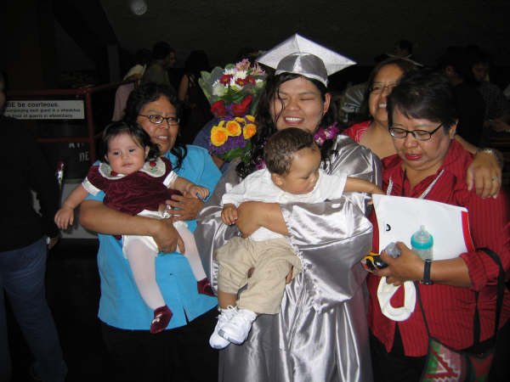
As health care providers, we must increase our awareness and understanding of the determinants of health, disease, and disability and their role in our patient’s health.
Physical Environment
5%
Social Environment
15%
Health Services
10%
Individual Behavior
40%
Biology & Genetics
30%
Our patients

Slide 6
CRS = Clinical Reporting System
Data is managed within the Indian Health Service using the Clinical Reporting System (CRS.)
CRS is intended to eliminate the need for manual chart audits for evaluating and reporting clinical measures that depend on RPMS data.
Each year, an updated version of CRS software is released to reflect changes in the logic and any additions to clinical performance measure definitions.

Slide 7
Determining Logic is simple math [division (÷)] – you need a numerator and a denominator .
# of Patients with Physical Activity (PA) (÷)
# of Patients with No Physical Activity (PA)
# of Tobacco Users (÷)
# of non-Tobacco Users
The only way to track data is to insert data (via documentation) into the EHR or the Medical Chart. The RPMS system then uses math to obtain needed data information.
# of Patients Testing Blood Sugar (÷)
# of Patients Not Testing Blood Sugar
# of Patients who need a Translator (÷)
# of Patients who do not need a Translator

Slide 8
Where does the data come from?
From provider documentation

Slide 9


You are the key to documentation: If it isn’t documented, it isn’t done!
How will you “prove” your site is communicating with patients?

Slide 10
Data Sources we use to prepare reports come from the National Data Warehouse (RPMS):
Outpatient visits
Inpatient discharges
Behavioral Health GUI
Notes:
Where do we get data from?

Slide 11
How is your facility doing?
Every Site that Uses RPMS can run the
CRS Education Report.
Ask your IT staff to run the
CRS Education Report.
You can track any education that has been provided through this report.

Slide 12
An Important Tool in Data Collection: Health Factors
What is a health factor?

Slide 13
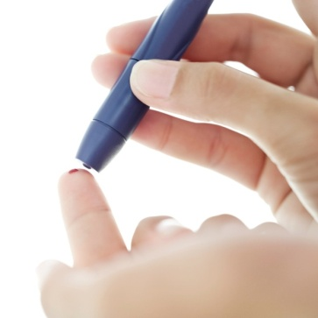

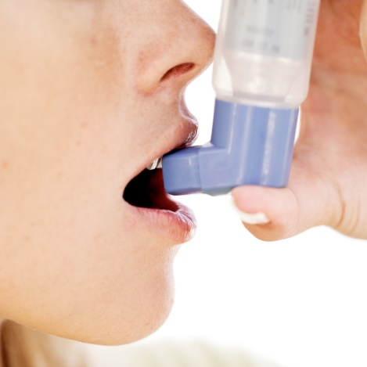
Health Factors: does your patient?
Test their sugar?
Drink?
Smoke?
Literacy level?
Type of work?
Exercise?
Have Asthma?

Slide 14
What is a Health Factor?
Health Factors describe a component of the patient’s health and wellness not documented elsewhere or does not have an ICD or CPT code.
Health factors are not visit specific and relate to the patient’s overall health status.
You/anyone can assess a person’s health factors at any visit.
Health factors should be re-assessed at least once yearly.

Slide 15
Educational Assessments are documented as Health Factors. What are Educational Assessments?
Healthcare accrediting organizations require the documentation of facts about a patient.
Included in those requirements, is the requirement that factors that might impact a patient’s ability to understand their health care – must also be documented.
In the IHS, these are called Educational Assessments.
  Learning Preferences
  Barriers to Learning
Bottom Line: Regardless of your facility accreditation: Providing education is a part of good patient care.

Slide 16
Educational Assessment:
Learning Preference (Health Factor) –
How do you prefer to learn new information?
Assess once a year – document as a Health Factor
Health Factor | Definition
Do or Practice | The patient states that doing or practicing a new skill is the preferred style of learning new information.
Read | The patient, or the patient’s family, states that reading is a preferred style of learning.
Small Group | The patient, or the patient’s family, states that participating in small groups is a preferred style of learning.
Talk* | The patient, or the patient’s family, states that talking and asking questions is their preferred style of learning.
Video | The patient, or the patient’s family, states that media (kiosk, videos, interactive displays) is a preferred style of learning.
* Current RPMS data indicates that AI/AN patients prefer to learn by talking with their provider

Slide 17
Education Assessment
Barriers to Learning (Health Factor)
Assess once a year – assess by observation.
Barriers to Learning | Definition
No Barriers | The patient has no apparent barriers to learning
Visually Impaired | The patient has difficulty seeing even with best corrected vision. The difficulty can be compensated with the use of other measures, devices, or both to improve vision (large print, better lighting, magnifying glasses).
Blind | The patient is blind and cannot compensate with low vision devices.
Hard of Hearing | The patient has a problem hearing that can be compensated with increased volume or hearing devices.
Deaf | The patient is deaf and CANNOT compensate with increased volume or hearing devices.
Does Not Read English | The patient is unable to read English.
Speaks English as a second language | The patient’s primary language is not English.

Slide 18
Barriers to Learning | Definition
Interpreter needed | The patient has fine motor skills impairment which can interfere with tasks requiring manual dexterity.
Fine Motor Skills Deficit | The patient has fine motor skills impairment which can interfere with tasks requiring manual dexterity.
Dementia | The patient may have difficulty learning because of impaired thought processes.
Values or Beliefs | The patient has values or beliefs that may impact learning; this may also include traditional Native American/Alaska Native values or beliefs that may impact the medical or clinical aspects of heath care.
Stressors (STRS) | The patient’s ability to learn is limited due to social stressors from current personal difficulties or ongoing mental or behavioral health issues.
Low Health Literacy | The patient does not demonstrate the ability to obtain, process, and understand basic health information.
Cognitive Impairment | The patient demonstrates cognitive impairment

Slide 19

Confidence Health Factor
Confidence is used to assess the likeliness that the patient will take an active role in managing their health and well being.
    Ask the patient, “How sure are you that you can manage and control most of your health problems?”

Slide 20
Confidence Health Factor
HEALTH FACTOR | DEFINITION
Very Sure | The patient is confident that they can take an active role and manage most of their health problems. The patient is very likely to achieve their health goals.
Somewhat Sure | The patient is at least 70% confident that they can take an active role and manage most of their health problems. The patient is likely to achieve their health goals.
Not Very Sure | The patient is less than 70% confident that they can take an active role and manage most of their health problems. Support and education should be provided to assist them in increasing their confidence and ability to participate in self care activities.
I do not have any health problems | The patient does not acknowledge health problems. It is unlikely that the patient will be willing to set and achieve health goals at this time. Emphasis should be placed on providing the patinet with support and education to understand their health problems, improve their confidence and ability to participate in self care activities.

Slide 21
Physical Activity Health Factor
Activity Level: How much exercise do you think you get in a week?
  Inactive – No physical activity
  Some Activity < 150 minutes 2 ½ hrs
  Active – Engages in 150 minutes
  Very Active - > 150 minutes
Adults: minimum of 30
minutes 3-5 times per
week
Children: minimum of 1 hour per
day
HEALTH FACTOR | DEFINITION
Inactive | Engages in little or no physical activity
Some Activity | Engages in < 150 minutes (approximately 30 minutes four or fewer times a week) of physical activity per week
Active | Engages in 150 - 299 minutes of physical activity per week
Very Active | Engages in 300 or more minutes of physical activity per week to achieve and maintain a healthy body weight and reduce body fat

Slide 22
Activity Assessment Algorithm
Patient Visit
Measure Ht/Wt
Calculate BMI
Assess Physical Activity
(Document as a Health Factor)
Provide Exercise Education
(Document Education using PEPC)

Slide 23
The 3 Steps in Physical Activity (PA) Assessment and Exercise Education
1st
Assessment of PA
2nd
Provide exercise education
Document PA Assessment
In Health Factor section of EHR
Document Exercise Education In Education section of EHR
It is a 3 step process:
PA assessment
Exercise education
Documentation

Slide 24
Physical Activity Assessment
Denominators
1. All Clinical patients ages 5 and older.
Numerators
Patients assessed for physical activity
Patients who have received exercise education following their physical activity assessment.

Slide 25
Medical Clearance
Medical Clearance: These require cardiac stress test within the last 1 year:
  Previous MI
  Recent Chest Pain
  Angina
  Q’s on ECG
If “None” of above, then any 2 below should be referred for cardiac stress test:
  Hyperlipidemia
  Smoker > ½ ppd & last 6 mos.
  Male > 45
  HTN uncontrolled
  Family Hx CVD
  Female > 55
Additional Medical Issues:
  Hypertension
  CVD
  Beta-blocker
  Warfarin
  Limitation on activity or weight loss/activity goals (describe):

Slide 26
Where to document Health Factors?

Slide 27
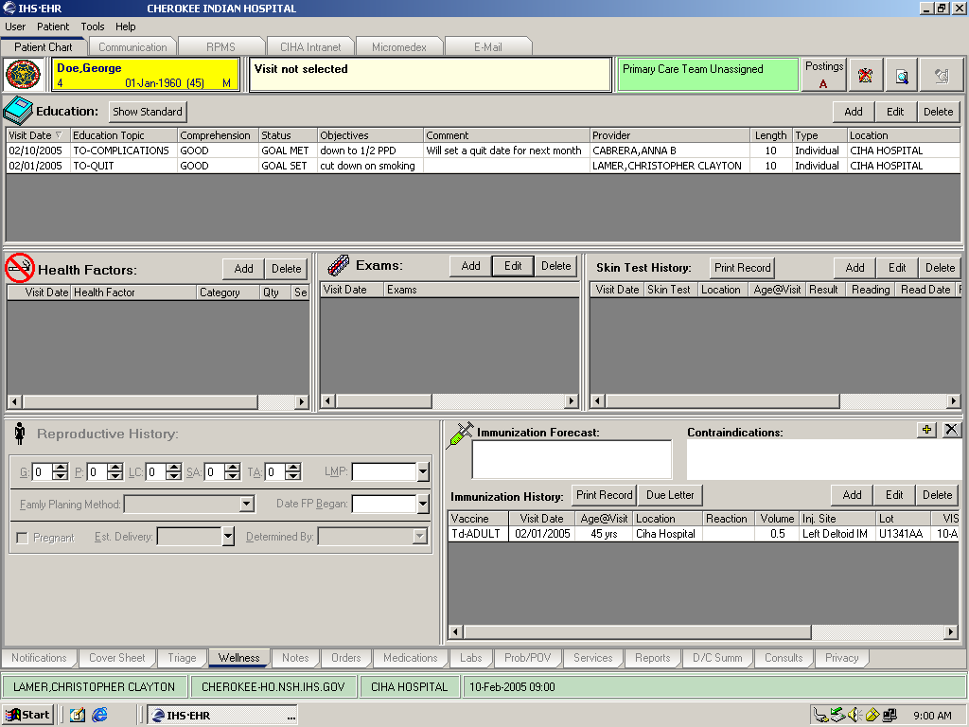
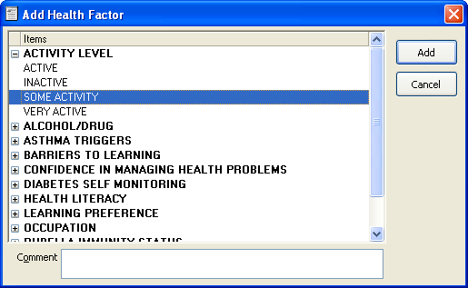
Documenting Health Factors in the EHR

Slide 28
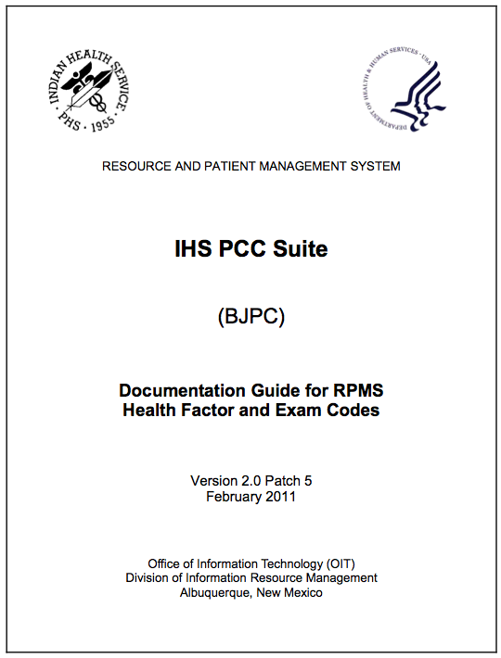
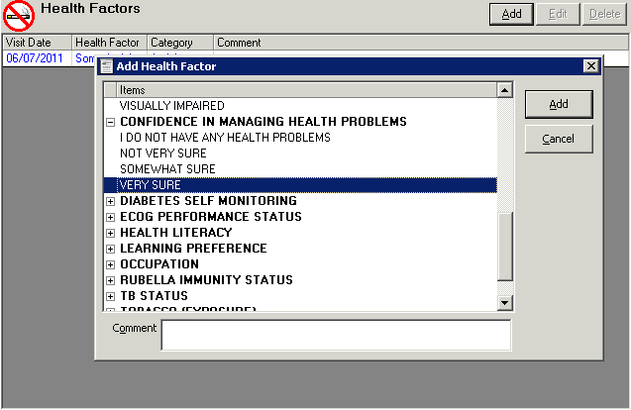
Health Factors – For More Information:
  http://www.ihs.gov/RPMS/PackageDocs/bjpc/bjpc0200.05o_aum.pdf

Slide 29
Patient Education Protocols and Codes (PEPC)

Slide 30
Regardless of the Physical Activity (PA) response, use this as an opportunity to provide some education on the importance of physical activity and exercise to all patients 5 years of age and older.
Obviously, if they are very active, congratulate and encourage them to “keep up the good work!”
If there is some exercise, encourage them to try to get more exercise and physical activity into their daily lives.
If there is no exercise or physical activity, help them think of ways to get more activity into their daily routine.

Slide 31
The IHS has a system to document Education for all I/T/U programs.
This system is called the IHS Patient Education Protocols And Codes (or PEPC)
All disciplines and Providers should be using this method of documentation and coding for education.

Slide 32
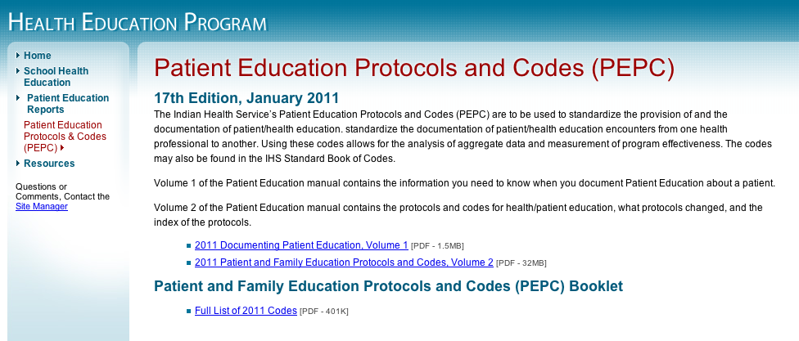
Patient Education
More information can be found at:
Document Health/Patient Education both within the facility and outside the facility. For more information, visit:
  http://www.ihs.gov/HealthEd/index.cfm?module=pepc

Slide 33

Patient Education covers many topics

Slide 34
You are almost ready to begin providing education. Before you begin to provide education – you have one more step!
Before providing education, you must determine if the patient is ready and willing to listen to the education. How does one determine this? You ask the patient!
“Ms. Smith, I am now going to talk to you about exercise and physical activity. Are you willing to listen to me for 5-8 minutes as we discuss the importance of exercise?”

Slide 35
Readiness to Learn
Identify the patient’s readiness to learn.
Readiness to learn reflects factors that may increase or decrease the patient’s ability to understand the patient education provided at this education encounter. You have the following documentation choices:
Readiness to Learn | Definition
Distraction | Patient is distracted.
Eager to Learn | Patient is eager to learn information.
Receptive | While not ‘eager’ patient indicates they will listen.
Unreceptive | Patient states she/he is not willing to listen. Gently probe to find out why the patient is not willing to learn about their health.
Pain | Patient is in severe pain.
Severity of Illness | Patient is too sick – at this time – for education. Will try again later.
Intoxication | Patient is under the influence of drugs or alcohol.

Slide 36
Steps for Documenting Patient Education
*7 Mandatory steps
*Readiness to Learn
*Disease state, illness, condition or system being
addressed
3. *Specific education topic
4. *Level of patient/family understanding of the material
5. *Time spent by the provider who did the education
6. *Initials of the provider who did the education
7. *Goal setting
8. Comments

Slide 37
Readiness to Learn
Identify the patient’s readiness to learn.
Readiness to learn reflects factors that may increase or decrease the patient’s ability to understand the patient education provided at this education encounter. You have the following documentation choices:
Readiness to Learn | Definition
Distraction | Patient is distracted.
Eager to Learn | Patient is eager to learn information.
Receptive | While not ‘eager’ patient indicates they will listen.
Unreceptive | Patient states she/he is not willing to listen. Gently probe to find out why the patient is not willing to learn about their health.
Pain | Patient is in severe pain.
Severity of Illness | Patient is too sick – at this time – for education. Will try again later.
Intoxication | Patient is under the influence of drugs or alcohol.

Slide 38
2. Disease state/Illness/Condition
You can document the disease state/ illness/condition in one of three ways:
1. Document the actual disease state/illness/condition: Obesity
2. Document using the ICD-9 code
Document with the mnemonic/code from the PFE protocol: OBS
Examples of common disease states:
CHF Coronary heart failure
HTN Hypertension
CAD Coronary artery disease
LIP Dyslipidemia
DM Diabetes
PM Pain management
EYE Eye condition
OBS Obesity
FP Family planning
TO Tobacco use

Slide 39
3. Education/topic modifier
Next, document the topic code of what you discussed with the patient. Examples of standard topics in the IHS protocols:
AP Anatomy & Physiology
C Complications
DP Disease Process
EQ Equipment
EX Exercise
FU Follow-up
HM Home Management
LA Lifestyle Adaptation
HY Hygiene
L Literature
M Medication
N Nutrition
P Prevention
PRO Procedures
S Safety
TE Testing
TX Treatment

Slide 40
Obesity-Exercise (the PEPC Protocol)
OBS-EX
STANDARDS:
Discuss medical clearance issues for physical activity.
Discuss the benefits of physical activity, such as weight loss, increased energy, improvement in well being, stress reduction, improved sleep, bowel regulation, and improved self image.
Discuss barriers to a personal physical activity plan and solutions to overcome barriers. Assist the patient in developing a personal physical activity plan. Refer to “HPDP-EX Exercise.
Encourage the patient to increase the frequency, intensity, and duration of the activity as the patient becomes more fit.
Refer to community resources as appropriate.

Slide 41
5. Level of understanding
Next to the topic code, Level of Understanding defines how well the patient and/or family understood the education.
G F P R Gp | Good Fair Poor Refused Group Education - unable to assess individually
Example:
EAGR-
BF
- EQ
- G

Slide 42
Levels of understanding
Good (G) | Fair (F) | Poor (P) | Refuse (R) | Group (Gp)
Verbalizes understanding Verbalizes decision or desire to change (plan of action indicated) Able to return demonstration correctly | Verbalizes need for more education Undecided about making a decision or a change Return demonstration indicates a need for further teaching | Does not verbalize understanding Refuses to make a decision or needed changes Unable to return demonstration | Refuses or declines patient education | Education provided in group Unable to evaluate individual responses

Slide 43
Levels of Understanding
Health care has a responsibility to make sure patients understand what they are told about their health conditions and their medications.
"One of the problems with health literacy is that many patients with low health literacy may also have low levels of literacy, period. In fact, some patients may not be able to read at all. To assume, as physicians do, that they're getting their message across without verifying that (fact) leaves a lot to be desired in terms of the patient-centered medical home, shared decision-making and patient safety.”
ARHQ National Research Network

Slide 44
6. Time
Next, document the length of Time you spent educating the patient next to the level of understanding.
Time should be documented in whole minutes.

Slide 45
7. Taking credit
To take credit for the education, place either your provider number or your initials next to Time spent. You can put your initials/provider number either before or after the Time spent. Obviously, this will be done automatically if you are using the EHR.

Slide 46
8. Patient Goals
Indicate patient Goals – Goal Not Set, Goal Set, Goal Met, or Goal Not Met using the following codes. (Be sure to also write down the goal.)
GNS GS GM GNM | Goal Not Set Goals Set Goals Met Goals Not Met
Example:

Slide 47
Goals – Set, Not Set, Met, or Not Met
(Assisting the patient to change behavior)
Examples of Goal Setting – assisting the patient to:
Develop a plan of how to get more exercise, physical activity into the patient’s daily routine.
Develop a plan on how to support a decision to get more exercise or activity into their daily routine.
Write a plan of management for exercise, physical activity
Choose at least one change to follow to have time and flexibility to exercise or get more physical activity.
Identify a way to cope with unexpected events that might interfere with your plan for exercise and physical activity.

Slide 48
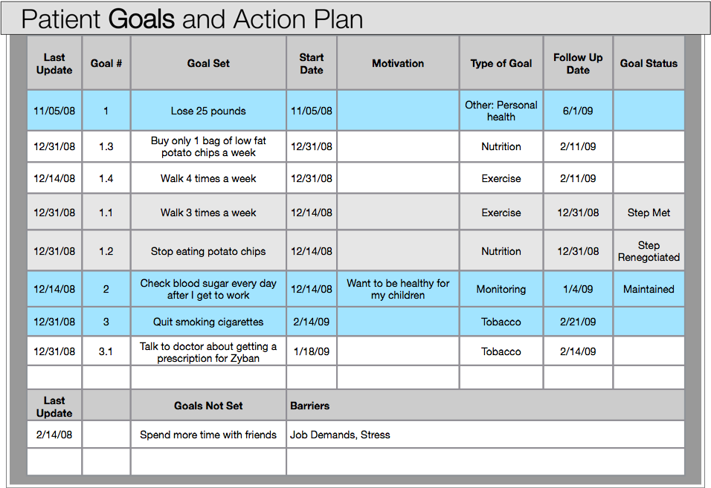
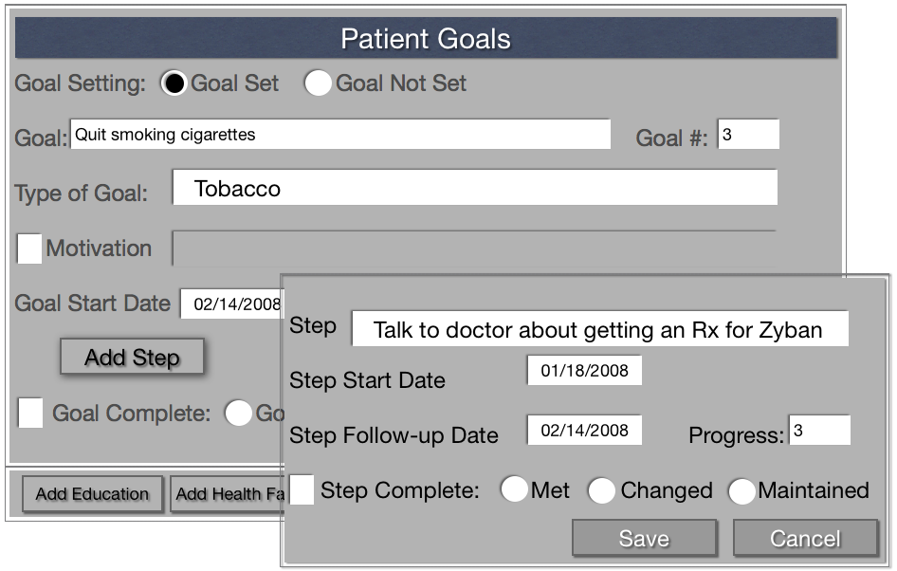
Tracking a patient’s Goals (new tool in development for EHR )

Slide 49
8. Comments – optional
You can document comments (called Free Text) in the Comment section (called a field) for documenting additional information about the breastfeeding education encounter.

Slide 50
DM M G ABC-Time GS
Disease State / Condition
You can document the disease state in one of three ways:
1) Diabetes type 2
2) ICD-9 code: 250.xx
3) DM - from the patient & family education protocols.
Common Disease States:
CHF Congestive Heart Failure
HTN Hypertension
CAD Coronary Artery Disease
LIP Dyslipidemia
DM Diabetes
PM Pain Management
EYE Eye condition
PL Pulmonary
FP Family Planning
TO Tobacco Use
Education Topic Modifier
What you talked about. There are 17 standard topics in the IHS Protocols. These include:
AP - Anatomy and Physiology
C - Complications
DP - Disease Process
EQ - Equipment
EX - Exercise
FU - Follow-up
HM - Home Management
LA - Lifestyle Adaptation
HY - Hygiene
L - Literature
M - Medication
N - Nutrition
P - Prevention
PRO - Procedures
S - Safety
TE - Testing
TX – Treatment
Level of Understanding
Defines how well the patient/family understood the education. It does not reflect on your ability to teach it!
G= good
F= fair
P= poor
R= refused
Gp= group
education-
unable to
assess
individually
Taking Credit
Use either your provider number or your initials to take credit for the education. It may also be important to place the length of time you spent educating the patient next to your initials for certain billing purposes
Patient Goals
GS = Goals set
GM = Goals met
GNM = Goals Not Met

Slide 51
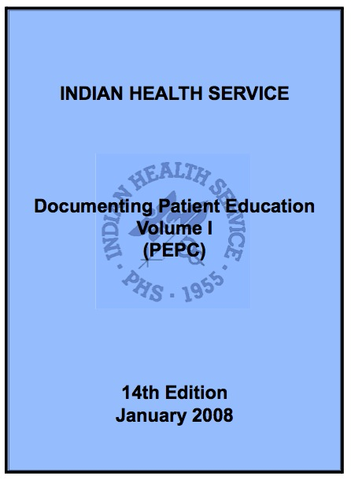
Patient Education Codes
Below is an education “string.”
Readiness to Learn
Level of Understanding
Topic
Sub-Topic
Provider
Time
GOAL
Education Code
-Good
-Fair
-Poor
-Refused
-Group
MW
4 Min.
Goal Not Set
Goal Set
Goal Met
Goal Not Met
-Receptive
-Eager
-Unreceptive
-Distraction
-Intoxication
-Severity of illness
-Mnemonic (TO, HTN)
-ICD9 Code
-CPT Code
AP - Anatomy & Physiology
C - Complications
DP - Disease Process
EQ - Equipment
EX - Exercise
FU - Follow-up
HM - Home Management
HY - Hygiene
LA - Lifestyle Adaptations
L – Literature
M – Medications
MNT – Med Nutrition Tx
N - Nutrition
P - Prevention
PRO - Procedures
S - Safety
TE - Tests
TX - Treatment

Slide 52
Sample of the EHR section where patient education and Health Factors are documented.

Slide 53
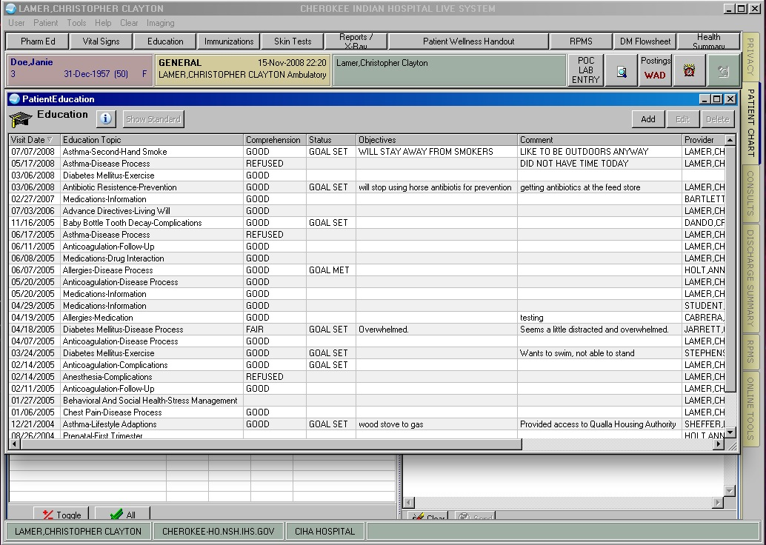
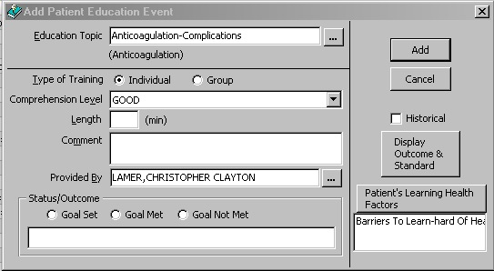
When you click “Add” – this box pops-up

Slide 54
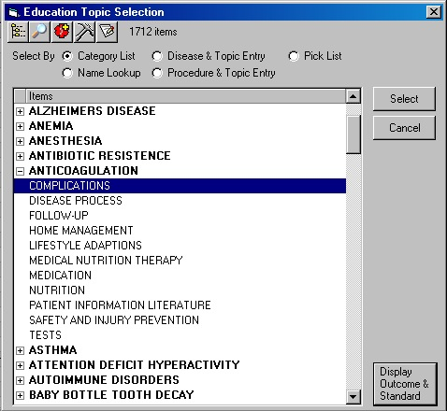
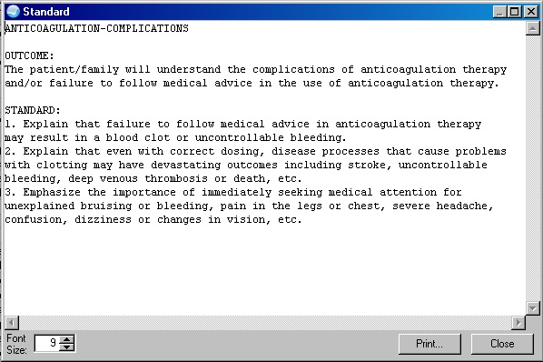
Don’t remember what to teach? To view the PEPC education Standard, click on “Show Standard”

Slide 55
To find online patient education information, click the “i” button

Slide 56
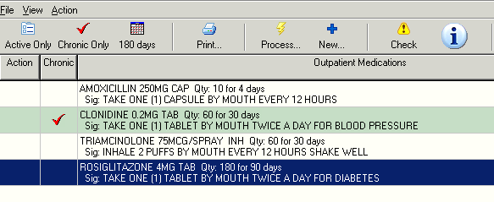
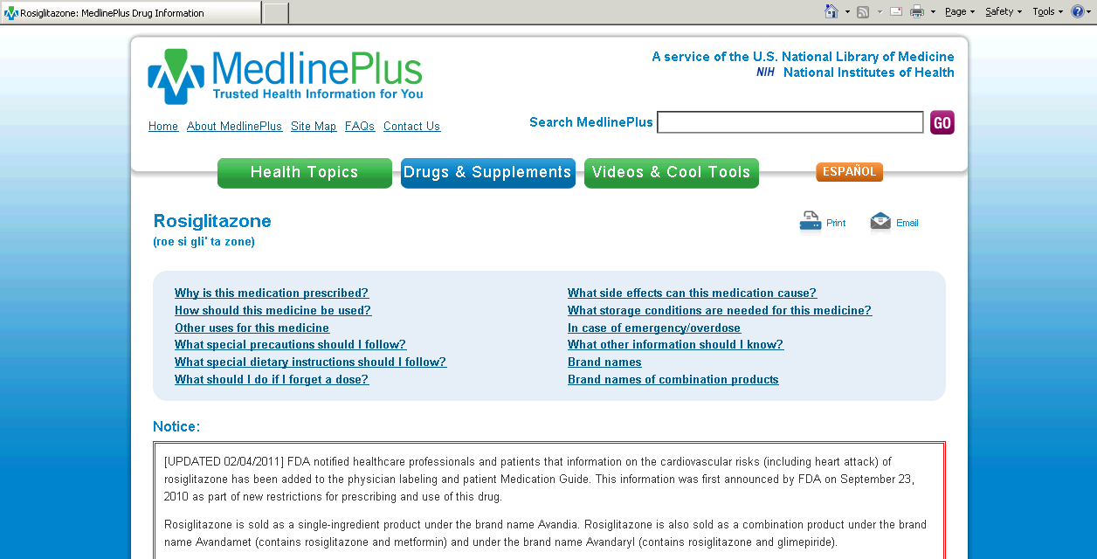
NLM HL7 Info Button
Click on the “i” button to obtain patient education materials.

Slide 57
Community Education
Any education provided at other locations such as schools, at prenatal classes or to other groups by any Health Provider such as PHNs, CHRs, or Health Educators - this education is also documented on an appropriate form to capture the education. The information is then entered into the EHR. There is no specific form to use; each facility can develop their own form. Only your Medical Records staff needs approve the form. The next slide is an example of such a form.

Slide 58
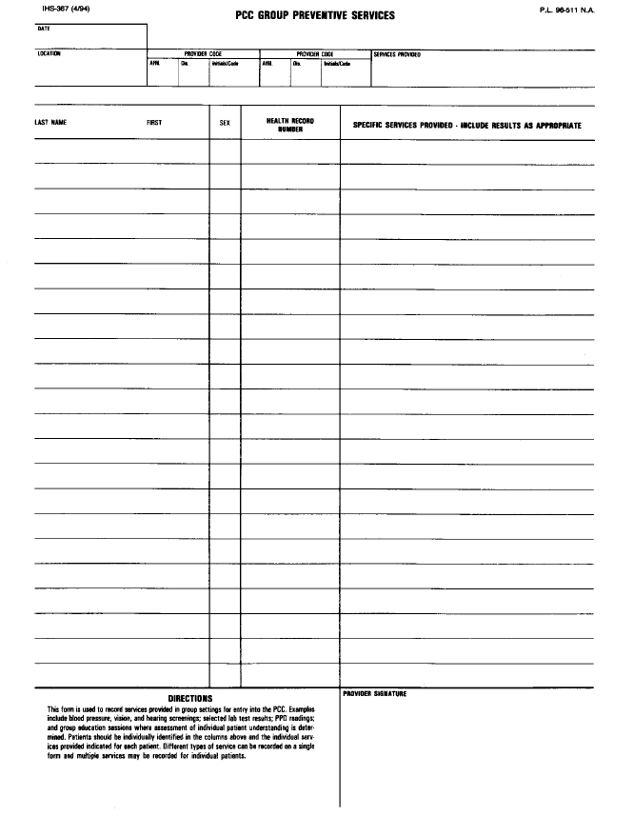
This is an example of a form to capture education provided outside of the facility. Any form needs the following information:
Name
Gender
Birthday or clinic
chart number
The education
provided, topic, level
of understanding
and time.
CAD-DP-Gp-15 Min. CAD-L-Gp-15 Min. CAD-P-Gp-15 Min. DM-DP-Gp-15 Min. GS: Pts. to Learn Early Warning Signs of heart Attack
In this column, ask participants to write their name.
In this column, ask patients to write in their hospital/clinic chart number, if they know this information. If not, ask them to write their birth date.
This “education string” documents that education was provided on CAD in a Group setting; duration of the educational encounter was approximately 15 minutes per each topic. GOAL SET: Patients to Learn Early Warning Signs of Heart Attack
In this column, ask participants to write their sex, Male or Female (M or F)

Slide 59
Community Resources
Familiarize yourself with the local community resources so that you can discuss using these resources with your patient.
Encourage the patient to encourage all family members to participate in physical activity and exercise.
Remind patients that fancy exercise equipment, a gym and other items associated with exercise and physical activity are not needed. “One foot in front of the other” for 15-30 minutes is all one needs!

Slide 60
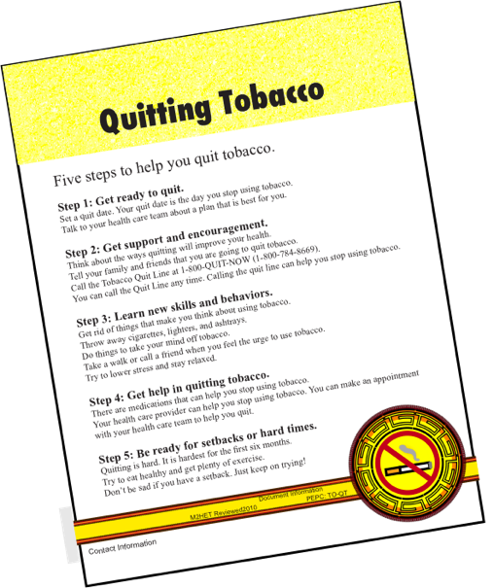
Online Patient Education handouts and other Resources can be found at www.ihs.gov

Slide 61
Mary.Wachacha@ihs.gov
Chris.Lamer@ihs.gov
Questions?

