Slide 1
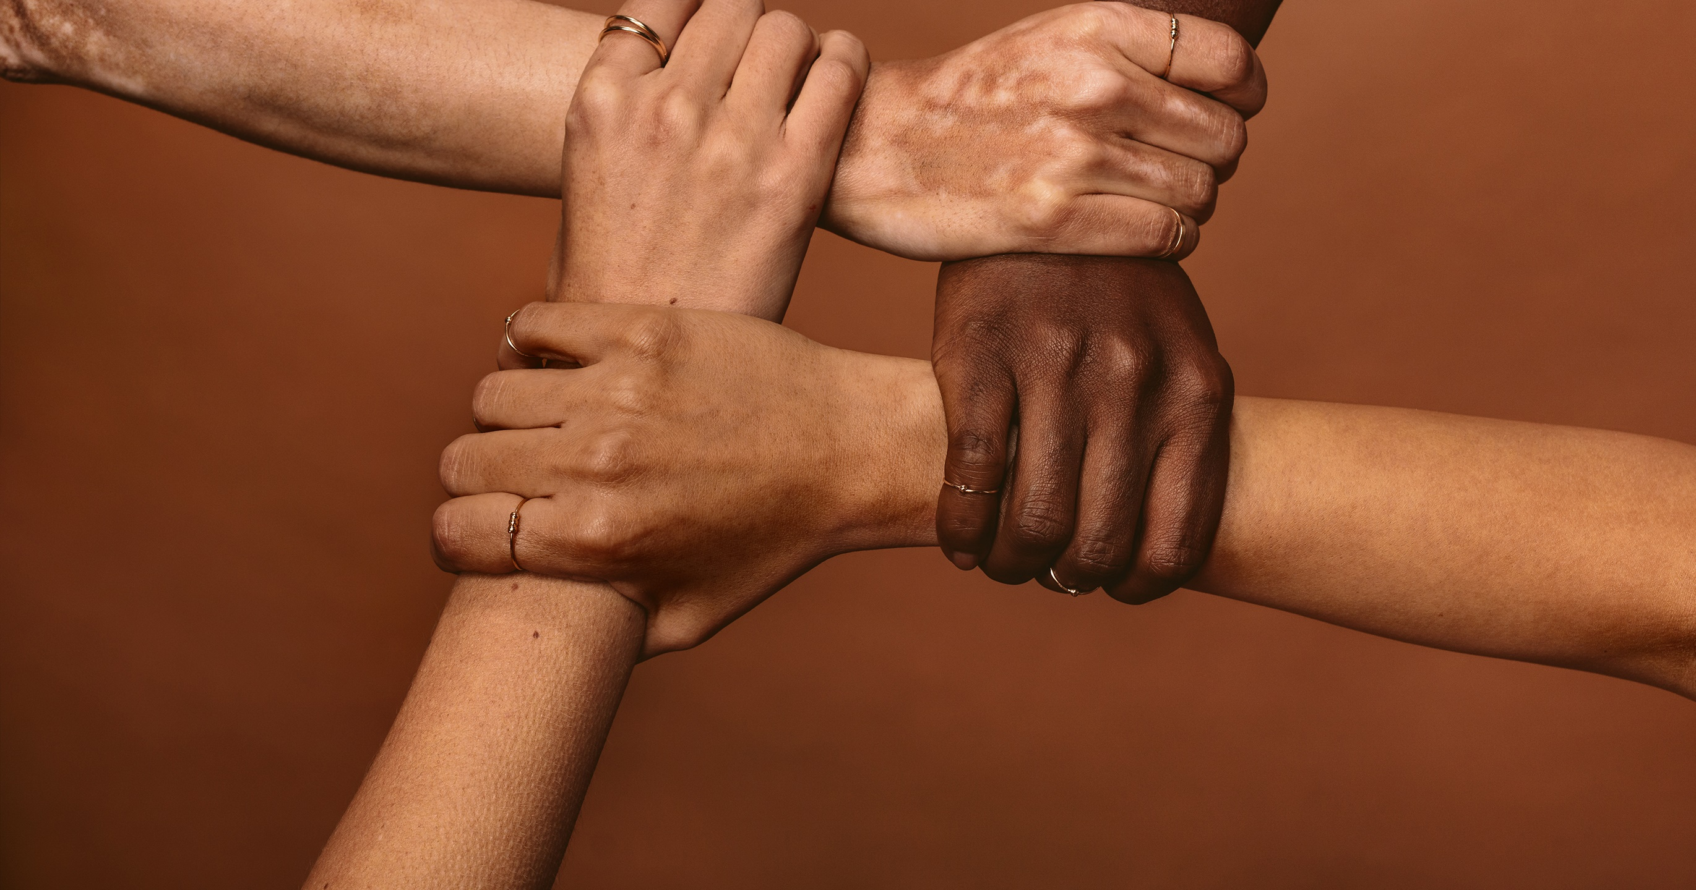
First Responder
Naloxone Training
Insert presenter's Name

Slide 2

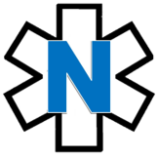
First Responder
Naloxone Training topics
1. What our words mean: Key definitions
2. Why should I learn about naloxone?
3. What's an opioid overdose?
4. Who is at risk?
5. How do we know an overdose is occurring?
6. What is naloxone and how can it stop overdose?
7. Naloxone in action
8. Accessing and storing naloxone
9. Putting it all together
10. Frequently asked questions
Notes:
Agenda.

Slide 3
Key definitions
Topic 1

Slide 4
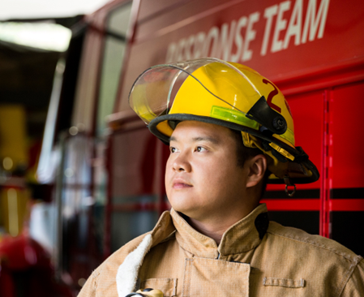
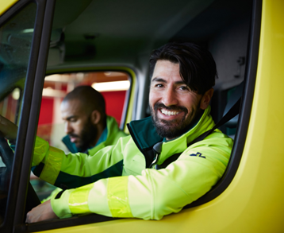
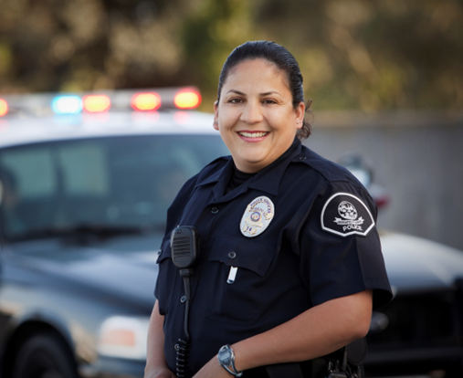

A first responder is:
A first responder is:
A person who is designated to immediately respond to an emergency
This may include:
  law enforcement officers,
  fire department.
  emergency medical workers,
  community representatives,
  volunteers, or
  any person trained to administer naloxone

Slide 5
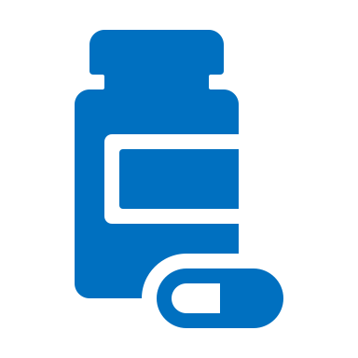


Key Definitions
Opioids
Opioids are substances that may include:
Prescription medications used to treat pain (morphine, codeine, oxycodone, hydrocodone, fentanyl, hydromorphone).
Medication to assist substance use disorder treatments (buprenorphine, methadone)
Illicit drugs (heroin, illegally-created fentanyl).
Overdose
An overdose is a severe and sudden condition resulting from an excessive amount of opioid being swallowed, inhaled, injected or absorbed through the skin, intentionally or unintentionally , leading to possible death.
Naloxone
Naloxone is a safe and life-saving medication that can reverse an overdose from all types of opioids - including heroin, fentanyl, and prescription medications - when given in time.
Notes:
Slang terms include: OCs, Oxy, perks, vics, smack, junk, black tar, ills, skittles, blues, rails, feddy.
(NOTE: there may be others that are more localized, consider adding for your area.)
https://store.samhsa. gov/sites/default/files/d7/priv/sma18-4742.pdf

Slide 6
Why should I learn about naloxone ?
Topic 2

Slide 7
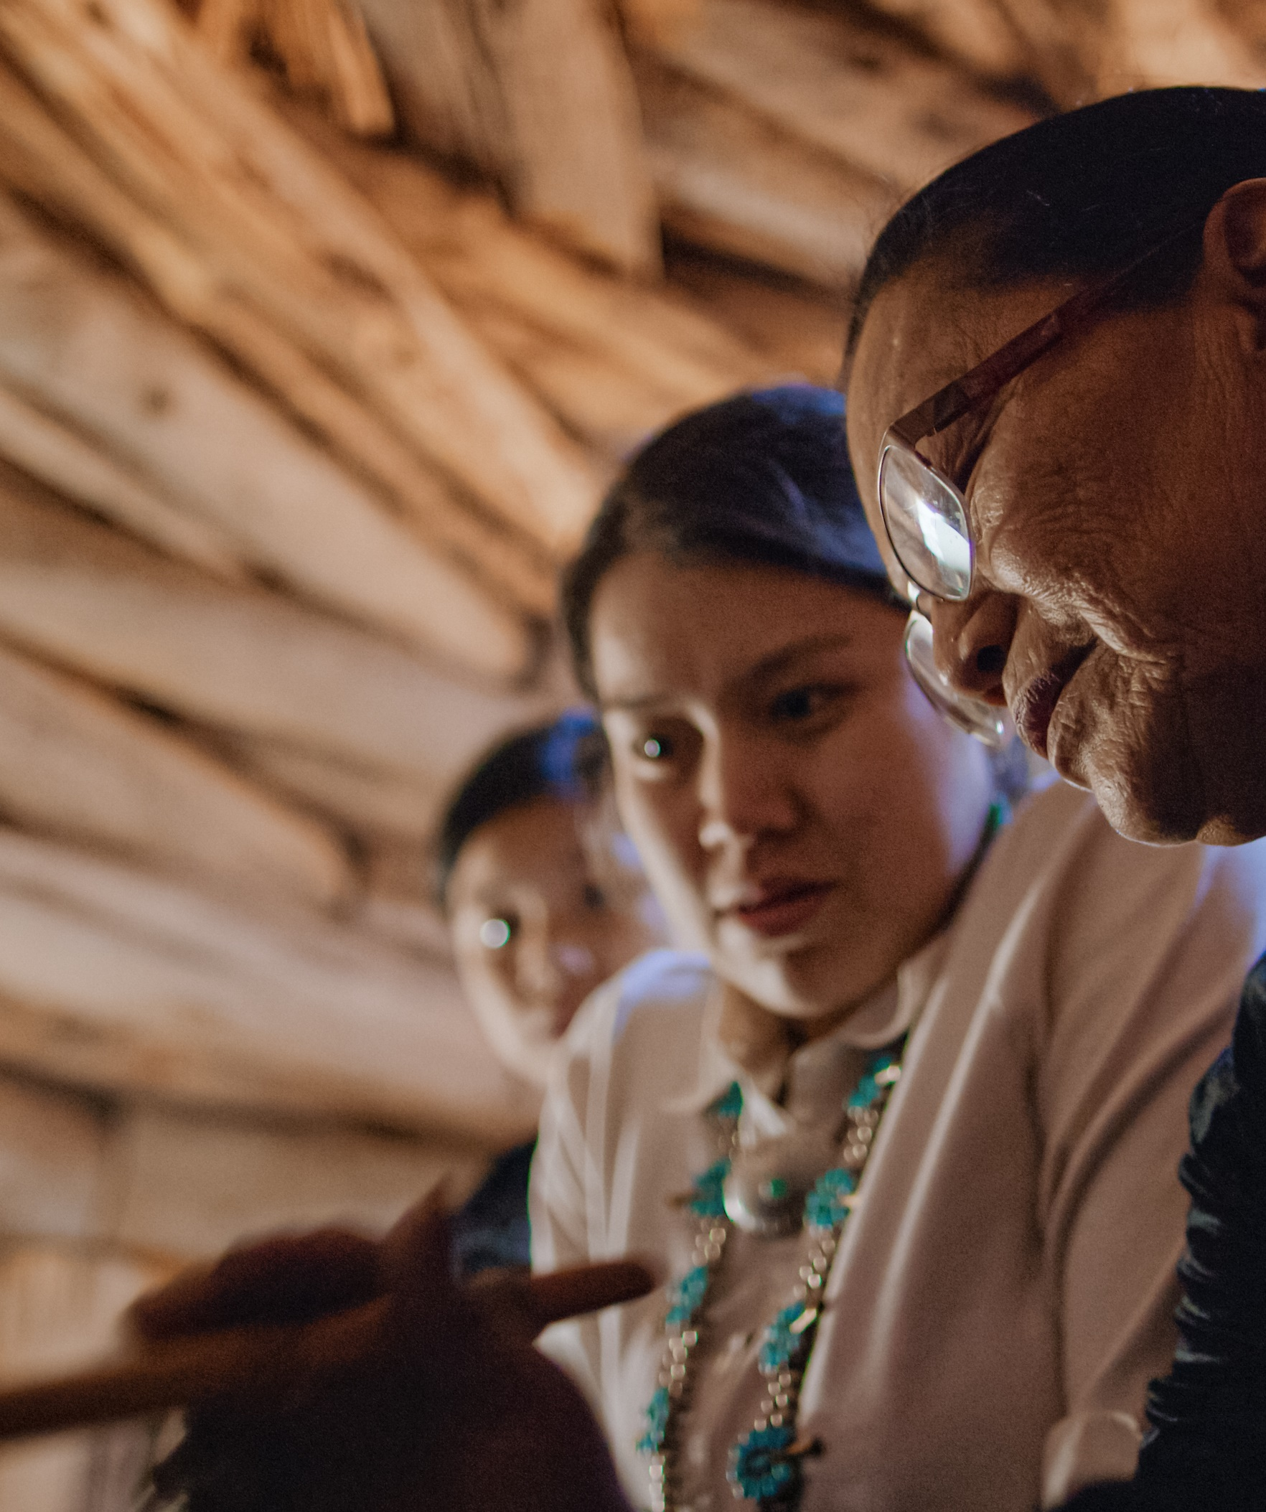
National crisis hitting home
On average, 250 Americans die every day from an opioid overdose
Overdoses in our Community
In one year (2019-2020) overdose death rates increased by 39% among American Indian or Alaska Native persons.
Notes:
The opioid epidemic has hit tribal communities especially hard.
“The overdose crisis is national, but the impact is personal”
Source: HHS - https://www.hhs.gov/overdose-prevention/#:~:text=The%20overdose%20crisis%20is%20national,removing%20barriers%20to%20effective%20interventions.
On average, 250 Americans die every day from an opioid
Source: overdosehttps://www.cdc.gov/injury/budget/opioidoverdosepolicy/TribalCommunities.html
American Indian and Alaska Native (AI/AN) populations had the second highest overdose rates from all opioids in 2017 (15.7 deaths/100,000 population) among racial/ethnic groups in the US. AI/AN populations also had the second highest overdose death rates from heroin (5.2) and third highest from synthetic opioids
Source: https://www.ihs.gov/opioids/opioidresponse/data/#:~:text=According%20to%20the%20most%20recent,ethnic%20groups%20in%20the%20US.
From 2019 to 2020, overdose death rates increased by 39% among American Indian or Alaska Native persons
Source: https://www.cdc.gov/mmwr/volumes/71/wr/mm7129e2.htm#:~:text=From%202019%20to%202020%2C%20overdose,increased%2C%20particularly%20among%20Black%20persons)
Overdose death rates for AI/AN women 25–44 years of age were nearly two times that of White women 25–44 years of age
Source: https://www.cdc.gov/media/releases/2022/s0719-overdose-rates-vs.html)

Slide 8
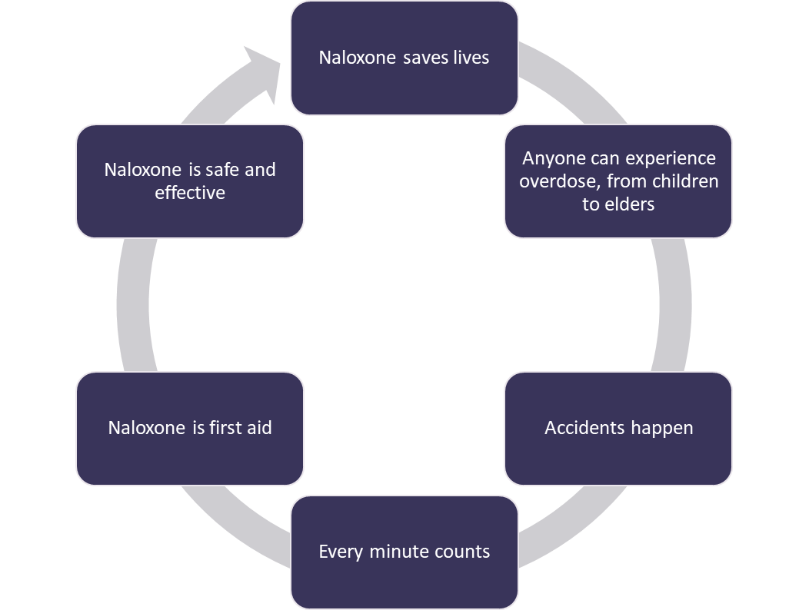
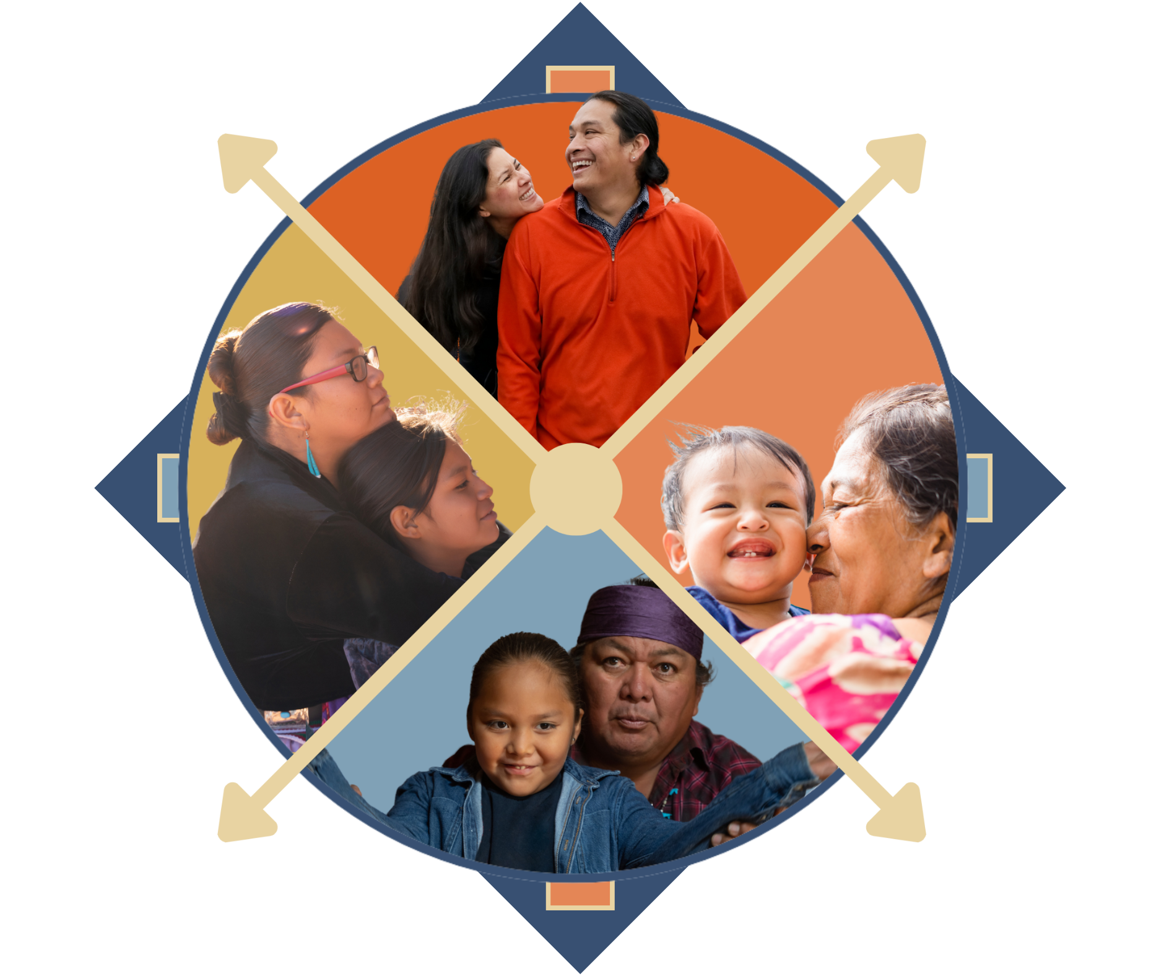
I carry naloxone because…
Naloxone keeps the circle strong
Notes:
We are learning about Naloxone because it is an essential tool to save a life.
Unfortunately, anyone can experience an overdose. We all make mistakes, and sometimes we grab the wrong medication or misread instructions.
Sometimes family members may not know they are at a higher risk of an overdose, like if they have chronic health problems like COPD.
There is a great deal of stigma around persons with Substance Use Disorder, or SUD. This may stem from a belief that SUD is a personal choice or a moral failing rather than a chronic, treatable disease from which patients can recover and continue to lead healthy lives. This stigma also contributes to negative attitudes toward Naloxone and the false belief that naloxone is only needed for persons with OUD. This continues to be a major barrier to naloxone distribution and harm reduction efforts to prevent opioid overdose.
Did you know :
Most people who died by overdose had no evidence of substance use treatment before their deaths
Some conditions in the places where people live, work, and play can widen these disparities. For instance, rural areas and low income areas have higher rates of overdose deaths.
Comprehensive, community-based prevention and response efforts should incorporate proven, culturally responsive actions that address disparities in drug overdose deaths and the inequities that contribute to them.
https://www.cdc.gov/vitalsigns/overdose-death-disparities/index.html

Slide 9
What is an opioid overdose?
Topic 3

Slide 10
What is an opioid overdose?
1. A person takes more opioids than their body can handle
2. Breathing slows as the opioid suppresses the urge to breath
3. Breathing stops and carbon dioxide builds up in their body
4. Oxygen levels decrease, which leads to brain damage
5. Their heart stops
Notes:
As we talked about in the last slide, overdoses can unfortunately occur in anyone. They are accidents. We should learn what happens during an overdose.
*Opioids suppress the urge to breath
*Carbon dioxide levels increase
*Oxygen levels decrease
*Process takes time
*There is time to respond, but no time to waste

Slide 11
Who is at risk?
Topic 4

Slide 12
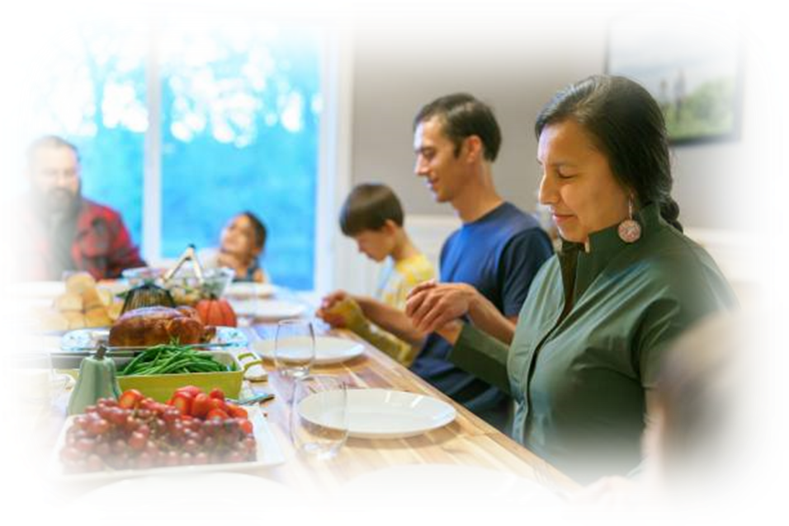
Keep the circle strong
Know who is at risk
An opioid overdose can happen to anyone!
Chronic health issues (asthma, COPD, sleep apnea, dementia)
Use high dose opioid medications
Elders
Intellectual or physical impairments
Uses multiple sedating medications
Recently underwent detox or incarceration
Curious young child
Use drugs via intravenous injection
History of substance use
In nearly 40% of overdose deaths, someone else was present
Notes:
Note for recently in jail/drug treatment:
Tolerance develops when someone uses an opioid drug regularly so that their body becomes accustomed to the drug and needs a larger or more frequent dose to continue to experience the same effect.
Loss of tolerance occurs when someone stops taking an opioid after long term use. When someone loses tolerance and then takes the opioid drug again, he or she can experience serious adverse effects, including overdose, even if the amount taken had not caused problems in the past. This can happen when someone was recently in jail or other program. They may not be aware of how much their tolerance has decreased
In nearly 40% of overdose deaths, someone else was present
- Source: https://www.cdc.gov/mmwr/volumes/69/wr/mm6935a1.htm?s_cid=mm6935a1_w

Slide 13
How do we know an overdose is occurring?
Signs of an overdose
Topic 5

Slide 14
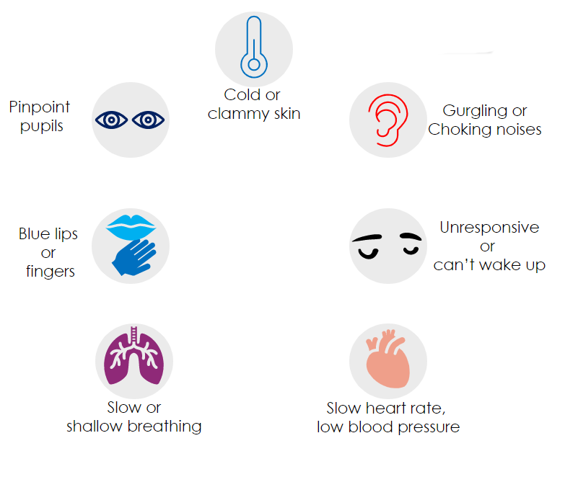
What are the signs of an overdose?
Notes:
Someone’s body will tell you when an overdose may be underway - We just need to know what to look for.
List from SAMHSA:
•The face is extremely pale and/or clammy to the touch.
•The body is limp.
•Fingernails or lips have a blue or purple cast.
•The person is vomiting or making gurgling noises.
•The person cannot be awakened from sleep or cannot speak.
•Breathing is very slow or stopped.
•The heartbeat is very slow or stopped.

Slide 15
What is naloxone?
Topic 6

Slide 16




What is naloxone and how does it work?
Naloxone….
Is a life-saving medication
Can be given as a nasal spray
Reverses overdoses from all types of opioids (heroin, fentanyl, and prescription medications)
Can be given even if there is uncertainty if an overdose is occurring
Lasts 30-90 minutes, giving you time to call for help
1
Opioid sits on a receptor in your brain
Overdose occurring
2
Naloxone enters your body and knocks the opioid away
3
Naloxone sits on the receptor, allowing your body to breathe again
Overdose stopped

Slide 17
Naloxone Myths Debunked
Naloxone encourages drug use,
increases addiction,
can be misused
There is no risk if there is no opioid in the blood stream
Bystanders can act to prevent overdose deaths
Most states have laws to protect person overdosing and bystanders
Naloxone is non-addictive and does not lead to more or riskier drug use
Only first responders can save a life of a person experiencing an overdose
Naloxone will cause harm
Naloxone is safe to use and can be given to elders, pregnant women and children
Naloxone can be given even if you are unsure if an overdose is occurring
Myth
Facts

Slide 18

What does naloxone reverse?
Does reverse
Does not reverse
Morphine
Opioids
Codeine
Oxycodone
Hydrocodone
Fentanyl
Hydromorphone
Oxymorphone
Cocaine
Methamphetamines
Diazepam
Alprazolam
Alcohol
Heroin
13
Notes:
Slang terms include: OCs, Oxy, perks, vics, smack, junk, black tar, ills, skittles, blues, rails, feddy. (NOTE: there may be others that are more localized, consider adding for your area.) https://store.samhsa. gov/sites/default/files/d7/priv/sma18-4742.pdf
Yes:
Oxycodone (Oxycontin®)
Hydrocodone (Vicodin®, Norco®)
Hydromorphone (Dilaudid®)
Oxymorphone (Opana®)
No:
Diazepam (valium®)
Alprazolam (Xanax®)

Slide 19
Naloxone in action
Topic 7

Slide 20
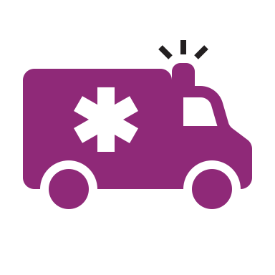
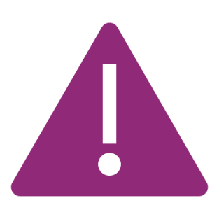
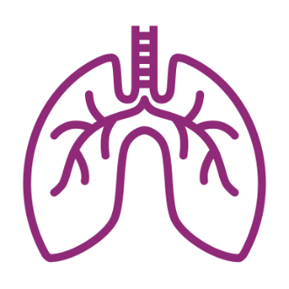
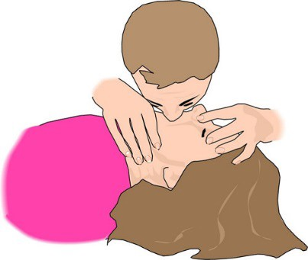
Instructions:
Someone is unresponsive and overdose is suspected
Activate 911
Report someone is unresponsive or not breathing.
Be safe! Check your surroundings.
Be careful of things like needles or anything that can be harmful.
Check for signs
Know the signs of an Opioid Overdose
Are there witnesses that can tell you what happened?
Support breathing
Open airways
If certified – begin CPR
Listen to the recommendations of the 911 dispatcher
Notes:
CPR info:
Verify airway is clear
Perform head-tilt chin-lift and pinch nose closed
Perform 2 rescue breaths and repeat 1 breath every 5 seconds for 1 minute

Slide 21
Prepare to give
Naloxone Nasal Spray
1. Prepare the Naloxone Spray
Remove Naloxone from the box
Peel back the tab with the circle at the top right corner to open
2. Position the person
Tilt the person’s head back and use your hand to support their neck
Hold the naloxone with your first and middle fingers on either side of the nozzle and your thumb on the plunger
Gently insert the tip of the nozzle into one nostril, until your fingers on either side of the nozzle are against the bottom of the person’s nose
Notes:
Spray is FDA-approved – it is a pre-filled, needle-free device that requires no assembly and is sprayed into one nostril while the person lays on their back

Slide 22
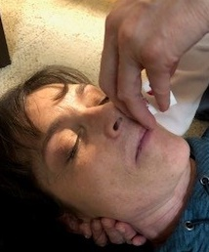
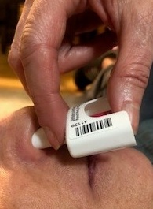
Administer:
Naloxone Nasal Spray
3. Press
4. Observe and Repeat
Repeat dose in other nostril within 2-3 minutes until independent breathing begins
5. Recovery
The effect of Naloxone lasts 30-90 minutes
Press the plunger firmly to spray the dose of naloxone into the person’s nostril
Look for independent breathing
If overdose signs set in again, repeat dose to maintain overdose reversal
Roll person onto their side once independent breathing has begun

Slide 23

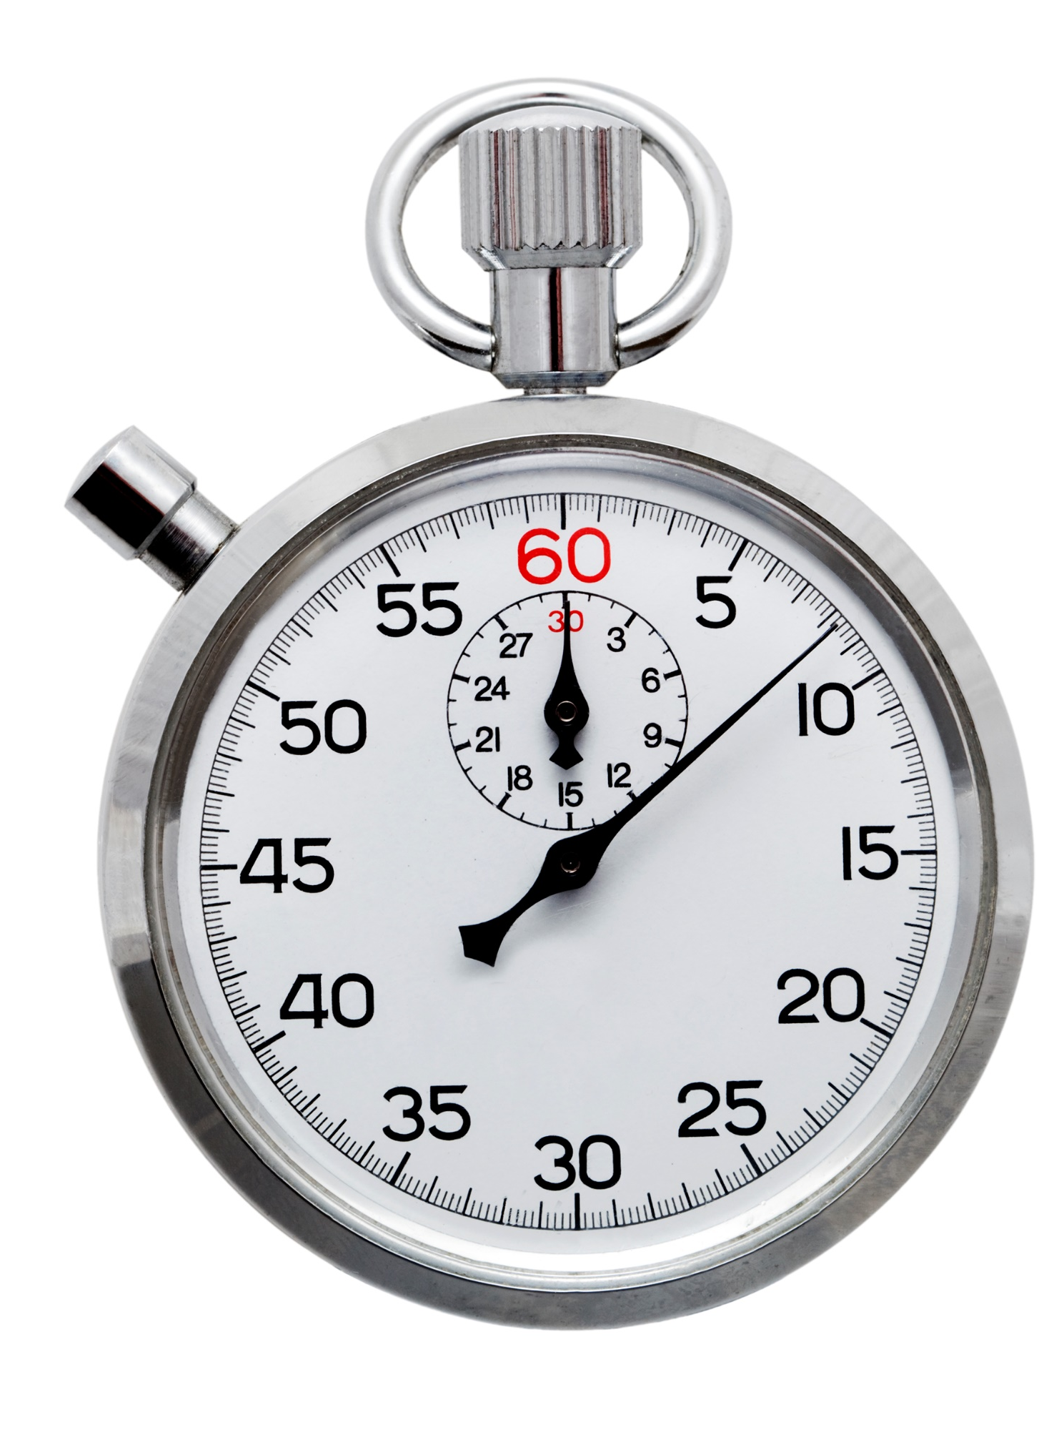
Maintaining Overdose Reversal
There is no maximum dose.
Naloxone’s effect lasts 30 to 90 minutes depending on the route of administration
Naloxone may need to be repeated every 20 to 60 minutes to maintain opioid reversal especially if extended-release products were taken

Slide 24
What to expect when reversing an overdose
Agitation
Nausea and vomiting
Excessive sweating
Runny or bloody nose
Fast heartbeat
High blood pressure

Slide 25
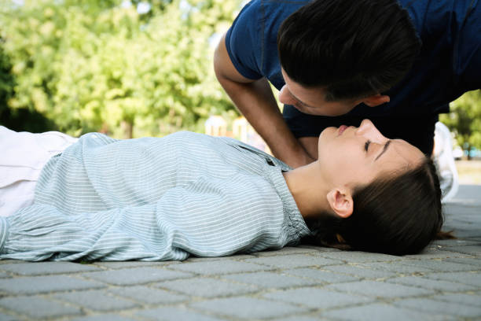
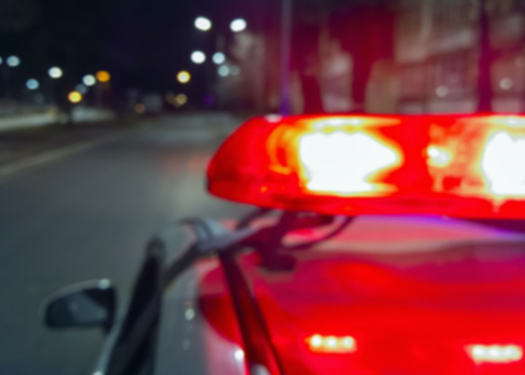
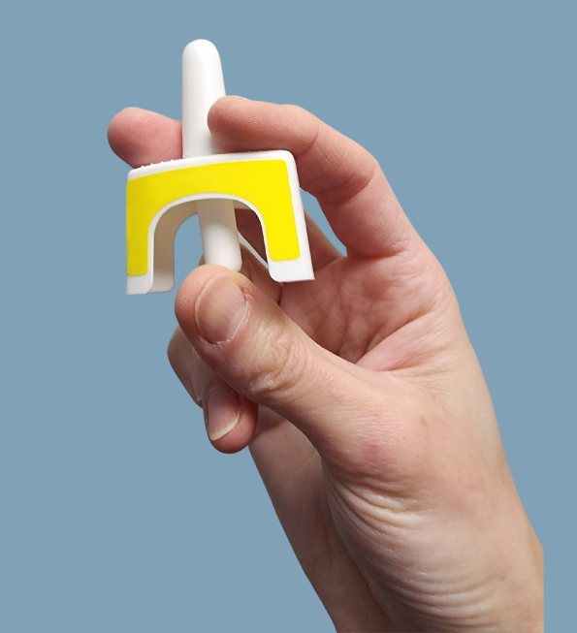
Recap:
How you can save a life
Recognize a potential
overdose
Call Emergency
Services
Give Naloxone

Slide 26
Key actions to remember
Do lay the person on their side
Do stay with the person and keep them awake
Do monitor the person's response to Naloxone
Do call for help
Do let others know you have Naloxone (you cannot use on yourself)
Don’t slap or forcefully try to wake the person
Don’t put the person in a cold bath or shower
Don’t inject the person with any substance (saltwater, milk, “speed”, heroin, etc.)
Don’t try to make the person vomit

Slide 27
Accessing and Storing naloxone
Topic 8

Slide 28
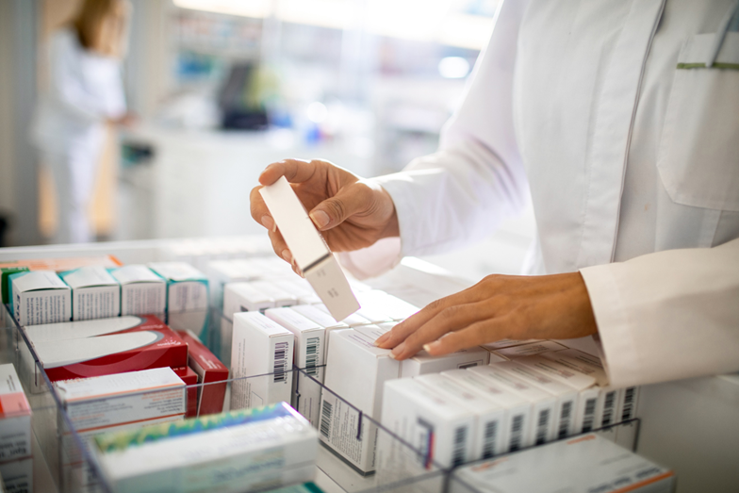
Getting access to naloxone
Procuring Naloxone
  Naloxone Nasal Spray can be received at the Indian Health Services (IHS) pharmacies
  Pharmacist will go over any questions, training, and will dispense per local policy and procedure.
Replacing Naloxone
  Check the expiration date and replace naloxone when it is expired.​
  Replace if stored improperly (kept outside of temperature range for more than a short period of time, stored at or less than 39F or more than 104F
  Replace after using in an incident

Slide 29
Naloxone storage best practices
Store at room temperature (59°F to 77°F)
Do not freeze or expose to excessive heat
Protect from light
Keep a full kit (2 nasal spray doses) in a cabinet or bag
Store in the carton provided
Inspect daily to ensure that it is intact and ready for use

Slide 30
Putting it all together
Topic 9

Slide 31
Putting it all together
This medicine is not harmful if no opioids in bloodstream
Will give time
Is life- saving
Can only help
Can be given at any point during an overdose
Naloxone has become standard in many communities throughout the country
Any delay in administering naloxone can lead to death and injury
It cannot be used to get high or set someone back in their recovery
It is effective usually within 1 to 3 minutes.
The effects last between 30 to 90 minutes – giving you time to get more help!
No negative health outcomes have been reported after over 40 years of utilization
In nearly 40% of overdose deaths, someone else was present
The life-saving benefits of naloxone in reversing opioid overdose is clear

Slide 32

Broaden your impact
Become a Naloxone
Train-the-Trainer
Broaden your
impact
Teach others about naloxone
Watch the video here

Slide 33
Thank you
Thank you for attending this naloxone training.
Remember:
Naloxone distribution is an effective strategy to prevent opioid overdose and death.
Your participation may lead to giving someone a second chance at life.
Naloxone keeps the circle strong

Slide 34
Frequently asked questions
Topic 10

Slide 35
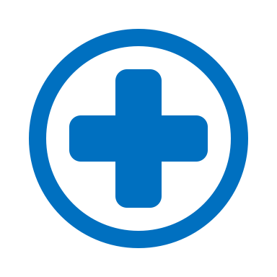
Frequently Asked Questions
Is naloxone a “safety net” that allows users to use even more opioids?
  Naloxone is non-addictive.
  Increasing the availability of naloxone to reduce deaths does not provide incentive to use opioids, the behavior will exist with or without naloxone.
  Providing naloxone is one approach to dealing with this national epidemic.
  Other strategies include safe opioid prescribing practices and increasing access to Medication Assisted Treatment (MAT) such as buprenorphine (Suboxone®) and methadone.
Naloxone is first aid.
Inhalers and Epipens can save a life, and so can naloxone.

Slide 36
Frequently Asked Questions
What happens if I accidentally expose myself to naloxone?
  Naloxone is safe if accidentally exposed. There will be no adverse effects if it gets on the skin or in the mouth.
If it is unknown why someone is unresponsive, should I give naloxone?
  Yes, naloxone should be given to someone found unconscious.
Is there an age cutoff to administer naloxone?
  No, it can be given at any age
What will happen if naloxone is given to someone who did not have an opioid overdose?
  Naloxone will not harm someone if they have not overdosed from opioid. It can only help if they are experiencing an overdose.
How quickly does naloxone work?
  Likely between 2-3 minutes but can be repeated until a full response and regaining of consciousness.
What do you do if someone is suspected to be pregnant?
  Naloxone is safe to give in pregnancy. Ensure they get emergency care following administration.

Slide 37
Frequently Asked Questions
Will the patient “wake up” agitated and aggressive?
  It is possible, but some can wake up slowly as well. Using needleless administration of naloxone was designed for quick and safe administration to prevent injury for emergency responders.
If someone starts to breathe after one dose but is not fully conscious, should a second dose be given?
  Yes, naloxone should be given every 2 – 3 minutes until a full response of regaining consciousness and breathing 12 – 20 breaths per minute (18 – 40 breaths if under 6 years old)
How much naloxone is too much? How many doses can you give?
  There is not a maximum dose, it can be given every 2 – 3 minutes until there is a response or emergency medical services assumes care.
When do you do rescue breathing versus full cardiopulmonary resuscitation (CPR)?
  If response is early enough only rescue breathing is needed, however if there is no pulse proceed with full CPR efforts

Slide 38

Questions or comments?

