Slide 1


Keep the Circle Strong:
Naloxone Training for
School Staff and Educators
By: [Name, credential]
email

Slide 2

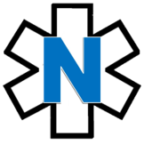
Naloxone Training for
School Staff and Educators
 | Why are we here today? Key definitions 2. Why should I learn about naloxone Opioid overdose basics Who is at risk What is naloxone Naloxone in action Accessing and storing naloxone Putting it all together School policy overview Competency assessment Closing Frequently asked questions
Notes:
Agenda.

Slide 3

National Crisis Hitting Home
On average, 250 Americans die every day from an opioid overdose.
Overdoses in our Communities
In one year (2019-2020), overdose death rates increased by 39% among American Indian or Alaska Native persons.
Teens are at risk.
Even though illicit drug use has declined among teenagers, overdose deaths have increased.
Notes:
Overarching/ National/ Community data:
“The overdose crisis is national, but the impact is personal”
Source: https://www.hhs.gov/overdose-prevention/#:~:text=The%20overdose%20crisis%20is%20national,removing%20barriers%20to%20effective%20interventions
.
On average, 250 Americans die every day from an opioid
Source: https://www.cdc.gov/injury/budget/opioidoverdosepolicy/TribalCommunities.html
American Indian and Alaska Native populations had the second highest overdose rates from all opioids in 2017 (15.7 deaths/100,000 population) among racial/ethnic groups in the US. AI/AN populations also had the second highest overdose death rates from heroin (5.2) and third highest from synthetic opioids
Source: https://www.ihs.gov/opioids/opioidresponse/data/#:~:text=According%20to%20the%20most%20recent,ethnic%20groups%20in%20the%20US
From 2019 to 2020, overdose death rates increased by 39% among American Indian or Alaska Native persons
Source: https://www.cdc.gov/mmwr/volumes/71/wr/mm7129e2.htm#:~:text=From%202019%20to%202020%2C%20overdose,increased%2C%20particularly%20among%20Black%20persons
66.8% of drug overdose deaths had at east one potential opportunity for intervention
Source: https://www.cdc.gov/drugoverdose/fatal/dashboard/index.html
46.1% overdose death had bystander present.
Source: https://www.cdc.gov/drugoverdose/fatal/dashboard/index.html
Teen Data:
Among persons aged 14–18 years, overdose deaths increased 94% from 2019 to 2020 and 20% from 2020 to 2021, although illicit drug use declined overall among surveyed middle and high school students during 2019–2020.
Source: https://www.cdc.gov/mmwr/volumes/71/wr/mm7150a2.htm#:~:text=*%20Among%20persons%20aged%2014%E2%80%9318,2019%E2%80%932020%20(2)
Widespread availability of illicitly manufactured fentanyls, proliferation of counterfeit pills resembling prescription drugs but containing IMFs or other illicit drugs, and ease of purchasing pills through social media have increased fatal overdose risk among adolescents.
Source: https://www.cdc.gov/mmwr/volumes/71/wr/mm7150a2.htm#:~:text=*%20Among%20persons%20aged%2014%E2%80%9318,2019%E2%80%932020%20(2)
From July–December 2019 to July–December 2021, Approximately 90% of overdose deaths involved opioids, and 83.9% involved illicitly manufactured fentanyls; however, only 35% of those who died had documented opioid use history. Counterfeit pill evidence was present in 24.5% of overdose deaths, and 40.9% of decedents had evidence of mental health conditions or treatment.
Source: https://www.cdc.gov/mmwr/volumes/71/wr/mm7150a2.htm#:~:text=*%20Among%20persons%20aged%2014%E2%80%9318,2019%E2%80%932020%20(2)
To prevent overdose deaths among adolescents, urgent efforts are needed, including preventing substance use initiation, strengthening partnerships between public health and public safety to reduce availability of illicit drugs, expanding efforts focused on resilience and connectedness of adolescents to prevent substance misuse and related harms, increasing education regarding IMFs and counterfeit pills, expanding naloxone training and access, and ensuring access to treatment for substance use and mental health disorders.
Source: https://www.cdc.gov/mmwr/volumes/71/wr/mm7150a2.htm#:~:text=*%20Among%20persons%20aged%2014%E2%80%9318,2019%E2%80%932020%20(2)
The rate of overdose deaths among U.S. teenagers nearly doubled in 2020, the first year of the COVID pandemic, and rose another 20% in the first half of 2021 compared with the 10 years before the pandemic, even as drug use remained generally stable during the same period, according to new UCLA research. The increases are almost entirely due to illicit fentanyls, which are increasingly found in counterfeit pills… counterfeit pills are spreading across the nation, and teens may not realize they are dangerous.” Fake versions of prescription drugs such as Xanax, Percocet and Vicodin, whose strength can fluctuate, also contributed toward the increase in overdose deaths, Source: https://jamanetwork.com/journals/jama/fullarticle/2790949?guestAccessKey=c6551d85-8488-4716-887d-a598dae6d048&utm_source=For_The_Media&utm_medium=referral&utm_campaign=ftm_links&utm_content=tfl&utm_term=041222
Among persons aged 14–18 years, overdose deaths increased 94% from 2019 to 2020 and 20% from 2020 to 2021
Source: https://www.cdc.gov/mmwr/volumes/71/wr/mm7150a2.htm
Most teen overdose deaths recorded by the CDC were caused by fentanyl, a synthetic opioid up to 100 times stronger than morphine and 50 times more potent than heroin. Recent research shows that particularly high rates of opioid misuse are seen among AI adolescents who live on or near reservations. Annual misuse of OxyContin and heroin among AI reservation adolescents in 2018 was significantly greater than among the comparable national population
Source: https://www.ncbi.nlm.nih.gov/pmc/articles/PMC8386181/
Substance Abuse and Mental Health Services Administration indicate that 5.8% of AI/ANs age 12 and older reported pain reliever misuse, compared to 3.6% of the general population, while AI/AN opioid misuse rates were 5.8%, compared to 3.7% nationally.
Source: https://www.ncbi.nlm.nih.gov/pmc/articles/PMC8386181/

Slide 4


Knowledge Check
True or false?
In nearly 40% of overdose deaths, someone else was present.
True or false?
In teenagers, age 14 to 18 years, overdose deaths increased 94% from 2019 - 2020.
Which statement is true?
    Naloxone is a life-saving medication that anyone can give to someone experiencing an opioid overdose.
    Naloxone is safe to give to everyone, including elders, children, pregnant women.
    Naloxone can only help – it can be given even if uncertain an overdose is occurring.
    All the above.
Notes:
1. This is true.
While sad, this does mean that there is someone else present that can act and safe a person’s life! With the right tools and trainings, we can all help to prevent an overdose death. Bystanders can act to prevent overdose deaths​; most states have laws to protect person overdosing and bystanders
2. This is true. A CDC report found that even though illicit drug use has declined in teenagers, overdose deaths in teens increased.
3. Choice “D” all of the above are true
Naloxone is a simple yet life-saving medication that can be given by anyone at anytime, to anyone who may be experiencing a drug overdose.
We are happy that everyone is here today to learn more about naloxone, be trained on how to use it, and potentially safe a life.

Slide 5
Key Definitions
Topic 1

Slide 6
What is an opioid?
Prescription medications that treat pain or a cough
Medications to treat substance use disorder
Illicit
drugs
Morphine
Codeine
Oxycodone
Hydrocodone
Fentanyl
Hydromorphone
Heroin
Illegally created fentanyl
Buprenorphine
Methadone
Notes:
Slang terms include: OCs, Oxy, perks, vics, smack, junk, black tar, ills, skittles, blues, rails, feddy.
(NOTE: there may be others that are more localized, consider adding for your area.)
https://store.samhsa. gov/sites/default/files/d7/priv/sma18-4742.pdf

Slide 7
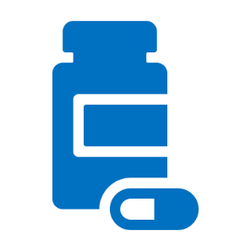

The Relationship Between
Opioids, Overdose and Naloxone
Opioids Overdose Naloxone
If someone ingests too many opioids, an overdose may occur.
An overdose is a severe and sudden condition resulting from an excessive amount of opioid being swallowed, inhaled, injected or absorbed through the skin, intentionally or unintentionally, leading to possible death.
Naloxone is a safe and life-saving medication that can reverse an overdose from all types of opioids, such as heroin, fentanyl, and prescription opioid medications.
Notes:
Slang terms include: OCs, Oxy, perks, vics, smack, junk, black tar, ills, skittles, blues, rails, feddy.
(NOTE: there may be others that are more localized, consider adding for your area.)
https://store.samhsa. gov/sites/default/files/d7/priv/sma18-4742.pdf

Slide 8
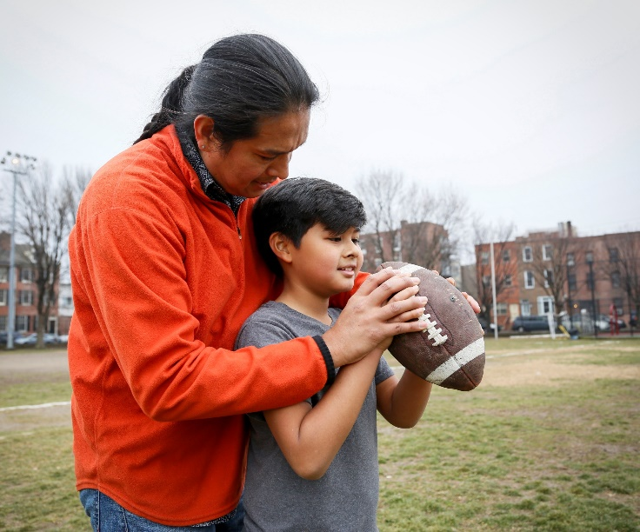



You are a first responder.
A first responder is a person who is designated to immediately respond to an emergency, including:
School administrators and staff
Community representatives
Volunteers
Any person trained to administer naloxone
Law enforcement officers
Emergency medical workers

Slide 9
Why should I learn about naloxone?
Topic 2

Slide 10
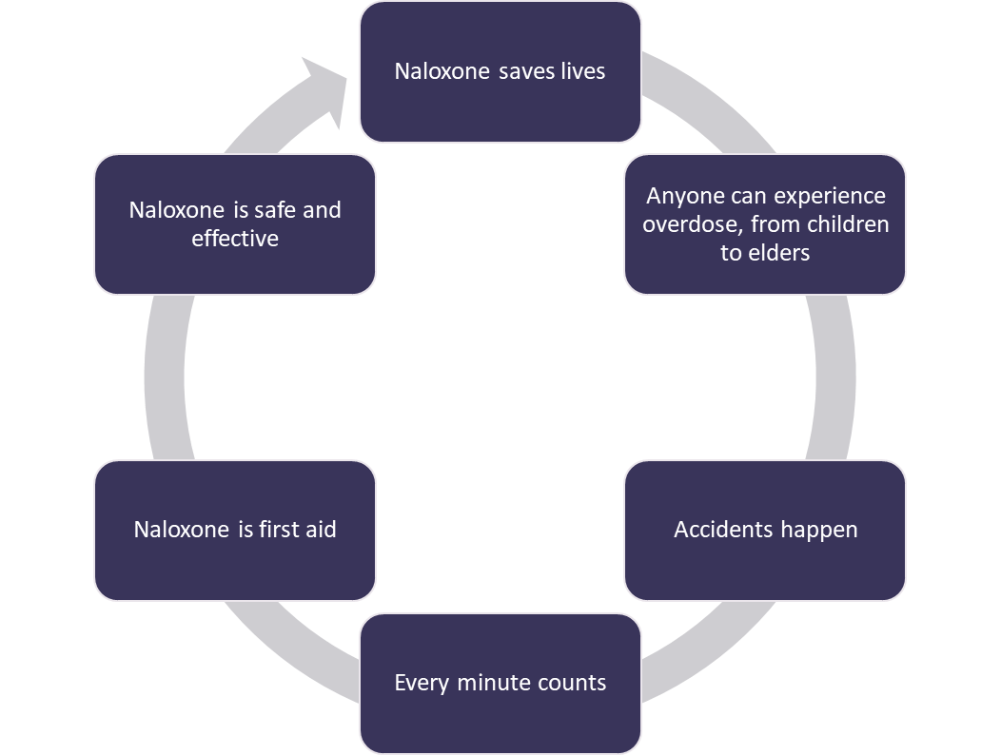
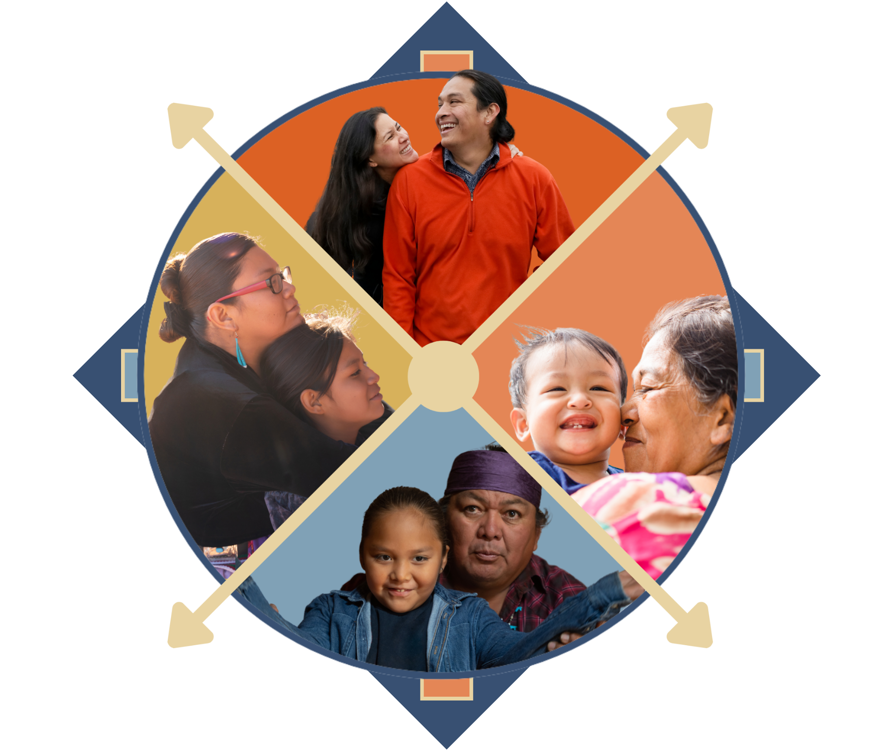
I carry naloxone because naloxone keeps the circle strong.
Notes:
We are learning about Naloxone because it is an essential tool to save a life.
Unfortunately, anyone can experience an overdose. We all make mistakes, and sometimes we grab the wrong medication or misread instructions.
Sometimes family members may not know they are at a higher risk of an overdose, like if they have chronic health problems like COPD.
There is a great deal of stigma around persons with Substance Use Disorder, or SUD. This may stem from a belief that SUD is a personal choice or a moral failing rather than a chronic, treatable disease from which patients can recover and continue to lead healthy lives. This stigma also contributes to negative attitudes toward Naloxone and the false belief that naloxone is only needed for persons with OUD. This continues to be a major barrier to naloxone distribution and harm reduction efforts to prevent opioid overdose.
Did you know :
Most people who died by overdose had no evidence of substance use treatment before their deaths
Some conditions in the places where people live, work, and play can widen these disparities. For instance, rural areas and low income areas have higher rates of overdose deaths.
Comprehensive, community-based prevention and response efforts should incorporate proven, culturally responsive actions that address disparities in drug overdose deaths and the inequities that contribute to them.
https://www.cdc.gov/vitalsigns/overdose-death-disparities/index.html

Slide 11

I carry naloxone because a single use of an opioid can be fatal.
What are synthetic opioids?
Potent, manufactured substances (not naturally derived)
Not regulated for purity or quality, so each “batch” can be very different
Why are synthetic opioids dangerous?
A very small amount can be lethal (10-15 grains of table salt)
Illicitly manufactured fentanyl is:
  50 times more potent than heroin
  100 times more potent than morphine
They can be mixed with other substances (such as methamphetamines) without the user's knowledge
What can we do?
Carry and administer naloxone!
Local authorities should be contacted if products are suspected in your area
Notes:
Discuss education points for youth and what to do should you be exposed to any unknown substance (i.e. wash hands with soap and water, no hand sanitizers, etc.).
We are learning about Naloxone because it is an essential tool to save a life.
Unfortunately, anyone can experience an overdose. We all make mistakes, and sometimes we grab the wrong medication or misread instructions.
Sometimes family members may not know they are at a higher risk of an overdose, like if they have chronic health problems like COPD.
There is a great deal of stigma around persons with Substance Use Disorder, or SUD. This may stem from a belief that SUD is a personal choice or a moral failing rather than a chronic, treatable disease from which patients can recover and continue to lead healthy lives. This stigma also contributes to negative attitudes toward Naloxone and the false belief that naloxone is only needed for persons with OUD. This continues to be a major barrier to naloxone distribution and harm reduction efforts to prevent opioid overdose.
Did you know :
Most people who died by overdose had no evidence of substance use treatment before their deaths
Some conditions in the places where people live, work, and play can widen these disparities. For instance, rural areas and low income areas have higher rates of overdose deaths.
Comprehensive, community-based prevention and response efforts should incorporate proven, culturally responsive actions that address disparities in drug overdose deaths and the inequities that contribute to them.
https://www.cdc.gov/vitalsigns/overdose-death-disparities/index.html

Slide 12
What is an opioid overdose?
How do we know an overdose is occurring?
Topic 3

Slide 13
What is an overdose?
A person takes more opioids than the body can handle.
Breathing slows as the opioid suppresses the urge to breathe.
What is occurring inside the body?
Breathing stops and carbon dioxide builds up in the body.
Oxygen levels decrease, which may lead to brain damage.
The heart stops.
Notes:
As we talked about in the last slide, overdoses can unfortunately occur in anyone. They are unintentional. We should learn what happens during an overdose.
*Opioids suppress the urge to breath
*Carbon dioxide levels increase
*Oxygen levels decrease
*Process takes time
*There is time to respond, but no time to waste
Every minute counts. The sooner we respond, the higher the potential for a better outcome.

Slide 14
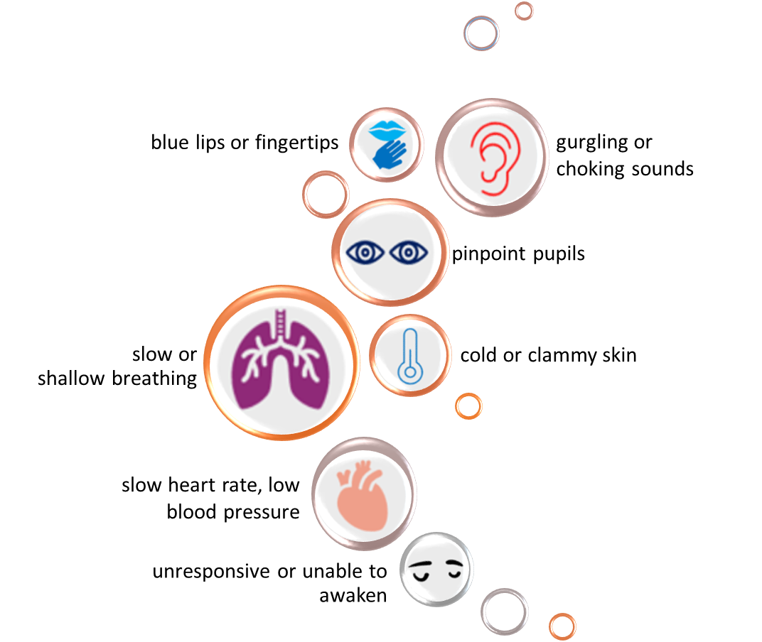
What are the signs of an opioid overdose?
What do I look for?
Notes:
Explain that 1 or all of these may be present. Having multiple substances on board can cause conflicting symptoms, but if someone is not arousable they should be treated with Narcan.

Slide 15
Who is at risk?
Topic 4

Slide 16

Opioid Overdose Risk Factors
Potential Risk Factors:
Youth who have chronic health issues (like asthma, sleep apnea)
Youth or household has prescription for opioid
Youth or household has multiple prescriptions for sedating medications
Youth or family has a history of substance use
Youth associates with substance-using peers
Youth, family or friends use injection drugs
Be on the look out for youth who may be at risk for opioid use.
Remember: ANYONE can experience an opioid overdose!
People are curious, can misunderstand instructions or be forgetful. EVERYONE can be prepared with naloxone.
Notes:
Note for recently in jail/drug treatment:
Tolerance develops when someone uses an opioid drug regularly so that their body becomes accustomed to the drug and needs a larger or more frequent dose to continue to experience the same effect.
Loss of tolerance occurs when someone stops taking an opioid after long term use. When someone loses tolerance and then takes the opioid drug again, he or she can experience serious adverse effects, including overdose, even if the amount taken had not caused problems in the past. This can happen when someone was recently in jail or other program. They may not be aware of how much their tolerance has decreased
In nearly 40% of overdose deaths, someone else was present
- Source: https://www.cdc.gov/mmwr/volumes/69/wr/mm6935a1.htm?s_cid=mm6935a1_w

Slide 17
What is naloxone?
Topic 5

Slide 18




What is naloxone, and how does it work?
aloxone
Is a life-saving medication
Can be given as a nasal spray
Reverses overdoses from all types of opioids (prescription and illicit)
Does not harm someone without opioids onboard (Give it if you've got it.)
Lasts 30-90 minutes
FDA-approved in 1971, but widely used since the 1990s
1
Opioid sits on a receptor in your brain;
overdose occurs.
2
Naloxone enters your body and knocks the opioid away.
3
Naloxone sits on the receptor, allowing your body to breathe again;
overdose stops.
Notes:
Discuss how pushing all the doses you have right away does not make the product work any better. Need to wait 2-3 minutes between doses to give medicine time to work. Need medical attention even if response is noted as overdose can occur again if substance onboard lasts longer than effects of naloxone.
Discuss tolerance—you can’t become tolerant to naloxone as you can with opioids. Dose required is dependent on what you took, how strong it is, how much, etc. Doses should be given until a response is noted.

Slide 19

What does naloxone reverse?
Does reverse
Does NOT reverse
Opioids
Morphine
Codeine
Oxycodone
Hydrocodone
Fentanyl
Hydromorphone
Oxymorphone
Heroin
Cocaine
Methamphetamines
Diazepam
Alprazolam
Alcohol
Xylazine
Notes:
Most substances are mixed with many others. If you have Narcan, it’s always better to give it than assume it won’t work. Can’t hurt if no opioids on board.
Slang terms include: OCs, Oxy, perks, vics, smack, junk, black tar, ills, skittles, blues, rails, feddy. (NOTE: there may be others that are more localized, consider adding for your area.) https://store.samhsa. gov/sites/default/files/d7/priv/sma18-4742.pdf
Yes:
Oxycodone (Oxycontin®)
Hydrocodone (Vicodin®, Norco®)
Hydromorphone (Dilaudid®)
Oxymorphone (Opana®)
No:
Diazepam (valium®)
Alprazolam (Xanax®)

Slide 20
Responding to an Opioid Overdose
Notes:
Naloxone Overview Video: https://www.youtube.com/watch?v=nVRm1GQgJmc

Slide 21
Legal Considerations
Learn more about your state and Good Samaritan laws here:
Prescription Drug Abuse Policy System (PDAPS) Good Samaritan Overdose Prevention Laws
https://pdaps.org/
Good Samaritan Law
“A person who is not a health care professional who acts in good faith in administering an opiate antagonist to another person whom the person believes in good faith to be suffering an opioid overdose is immune from criminal prosecution for the act and is not liable for any civil damages for acts or omissions resulting from the act.”
Notes:
Include review of tribal code if it applies in your area.

Slide 22
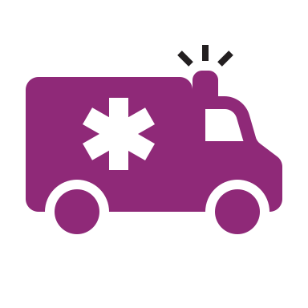

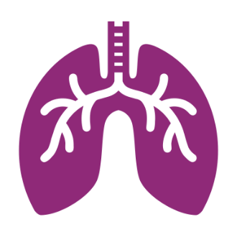
Take action if someone is in need.
Activate 911/emergency medical services (EMS).
Check for symptoms.
Support breathing.
Person is unresponsive or not breathing.
Activate the emergency response system (call 911).
Assess for signs of an opioid overdose.
Are there witnesses that can tell you what happened?
Give naloxone.
Open airways.
If certified, begin CPR.
Roll person on their side to prevent choking and monitor until help arrives.
Notes:
CPR info:
Verify airway is clear
Perform head-tilt chin-lift and pinch nose closed
Perform 2 rescue breaths and repeat 1 breath every 5 seconds for 1 minute

Slide 23

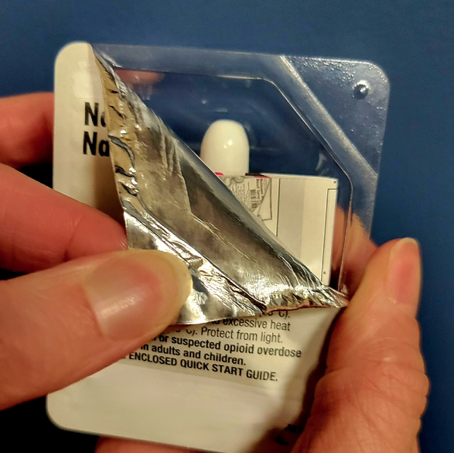

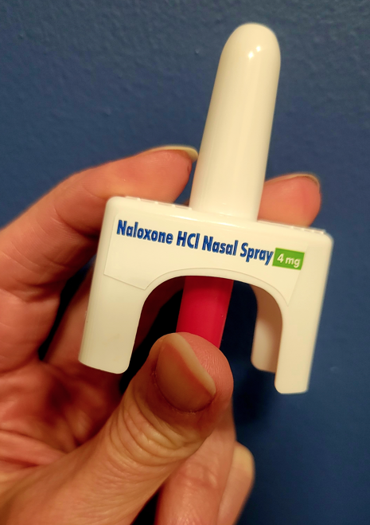
How to Administer Naloxone Nasal Spray
Prepare the naloxone spray.
Remove naloxone from the box.
Peel back the tab with the circle at the top right corner to open.
Position the person.
Tilt the person’s head back and use your hand to support their neck.
Hold naloxone with your first and middle fingers on either side of the nozzle and your thumb on the plunger.
Gently insert the tip of the nozzle into one nostril until your fingers on either side of the nozzle are against the bottom of the person’s nose.
Notes:
Spray is FDA-approved – it is a pre-filled, needle-free device that requires no assembly and is sprayed into one nostril while the person lays on their back

Slide 24

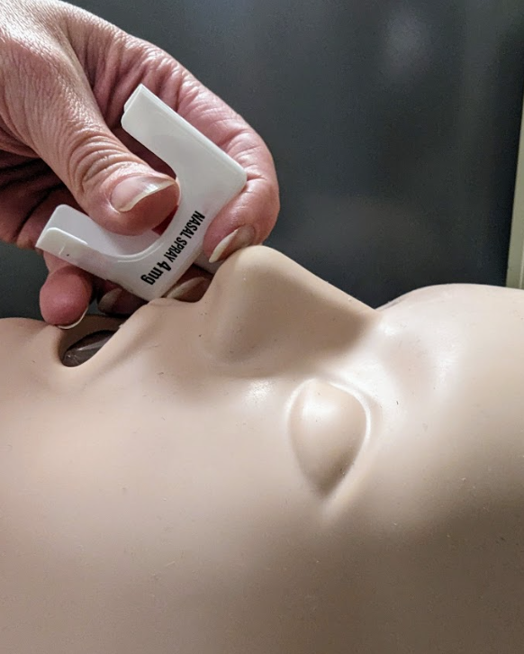


How to Administer Naloxone Nasal Spray (cont.)
Press.
Press the plunger firmly to spray the dose of naloxone into the person’s nostril.
Observe and repeat.
Roll person onto their side (recovery position) and look for independent breathing.
Repeat doses in alternating nostrils every 2-3 minutes until independent breathing resumes.
Maintain recovery.
The effect of naloxone lasts 30-90 minutes.
If overdose signs set in again, repeat dose to maintain overdose reversal.

Slide 25
Recovery Position
What is the recovery position?
The recovery position refers to placing the person on their side so airways stay open, reducing the risk of choking.
How do you place someone in the recovery position?
Person is laying on their back after naloxone was given.
Kneel on the side of the person.
Straighten their arms so the person is in a T-shape.
Fold one arm over their chest and lift their knee into a bend.
Tuck their other arm close to their side.
While supporting their head and neck, take the bent knee and gently roll person away from you onto their side.
Tilt their head back and make sure their airways are clear and open.
Allow the person to lay peacefully. Assist them in remaining calm when they become aware of the situation.
Notes:
Once the patient is stabilized it is important to place the individual in a position to prevent complications of vomiting by placing them in the recovery position.
Continue to stay with the victim and to observe for any return of overdose symptoms especially since the opioid drugs last longer in the body than the naloxone.
Keep person calm and encourage him/her not to take more opioids. While waiting for EMS, it is important not to give them any medications or pain meds if they awake in pain.

Slide 26
After Administration:
What to Expect When Reversing an Overdose
Agitation
Remember:
Experiencing opioid withdrawal symptoms can be unpleasant, but not life-threatening
Nausea and vomiting
Excessive sweating
Runny or bloody nose
Fast heartbeat
High blood pressure

Slide 27

Allergy Considerations
Symptoms described as allergies are typically symptoms of opioid withdrawal.
No clinically significant allergic responses have been convincingly demonstrated.
Allergy information often cannot be determined in an emergency situation.
  Best practice is to administer naloxone.
    In the very rare event an allergy was noted, it could be treated as well.
Notes:
https://www.aaaai.org/allergist-resources/ask-the-expert/answers/old-ask-the-experts/naloxone

Slide 28
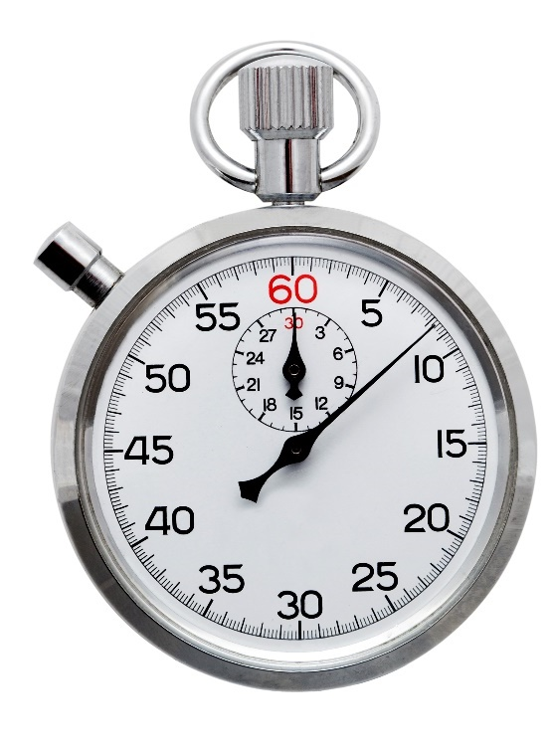
Maintaining Overdose Reversal
Monitor the person’s response.
Are they breathing normally?
Have they maintained or regained consciousness?
If not, you may need to give naloxone again.
Remember:
Naloxone’s effect lasts between 30 to 90 minutes
Naloxone may need to be repeated after normal breathing has returned to maintain opioid reversal, especially if extended-release products were taken
There is no maximum dose!

Slide 29
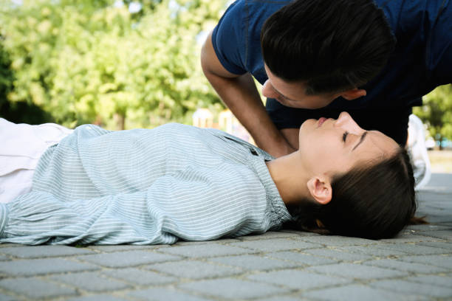
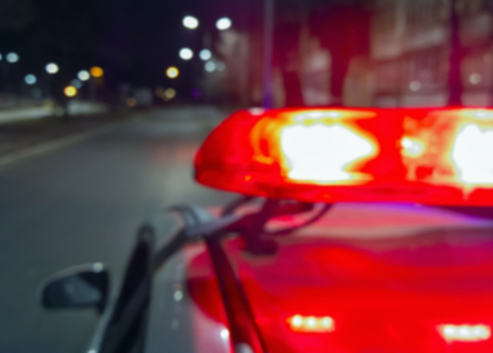
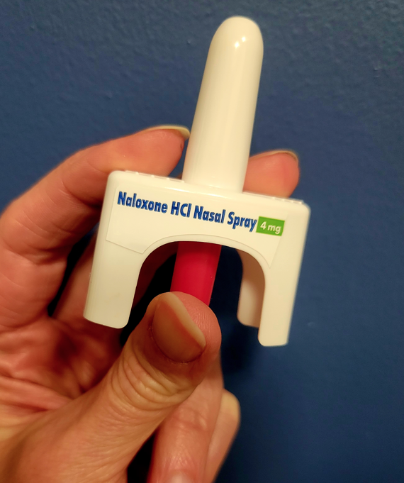
Recap:
How You Can Save a Life
Recognize a potential
opioid overdose.
Call emergency
services.
Give naloxone.
Video: https://www.youtube.com/watch?v=nVRm1GQgJmc

Slide 30
Key Actions to Remember
DO call for help.
DO lay the person on their side.
DO stay with the person until additional help arrives.
DO monitor the person’s response.
DO let others know you have naloxone. (You cannot use it on yourself.)
DO NOT slap or forcefully try to wake the person.
DO NOT spray nasal naloxone in a person’s mouth.
DO NOT try to make the person vomit.

Slide 31
Post-Overdose
Care
What if the overdose occurred following intentional drug misuse?
In the event of overdose following intentional misuse, consider supportive care coordination.
  Discuss treatment options/programs available in your area.
  These programs offer medication and behavioral support for people on their path to recovery.
  Offer harm reduction resources in your area if someone is not ready for treatment.
  Offer local naloxone programs.
Acute Care
Treatment Resources
Family Support
Harm Reduction
Notes:
Opioid overdose can occur accidentally – accidental exposure to skin or eyes, accidentally taking wrong medication, etc. But sometimes individuals will intentionally take an opioid incorrectly

Slide 32

Where can someone get naloxone?

Slide 33
Accessing and Storing Naloxone
Topic 7

Slide 34
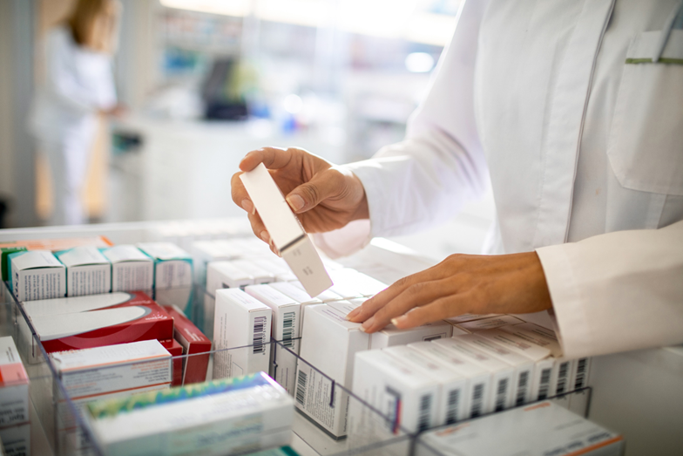
Getting Access to Naloxone in the Community
Getting naloxone
  Naloxone nasal spray can be obtained at Indian Health Service (IHS) pharmacies.
  It is also available for purchase at retail pharmacies.
  The pharmacist will go over any questions and training and will dispense per local policy and procedure.
  It will soon be available to purchase over-the-counter.
Replacing naloxone
  Be sure to check the expiration date and replace naloxone if expired, damaged or used.

Slide 35

Recommended Locations to Store Naloxone in School Settings
Consider storing naloxone:
Dean of student’s office – 2 boxes
Nurse’s office – 2 boxes
School resource officer or security locations
    Consider response time:
    If it would take your staff more than 2 minutes to reach the naloxone, additional store sites may be necessary.

Slide 36
Naloxone Storage Best Practices
Store at room temperature.
Do not freeze or expose to excessive heat.
Protect from light.
Keep a full kit (2 nasal spray doses) per location.
Store in the carton provided, when possible.
Inspect daily to ensure it is intact and ready for use.

Slide 37
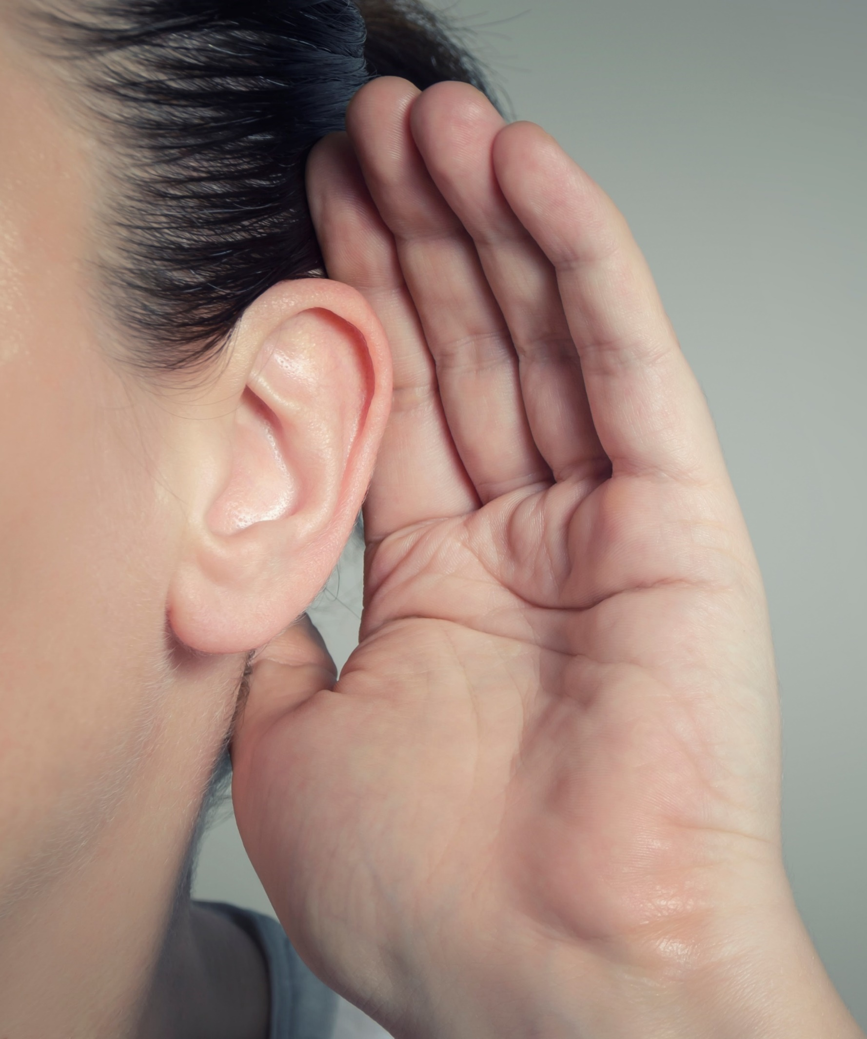
Your Feedback Matters
Where are other potential storage locations places within your buildings?
Could staff be allowed to keep naloxone on themselves or in the classroom for quick access?

Slide 38
Putting it all together
Topic 8

Slide 39
Put It All Together
Not harmful if no opioids in blood stream
Delay in administering can lead to injury or death
Cannot be used to get high or set someone back in recovery
Can only help
Can be given at any point during an overdose
Usually is effective within 1 to 3 minutes
Effects last 30 to 90 minutes; recipients should be monitored by medical professionals, even if reversal is achieved
Will give time
Has become a standard component of first aid kits in many communities
No negative health outcomes reported after 40+ years of use
In nearly 40% of overdose deaths, someone else was present
Naloxone’s life-saving benefits in reversing opioid overdose are clear
Is life-saving

Slide 40
School Policy Overview
Topic 9

Slide 41

Discussion
School Policy Expectations
Q&A

Slide 42
Competency Assessment
Topic 10
Notes:
The following slides can be adapted for whatever content the speaker would like to focus on in the competency assessment
IF required by school

Slide 43
What steps can be taken if you or a loved one would like access to naloxone?
Notes:
Discuss local resources for naloxone
IHS Federal facilities: no charge for IHS beneficiaries
Veterans: mail order
Local pharmacy access: INSERT – e.g.: Thrifty White Bagley appointment with pharmacist—insurance charged for medication (approximately $120 cash pay)

Slide 44
Answer
Naloxone spray can be obtained at an Indian Health Service (IHS) pharmacy, retail pharmacies, harm reduction programs and many other locations across the country.

Slide 45
What are the signs of an opioid overdose?

Slide 46
Answer
Cold or clammy skin
Pinpoint pupils
Blue lips or fingers
Slow or shallow breathing
Gurgling or choking noises
Unresponsive or can't wake up
Slow heart rate, low blood pressure
Notes:
Pinpoint pupils, Shallow breathing
Choking or Gurgling Sounds, Unconsciousness

Slide 47
What steps are recommended for responding to an opioid overdose?

Slide 48
Answer
Ensure scene safety.
Check for breathing; attempt to rouse.
Call 911/EMS.
Administer/re-administer naloxone.
Further resuscitation if needed.
Evaluate and support.

Slide 49
Closing
Topic 11

Slide 50
Thank you
Thank you for attending this naloxone training.
Remember:
Naloxone distribution is an effective strategy to prevent opioid overdose and death.
Your participation may lead to giving someone a second chance at life.
Naloxone keeps the circle strong.

Slide 51

We want to hear from you!
  Please share your training feedback:
  What did you like?
  What are we missing?
  Any other comments or feedback?

Slide 52
Frequently Asked Questions
Topic 12

Slide 53

Frequently Asked Questions
Part 1
Is naloxone a “safety net” that allows people who struggle with substance use to use even more opioids?
  Naloxone is non-addictive.
  Increasing the availability of naloxone to reduce deaths does not provide incentive to use opioids. The behavior will exist with or without naloxone.
  Providing naloxone is one approach to dealing with this national epidemic. Other strategies include safe opioid prescribing practices and increasing access to Medications for Opioid Use Disorder (MOUD) such as buprenorphine (Suboxone®) and methadone.
Naloxone is first aid.
Inhalers and EpiPens can save a life, and so can naloxone.
=

Slide 54
Frequently Asked Questions
Part 2
What happens if I accidentally expose myself to naloxone?
  Naloxone is safe. There will be no adverse effects if it gets on your skin or in your mouth.
If it is unknown why someone is unresponsive, should I give naloxone?
  Yes, naloxone should be given to someone found unconscious.
Is there an age cutoff to administer naloxone?
  No, it can be given at any age.
What will happen if I give naloxone to someone who did not have an opioid overdose?
  Naloxone will not harm someone if they have not overdosed from opioids.
How quickly does naloxone work?
  Likely between 2-3 minutes but can be repeated until a full response and regaining of consciousness.
What do I do if I think the person might be pregnant?
  Naloxone is safe to give in pregnancy but will impact the pregnant person and baby. Ensure they both get emergency care following administration.

Slide 55
Frequently Asked Questions
Part 3
Will the person “wake up” agitated and/or aggressive?
  It is possible but not always the case. Using needleless administration of naloxone was designed for quick and safe administration to prevent injury for emergency responders.
If the person begins to breathe after I give one dose but is not fully conscious, should I give a second dose?
  Yes, naloxone should be given every 2 to 3 minutes until the person has a full response of regaining consciousness and is breathing 12 to 20 breaths per minute (18 to 40 breaths if under 6 years old).
How much naloxone is too much? How many doses can I give?
  There is not a maximum dose. Naloxone can be given every 2 to 3 minutes until there is a response or emergency medical services personnel assumes care.
When do I give rescue breathing versus full cardiopulmonary resuscitation (CPR)?
  If response is early enough, only rescue breathing may be needed. If there is no pulse, proceed with full CPR efforts if you are trained to do so.

Slide 56



In collaboration with the Indian Health Service (IHS) Heroin Opioids and Pain Efforts (HOPE) Committee, this material was prepared by Comagine Health for the American Indian Alaska Native Healthcare Quality Initiative under contract with the Centers for Medicare & Medicaid Services (CMS), an agency of the U.S. Department of Health and Human Services. Views expressed in this material do not necessarily reflect the official views or policy of CMS or HHS, and any reference to a specific product or entity herein does not constitute endorsement of that product or entity by CMS or HHS.
NQIIC-AIHQI-380-06/05/2023

