Slide 1
CMS EHR Incentive Registration and Attestation
JoAnne Hawkins
Meaningful Use Sr. Healthcare Policy Analyst
DNC (Contractor) for
U.S. Indian Health Service
February 7, 2013

Slide 2
Today’s Objectives
Understand Eligible Professional (EP) eligibility.
Review deadlines.
Understand the difference between Medicare and Medicaid registration for EPs.
Identify information needed for registration and attestation.
Attest for the Medicare or Medicaid Incentive program.
Review registration/attestation resources.

Slide 3
Participation Year 2012 Deadlines
February 28, 2013, is the last day for a Medicare EP to register and attest to receive an incentive payment for calendar year (CY) 2012.
Medicaid EPs should check with their states for deadlines.

Slide 4
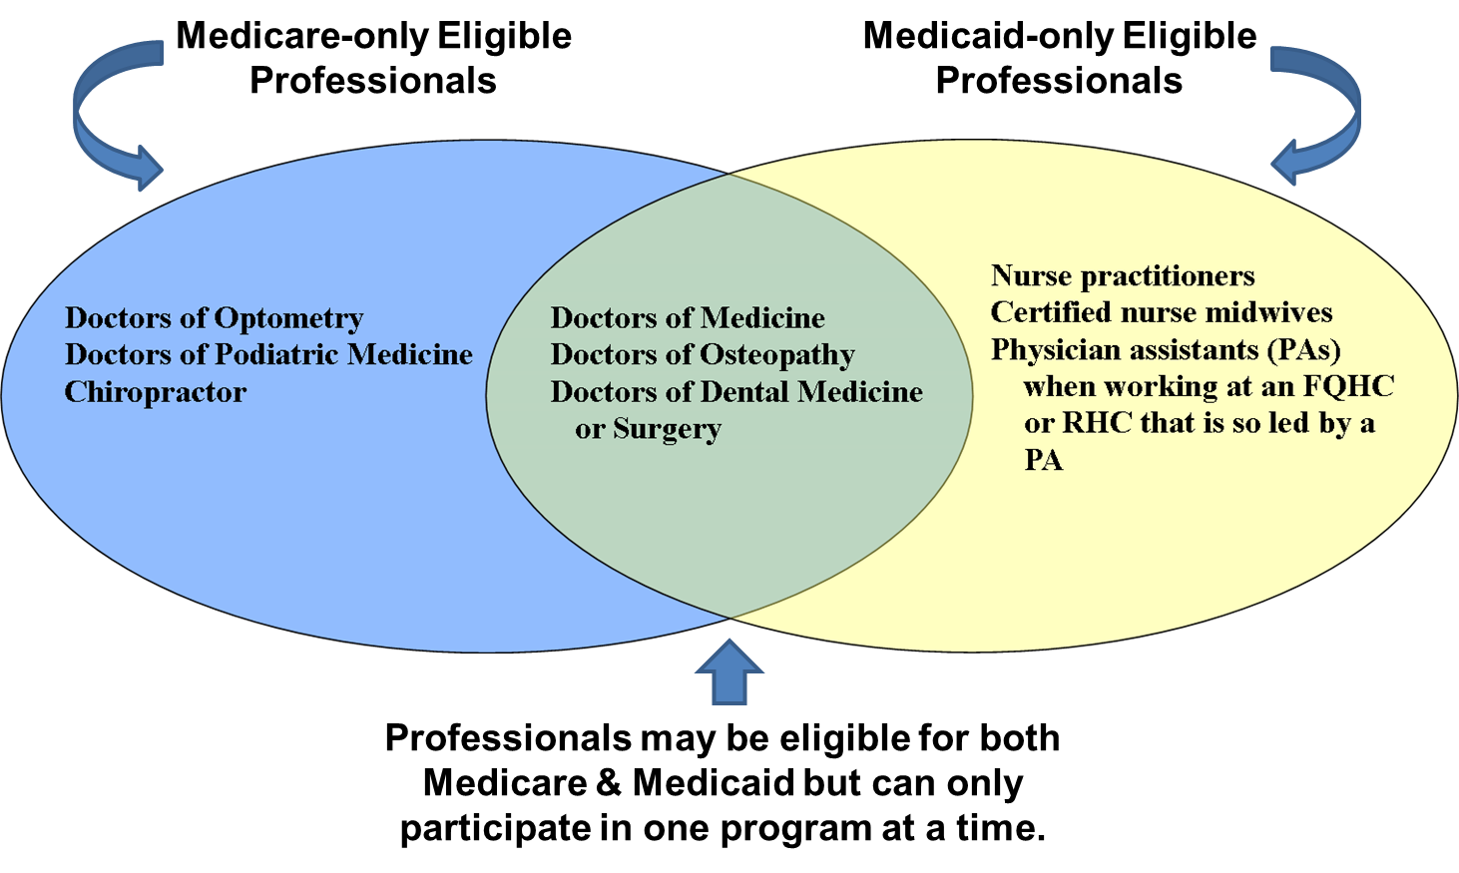
Eligible Professionals:
Medicare and Medicaid Comparison

Slide 5
Eligible Professional registration

Slide 6
EP Registration Checklist
An EP will need the following:
  PECOS/National Plan and Provider Enumeration System (NPPES) ID and password
  National Provider Identifier (NPI)
  Group name
An EP reassigning his/her benefits will need:
  Payee tax identification number
  Payee NPI

Slide 7
PECOS/NPPES
To access the Identity and Access Management (I&A) system, the EP will need either a PECOS or NPPES username and password.
If you forget your password, contact the PECOS Help Desk:
  https://pecos.cms.hhs.gov
  (866) 484-8049
  TTY (866) 523-4759
To locate your NPI, contact NPPES:
  https://nppes.cms.hhs.gov/NPPES/NPIRegistryHome.do
  (800) 465-3203
  TTY (800) 692-2326

Slide 8
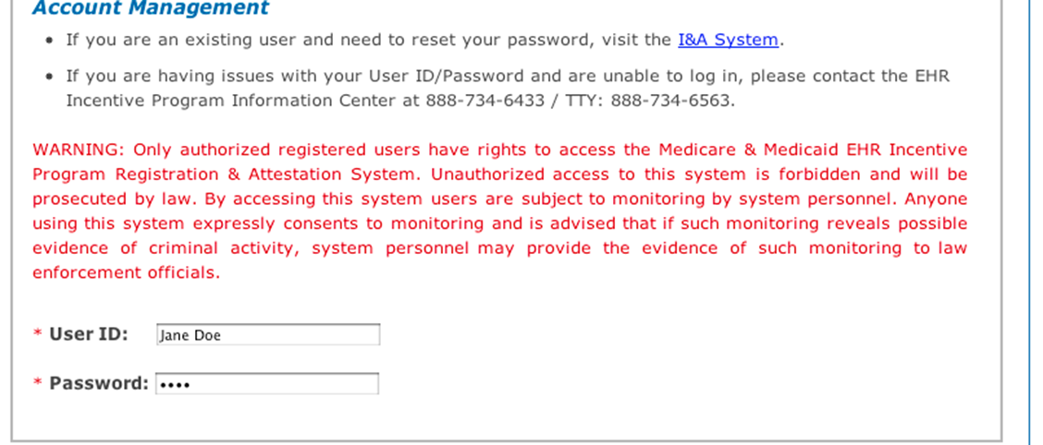
CMS Registration
EPs participating in the Medicare or Medicaid program will need to register at http://ehrincentives.cms.gov.
Notes:
In order to register for the Medicare Incentive program the EP will need an active enrollment in Pecos.
In order to register for the Medicaid program an EP will need either an active PECOS user id or password or an NPPES.

Slide 9
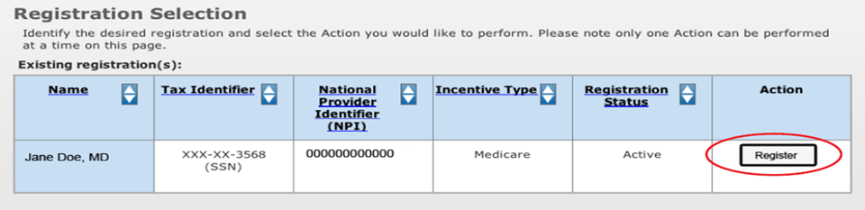
EP Registration
Answer all questions marked with a red asterisk.
Click Proceed with Submission.
Verify all information is accurate, and click Submit Registration.
Print out the submission receipt for reference.

Slide 10
Medicaid Registration
After registering with the CMS EHR Incentive program, EPs may go to the state’s Medicaid website and continue registering for the state Medicaid EHR Incentive Program.
Each state may have a different registration process. To find your state’s registration website, visit http://www.cms.gov/apps/files/statecontacts.pdf.

Slide 11
Third-Party
Registration

Slide 12
Third-Party Registration
CMS has implemented functionality that allows EPs to designate a third party to register and attest on their behalf.
Users working on the behalf of an EP must have an I&A web user account (ID and password) and be associated with the EP’s NPI.
If you are working on behalf of an EP and do not have a I&A user account, create one at the I&A Security Check: https://nppes.cms.hhs.gov/NPPES/IASecurityCheck.do.

Slide 13
Third-Party Registration Checklist
A third-party registrar will need the following:
I&A system user ID and password
EP’s name
EP’s National Provider Identifier (NPI)
EP’s group name
EP’s practice location address
Payee NPI/TIN

Slide 14
Attestation

Slide 15
When Can an EP Attest?
Medicaid
Year 1 of participation:
  Meet the patient volume threshold.
  Adopt, Implement, and Upgrade (AIU) certified EHR technology.
Year 2 and later:
  Continue to meet patient volume.
  Demonstrate MU for a continuous reporting period of 90 or 365 days.
Medicare
Demonstrate MU for a continuous reporting period of 90 or 365 days.

Slide 16
What does an EP Need to Attest?
EPs will also need the following information:
EHR Certification Number
Patient Volume report (Medicaid only)
MU Performance Measure reports for the EHR reporting period
MU Clinical Quality Measure report for the EHR reporting period
Vendor letter (RPMS EHR users)

Slide 17
How to Attest of the Incentive Program?
Medicare EPs will have to demonstrate MU through the CMS web-based Registration and Attestation System.
EPs must provide numerators and denominators for performance measures and CQMs; indicate if they qualify for available exclusions; and legally attest that they have successfully met other measures.
To qualify for an incentive payment, an EP must successfully complete an online submission through the attestation module.
Medicaid EPs should contact their state for attestation information: http://www.cms.gov/apps/files/statecontacts.pdf.

Slide 18
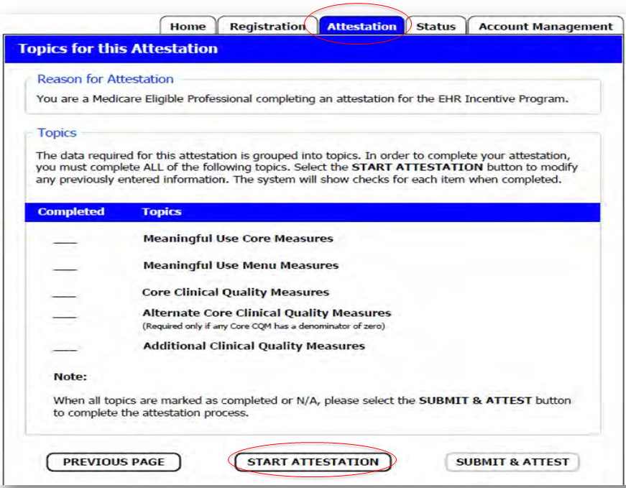
Start Attestation
Notes:
This image is of the first screen that appears after clicking the Attestation tab. Shown here are all of the attestation topics that the EP must complete in order to attest to demonstrate meaningful use successfully and to receive an incentive payment. After each topic has been completed, a check mark will appear in the completed tab next to the topic. Clicking on the Start Attestation button will bring the user to the first Meaningful Use core measure question.

Slide 19
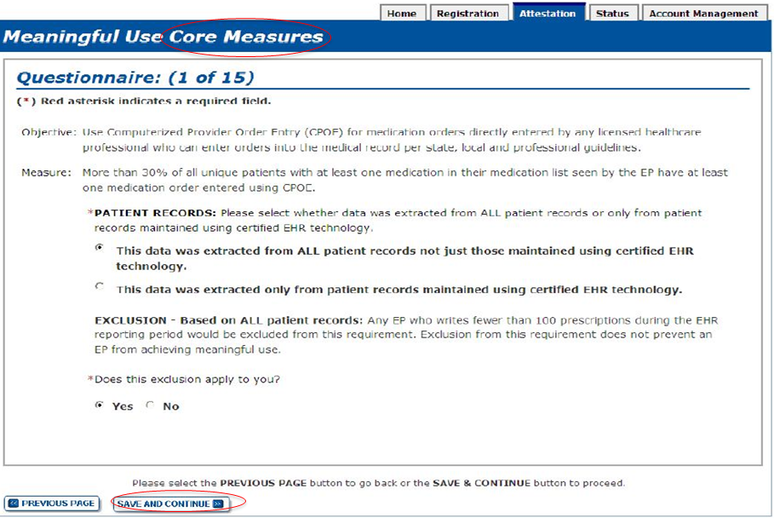
Core Measures
Notes:
Certain core and menu measures also provide exclusions based on specific requirements. Eligible professionals may be excluded from meeting an objective if they meet the circumstances of the exclusion.

Slide 20
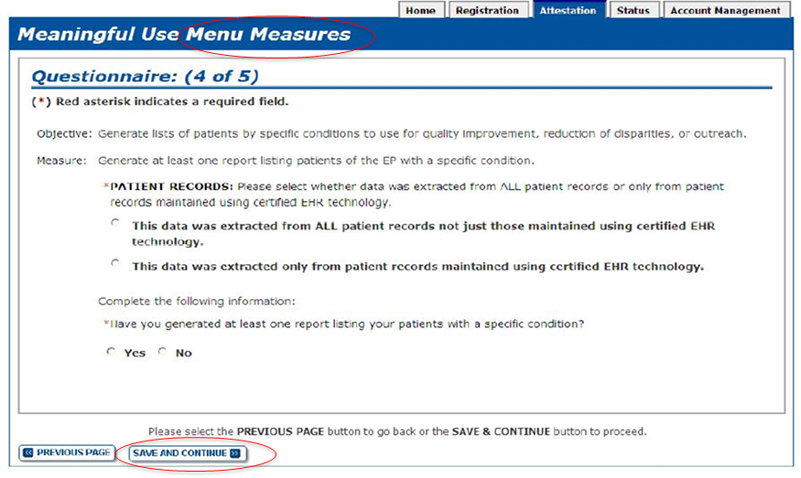
Menu Measures
Notes:
The menu measure questions follow the same format as the core measure questions.

Slide 21
Core Clinical Quality Measures
EPs must report calculated CQMs directly from their certified EHR technology.
Each EP must report on three core CQMs (or alternate core) and three additional quality measures.
If the denominator value for all three of the core CQMs=0, the EP must report a zero denominator for all such core measures and then must also report on all three alternate core CQMs.

Slide 22
Summary of Measures
This is the last chance to review and edit the information that has been entered before attestation.
Check for data entry errors as the system will not indicate the calculated percentages of the numerators and denominators prior to official submission of attestation.
To make changes, click Modify under the actions section, then follow the steps for editing.

Slide 23
Attestation Submission Process
Click Agree if you agree to all the terms of submission:
  If you click Disagree, the home page will redisplay and your attestation will not be submitted.
  If you click Agree, the confirmation page will display.

Slide 24
Submission Confirmation Page
On the confirmation page, review the summary information for accuracy.
Click Yes to submit.
The system will indicate immediately whether the attestation has been successful or whether it has failed.
The summary page shows which measures have been accepted or rejected.
If you click No, a message is displayed stating that you are not submitting at this time. Your information will be saved and your attestation will display In Progress.
Notes:
CMS recommends you review all of their attestation information before submitting. EPs who fail their attestation can submit their information again, but cannot submit information for the exact same 90-day period. The 90-day period can be a day later (3/1-5/31 vs. 3/2-6/1), but that will mean that EPs may have to recalculate all of their numerator and denominator information

Slide 25
Attestation Disclaimer
Read the disclaimer and click Agree to continue your attestation or Disagree to stop the process.
If you click Disagree, the attestation instructions page redisplays. Your status under the Action column will read Modify or Cancel.

Slide 26
Rejected Attestation
If your attestation is rejected:
You did not meet one or more of the MU minimum thresholds.
Attestation can be resubmitted.
Reassess or modify your practice so that you can meet the measures.
You may resubmit your attestation information, correct mistakes or submit new information if no mistakes were made.

Slide 27
Registration Resources
NPPES:
  https://nppes.cms.hhs.gov/NPPES/NPIRegistryHome.do
Pecos:
https://pecos.cms.hhs.gov
I&A:
https://nppes.cms.hhs.gov/NPPES/IASecurityCheck.do
EP User Guide:
http://www.cms.gov/Regulations-and-guidance/
Legislation/EHRIncentivePrograms/Downloads/
EHRMedicareEP_RegistrationUserGuide.pdf
EHR Incentive Program Information Center:
(888) 734-6433 or TTY (888) 734-6563

Slide 28
Attestation Resources
MU Attestation Calculator:
http://www.cms.gov/apps/her
EP Attestation Worksheet:
http://www.cms.gov/EHRIncentivePrograms/Downloads/
EP_Attestation_Worksheet.pdf
EP Attestation Guide:
http://www.cms.gov/EHRIncentivePrograms/Downloads/
EP_Attestation_User_Guide.pdf
MU checklist:
http://www.cms.gov/EHRIncentivePrograms/10_Pathto
Payment.asp
MU Website:
http://www.cms.gov/EHRIncentivePrograms/
30_Meaningful_Use.asp

Slide 29
Area MU Contacts
Area | Area MU Contact | Email | Phone Number
Aberdeen | CAPT Scott Anderson | Scott.Anderson@ihs.gov | (605) 335-2504
Alaska | Richard Hall Kimi Gosney Karen Sidell | rhall@anthc.org kgosney@anthc.org ksidell@anthc.org | (907) 729-2622 (907) 729-2642 (907) 729-2624
Albuquerque | Jacque Candelaria | Jacque.Candelaria@ihs.gov | (505) 946-9311
Bemidji | Jason Douglas | Jason.Douglas@ihs.gov | (218) 444-0550
Billings | CAPT James Sabatinos | James.Sabatinos@ihs.gov | (406) 247-7125
California | Marilyn Freeman Steve Viramontes | Marilyn.Freeman@ihs.gov Steve.Viramontes@ihs.gov | (916) 930-3981, x362 (916) 930-3981, x359
Nashville | Robin Bartlett | Robin.Bartlett@ihs.gov | (615) 467-1577
Navajo | CDR Michael Belgarde Donna Nicholls | Michael.Belgarde@ihs.gov Donna.Nicholls@ihs.gov | (928) 871-1416 (505) 205-9177
Oklahoma | Amy Rubin | Amy.Rubin@ihs.gov | (405) 951-3732
Phoenix | CAPT Lee Stern Keith Longie, CIO | Lee.Stern@ihs.gov Keith.Longie@ihs.gov | (602) 364-5287 (602) 364-5080
Portland | Woody Crow | Sherwood.Crow@ihs.gov | (503) 414-5594
Tucson | Scott Hamstra, MD | Scott.Hamstra@ihs.gov | (520) 295-2532

Slide 30
Regional Extension Center
REC | REC Contact | Email | Areas
NIHB | Tom Kauley | Tkauley@nihb.org; (505) 977-6053 | All
ANTHC | Richard Hall Kimi Gosney Karen Sidell | RHall@anthc.org; (907) 729-2622 KGosney@anthc.org; (907) 729-2642 KSidell@anthc.org; (907) 729-2624 | Alaska
CRIHB | Tim Campbell Rosario Arreola Pro Amerita Hamlet | Tim.campbell@ihs.gov; (707) 889-3009 Rosario.arreolapro@crihb.net; (916) 929-9761, x1300 Amerita.hamlet@crihb.net; (916) 929-9761, x1323 | California
NPAIHB | Katie Johnson | Kjohnson@npaihb.org; (503) 416-3272 | Portland
USET | Vicki French | Vicki.French@ihs.gov; (615) 467-1578 | Aberdeen Albuquerque Bemidji Billings Nashville Navajo Oklahoma Phoenix Tucson

Slide 31
IHS Meaningful Use: Contact Information
Contact | Title | E-mail | Phone
Chris Lamer | Meaningful Use Project Lead, IHS | Chris.Lamer @ihs.gov | (615) 669-2747
Luther Alexander | MU Project Manager, DNC | Luther.Alexander@ihs.gov | (301) 443-8114
JoAnne Hawkins | MU Healthcare Policy Analyst, DNC | JoAnne.Hawkins@ihs.gov | (505) 767-6600, x1525
Cecelia Rosales | MU Requirements Manager, DNC | Cecelia.Rosales@ihs.gov | (505) 767-6600, x1230

Slide 32
Questions?
Sign up for the MU Listserv! http://www.ihs.gov/listserver/index.cfm? module=signUpForm&list_id=168Meaning fulUseTeam@ihs.gov

