Slide 1
Retaining Participants Shandiin Begay, MPH
Retaining Participants
Shandiin Begay
Albuquerque, NM SDPI DP Meeting
June 27, 2012

Slide 2
Introduction
The good news
“The research was done in our communities, and it's already making a big difference here. We contributed to this study, and we are benefiting from it. The lifestyle changes the participants made helped not only themselves but their families and communities. This study shows that we can change the future of diabetes in Indian country.” February 6, 2002
Notes:
"The research was done in our communities, and it's already making a big difference here. We contributed to this study, and we are benefiting from it," added Shandiin Begay, a member of the Navajo Nation who works closely with participants in three Indian communities in Arizona. "The lifestyle changes the participants made helped not only themselves but their families and communities. This study shows that we can change the future of diabetes in Indian country.“ You are changing the future of DM in your program! Pat yourself on the back.

Slide 3
The Good News
Lifestyle Intervention reduced the risk of diabetes by 58%.
Treating 7 people with Lifestyle intervention will prevent 1 new case of Diabetes in 3 years.
The DPP Research Group, NEJM, 346:393-403; 2002
Weight loss was the factor that prevented Diabetes in the Intensive Lifestyle group.
Hamman, R. for the The DPP Research Group, ADA Oral Presentation, 2002, # 115
Notes:
After reviewing all of these findings these are the two take home messages.
Metformin will need to treat 14 people to prevent 1 case.

Slide 4
More Good News
Lifestyle intervention was beneficial regardless of ethnicity, age, BMI, or sex.
For every 1 Kg of weight lost, diabetes risk was reduced by 13%.
Increased physical activity was not associated with initial weight loss but was significantly related to long term weight loss.
Self-reported improvements in diet and physical activity that do not result in weight loss do not result in lower diabetes risk.
Notes:
Metformin 31% reduction. Changes in percent of calories from dietary fat was consistently associated with both short and long term weight loss.

Slide 5
More Good News
Those genetically predisposed to diabetes are nullified if successful in lifestyle change.
Regression from prediabetes to normoglycemia, even if only transient, significantly reduces the risk for future diabetes. Perreault,L., Pan,Q., Mather,K., Watson,K., Hamman,R., Kahn,S., for the Diabetes Prevention Program Research Group (2012). Regression from Pre-diabetes to Normal Glucose Regulation is Associated with Long-term Reduction in Diabetes Risk: Results from the Diabetes Prevention Program Outcomes Study. Lancet accepted

Slide 6
What is Retention in DP?
Keeping the DP participants active in the program
Keeping appointments for program assessment visits
Attendance to program activities
Actively engaged in program and achieving lifestyle goals
Notes:
understanding where each participant is in the in the big picture of the program- are they at a point to where all they are willing to do is come in for their data visits- are they willing to work on program re-starts- do they need that extra attention to make goal. Have they been at goal and are starting to gain and lose interest? Need to understand where the each participant generally stands.
We have report that tells us how long it’s been since we’ve seen them—1 year etc or it’s been 3 years we know each of our participants situations for the most part--

Slide 7
What is Retention in DPPOS?
DPPOS Retention is measured by:
Data Visit 2x a year (4x/yr in DPP)
Lifestyle Report- how long it’s been since last lifestyle contact
Class Attendance
Notes:
Tracked and reported separately similar to DP

Slide 8
Missed last 2 Visits

Slide 9
What’s Important to Participants
Be friendly and accepting
Be optimistic
Model healthy behaviors
Follow through with what you say you’ll do
Hold accountable in a non-threatening way
Be able to work with a team
Be willing to persevere and endure
Believe people can lose weight
Believe that those you work with can change
Notes:
Didn’t get our first LS person to goal for 18 months after we started
Model healthy- try programs before implement with participants no fritos and coke
Other people lives may be overwhelming to us but they may not be as overwhelming to them.
If they are coming in for appointments…

Slide 10
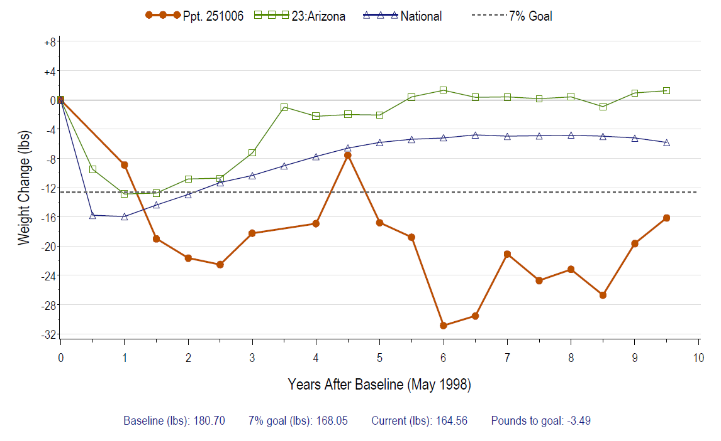
Example of Weight Graph

Slide 11
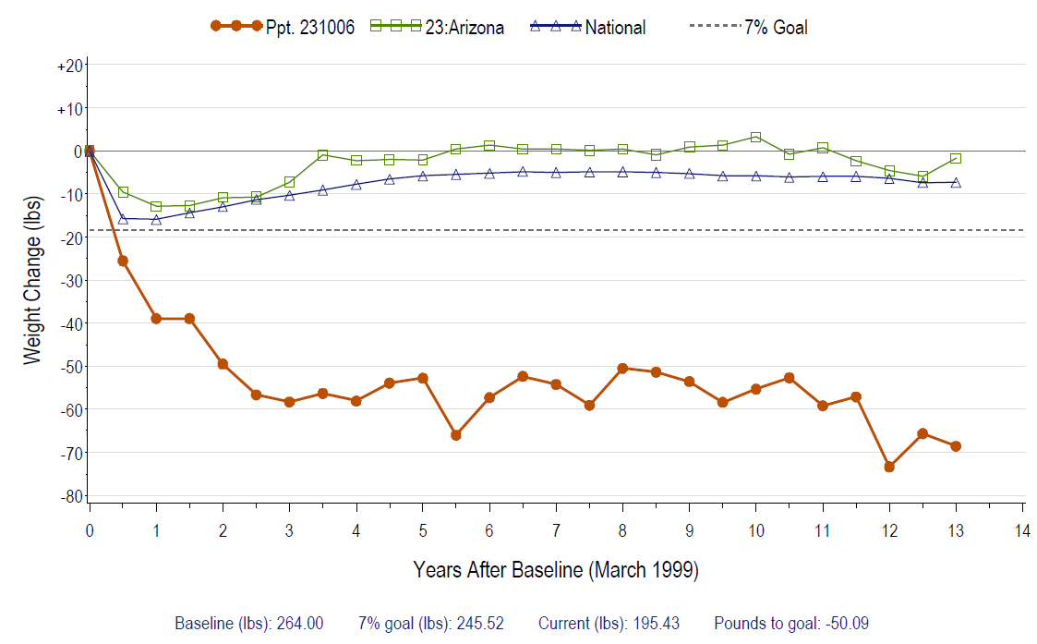
Example of Weight Graph

Slide 12
When to Plan Retention
Plan early and integrate
Recruitment is the key to retention
Begins at first contact and continues with each contact
Long commitment
Notes:
Think about retention as you think about recruitment- the way you build relationship and the excitement you have for the way lifestyle can help them. Think long term—you’ve been the study for 7 years that’s a long time—what have you learned about the participant in those years? When DPP first began I thought 3 year was long let alone 5 years… now we are in year 15/ year 11 DPP Of the overall study….Retention will help with recruitment and so forth…if you recruit solid participants from day one that will help with retention and their satisfaction and success with the study will help with recruitment. Still you have the proof of the DPP results to say lifestyle change resulting in weight loss can prevent DM…instead of how things were when I was recruiting…you might and you’ll be randomized… Where is your buy-in for the lifestyle program?? Make sure that your being burned out isn’t rubbing off on your participants…it can be contagious. Positive this is a great program to be involved with! Are you correctly recruiting for the program? Are you telling them the good with the bad??? Do they really know what they are getting into? Be straight with participants from the beginning so they really are sure they want to join the program. This is not any ordinary program it’s different…

Slide 13
Phoenix Urban Recruitment
Number of participant contacts/
% of previous step
Step 1 Screening
1,268
Step 2 OGTT
202 (16%)
# with IGT
47 (23%)
Step 3 start run-in
22 (46%)
Step 3 End run-in
17
Step 4 Join Study
14 (30% IGT)
64% (End)
Notes:
Just a glimps of what recruitment looked like in the PHX are where I first began my recruiting with DPP

Slide 14
DPP Retention and Participation
99.6% of the study cohort alive at study end
93% completed study
93% of annual visits completed
Average follow-up 2.8 years (range 1.8 - 4.6)
86% joined DPPOS
Native sites consistently have higher retention than national average
Notes:
For example the retention in the Research original DPP study very early parts of retention--Higher in the American Indian Center- For Salt River Phoenix, and Gila River no drop outs-

Slide 15
The “Why” of Retention
In the DPP we have the goal to retain to have a valid study to report.
In the DP programs why is retention important?
Made a commitment to the participants
Reputation of the program in the community
Funding for programs
Bottom line changing the face of Diabetes
Being actively involved could help with accountability and getting to the bottom line of achieving weight loss goal.
Notes:
Sound data is important but the bottom line is still to show the prevention of DM through lifestyle change…
When we get down and think it’s hard we need to remember the hope of the lifestyle program and get excited about the steps along the way success in the program is a big in retention.
You can change the DM one participant at a time: For example if there are so many new DM in the community a year You held a class of 10 etc (ask Mary)
Because we KNOW from the DPP but it doesn’t make it easy just possible

Slide 16
The “How” of Recruitment/Retention
Set your program apart from any other programs
How do you market your program?
How is it different?
What are your talking points?
Notes:
Are you really recruiting or are your sitting back and following up on referrals: We literally searched high and low for our pts. We had several places we recruited from…not one source. Early on we accommodated the working volunteers not your usual doctor office visits.
Get out into the community don’t just sit in the office for people to come to you.
Share those differences with potential interested people.

Slide 17
Tracking Retention
How do you know what your retention looks like?
DPPOS tracking examples
Team meeting to focus on discussing retention issues
Make a plan
Follow-up and re-visit the plan regularly
Document
Notes:
Our team meeting discuss potential or current retention issue or red flags…who can help how should we approach—Depending on situation someone may just need a DP break death in family, new job, moving etc

Slide 18
Applying Techniques
“If you’ve tried something 2 times and it hasn’t worked try something different.” Richard Rubin PhD, CDE
Example: What do you do when someone is a no show?
Understand barriers and document
Notes:
For Example: If you are trying to see if you can get someone to come in for a visit and you called them 2 times try some thing different. Maybe call at a different time, try a different number. Send them an appointment in the mail. Email them a note. Stop by and visit them at home or work.
if they started a new job and can’t take leave for a visit- can you accommodate on a different day? What are their days off. Do they have reliable transportation? Do they need day care?
They joined the program for a reason and it is important that you still provide a lifestyle program in their lives. We all know that lifestyle change is not easy and it takes time.

Slide 19
Retention-Create Belonging
Group Events
Contracts
Incentives with logo
Connection with staff
Mailings- newsletters, health information, birthday cards
Notes:
From the beginning create belonging and buy-in
Annual events that they all feel apart of for example Shiprock does an annual Healthy thanksgiving day dinner for participants and their support people.
Set up a special outing for participants and tailor the outing to the participants.
Sometimes incentives help create that buy in to participants—for example a t-shirt upon joining the program.
Connection with staff—Make sure they have a primary staff person over them but at the same time they can become acquainted more staff involved with the program…keep the primary recruiter involved for example if it was a physician that helped refer them to the program keep that person involved at a certain level. Staff retention can play big in the connection with the staff we will touch on this later.
Communication is key! Don’t forget to keep them in the loop as much as possible. If it is someone actively in core and they miss a class be alarmed make a deal out of it! Meaning don’t act like it doesn’t matter give them a call immediately if they miss a core class make time for a make-up class and accommodate their situation. Newsletters are a nice way to make them feel part of something. All our participants love the birthday cards! Something small yet big for retention.

Slide 20
Group Events
Gathering around a community event
Group walks or hikes
Community attractions
Learning a new skill
Include the family
Notes:
Meet up at an even t with same t-shirts create unity as a group-
Keep cost effective to be able to invite family to event. Examples Light parade, Zoolights,
Heard Museum tour South Mt. Picnic including opportunity for hike or volleyball, Christmas craft demonstration
You never know what event or activity will bring in participants but once you find out it’s important to take note of it.
When doing our group events over the years we have been pleasantly surprised with participants that came out to the event.
Red Heart month event where we asked everyone to wear red and if they wanted to they could wear traditional clothing—MM
Native Chef coming and cook for our group at SCC that was a really nice event
Phoenix Suns Game- excitement and belonging welcome over jumbo tron high five the players!

Slide 21
Keys to Success
Flexible Clinic Schedule
Telephone reminders/text messages
E-mail reminders
Postcard reminders
Follow-up a missed appointment
One-on-One support/ building relationships
Notes:
Knowing our participants schedules share story about DA from SR and her schedule knowing when to call Days off shift schedules

Slide 22
Program and Participant Relationship
Building Trust
Facilitating Change
Valuing Diversity
Communication
Gaining Commitment
Problem Solving
Revisiting and Adjusting
Building on Success
Notes:
Trust is essential this starts from your projects first interaction with the potential volunteer. Doing what you say you will do and being consistent with follow through with what you say you’ll do. Being an organized project also helps. One of the first documents you go over as a group is the Lifestyle Contract.
Change is facilitated, not prescribed participants are not told how and what to change (MARVEL EXAMPLE) Instead to not going out to eat she eats smaller portions when eating out and also plans her meals before and after eating heavy. Not telling them what to do they figure out what will work for them.
We aren’t just talking about being American Indian and our ethnic background. We have to value what they bring to the table whatever curcumdtance it maybe. So of our participants come from some really tough lives and but we need to remember that it is their life and we may never be able to fill their lives not even for one days but they do and they have strength because of that. Remember they are equally capable of succeeding at lifestyle change. Never think of their background as a reason why they can’t succeed. Example would be Rhythm.
Understanding & accepting differences culturally and individually- trying to get to the bottom line
Communication- Understand where they are coming from and it’s okay to have little talking give them time to communicate. Example would be AFFIRM. If we jump in and talk the whole session she would not say a word to us. We need to sit back and listen…This person is still hard to read and we really don’t know what she does to control her weight but we know that she is aware and does make decisions to make better choices daily. She doesn’t want to be noticed. She doesn’t want people to notice that she lost weight. We would have never found out any of that if we didn’t listen.
need to have an environment where you can express
Gaining commitment- by building relationship and developing successes How many project give out incentives? How are we using incentives. There should be a difference in “Belonging Incentives” vs giving an incentive for sneezing. We want them to see the big picture of the group. What do you see the “Big Picture” as? We want them to know that we are committed to them. This is not a stop by and get screened health fair education in a day group…we are a committed group and their for them from the first contact through the project. Example Rhythm and how Mary gained commitment first by letting her know we would be there for her when we said we would be there. Follow through. Exercised with her twice and week and helped make family recipes for her and family to rate and try using ingredients not to foreign to the family. Does this participant know we are in for the long hull? You bet she does.
Problem solving- building skills to problem solve in all areas not just lifestyle changeThis is a little tricky as coaches not to want to solve our volunteers problems. But really what will they stick to something we tell them or something they problem solve through and see for themselves what they are willing to do. I know we are full or ideas to break through peoples barriers but really what matters is giving them the opportunity to get there by working on “problem Solving” during sessions and during after core. The bottom line in after core is not to have a great fun party but really to continue to help volunteers get to their bottom line their goal in physical activity and weight. Let them tell us the problem don’t tell them their problems. I think some individuals are sometimes wanting us to tell them but then who owns the problem us or them? Example of Wilfred or ???
Revise and adjusting constantly to achieve goals and master skills Understanding that someone might have a bad week vs if something really is not working for them. Building up to 150 minutes of PA. How do we do this? There is power in actually writing down a plan and if they want to tell people about their plan. Take a work situation. Making a plan to walk during lunch. Make a plan revisit and adjust. There is a good lesson on this in the curriculum. Problem Solving lesson.
Example: WORKER or SAFTY
We’ve said this before and I’m sure some of you have seen this is the biggest incentive or reward on can get is really their own success. At the end of the day we can’t eat for them we can’t exercise for them and when they are successful they know it was their hard work and effort. It’s nice to get a sweatshirt but don’t underestimate the value of success and achievement. We really want people to be motivated beyond the end of the project. On a participant level always acknowledge the little things for example keeping track.
Building on Success- always keep a positive look-out make small steps toward LS goals

Slide 23
Do your DP Programs include…
Consistent coaching relationships
Working with the participant as a team
Hang in there - reinforcement
Supportive relationship
Utilizing a multidisciplinary approach
Notes:
Over the years there will be turn over and with our study the same has happened and we keep the participants up-dated of old staff. We’ve even had special events where old staff have been invited.
Sort of like a reunion with former staff.
Utilize your team because someone may have a better rapport with a participant– or you may really just need a fresh approach to this person or a break from the participant
We are the ones encouraging our participants to hang in there so we have to hang-in there.
Be a positive person and build on positive things participants say and not so much the negstive. Positive reasons to lose weight Play with my grand children

Slide 24
Don’t Give Up!

