Slide 1





What is going on with my patient?!
Tipping the Motivational Balance for Change!
Presentation: Responding to Resistance
Daryl Tonemah
Session 1: Responding to Resistance
Darryl Tonemah, PhD

Slide 2
Resistance is a natural and even expected part of any change relationship. How we respond to the resistance can play a significant role in the outcomes for our participants.

Slide 3







Getting Started!
What we have learned from stages of change is that change is a spiraling process, not so linear.
Patient/participant’s motivation for change is effected by life, love and the pursuit of all things fried.
Our role is to have skills in our tool box that recognize when an individual has moved to a different stage and use those tools to adjust motivation toward change.
REMEMBER we are motivated for whatever we are doing...So what motivates us for behaviors?

Slide 4
Its not a volume issue, it’s a clarity issue.

Slide 5

What is resistance?
Describe…

Slide 6


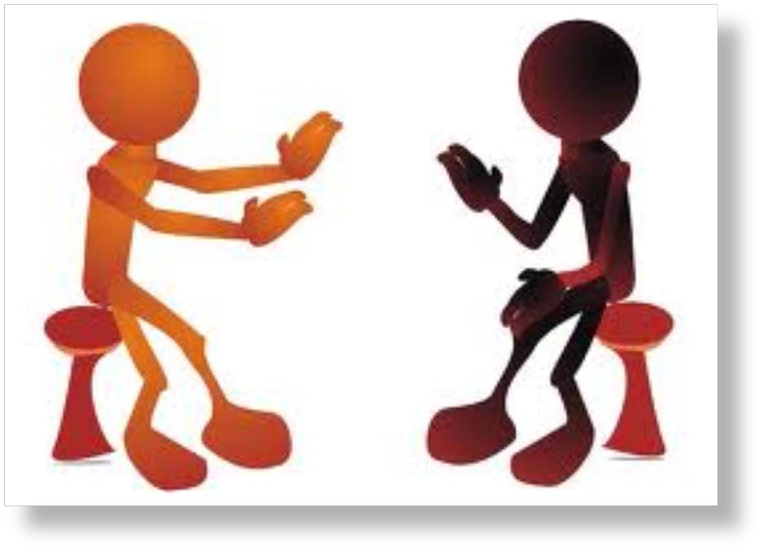
Categories of Resistance
Arguments
Challenging
Interrupting
Blame others
Excuses
Pessimism

Slide 7






Resistance in the Moment
Unwillingness to change
Sidetracking
Answering a different question
Acquiescence
Being overly cooperative

Slide 8




More Resistance
Resistance seen between appointments
Not completing certain tasks
Late for sessions
No-shows
Not picking up phone

Slide 9

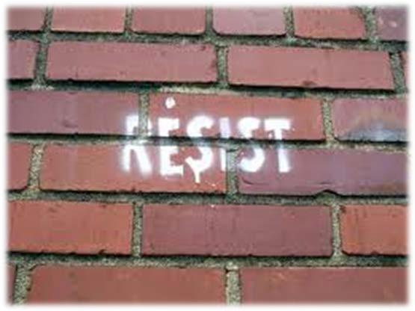
Resistance (Continued)
Resistance is:
  a cue to change strategies
  a case manager problem, not a client problem
  easy to provoke
Resistance exists between people, there has to be someone/thing to resist. If I stop pushing back, there is nothing to resist.
Example: Football

Slide 10
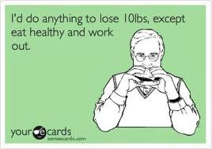
Resistance (Continued)
Rolling with resistance
Not taking it personally
  Recognize that people will not do anything they don’t want to do, it is their decision

Slide 11
Motivational Interviewing: Thermostat versus Thermometer
A thermostat determines the temperature of a room.
A thermometer responds to the temperature.

Slide 12
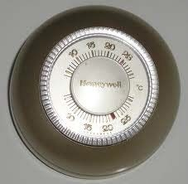
How do we feel when the temperature of the room changes? (at our best)
Challenged - to use my skills
Competent – skilled to meet the challenge
Resourceful – can access tools in my tools box
Like a thermostat

Slide 13
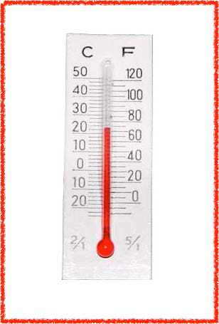
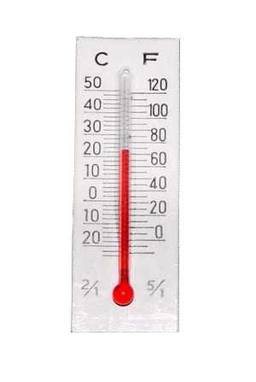
How do we feel when the temperature of the room changes? (at our not so best)
Challenged - Questioning my skills
Angry
Frustrated
Insecure
Try to have all the answers – argue
Like a thermometer

Slide 14



Why do we respond in our “Not so Best”
“I know what’s best, JUST LISTEN TO ME!
I don’t have the skills to move you forward, so I will match aggression with aggression
I have some unhealthy defaults
You are touching on my insecurities
What are you bringing to the moment?

Slide 15
Rethinking “Resistance”

Slide 16





Resistance or Counter-motivation?
Understanding that client/patient is putting energy in a different direction. Motivated for something other than change.
Resistance may be one type of counter-motivation.

Slide 17





Resistance or Counter-motivation?
Continued…
There may be many reasons a person continues behavior- e.g., feeling inadequate, low efficacy, inherent value in current behavior.
Possibly the patient/client hasn’t challenged him/herself to meet a significant goal previously. There is not a roadmap.
The term “resistant” may change our mindset to something more feisty.

Slide 18


Changing the Temperature
Work on our skills-open up our tool box
Have a skilled conversation
Roll with resistance
Don’t take it personally
It is a cue to change strategies

Slide 19



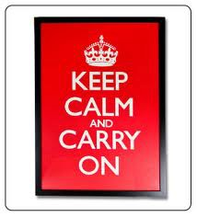

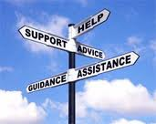
Related Motivational Interviewing Principles
Avoiding arguing
Rolling with resistance

Slide 20

Avoid Arguing
Sometimes our natural tendency is to push back or argue for the side of change. Unfortunately, that actually makes the patient/client defend not changing. We would be speaking the language of the action stage of change, and they are speaking the language of pre-contemplation or contemplation. Breathe for a moment and open your tool box.

Slide 21


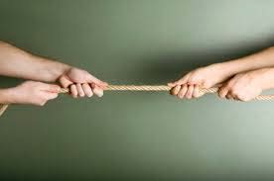
Roll with Resistance
Resistance is energy. It requires energy to be resistant, but rather than meet resistance with resistance. Don’t take it personally. If there is not at the other end of the argument, there can’t be a back and forth.

Slide 22



With the MOST resistant patients
Maintain the spirit of motivational interviewing and relationship
Early and frequent empathy
Roll with it – stick to the topic at hand
EXPLORE the resistance (“tell me more about that…”, Rulers)
Develop discrepancy
Emphasize personal choice – unexpected
Avoid the traps

Slide 23


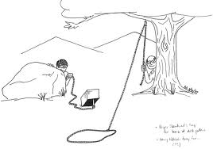
Avoid the Traps
Expert- Trying to have all the answers
Labeling – You’re the one with diabetes!

Slide 24



Two Ways for Responding to Resistance
Reflective Response
Strategic Response

Slide 25


Reflective Response
Simple Reflection - Meeting resistance with non-resistance. Reflecting back meaning or a few words they stated back to the patient/participant/client. Really not adding interpretation. Its said as a statement, not a question.

Slide 26

ROLE PLAY

Slide 27

Reflective Response (continued)
Double Sided Reflection - Capture both sides of ambivalence.
If the patient/client is displaying only the resistance side of ambivalence, use information they have offered from the other side of ambivalence, using the word AND to maintain balance.

Slide 28

ROLE PLAY

Slide 29
Strategic Responses

Slide 30



Strategic Responses
Shifting focus: Finding something else to talk about, going around barriers rather than over them.

Slide 31


Slide 32


Strategic Response (continued)
Reframing - Acknowledges clients raw feelings and thoughts, but offers a different perspective.

Slide 33


Slide 34



Strategic Response (continued)
•
Agreement with a twist - Reflection followed by a reframe this strategy involves reflecting and affirming the clients statement, but with a slight twist or change of direction that keeps the discussion moving forward.

Slide 35


Slide 36


Strategic Response (continued)
Emphasize person’s choice and control -
  The client tries to establish autonomy, we need to emphasize that they are in control of what happens.

Slide 37


Slide 38



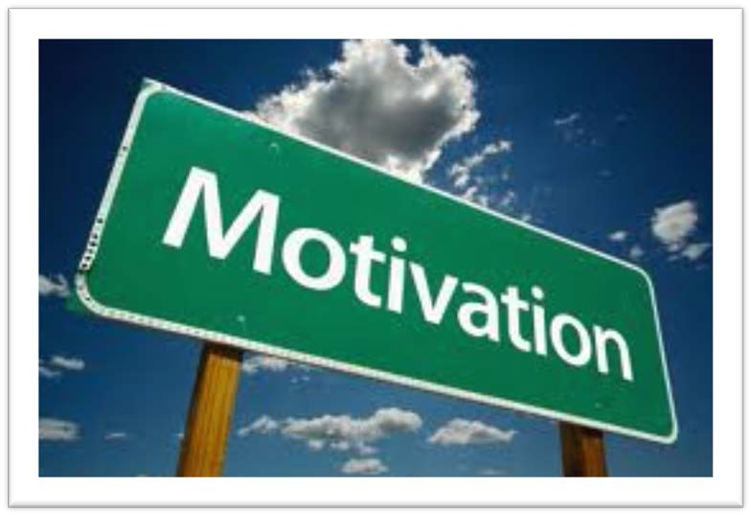
Strategic Response - Develop Discrepancy
Motivation for change increases when a patient becomes aware of discrepancies between current situation and goals or hopes for the future.
Creates dissonance.
Don’t argue the patient’s cons for change; forces patient to defend the cons, reinforcing them for him/her.

Slide 39




Repeat Pros and Cons
“It sounds like, on the one hand, you want to reduce your risk of complications by lowering your blood sugar, but on the other hand you don’t like to take medication and you feel fine most of the time.”

Slide 40




Ask questions about behaviors that don’t support goals set by patient/participant
“Mrs. Jones, I am concerned that you don’t want to refill your diabetes medicine. What are your thoughts about how this might affect the goal you set about reducing your risk of the diabetes complications?”

Slide 41




Ask thought provoking questions
“What would have to happen for you to think about getting more activity into your daily routine?”
OR
“What would life be like for you if you lost the 30 pounds you said you’d like to lose?”
OR
If things worked out just right, what would that be like for you? OR ….

Slide 42
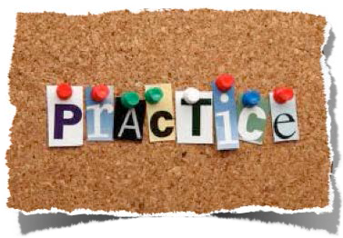
Summary for
Responding to Resistance
Resistance is a natural part of any change relationship.
We need to be aware of what we bring to the table.
We need to develop our abilities to have skilled conversations.
Don’t take it personally.
Practice!

Slide 43
The only way to keep your health is to eat what you don’t want, drink what you don’t like, and do what you’d rather not.
-Mark Twain
Be Well Good People

