Slide 1


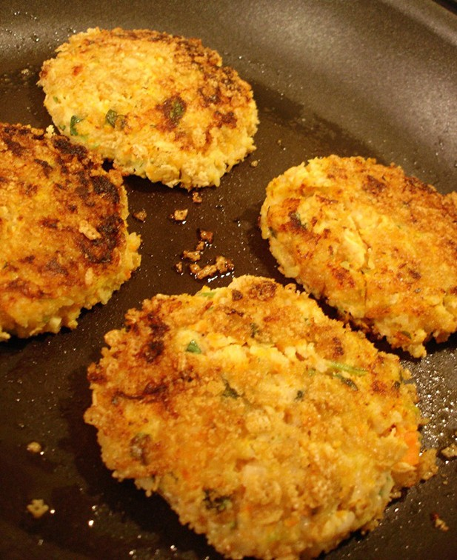


Yukon-Kuskokwim Health Corporation
Health benefits of salmon
Yukon-Kuskokwim Health Corporation
Salmon Recipe
Speedy Salmon Patties
Makes about 6 patties that are the size of the palm of your hand
Ingredients
1 pound cooked salmon or 1 can of salmon, drained
1/3 cup finely chopped onion
1 egg
5 saltines crackers, crushed
1/2 teaspoon Worcestershire sauce
1/4 teaspoon salt
1/8 teaspoon pepper
2 teaspoons butter or margarine
Directions
In a bowl, combine the first seven ingredients; mix well. Shape into six patties. In a skillet,
fry patties in butter over medium heat for 3-4 minutes on each side or until heated through.
You can top patties with ketchup, light mayon- naise or relish
—maybe even try dipping them in seal oil. They are yummy served with a can of green beans or other mixed vegetables.
Adapted from www.
allrecipes.com
Health Benefits of Salmon
Tastes good
and is good for you
Yukon-Kuskokwim Health Corporation Diabetes Prevention & Control Program Healthy Hearts Program
P.O. Box 528 Bethel, AK 99559
Toll Free 1-877-543-6133
Direct line 907-543-6133
Working Together to Achieve Excellent Health

Slide 2

If you are interested to learn more about the Healthy Hearts Program, please call 1-877-543-6133
Vitamins found in salmon and how they can help us
Vitamin A - needed for healthy skin and good night vision, it also helps fight infections
There are several B vitamins that work together to keep our bodies healthy and help turn food into energy:
Vitamin B3 (Niacin) – may help lower cholesterol levels and protect against heart attacks and cancer.
Vitamin B6 – helps balance hormones, strength- en our body’s defenses against infection and may help fight against heart disease.
Vitamin B12 – helps give us energy, maintain a healthy nervous system, and may help fight against heart disease.
Vitamin D – needed for our body to absorb cal- cium from our food.
Did you know salmon is the richest source of Omega-3 fatty acids?
Omega-3 fatty acids are nutrients that cannot be made by our bodies and are important for many reasons. Getting enough Omega-3 fatty acids can help fight against things like heart disease. This is because it helps fight inflammation (or swelling) in the blood vessels and encourages large arteries and blood ves- sels to relax. This makes it much easier for our blood and heart to do their job. Omega-3’s are also shown to be involved in fetal and infant brain development, so it is important that pregnant mothers and chil- dren get enough of these in their diet.
Other research shows that Omega-3 fatty acids may:
Help lower:
Blood pressure
Cholesterol
Risks associated with type 2 diabetes
Risks of heart attack or stroke
Improve:
HDL or ‘healthy’ cholesterol
Brain function
Symptoms of mental disorders such as depression, schizophrenia, Alzheimer’s, etc.
Symptoms of rheumatoid arthritis
Prevent:
Inflammation and swelling
Childhood allergies
Breast, colon and prostate cancer
Minerals found in salmon and how they can help us
Calcium – keeps bones strong and healthy, helps our body absorb nutrients and helps with high blood pressure, colon cancer and premenstrual syndrome in women.
Zinc, Iodine and Selenium – help our body’s immune system (the body’s defense against infection and diseases like cancer, heart disease and diabetes).
Salmon helps keep the heart healthy and strong!

