Slide 1
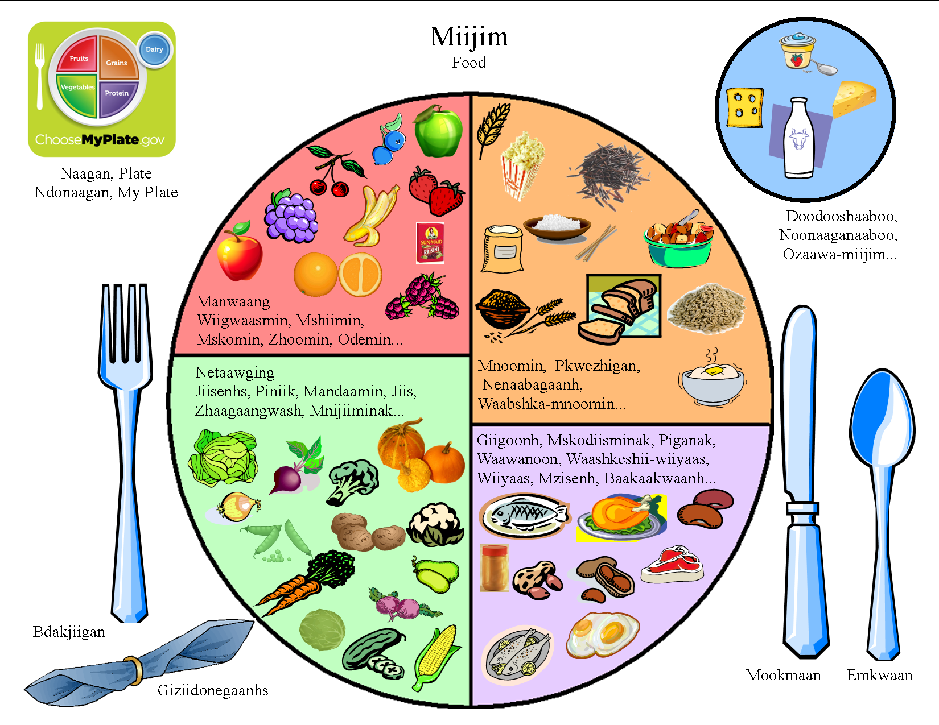
My Plate (adapted and translated)
Little Traverse Bay Band of Odawa Indians

