Slide 1

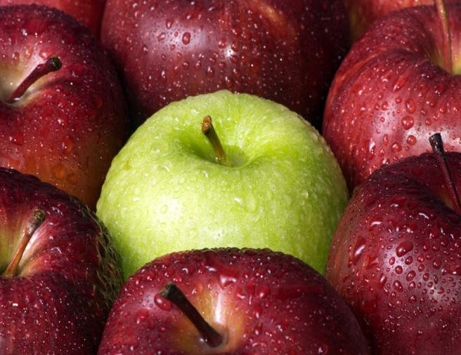
From Apples to Zinc:
October, 2011 The View from the Dietitian’s Office.
Newsletters
St. Croix Band of Lake Superior Chippewa
Vol. 1 Issue 1
From Apples to Zinc
“From Apples to Zinc” is an all- encompassing nutrition and wellness newsletter. I’ll incorporate nutrition information with useful tips, like how to eat well on a budget or stay active during the winter. From prevention and management of chronic diseases to using local foods, we’ll cover a wide variety of topics.
Proper nutrition is an essential part of good health. A healthy diet fuels your body, so you’re ready for whatever life throws at you. As a Registered Dietitian, my tips can help you optimize your health through food and nutrition.
This newsletter will also be available online in blog format at
fromapplestozinc.blogspot.com
Meet the Dietitian
A true Midwestern girl, I’ve lived in Minnesota, North Dakota, South Dakota, Iowa, and now Wisconsin! I hold a Bachelor of Arts degree in Nutrition and Dietetics from the College of Saint Benedict and I completed my dietetic internship at the University of Iowa Hospitals and Clinics.
I’m thrilled to be starting my professional life providing outpatient education and community nutrition for the St. Croix Tribal Health Clinic.
Photo provided by Fotolia from office.com
Nutrition Tidbit
Did you know wild rice is a
heart healthy whole grain?
Aim for at least 50% of your
daily grains as whole grains.
St. Croix Tribal Health Clinic
4404 State Rd 70
Webster, WI 54893
E: alishan@stcroixtribalcenter.com
P: (715) 349-8554 ext. 5213

Slide 2
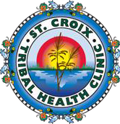
From Apples to Zinc
Recipe Row
Wild Rice and Wild Mushrooms
Fall is wild rice season. Mushrooms are a hearty addition to this side. Please be careful if using wild mushrooms. Only a few local mushrooms are dangerous, but one mistake could be deadly.
Ingredients
2 c low sodium chicken broth 1 c dried mushrooms*
1 c wild rice, rinsed under cold water 1 bay leaf (if you have it)
3/4 c chopped onion
1/2 cup finely chopped carrot* 2 garlic cloves, minced
1 ½ tsp of your favorite dried herbs Olive or canola oil
Directions
Combine broth, wild rice, dried mushrooms and bay leaf in a stock pot. Bring to a boil, then cover and reduce heat. Simmer for 40 minutes. When the rice is almost done place a small amount of oil in a non-stick skillet. Add onions, carrot, garlic and seasonings. Sauté for 5 minutes. Add to the wild rice and mushroom mixture. Cook for 10 more minutes. Serve with your favorite protein such as fish or poultry.
* If you don’t have dried mushrooms you can substitute fresh. Cook them with the onions and carrots. Canned carrots can also be substituted for fresh. Just add them when you add the rice.
adapted from Bon Appetit’s Wild Rice with Wild Mushrooms, November 1995
Money Saving Groce^{V}r^{Vo}y^{ol.l}T^{.1}i^{1I}p^{sIss}s^{suuee11}
Make a list—and stick to it ☺
Clip coupons from the newspaper, but only for the things on your list. Online is a great place to find them too!
Shop the perimeter of a store. Avoid the center aisles where all the processed high fat, high sodium foods lurk. Save your money for fresh produce and lean meats.
If you have the space, stock up on staples like frozen or canned vegetables when they’re on sale. In order to make them heart healthy read the labels for added sodium and fat.
Only buy the amount of food your family can eat. Food waste= money in the trash!
Buy fruits and vegetables fresh when they are in season. They’re cheaper and tastier too!
Anything you’d like to know
more about? Please send your
nutrition and wellness ideas to
me at:
alishan@stcroixtribalcenter.com
No email? Leave me a phone
message or stop by the clinic
and talk to me!
“It is health that is the real wealth and not pieces of gold and silver”
~Mohandas Gandhi

